Slide 1
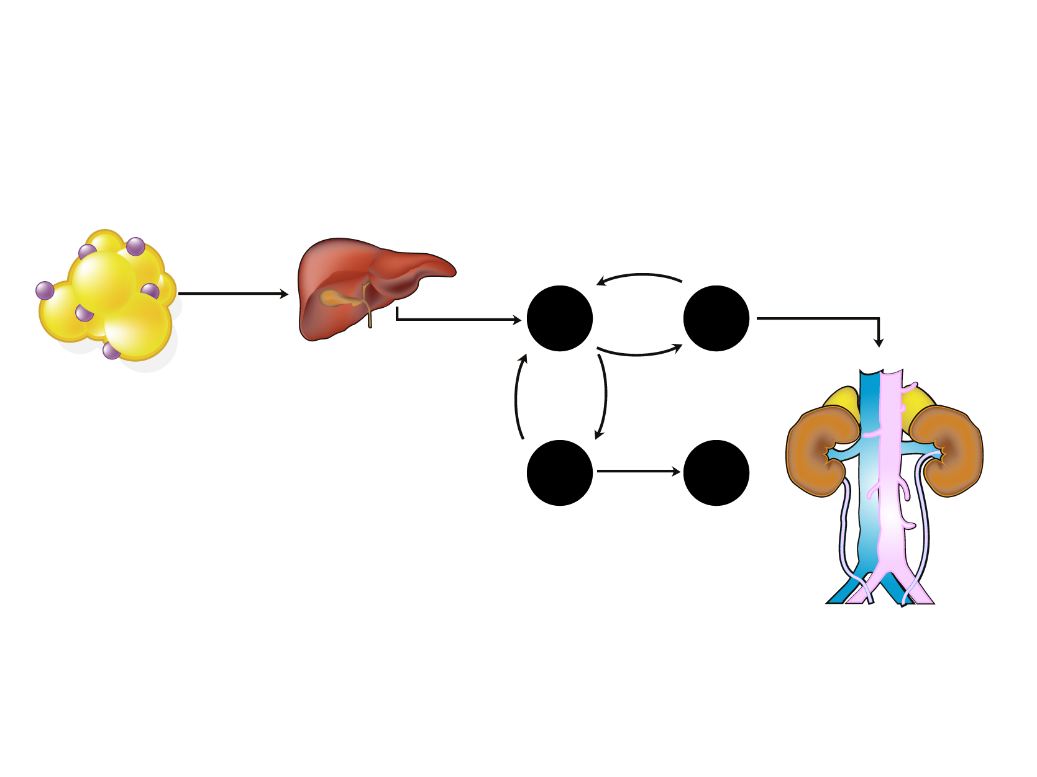
HOW INSULIN RESISTANCE AND DYSLIPIDEMIA ARE LINKED
Adipose tissue*
Liver*
Blood
Kidney
Shorter HDL Half-life
CE
Fatty acids Adipokines
HTGL
VLDL
CETP
HDL
TG
Apo B
VLDL
Small HDL
Apo AI
TG
Hypertriglyceridemia
CE
CETP
TG
LDL
LDL
HTGL
Small LDL
Legend
* Insulin resistance
CE = cholesteryl ester
CETP = cholesteryl ester transfer protein
HTGL = hepatic triglyceride lipase
TG = triglyceride

