Slide 1
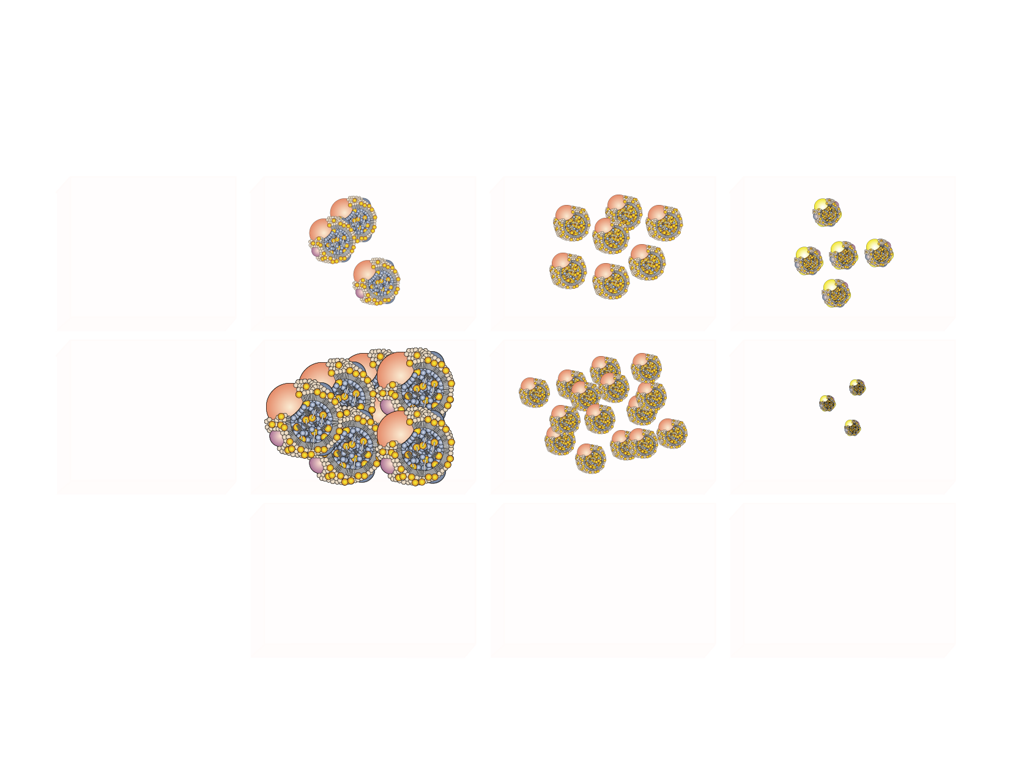
THE DYSLIPIDEMIA OF INTRA-ABDOMINAL OBESITY AND THE METABOLIC SYNDROME
VLDL
LDL
HDL
NORMAL
INSULIN
RESISTANCE
↓ HDL₂ cholesterol
↓ Number
↓ Size (small, dense)
↑ VLDL triglycerides
↑ VLDL apo B
↑ Number
↑ Size
⁼ LDL cholesterol
↑ LDL apo B
↑ LDL apo B/LDL
↑ Number
↓ Size (small, dense)

