Slide 1
Illustrations relevant to Evaluating CMR section

Slide 2
BMI CATEGORIES FOR CLASSIFYING NORMAL WEIGHT, OVERWEIGHT, AND OBESITY IN CAUCASIANS
BMI Categories
BMI Cut-offs (kg/m²)
Underweight
<18.5
Normal Weight
18.5 to 24.9
Overweight
25.0 to 29.9
Obese
≥30.0

Slide 3
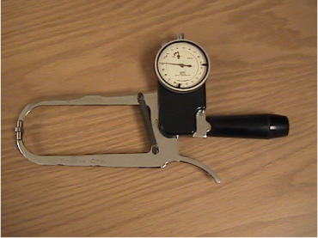
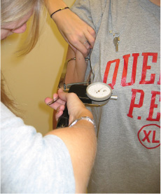
EXAMPLE OF A SKINFOLD CALIPER AND OF A SKINFOLD MEASURMENT (BICEPS)

Slide 4
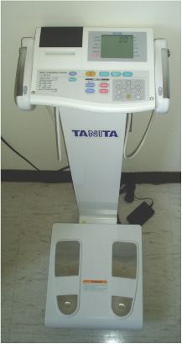
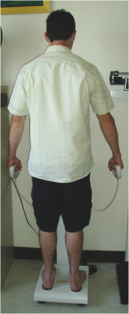
EXAMPLE OF A BIOELECTRICAL IMPEDANCE ANALYSIS (BIA) SEGMENTAL SCALE ALSO SHOWING AN INDIVIDUAL ON THE SCALE

Slide 5
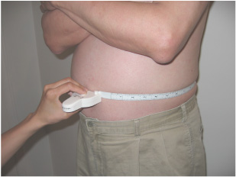
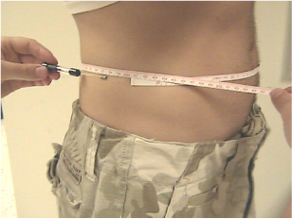
TECHNICIAN-MEASURED WAIST CIRCUMFERENCE USING A MYOTAPE (A) OR A GULICK TAPE (B)
A
B

Slide 6
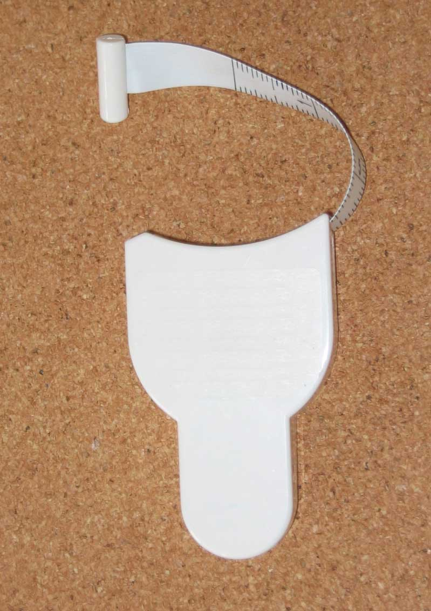
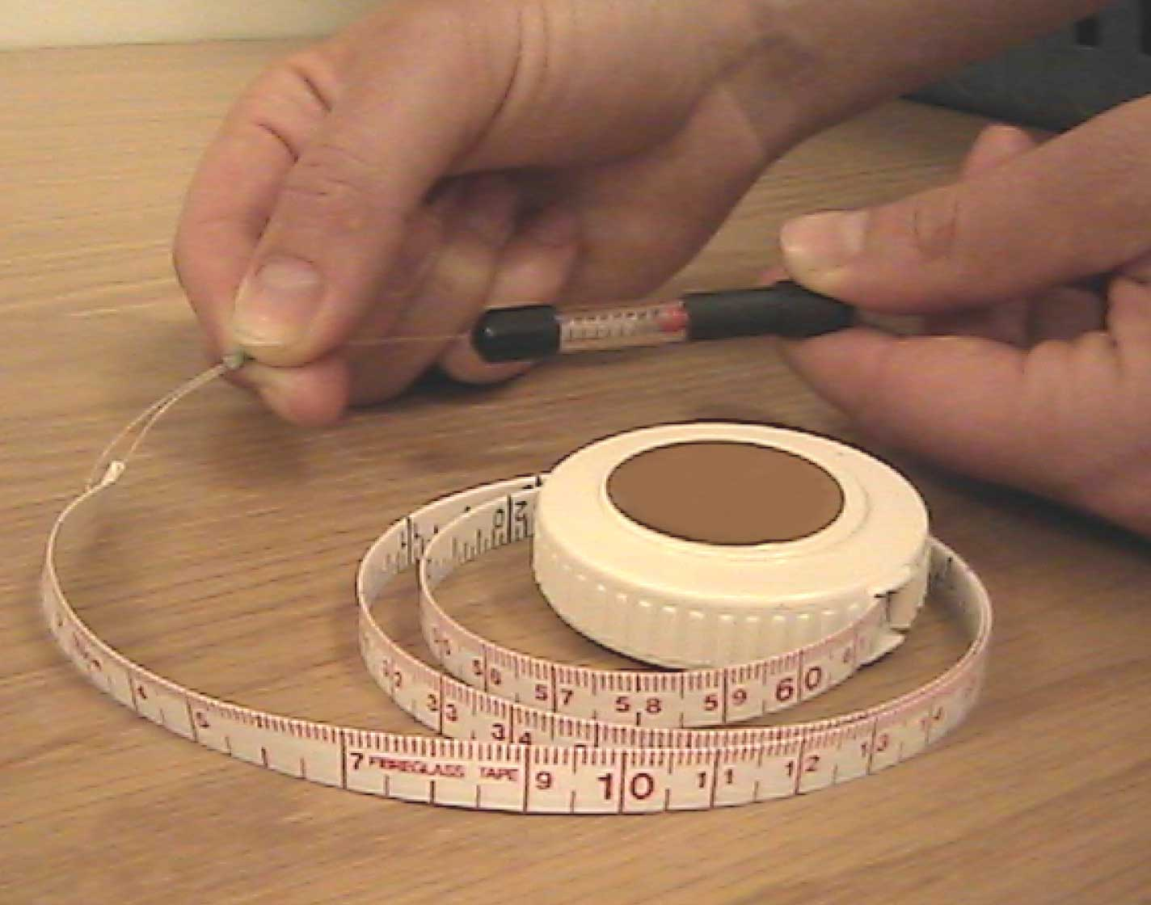
SPRING-LOADED WAIST CIRCUMFERENCE MEASUREMENT TAPES
Myotape
Gulick Tape

Slide 7
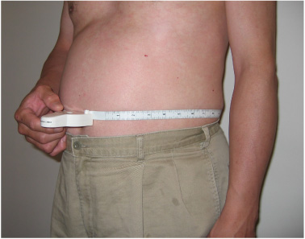
SELF-MEASURED CIRCUMFERENCE USING A MYOTAPE

Slide 8
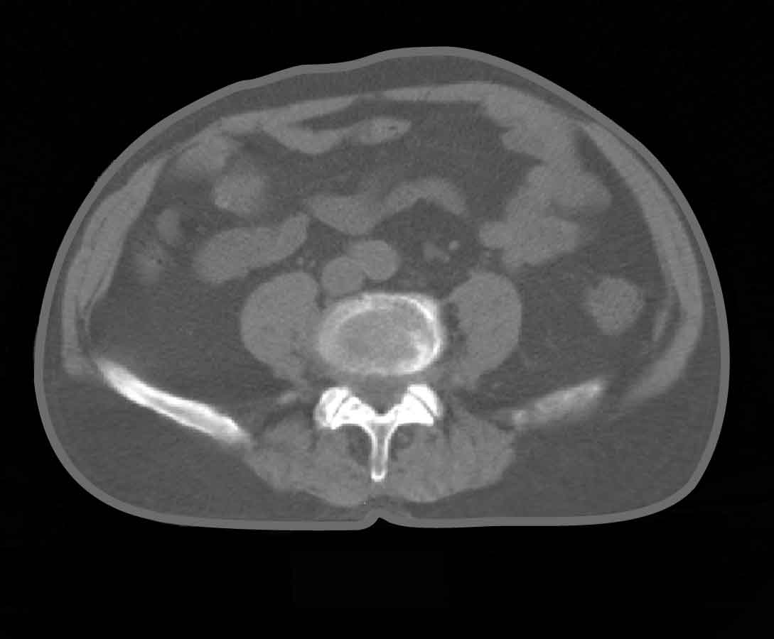
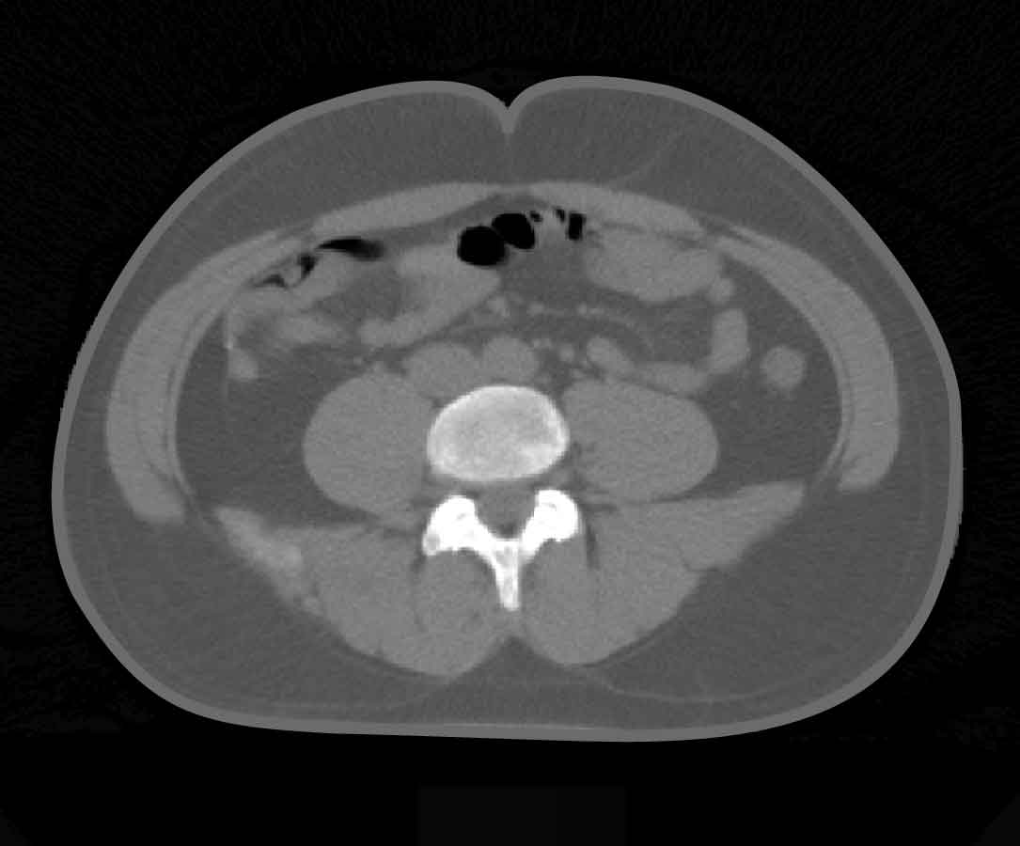
INTRA-ABDOMINAL FAT IN ELDERLY VERSUS YOUNG MEN WITH THE SAME WAIST CIRCUMFERENCE
82 years old
37 years old
• Waist Circumference: 91 cm
• Intra-abdominal Fat: 190 cm²
• Subcutaneous Fat: 162 cm²
• Waist Circumference: 93 cm
• Intra-abdominal Fat: 98 cm²
• Subcutaneous Fat: 274 cm²

Slide 9
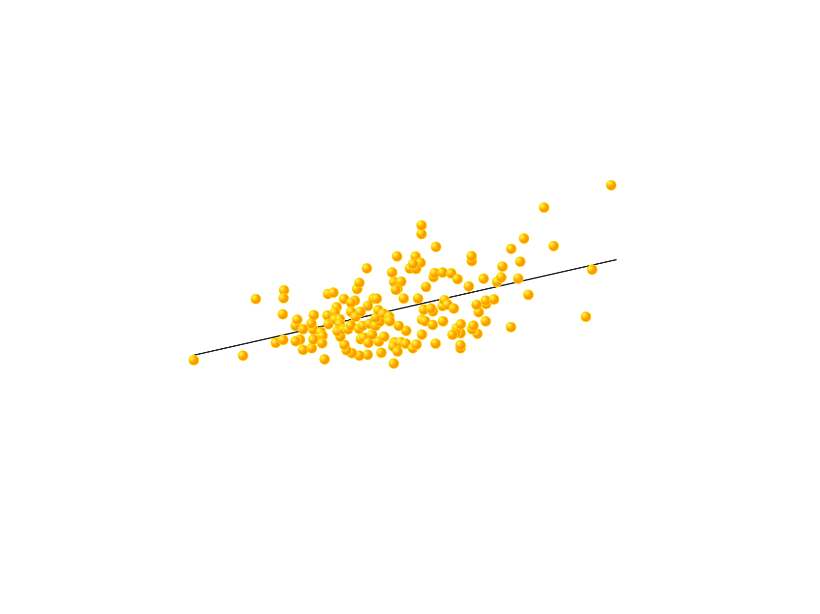
RELATIONSHIP BETWEEN REDUCTIONS IN WAIST CIRCUMFERENCE AND INTRA-ABDOMINAL FAT
3
R² = 0.25
2
Reduction in Intra-abdominal Fat (kg)
1
0
-1
-10
-5
0
5
10
15
20
25
Reduction in Waist Circumference (cm)

Slide 10
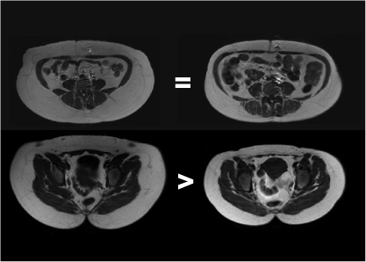
WOMEN WITH HIGH VS. LOW WAIST-TO-HIP RATIO (WHR) BUT THE SAME WAIST CIRCUMFERENCE AND INTRA-ABDOMINAL ADIPOSE TISSUE (AT)
Low WHR
High WHR
Low WHR
High WHR
WHR
0.80
0.94
Waist Level
Waist
Circumference (cm)
93.1
95.0
Intra-abdominal AT
(cm²)
116
115
Abdominal
Subcutaneous AT (cm²)
513
231
Abdominal
Subcutaneous AT (cm²)
Abdominal Skeletal Muscle (cm²)
126
105
Hip Circumference
116.7
101.5
Hip
Subcutaneous AT (cm²)
459
264
Hip Level
Hip Skeletal
Muscle (cm²)
230
187

Slide 11
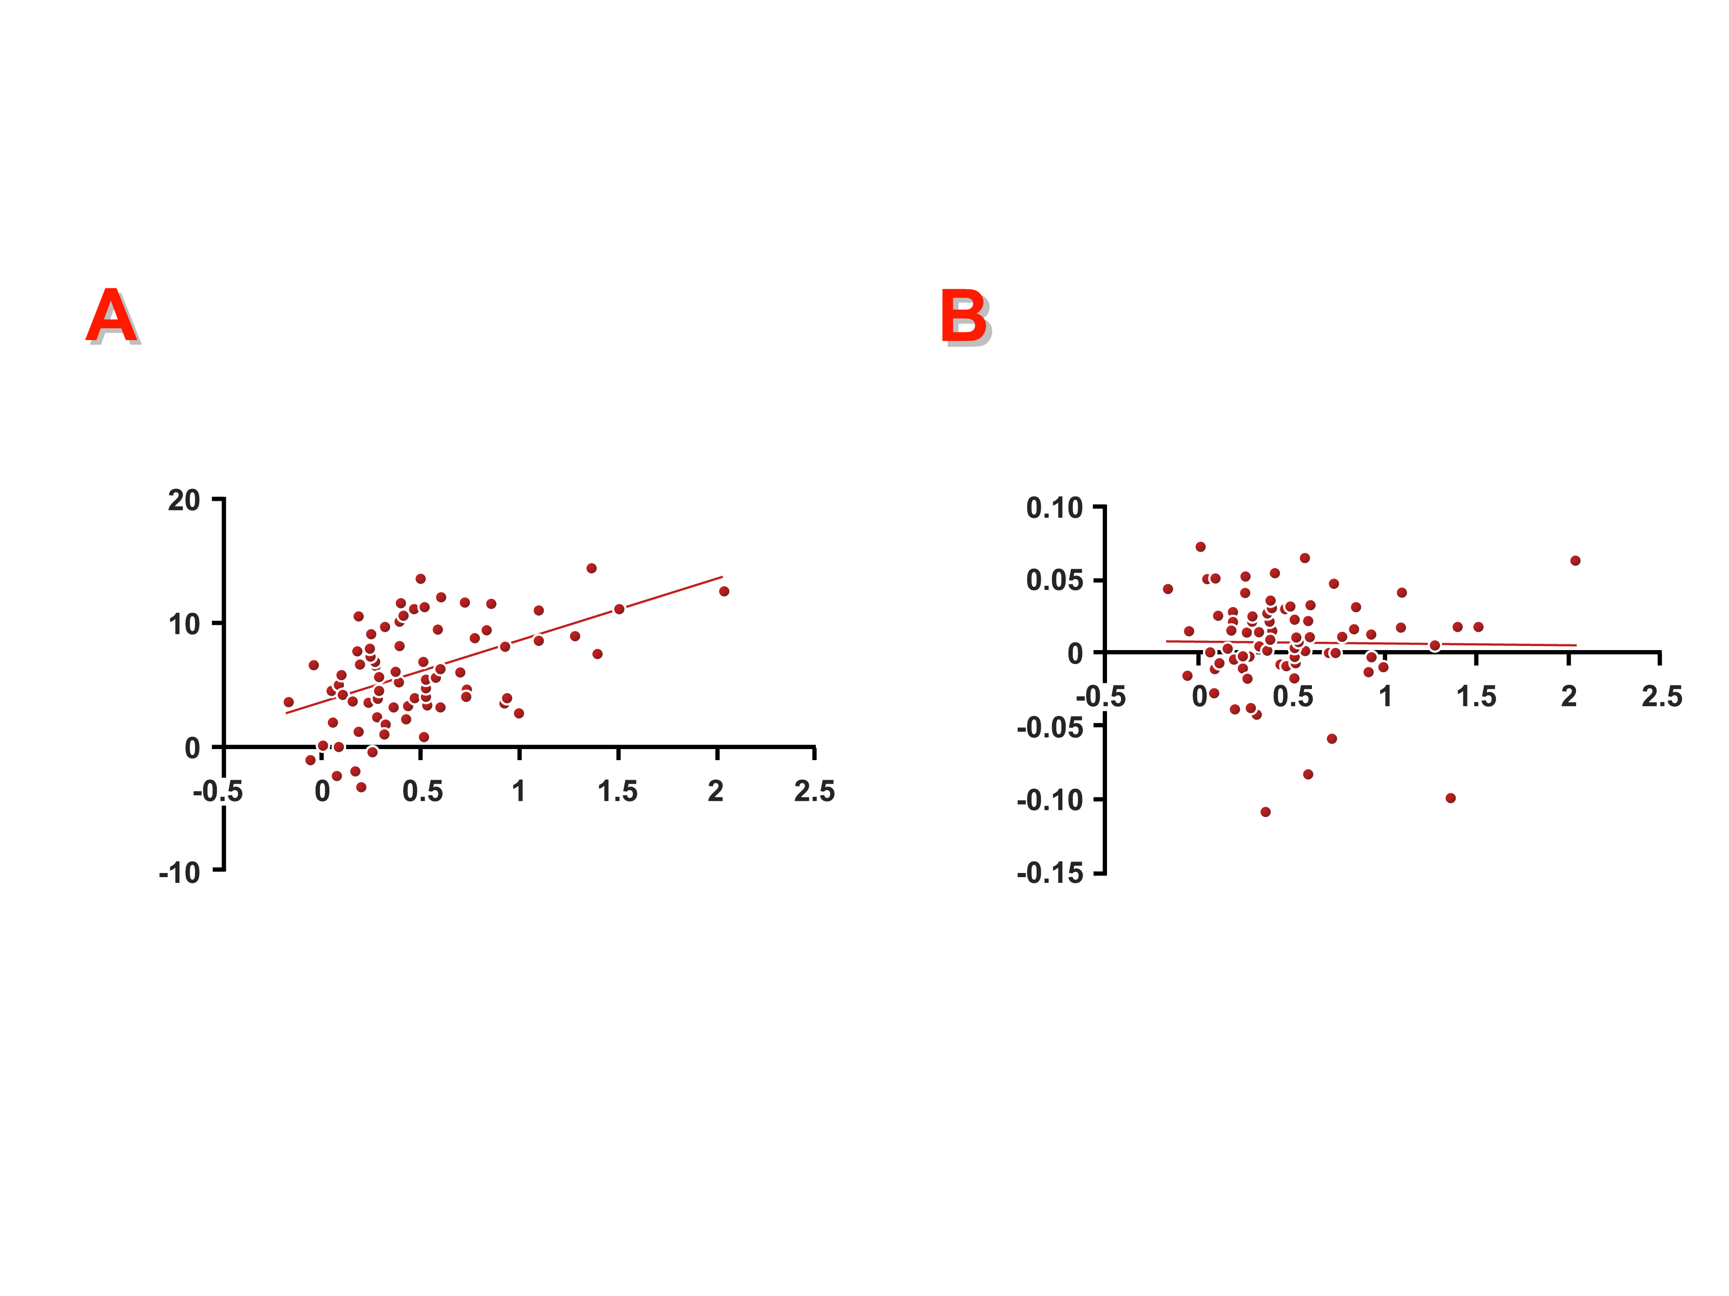
RELATIONSHIPS BETWEEN CHANGES IN INTRA-ABDOMINAL FAT AND REDUCTION IN WAIST CIRCUMFERENCE (A) AND WAIST-TO-HIP RATIO (WHR) (B) IN OBESE WOMEN
r=0.49
r=-0.02
p<0.0001
p>0.10
Reduction in Waist (cm)
Reduction in WHR
Reduction in Intra-abdominal Fat (kg)
Reduction in Intra-abdominal Fat (kg)
From Kuk J et al. Measurement of Body Composition in Obesity.
In Treatment of the Obese Patient. Humana press; 2007, pp. 121-49
Reproduced with permission

Slide 12
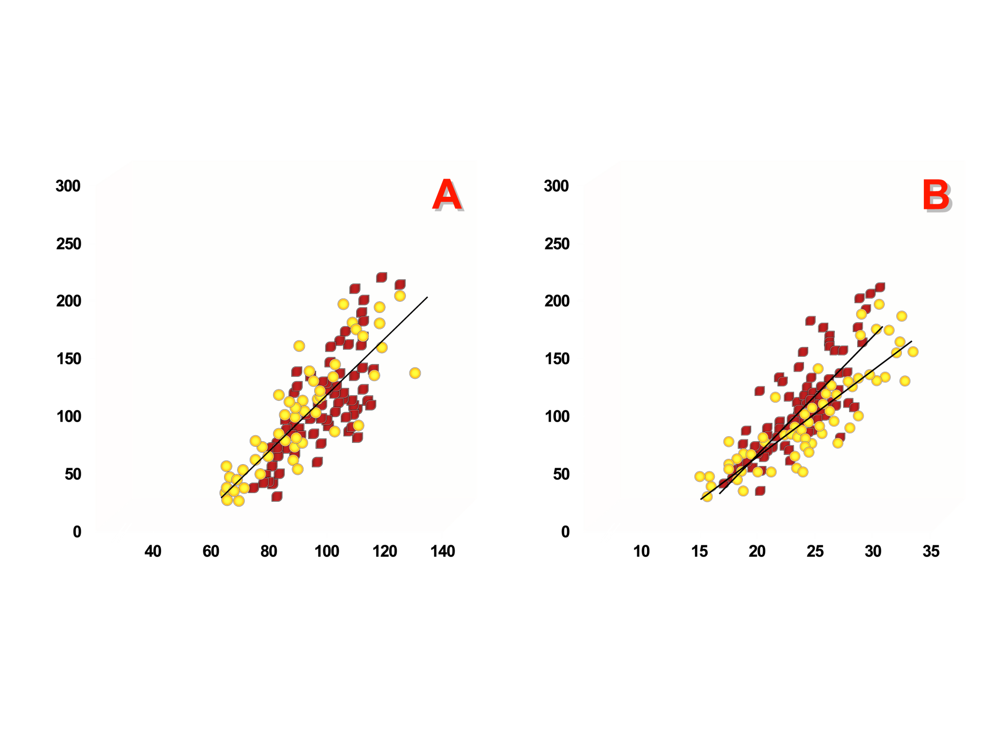
RELATIONSHIP BETWEEN INTRA-ABDOMINAL FAT WITH WAIST CIRCUMFERENCE (A) AND SAGITTAL DIAMETER (B)
r=0.87
r=0.87
r=0.77
r=0.80
Intra-abdominal Fat (cm²)
Intra-abdominal Fat (cm²)
Waist Circumference (cm)
Abdominal Sagittal Diameter (cm)
From Pouliot MC et al. Am J Cardiol 1994; 73: 460-8
Reproduced with permission

Slide 13
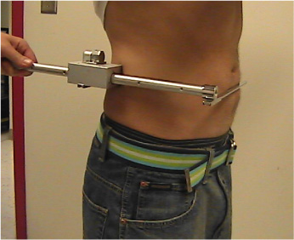
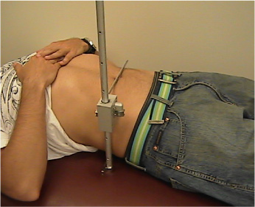
MEASUREMENT OF SAGITTAL DIAMETER IN THE STANDING AND SUPINE POSITIONS
Standing
Supine

Slide 14
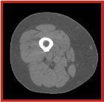
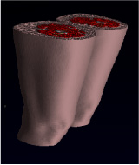
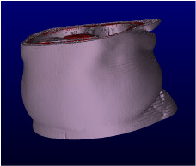
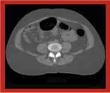
3-D RECONSTRUCTION OF THE THIGH AND ABDOMEN USING MULTIPLE COMPUTED TOMOGRAPHY (CT) IMAGES
CT image at the mid-thigh
3-D reconstruction of the thigh using
50 contiguous CT images
CT image at L4-L5
3-D reconstruction of the abdomen using
40 contiguous CT images

Slide 15
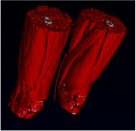
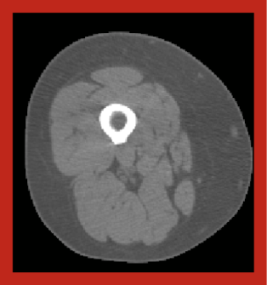
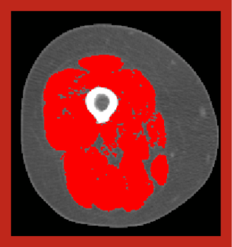
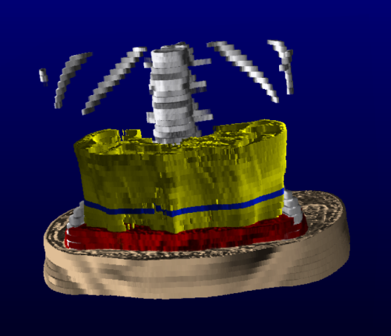
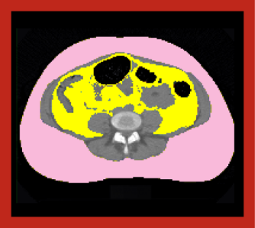
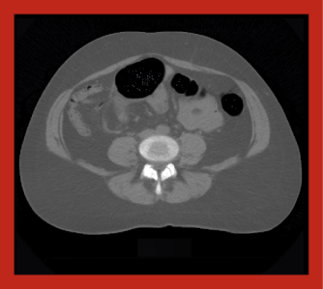
EXAMPLE OF A NON-SEGMENTED AND SEGMENTED COMPUTED TOMOGRAPHY (CT) IMAGE AT THE MID-THIGH AND ABDOMEN (L4-L5)
CT image at the mid-thigh
Muscle
Subcutaneous Fat
Intra-abdominal Fat
CT image L4-L5 level

Slide 16
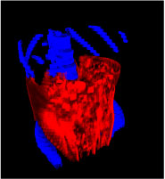
CONTRIBUTION OF INTRA-ABDOMINAL FAT TO TOTAL BODY FAT IN MEN AND WOMEN
10.2
9.3
11.5
5.0
85.7
78.3
% of Total Fat
Intra-abdominal
Fat
Men
Women
Intra-abdominal Fat
Subcutaneous Fat
Other Fat

Slide 17
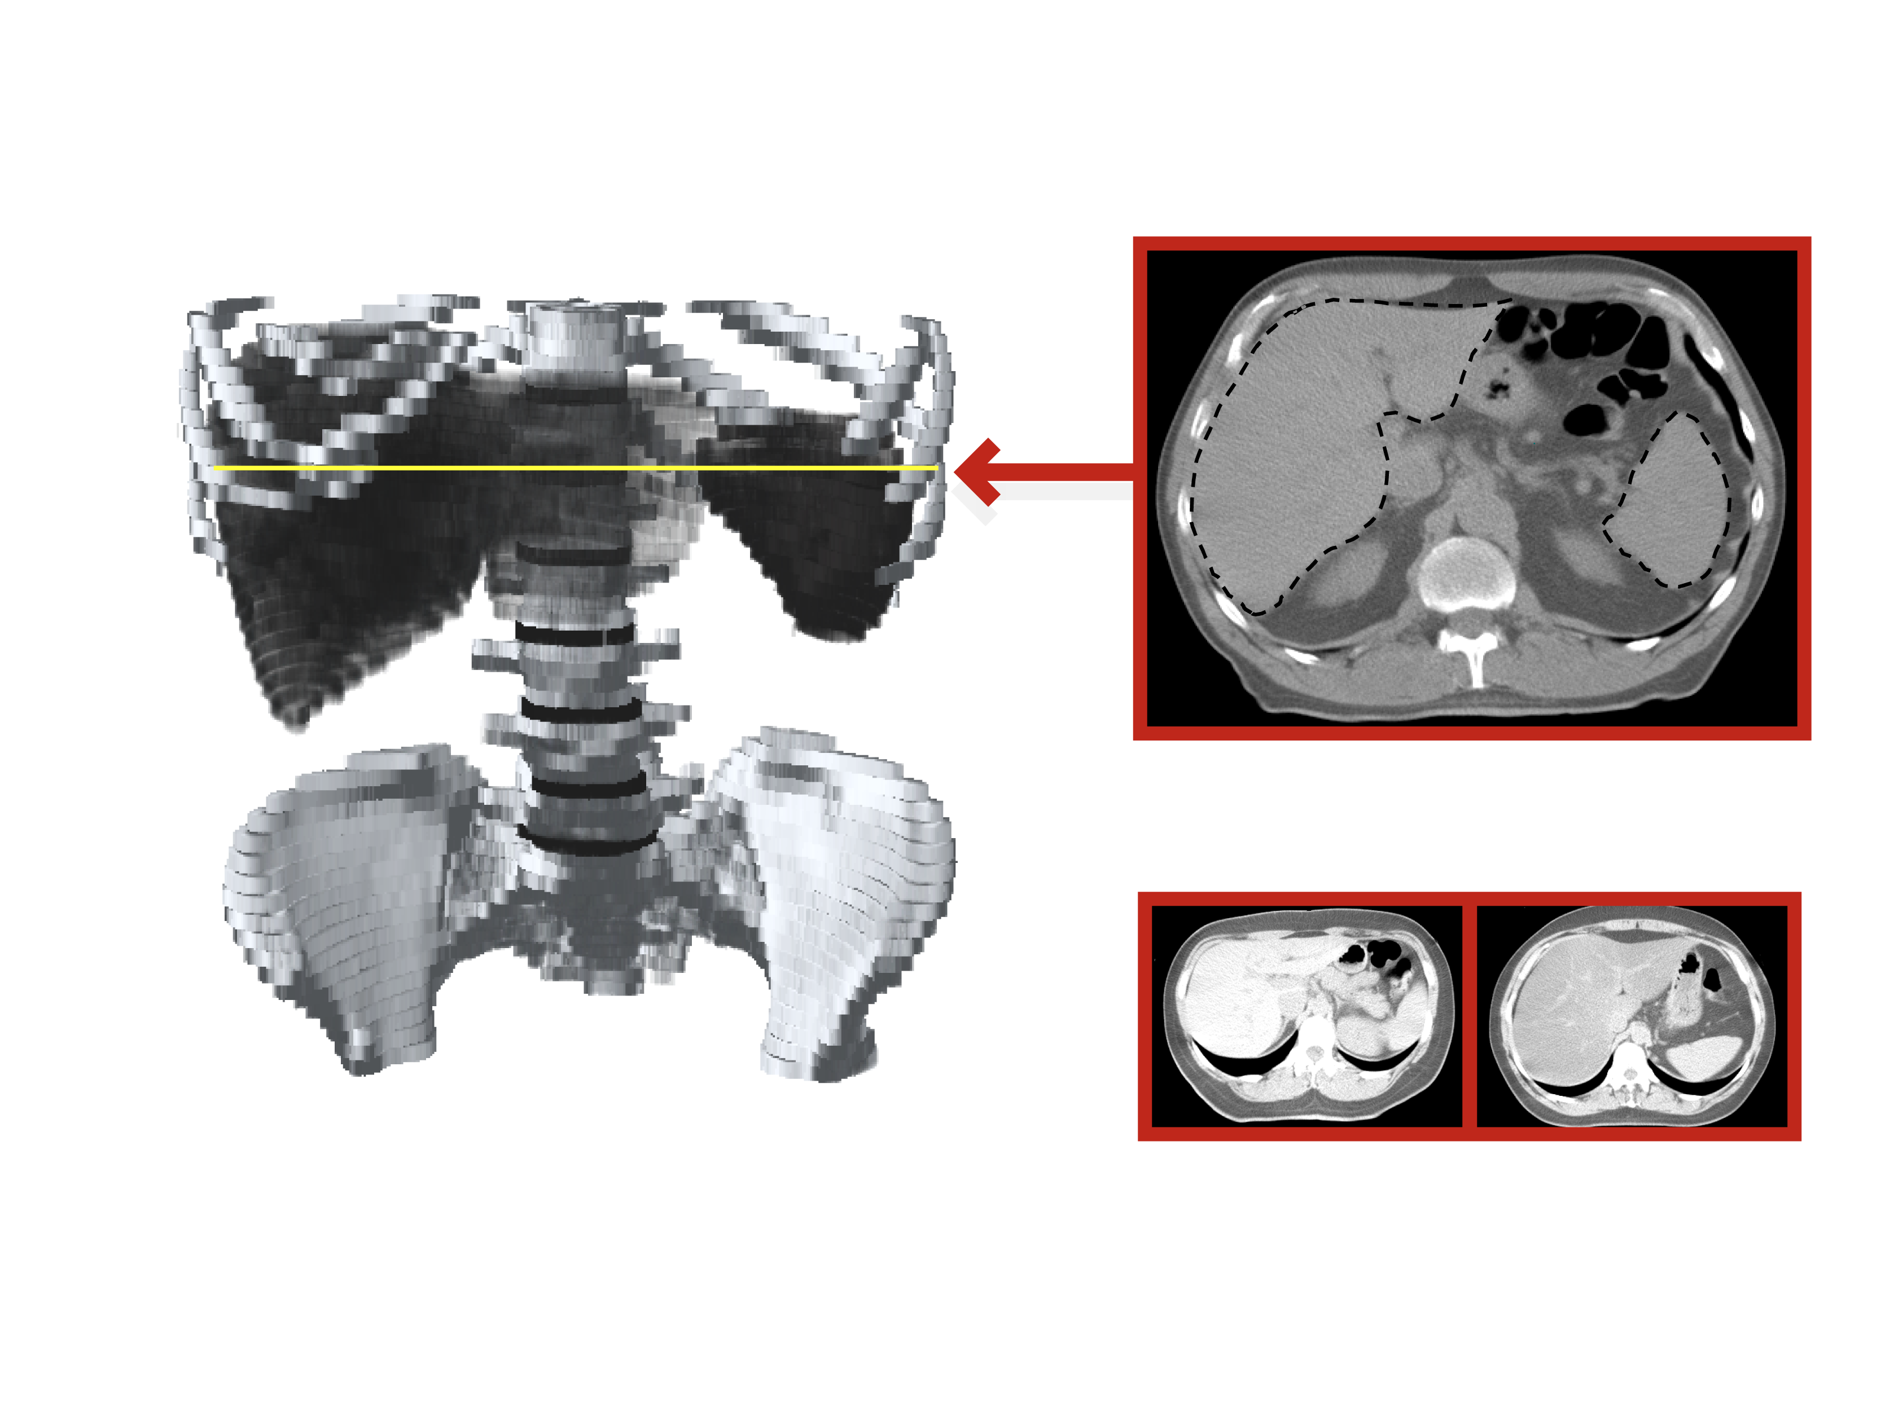
MEASURING LIVER FAT BY COMPUTED TOMOGRAPHY (CT): NORMAL VERSUS FATTY LIVER
T11
T12
Liver
LIVER
L1
SPLEEN
Spleen
L2
L3
L4
L5
Mean Liver Attenuation Value
Mean Spleen Attenuation Value
CTL/CTS
("Fatty Liver" Index)
79.4 HU
59.6 HU
14.8 HU
60.7 HU
HU: Hounsfield unit
Normal Liver
CTL/CTS = 1.33
"Fatty Liver"
CTL/CTS = 0.24
Adapted from Davidson LE et al. J Appl Physiol 2005; 100: 864-8

Slide 18
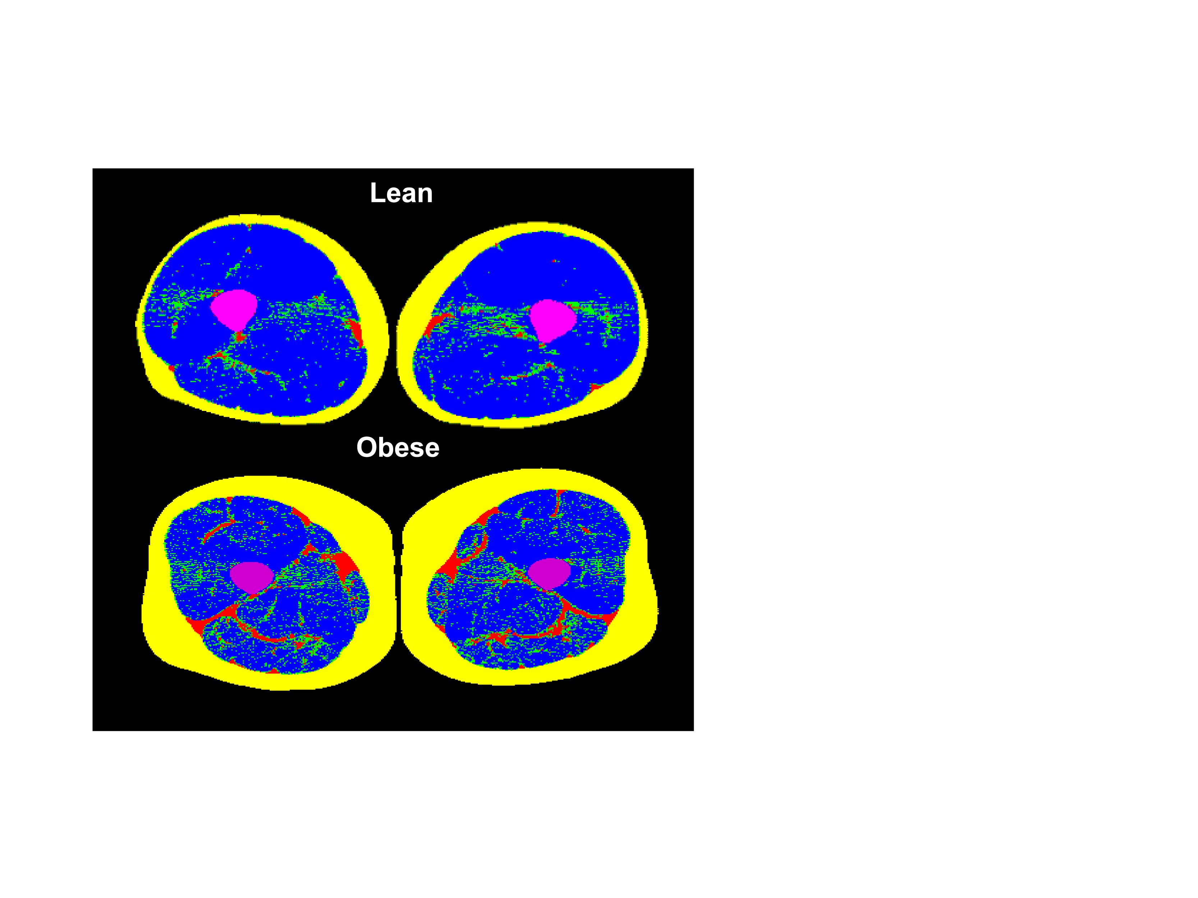
MEASURING SKELETAL MUSCLE LIPID CONTENT BY COMPUTED TOMOGRAPHY (CT) IN LEAN AND OBESE MEN
Bone
Subcutaneous Fat
Inter-muscular Fat
Low-density Muscle
High-density Muscle

Slide 19
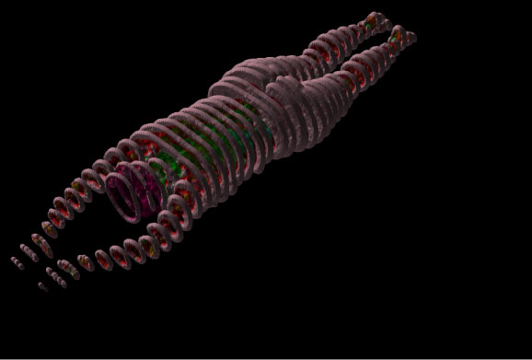
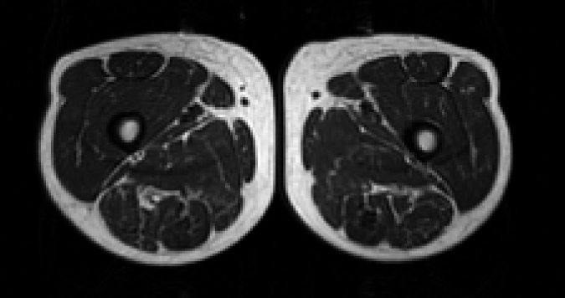
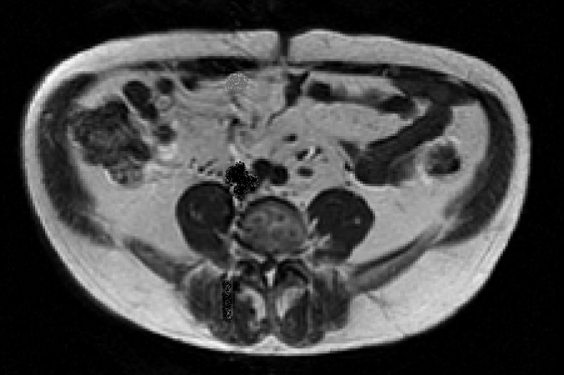
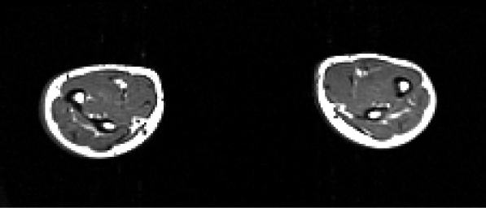
WHOLE BODY MAGNETIC RESONANCE IMAGING (MRI) AQUISITION
Legs
Abdomen
Arms

Slide 20
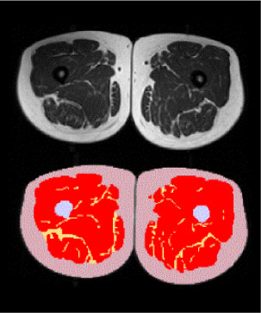
GREYSCALE NON-SEGMENTED AND SEGMENTED MAGNETIC RESONANCE IMAGING (MRI) IMAGE AT THE MID-THIGH IN AN OBESE WOMAN
FRONT
Subcutaneous Fat
Muscle
Inter-muscular Fat
Bone
BACK

Slide 21
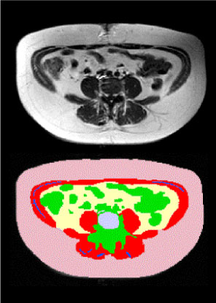
GREYSCALE NON-SEGMENTED AND SEGMENTED MAGNETIC RESONANCE IMAGING (MRI) ABDOMINAL IMAGE AT L4-L5 IN AN OBESE WOMAN
FRONT
Subcutaneous Fat
Intra-abdominal Fat
Inter-muscular Fat
Lean Tissue
Muscle
Bone
BACK

Slide 22
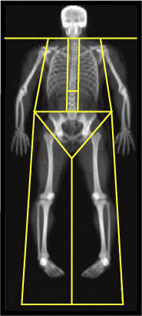
EXAMPLE OF DEXA OUTPUT
DEXA Results Summary
Region
Fat
(g)
Lean + Bone
Mineral Content
(g)
% Fat
Left Arm
1781.3
4183.2
29.9
Right Arm
2045.7
4487.9
31.3
Trunk
19480.8
35845.3
35.2
Left Leg
4788.3
10913.8
30.5
Right Leg
5110.0
11403.3
30.9
Subtotal
33206.2
66833.6
33.2
Head
1203.4
4609.2
20.7
Total
34409.6
71442.8
32.5

Slide 23
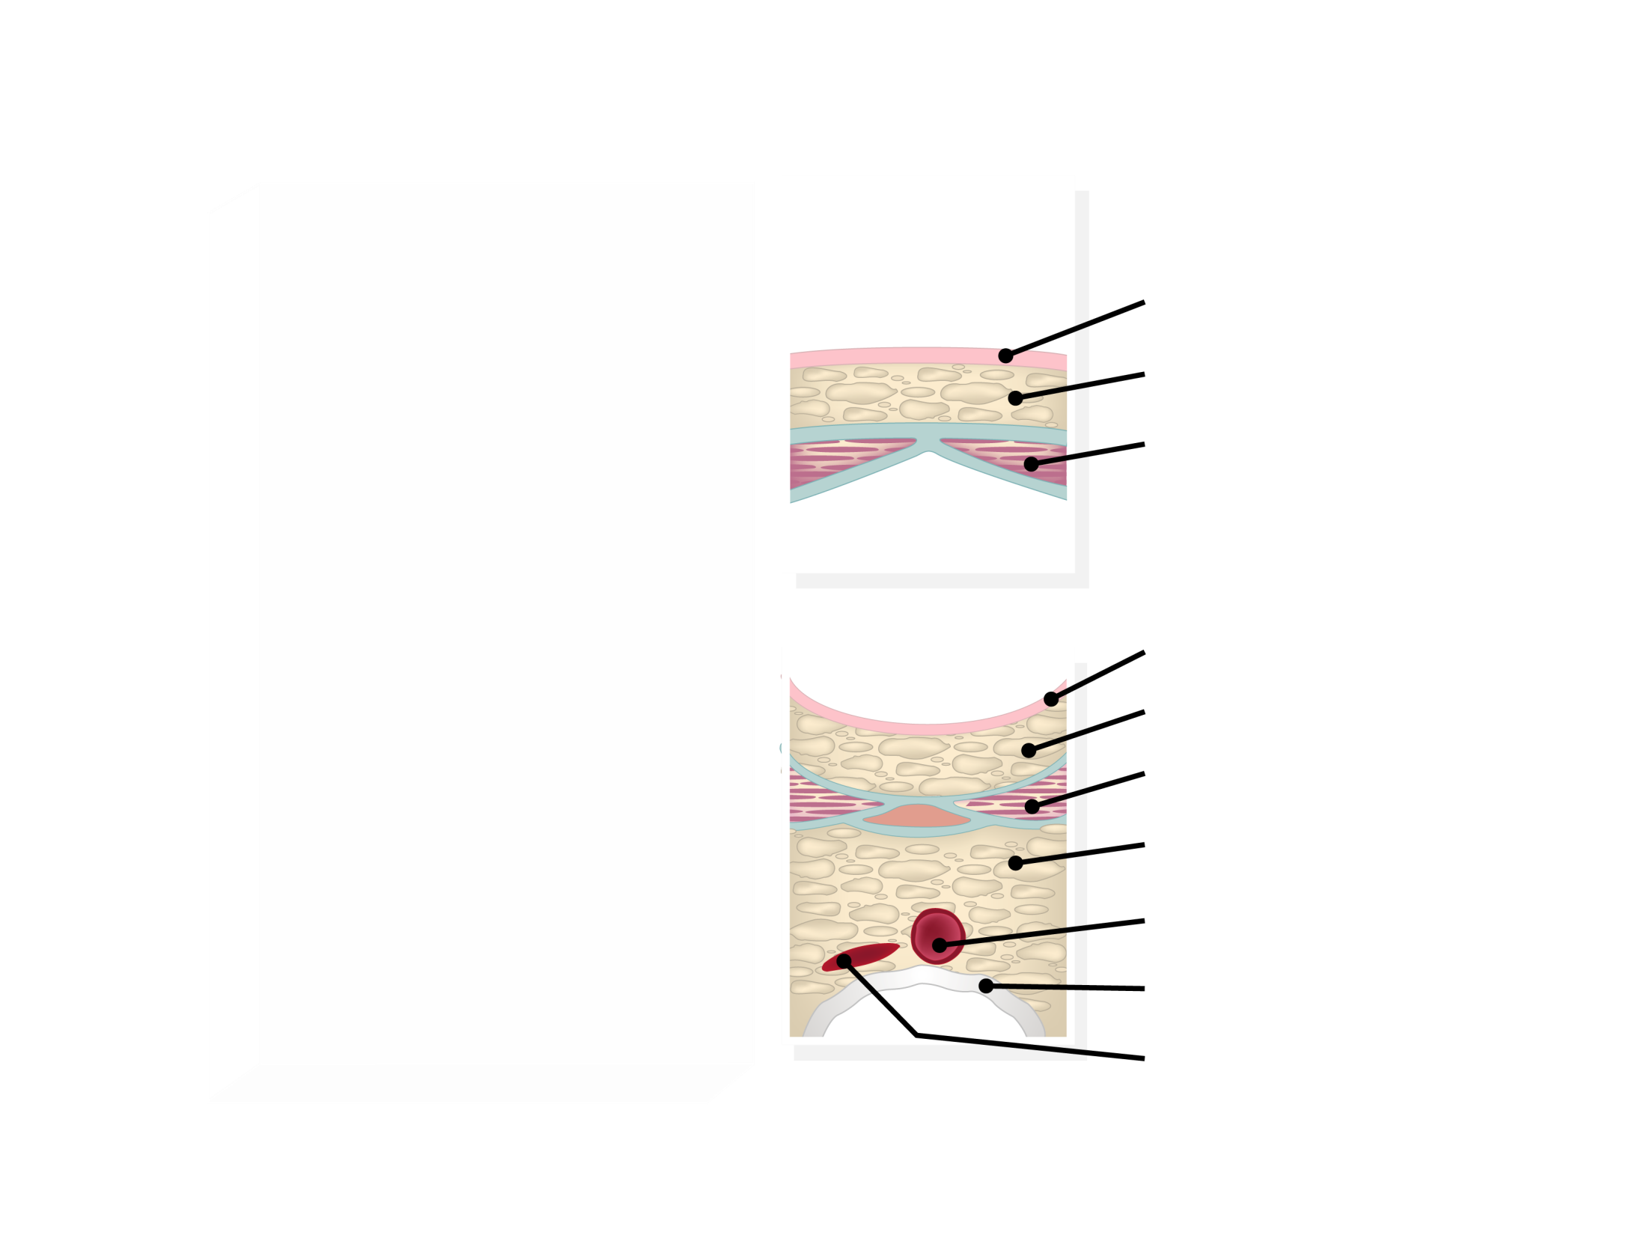
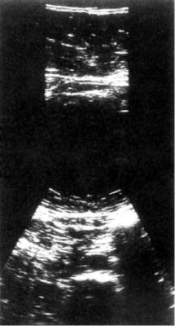
ULTRASONOGRAPHY MEASUREMENTS OF ABDOMINAL TISSUE COMPOSITION
Skin
Subcutaneous Fat
Rectus Abdominis Muscle
Skin
Subcutaneous Fat
Rectus Abdominis Muscle
Intra-abdominal Fat
Aorta
Spine
Inferior Vena Cava
Adapted from Armellini F et al. J Clin Ultrasound 1990; 18:563-7

Slide 24
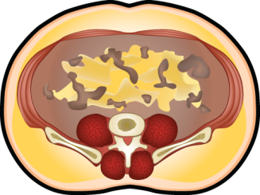
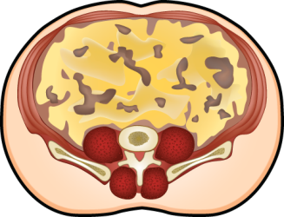
USE OF HYPERTRIGLYCERIDEMIC WAIST AS A SCREENING TOOL TO IDENTIFYING INDIVIDUALS LIKELY TO BE CHARACTERIZED BY THE CLUSTER OF ABNORMALITIES OF THE METABOLIC SYNDROME
NORMAL ADIPOSE TISSUE (FUNCTIONAL)
ABNORMAL ADIPOSE TISSUE (DYSFUNCTIONAL)
OBESITY PHENOTYPE
CLINICAL PHENOTYPE
OBESITY PHENOTYPE
CLINICAL PHENOTYPE
Subcutaneous obesity
Elevated waist girth alone
Intra-abdominal obesity
Hypertriglyceridemic waist
Waist girth
+
Waist girth
+
Favorable genotype
Healthy diet
Physically active
Insulin sensitive
Unfavorable genotype
Unhealthy diet
Sedentary
Insulin resistant
Normal
triglycerides
Eleveted
triglycerides
CORRELATES OF HYPERTRIGLYCERIDEMIC WAIST
• Atherogenic metabolic triad
• Cholesterol/HDL cholesterol
• Postprandial hyperlipidemia
• Glucose intolerance
• Hyperinsulinemia
• Blood pressure
• Risk of cardiovascular disease
• Risk of coronary artery disease
• Annual progression rate of aortic calcification
• Risk of type 2 diabetes

Slide 25
ASSOCIATIONS OF METABOLIC SYNDROME COMPONENTS WITH CRITERIA FOR THE CLINICAL DIAGNOSIS OF THE METABOLIC SYNDROME AS PROPOSED BY THE NCEP-ATP III
Metabolic Syndrome
Components
Clinical Criteria
Abdominal Obesity
Waist circumference ≥102 cm for men or ≥88 cm for women
Insulin Resistance
Fasting glucose ≥5.6 mmol/l or on drug treatment for elevated glucose
Atherogenic Dyslipidemia
Triglycerides ≥1.69 mmol/l or on drug
treatment for elevated triglycerides
HDL cholesterol <1.03 mmol/l for men or <1.29 mmol/l for women or on drug treatment for reduced HDL cholesterol
Elevated Blood Pressure
Blood pressure ≥130 or ≥85 mmHg or on antihypertensive drug treatment in a patient with history of hypertension
Pro-inflammatory State
none
Pro-thrombotic State
none

Slide 26
RELATIVE RISK OF CARDIOVASCULAR DISEASE (CVD) ASSOCIATED WITH THE METABOLIC SYNDROME OF STUDIES INCLUDED IN THE META-ANALYSIS OF GALASSI ET AL.
*Statistically significant
*
*
*
*
*
*
*
*
*
Relative Risk of CVD
*
*
Adapted from Galassi A et al. Am J Med 2006; 119: 812-9

Slide 27
CRITERIA FOR THE CLINICAL DIAGNOSIS OF THE METABOLIC SYNDROME ACCORDING TO THE IDF
Central Obesity
Waist circumference* - ethnicity specific
Plus any two:
Raised Triglycerides
>1.7 mmol/l (150 mg/dl)
Specific treatment for this lipid abnormality
*If BMI is over 30 kg/m², central obesity can be assumed and waist circumference does not need to be measured.
**In clinical practice, impaired glucose tolerance is also acceptable, but all reports of prevalence of metabolic syndrome should use only fasting plasma glucose and presence of previously diagnosed diabetes to define hyperglycemia. Prevalences also incorporating 2-h glucose results can be added as supplementary findings.
Reduced HDL Cholesterol
<1.03 mmol/l (40 mg/dl) in men
<1.29 mmol/l (50 mg/dl) in women
Specific treatment for this lipid abnormality
Raised Blood Pressure
Systolic ≥130 mmHg
Diastolic ≥85 mmHg
Treatment of previously diagnosed hypertension
Raised Fasting Plasma Glucose**
Fasting plasma glucose ≥5.6 mmol/l (100 mg/dl)
Previously diagnosed type 2 diabetes
If above 5.6 mmol/l or 100 mg/dl, oral glucose tolerance test is strongly recommended, but is not necessary to define presence of syndrome
Adapted from Alberti KG et al. Lancet 2005; 366: 1059-62

Slide 28
ETHNIC-SPECIFIC VALUES FOR WAIST CIRCUMFERENCE FOR THE CLINICAL DIAGNOSIS OF THE METABOLIC SYNDROME AS PROPOSED BY THE IDF
Europids*
Men
≥94 cm
Data are pragmatic cut-offs and better data are
required to link them to risk. Ethnicity should be
basis for classification, not country of residence.
*In USA, Adult Treatment Panel III values (102 cm
male, 88 cm female) are likely to continue to be
used for clinical purposes. In future epidemiological studies of populations of Europid origin (white people of European origin, regardless of where they live in the world), prevalence should be given, with both European and North American cut-offs to allow better comparisons.
Women
≥80 cm
South Asians
Men
≥90 cm
Women
≥80 cm
Chinese
Men
≥90 cm
Women
≥80 cm
Japanese
Men
≥85 cm
Women
≥90 cm
Ethnic south and central Americans
Men
Use south Asian recommendations
until more specific data are available
Women
Sub-Saharan Africans
Men
Use European data until
more specific data are available
Women
Eastern Mediterranean
and middle east (Arab) population
Men
Use European data until
more specific data are available
Women
Adapted from Alberti KG et al. Lancet 2005; 366: 1059-62

Slide 29
CRITERIA PROPOSED FOR CLINICAL DIAGNOSIS OF THE METABOLIC SYNDROME
Clinical Measure
WHO (1998)
EGIR
NCEP-ATP III (2005)
AACE (2003)
IDF (2005)
Insulin Resistance
IGT, IFG, T2D, or
lowered insulin
sensitivity* plus any 2 of the following
Plasma insulin >75th percentile plus any 2 of the following
None, but any 3 of the following 5 features
IGT or IFG plus any of the following based on clinical judgment
None
Adiposity Index
Men: WHR >0.90;
Women: WHR >0.85 and/or BMI >30 kg/m²
WC ≥94 cm in men or ≥80 cm in women
WC ≥102 cm in men or ≥88 cm in women
BMI ≥25 kg/m²
Increased WC (population specific) plus any 2 of the following
Lipid
TG ≥1.69 mmol/l and/or HDL-C <0.90 mmol/l in men or <1.01 mmol/l in women
TG ≥2.0 mmol/l and/or HDL-C <1.0 mmol/l in men or women
TG ≥1.69 mmol/l or on TG Rx; HDL-C <1.03 mmol/l in men or <1.29 mmol/l in women or on HDL-C Rx
TG ≥1.69 mmol/l and HDL-C <1.03 mmol/l in men or <1.29 mmol/l in women
TG ≥1.69 mmol/l or on TG Rx; HDL-C <1.03 mmol/l in men or <1.29 mmol/l in women or on HDL-C Rx
Blood Pressure
≥140/90 mmHg
≥140/90 mmHg or
on hypertension Rx
≥130 mmHg systolic or ≥85 mmHg diastolic or on hypertension Rx
≥130/85 mmHg
≥130 mmHg systolic or ≥85 mmHg diastolic or on hypertension Rx
Glucose
IGT, IFG, or T2D
IGT or IFG (but not diabetes)
≥5.6 mmol/l (includes diabetes)
IGT or lFG (but not diabetes)
≥5.6 mmol/l (includes diabetes)
Other
Microalbuminuria
Other features of insulin resistance
Legend:
WHO, World Health Organization; EGIR, European Group for the Study of Insulin Resistance;
NCEP-ATP III, National Cholesterol Education Program-Adult Treatment Panel III; AACE,
American Association of Clinical Endocrinologists; IDF, International Diabetes Federation;
T2D, type 2 diabetes; WHR, waist-to-hip ratio; WC, waist circumference; BMI, body mass index; and TG, triglycerides.
*Insulin sensitivity measured under hyperinsulinemic-euglycemic conditions.

Slide 30
CVD DEATH RATES IN THE AEROBICS CENTER LONGITUDINAL STUDY ACCORDING TO CATEGORIES OF WAIST CIRCUMFERENCE (WC) AND THE PRESENCE OR ABSENCE OF TWO OR MORE OTHER METABOLIC SYNDROME RISK FACTORS
2838
(53)
CVD death rate per 10 000 man-years
3595
(45)
3640
(45)
1002
(8)
≥ 2 risk factors
7327
(42)
2569
(17)
< 2 risk factors
WC < 94 cm
94< WC < 102 cm
WC > 102 cm
From Katzmarzyk PT et al. Diabetes Care 2006; 29; 404-9
Reproduced with permission

Slide 31
www.cardiometabolic-risk.org

