Slide 1
Illustrations relevant to Managing CMR section

Slide 2
COMPOSITION OF A 10-KG WEIGHT LOSS DUE TO EXERCISE AND DIET IN OBESE MEN AND WOMEN
Exercise
Diet
Exercise
Diet
Men
Women
Subcutaneous Fat
Intra-abdominal Fat
Muscle
Others

Slide 3
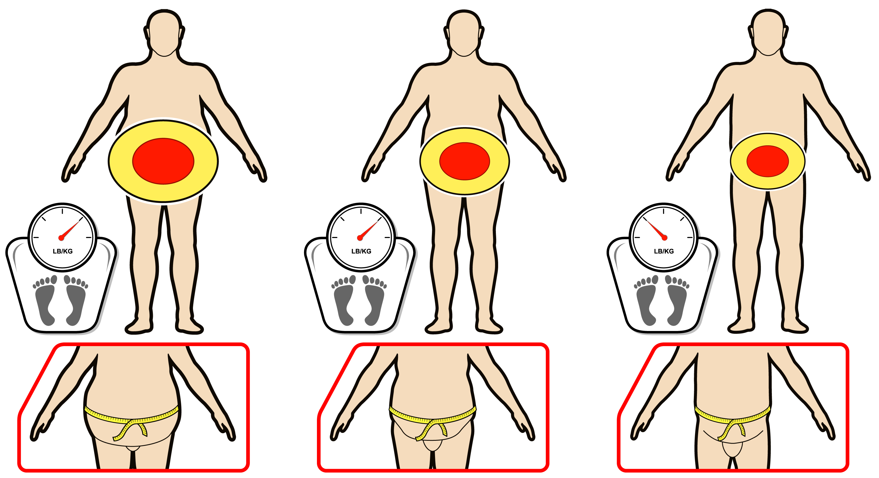
EFFECTS OF EXERCISE WITH AND WITHOUT CONSEQUENT WEIGHT LOSS ON CHANGES IN INTRA-ABDOMINAL FAT (IAF)
Sedentary Obese
Exercise Without Weight Loss
Exercise With Weight Loss
IAF
IAF
IAF
Exercise without weight loss is associated with reduction in intra-abdominal fat (10-20%) and a consequent reduction in waist circumference. However, exercise-induced weight loss leads to greater reductions in both intra-abdominal fat (30%) and waist circumference.

Slide 4
MEAL PLANS FOR A HEALTHY MENU
a) 1.200 kcal menu
Breakfast
Lunch
Dinner
1 medium slice whole wheat bread
2 tbsp (30 ml) peanut butter (natural)
½ cup (125 ml) wheat cereal
(Shredded Wheat, All Bran, Bran Flakes)
½ cup (125 ml) 1% milk
¾ cup orange juice
Sandwich
2 medium slices whole wheat bread
- 75 g chicken
- 1 leaf lettuce
3 medium slices tomato
1 tsp (5 ml) low-fat mayonnaise
1 medium orange
1 cup (250 ml) water
- 75 g salmon
1 ½ tsp (7 ml) vegetable oil
¾ medium baked potato
- 1 tsp (5 ml) margarine
½ cup (125 ml) green beans
- ½ cup (125 ml) carrots
- ½ cup (125 ml) yogurt
b) 1.600 kcal menu
Breakfast
Lunch
Dinner
2 medium slices whole wheat bread
50 g cheese
1 egg
2 tsp (30 ml) peanut butter (natural)
- ½ cup (125 ml) orange juice
- 1 cup coffee (250 ml), regular
Pasta with tofu-tomato sauce
1 cup (250 ml) whole wheat pasta
1 cup (250 ml) tofu-tomato sauce*
- 1 apple
75 g pork
1 cup (250 ml) salad
1 tbsp (15 ml) olive oil with
balsamic vinegar
- ½ cup (125 ml) carrots
- ½ cup (125 ml) basmati rice
- ½ cup (125 ml) yogurt
*Tofu tomato sauce
You may initially find it helpful to use a measuring cup to ensure your serving sizes are correct.
3 tbsp (45 ml) olive oil
2 cloves garlic
2 onions
2 tomatoes
2 green peppers
6 mushrooms
1 grated carrot
3 cups (750 ml) tomato juice
454 g firm tofu, drained and cubed
½ tsp (125 ml) tomato purée
Pepper, spaghetti spices, thyme, basil, oregano,
rosemary, parsley, chilli, and bay leaf
In a small sauce pan, heat oil over medium heat and
sauté onion and garlic until soft.
Mix all ingredients together and cook on medium heat
for about 60 minutes or until tomatoes reach a pasty
consistency.

Slide 5
HANDY PORTION GUIDE
Vegetables
Fruits, Grain products, Milk
Meat and alternatives
Choose as much as you can
hold in both hands
Choose an amount up to the size of your fist
Choose an amount up to the size
of the palm of your hand and the
thickness of your little finger
Cheese
Fat and oils
Choose an amount the size of
two fingers (index and middle finger)
Limit fat to an amount the size
of the tip of your thumb

Slide 6
KEY FEATURES OF A "SENSIBLE" DIET FOR ACHIEVING CARDIOMETABOLIC HEALTH
Food groups
Choose
Vegetables and fruits
Try to have at least 5 servings of vegetables
and 5 servings of fruit per day
Fresh or frozen vegetables and fruits
Dried fruits
Add vegetables to salads and soups
Grain products
Whole wheat bread, pumpernickel, rye, pita, rolls, bagels, homemade muffins
Whole grain cereal, oatmeal, bran flakes
Saltine crackers, breadsticks, rice cakes
Whole grain pasta, rice, barley
Choose whole grain cereals
Milk and alternatives
Check the % milk fat (M.F.) on labels
Skim milk, 1% milk
Buttermilk, skim milk powder
Yogurt < 1% M.F.
Cheese < 15% M.F.
Fortified soy beverage
Meat and alternatives
Choose fat-free cooking methods: BBQ, bake, braise,
broil, roast, sauté in tomato sauce, broth, or lemon juice
Chicken or turkey without the skin, lean cuts of veal, beef, lamb, pork, fish
Legumes: chick peas, lentils, peas, navy beans, kidney beans
Tofu, natural peanut butter, eggs
Fat and oils
Avoid saturated fat from butter, shortening,
tropical oils, and trans fats*
Vegetable oils: olive, canola, corn, soybean, safflower, sesame, flaxseed
Non-hydrogenated margarine
Nuts and seeds
*To reduce the amount of trans fats you eat, choose fewer crackers, cookies and pastries made with shortening and select soft, non-hydrogenated margarines

Slide 7
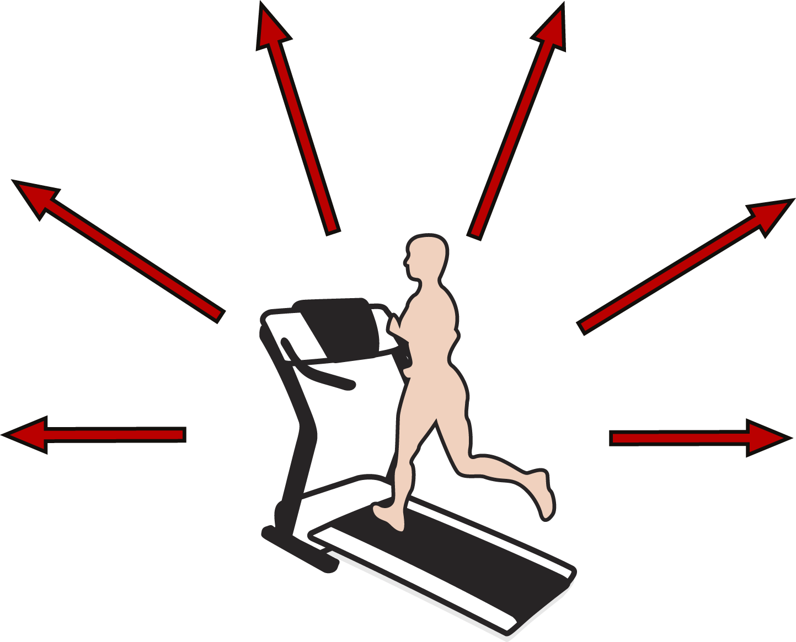
IMPROVEMENTS IN CARDIOMETABOLIC RISK FACTORS INDUCED BY REGULAR EXERCISE
Insulin Resistance
Atherogenic Dyslipidemia
A 30-85% improvement
Increased HDL cholesterol (~5%) and decreased trlglycerldes (~15%) and a shift in the distribution of LDL particle size (from small to large)
Abdominal Obesity
Hypertension
A 30% reduction in
intra-abdominal fat
A 4 mm Hg reduction in
both systolic and diastolic
blood pressure
Thrombosis
Systemic Inflammation
Induces an anti-thrombotic
state (decreased coaguability
and increased fibrinolysis)
Approximately 30% reduction
in inflammatory markers
Moderate intensity endurance exercise on most days of the week

Slide 8
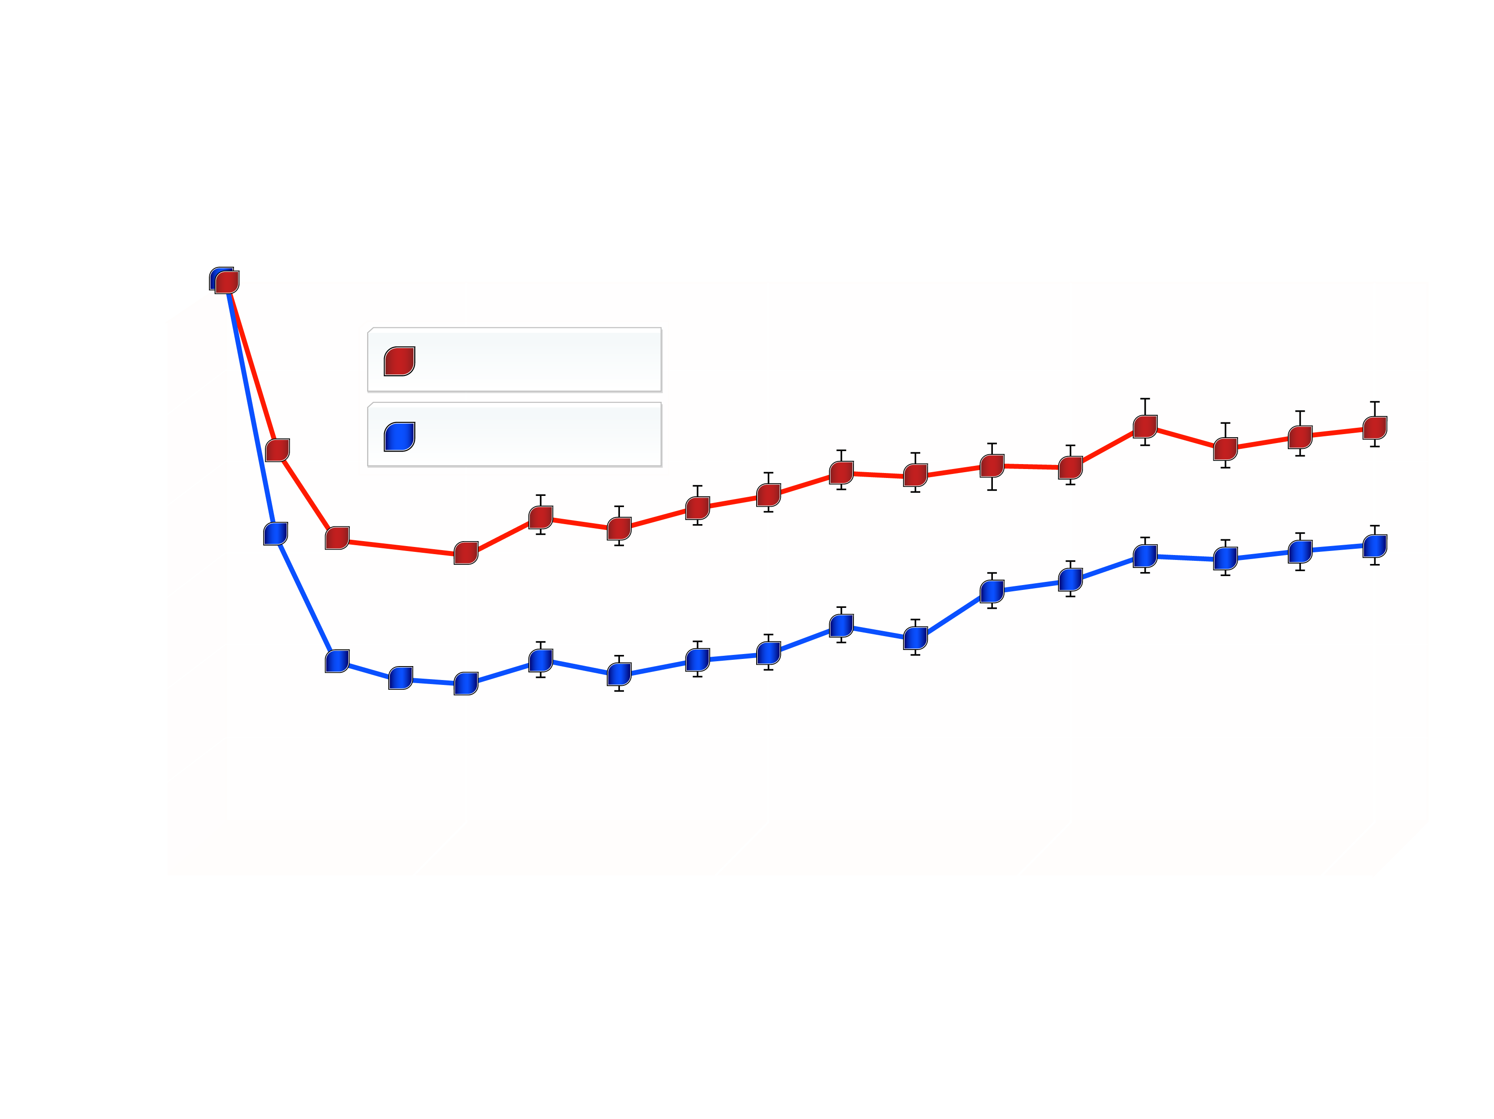
EFFECT OF ORLISTAT ON BODY WEIGHT IN A FOUR-YEAR RANDOMIZED, PLACEBO-CONTROLLED CLINICAL TRIAL
XENDOS Study
0
Placebo
Orlistat
-5
Weight Loss (kg)
-10
-15
0
52
104
156
208
Weeks of Treatment
From Torgerson JS et aI. Diabetes Care 2004; 27: 155-61
Reproduced with permission

Slide 9
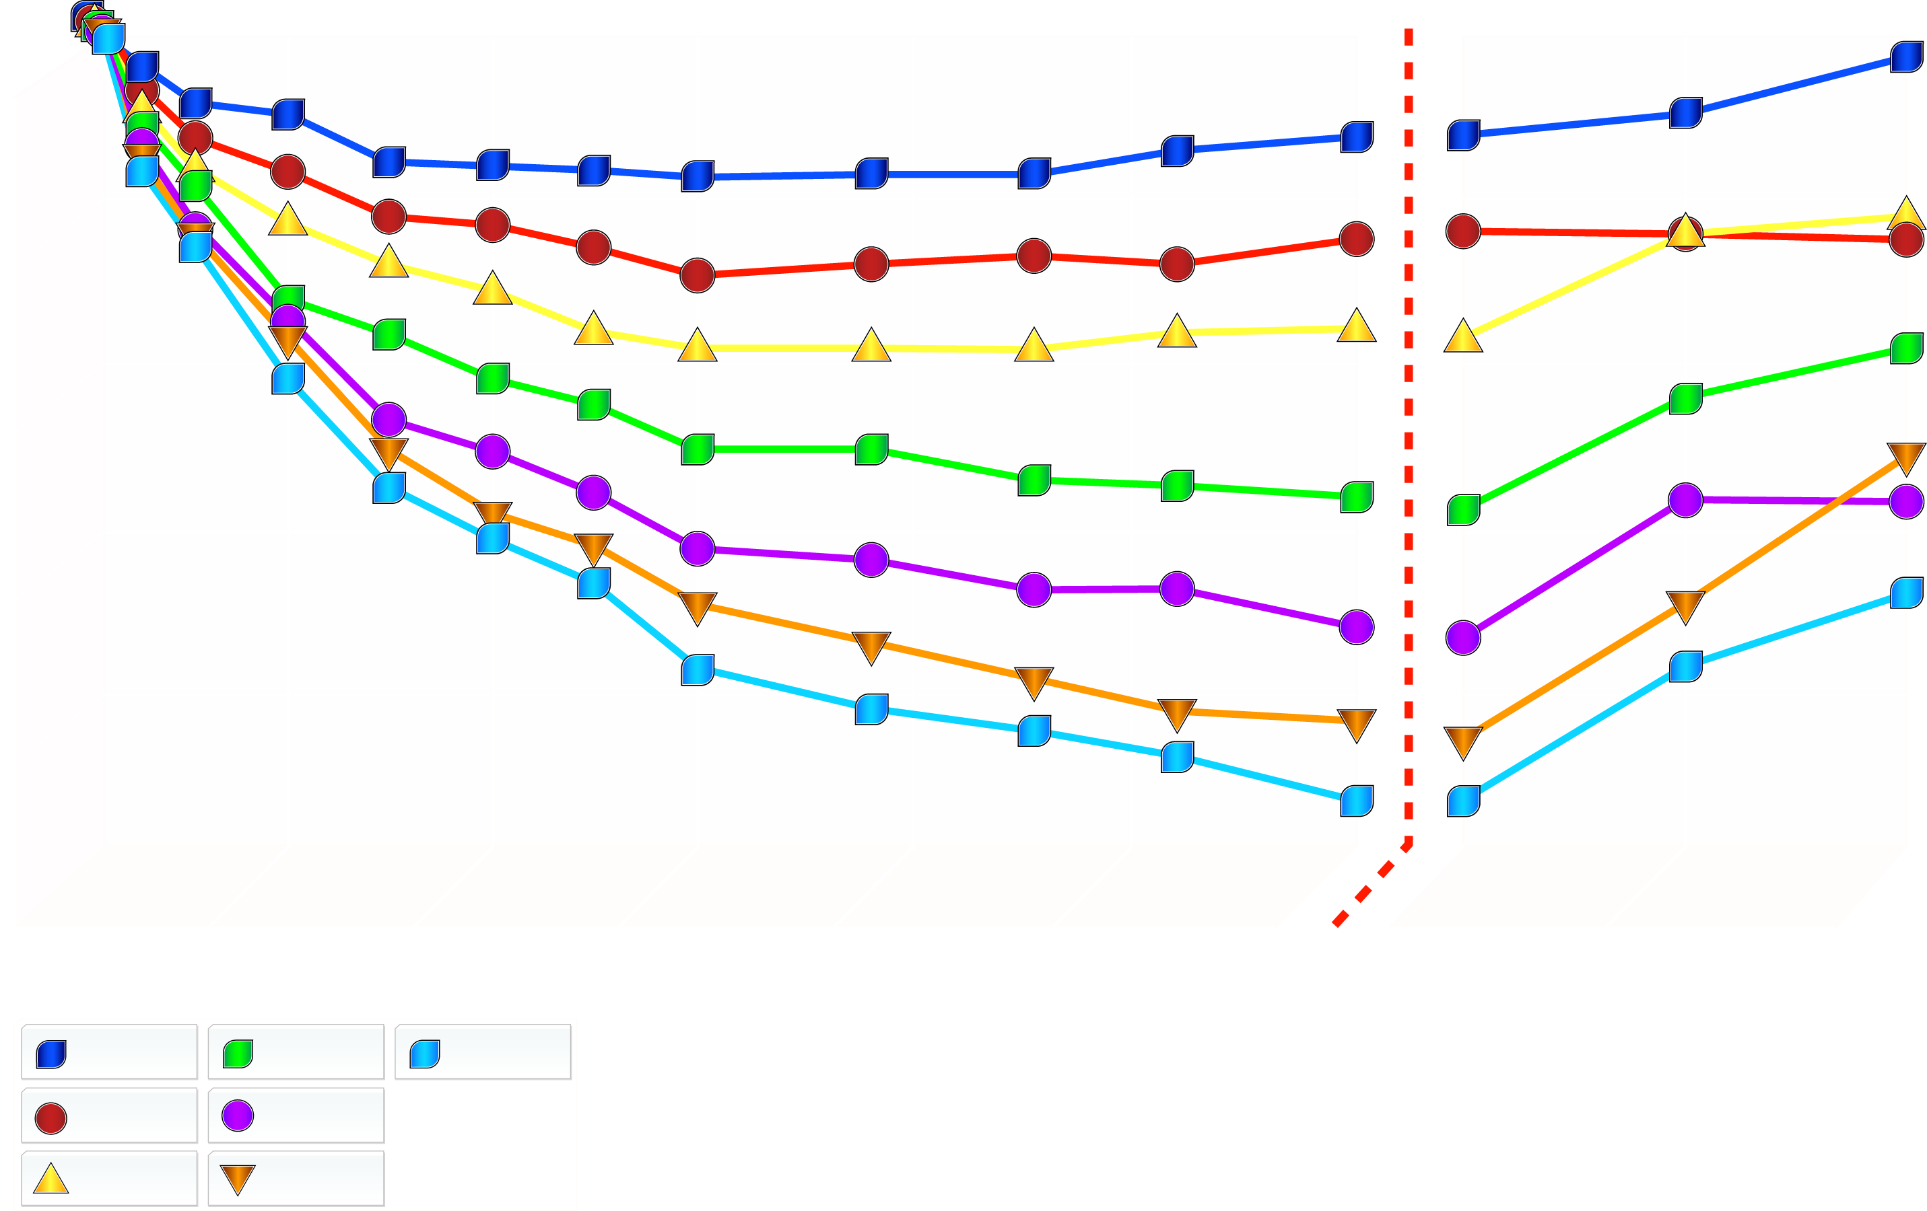
EFFECT OF A SIX-MONTH TREATMENT WITH SIBUTRAMINE ON BODY WEIGHT
End of
Treatment
0
-2
-4
Mean % Change in Weight
-6
-8
-10
0
4
8
12
16
20
24
24
27
30
Placebo
10 mg
30 mg
Treatment Week
1 mg
15 mg
5 mg
20 mg
From Bray GA et aI. Obes Res 1999; 7: 189-98
Reproduced with permission

Slide 10
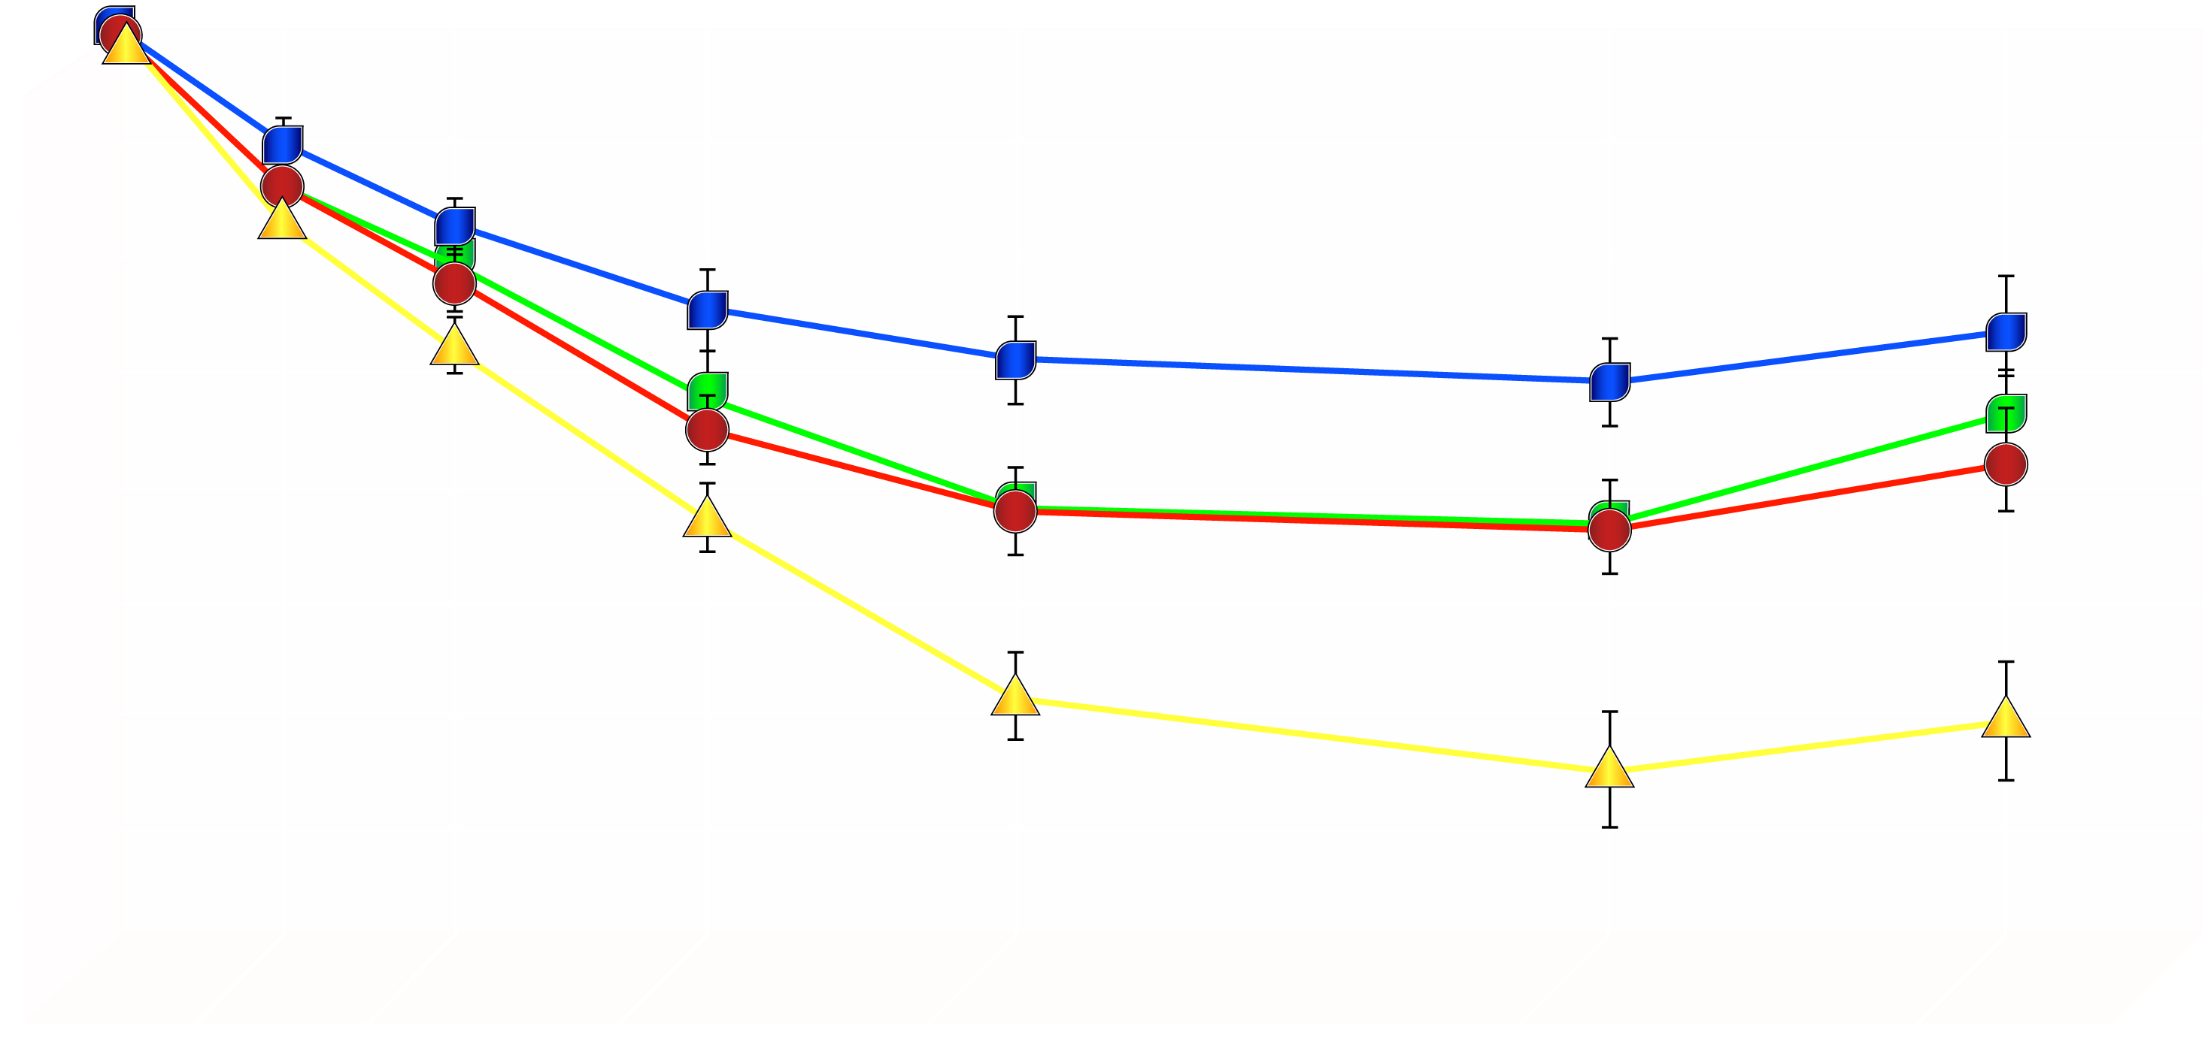
EFFECT OF ADDING A LIFESTYLE MODIFICATION PROGRAM TO SIBUTRAMINE THERAPY ON BODY WEIGHT LOSS
Sibutramine alone
Sibutramine + brief therapy
Lifestyle modification alone
Combined therapy
0
2
4
6
Weight Loss (kg)
8
10
12
14
16
0
3
6
10
18
40
52
Weeks of Treatment
From Wadden TA et al. N Engl J Med 2005; 353: 2111-20
Reproduced with permission

Slide 11
EFFECT OF RIMONABANT ON BODY WEIGHT OVER TWO YEARS
Placebo
Placebo
0
Rimonabant 5 mg
Rimonabant 20 mg
-2
-4
Weight Loss (kg)
-6
-8
-10
0
12
24
36
48
60
72
84
96
108
Weeks of Treatment
Adapted from Pi-Sunyer FX et aI. JAMA 2006; 295: 761-8
Copyright © (2006), American Medical Association. All Rights Reserved.

Slide 12
RESULTS OF THE RIMONABANT IN OBESITY (RIO) PROGRAM AT 1 YEAR
Placebo-substracted improvement in outcome
with rlmonabant 20 mg daily* (95% CI)
Population
Follow-up rate
Comparaison (n)
Waist Circumference (cm)
Weight (kg)
HDL
Cholesterol (%)
Triglycerides
(%)
RIO-Europe
1507 overweight or obese
European (82%) and American
patients, 41% with hypertension
and 61% with dyslipidemia
61%
Rimonabant 20 mg daily (599)
vs. rimonabant 5 mg daily (603)
vs. placebo (305)
4.8 (3.9-5.7)
4.1 (3.1-5.1)
9 (6-12)
15 (10-21)
RIO-Lipids
1036 overweight or obese
patients from Europe and North
America with untreated
dyslipidemia
62%
Rimonabant 20 mg daily (346)
vs. rimonabant 5 mg daily (345)
vs. placebo (342)
5.4 (4.6-6.2)
4.7 (3.7-5.7)
8 (5-11)
12 (6-19)
RIO-North America
53%
Rimonabant 20 mg daily (1222)
vs. rimonabant 5 mg daily (1216)
vs. placebo (607)
4.7 (4.1-5.4)
3.6 (2.9-4.3)
7 (6-9)
13 (9-18)
3045 overweight or obese
subjects from North America,
30% with hypertension and 63%
with untreated dyslipidemia
RIO-Diabetes
1047 patients with type 2
diabetes from 11 countries
66%
Rimonabant 20 mg daily (339)
vs. rimonabant 5 mg daily (358)
vs. placebo (348)
3.9 (3.2-4.6)
3.3 (2.4-4.1)
8 (6-11)
16 (10-23)
*Intention-to-treat last-observation-carried-forward, means shown. When necessary,
95% Cls were calculated from data reported.
From Padwal RS et al. Lancet 2007; 369: 71-7
Reproduced with permission

Slide 13
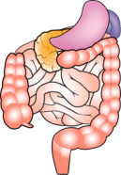
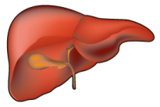
THE ENDOCANNABINOID SYSTEM AND CARDIOMETABOLIC RISK
Excess food intake - obesity
Overactivity of the EC system
Brain
CB₁
Gastrointestinal tract
Food intake
?
Genetic susceptibility?
CB₁
Abdominal adiposity
FFA
Liver
Adipocytes
Skeletal muscle?
Adiponectin
FFA
CB₁
TNF-α
CB₁
CB₁
IL-6
CRP
Lipogenesis
LPL
Lipogenesis
Impaired insulin action
Liver fat
VLDL
Glucose production
Insulinemia
Insulin degradation
Apo AI synthesis
Glucose intolerance
Increased waist (abdominal obesity)
Insulin resistance
High triglyceride-low HDL choIesteroI dyslipidemia
Pro-inflammatory profile
Risk of CVD and type 2 diabetes
Adapted from Després JP et al. Int J Obes 2006; 30: S44-52

Slide 14
THE ENDOCANNABINOID SYSTEM AND CB1 MECHANISM OF ACTION
Excess food intake - obesity
Overactivity of the EC system
Brain
Rimonabant
Rimonabant
X
CB₁
X
Gastrointestinal tract
Food intake
?
Genetic susceptibility?
CB₁
Rimonabant
Rimonabant
Abdominal adiposity
X
FFA
X
Liver
Adipocytes
Skeletal muscle?
Adiponectin
FFA
CB₁
TNF-α
CB₁
CB₁
IL-6
X
Rimonabant
CRP
Lipogenesis
LPL
Lipogenesis
Improved insulin action
Liver fat
VLDL
Glucose production
Insulinemia
Insulin degradation
Apo AI synthesis
Improved glucose tolerance
Decreased waist (abdominal obesity)
Improved insulin sensitivity and glucose tolerance
Triglycerides and HDL choIesteroI
Reduced inflammation
Risk of CVD and type 2 diabetes
Adapted from Després JP et al. Int J Obes 2006; 30: S44-52

Slide 15
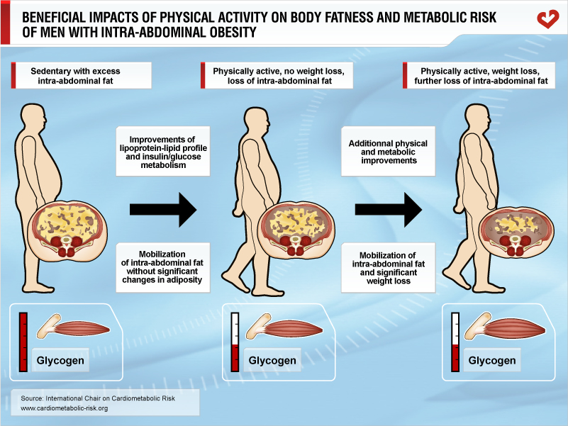

Slide 16
CUMULATIVE INCIDENCE OF DIABETES ACCORDING TO STUDY GROUP IN THE DIABETES PREVENTION PROGRAM
40
30
20
Cumulative Incidence of Diabetes (%)
10
0
0.0
0.5
1.0
1.5
2.0
2.5
3.0
3.5
4.0
Years
Placebo
Metformin
Lifestyle
Adapted from Knowler WC et al. N Engl J Med 2002; 346: 393-403
Reproduced with permission

Slide 17
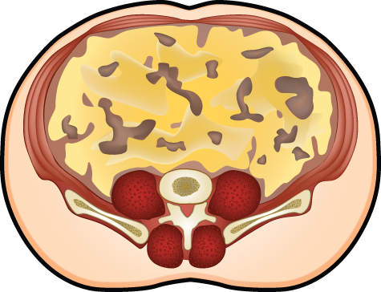
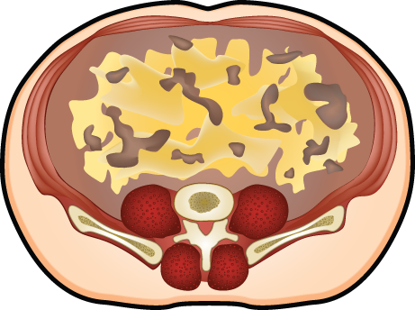
SCHEMATIC REPRESENTATION OF THE GREATER RELATIVE LOSS IN INTRA-ABDOMINAL ADIPOSE TISSUE AS COMPARED WITH SUBCUTANEOUS ADIPOSE TISSUE INDUCED BY EXERCISE TRAINING IN THE ABSENCE OF WEIGHT LOSS
Exercise without concomitant
weight loss
Mobilization of intra-abdominal
adipose tissue
Improvement of
glucose-insulin homeostasis
Risk of Type 2 Diabetes

Slide 18
www.cardiometabolic-risk.org

