Slide 1
Illustrations relevant to The Concept of CMR section

Slide 2
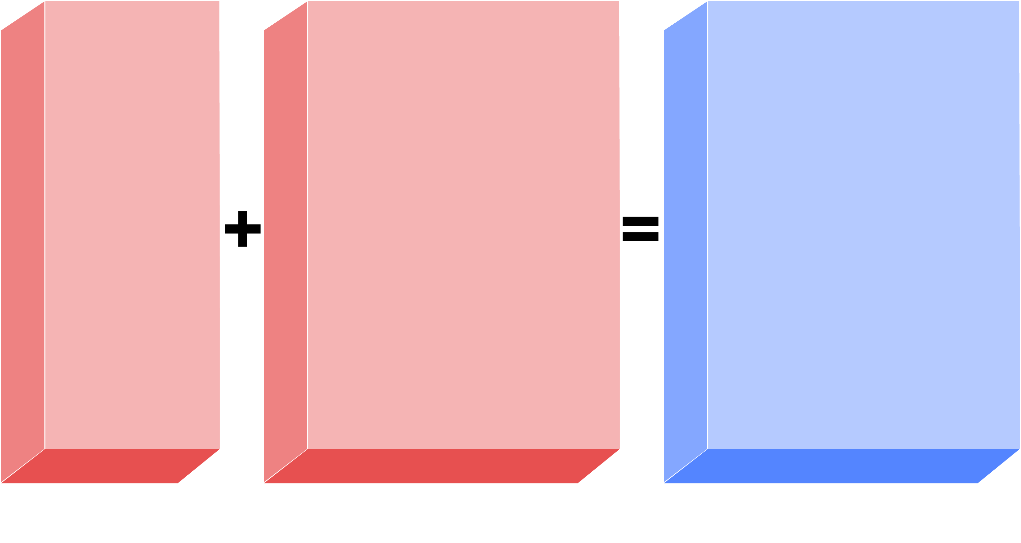
FACTORS CONTRIBUTING TO CARDIOMETABOLIC RISK
Metabolic
syndrome?
LDL
Metabolic
syndrome?
LDL
HDL
HDL
Hypertension
Diabetes
Hypertension
Diabetes
Age
Male gender
Age
Male gender
Smoking
Other (genetic factors)
Smoking
Other (genetic factors)
A new CVD risk factor
Global CVD risk from traditional
risk factors
Global cardiometabolic risk
Adapted from Després JP and Lemieux I Nature 2006; 444: 881-7

Slide 3
OVERWEIGHT AND OBESITY BY AGE, UNITED STATES, 1960-2000
Overweight, 20-74 years
Percent
Obesity, 20-74 years
Overweight, 6-11 years
Overweight,12-19 years
1960-1962
1963-1965
1966-1970
1971-1974
1976-1980
1988-1994
1999-2000
Year
From National Center for Health Statistics. Health, United States, 2003
Reproduced with permission

Slide 4
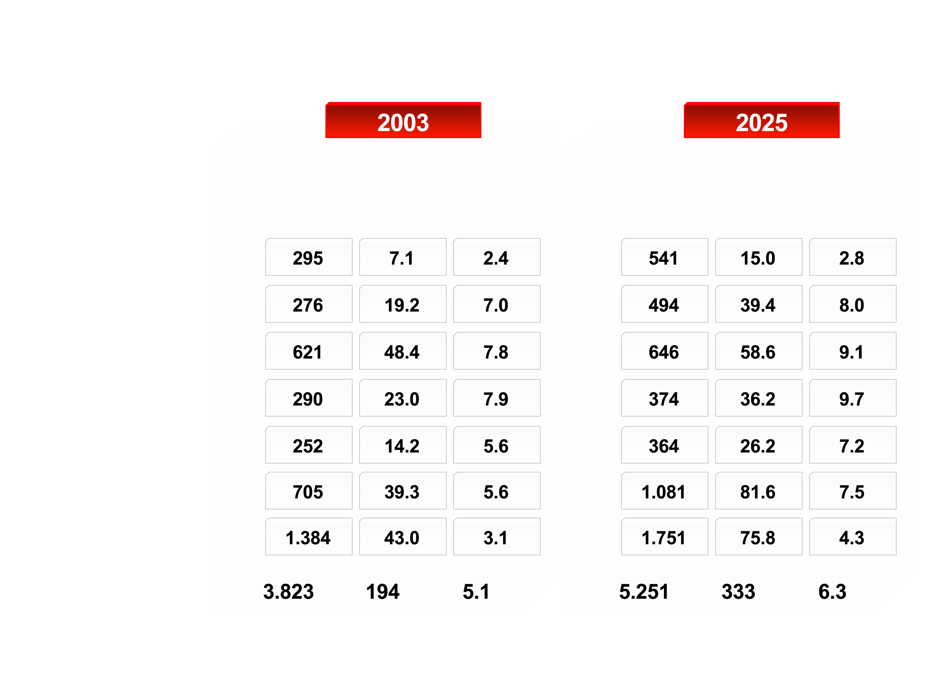
REGIONAL ESTIMATES FOR DIABETES (20-79 AGE GROUP), 2003 AND 2025
Population (20-79 group) (million)
No. of people with diabetes (million)
Prevalence (%)
Population (20-79 group) (million)
No. of people with diabetes (million)
Prevalence (%)
African Region
Eastern Mediterranean and Middle East Region
European Region
North American Region
South and Central American Region
Southeast Asian Region
Western Pacific Region
Total
From Intemational Diabetes Federation (IDF)
http://www.eatlas.idf.org/Prevalence/AlI_diabetes/
Reproduced with permission

Slide 5
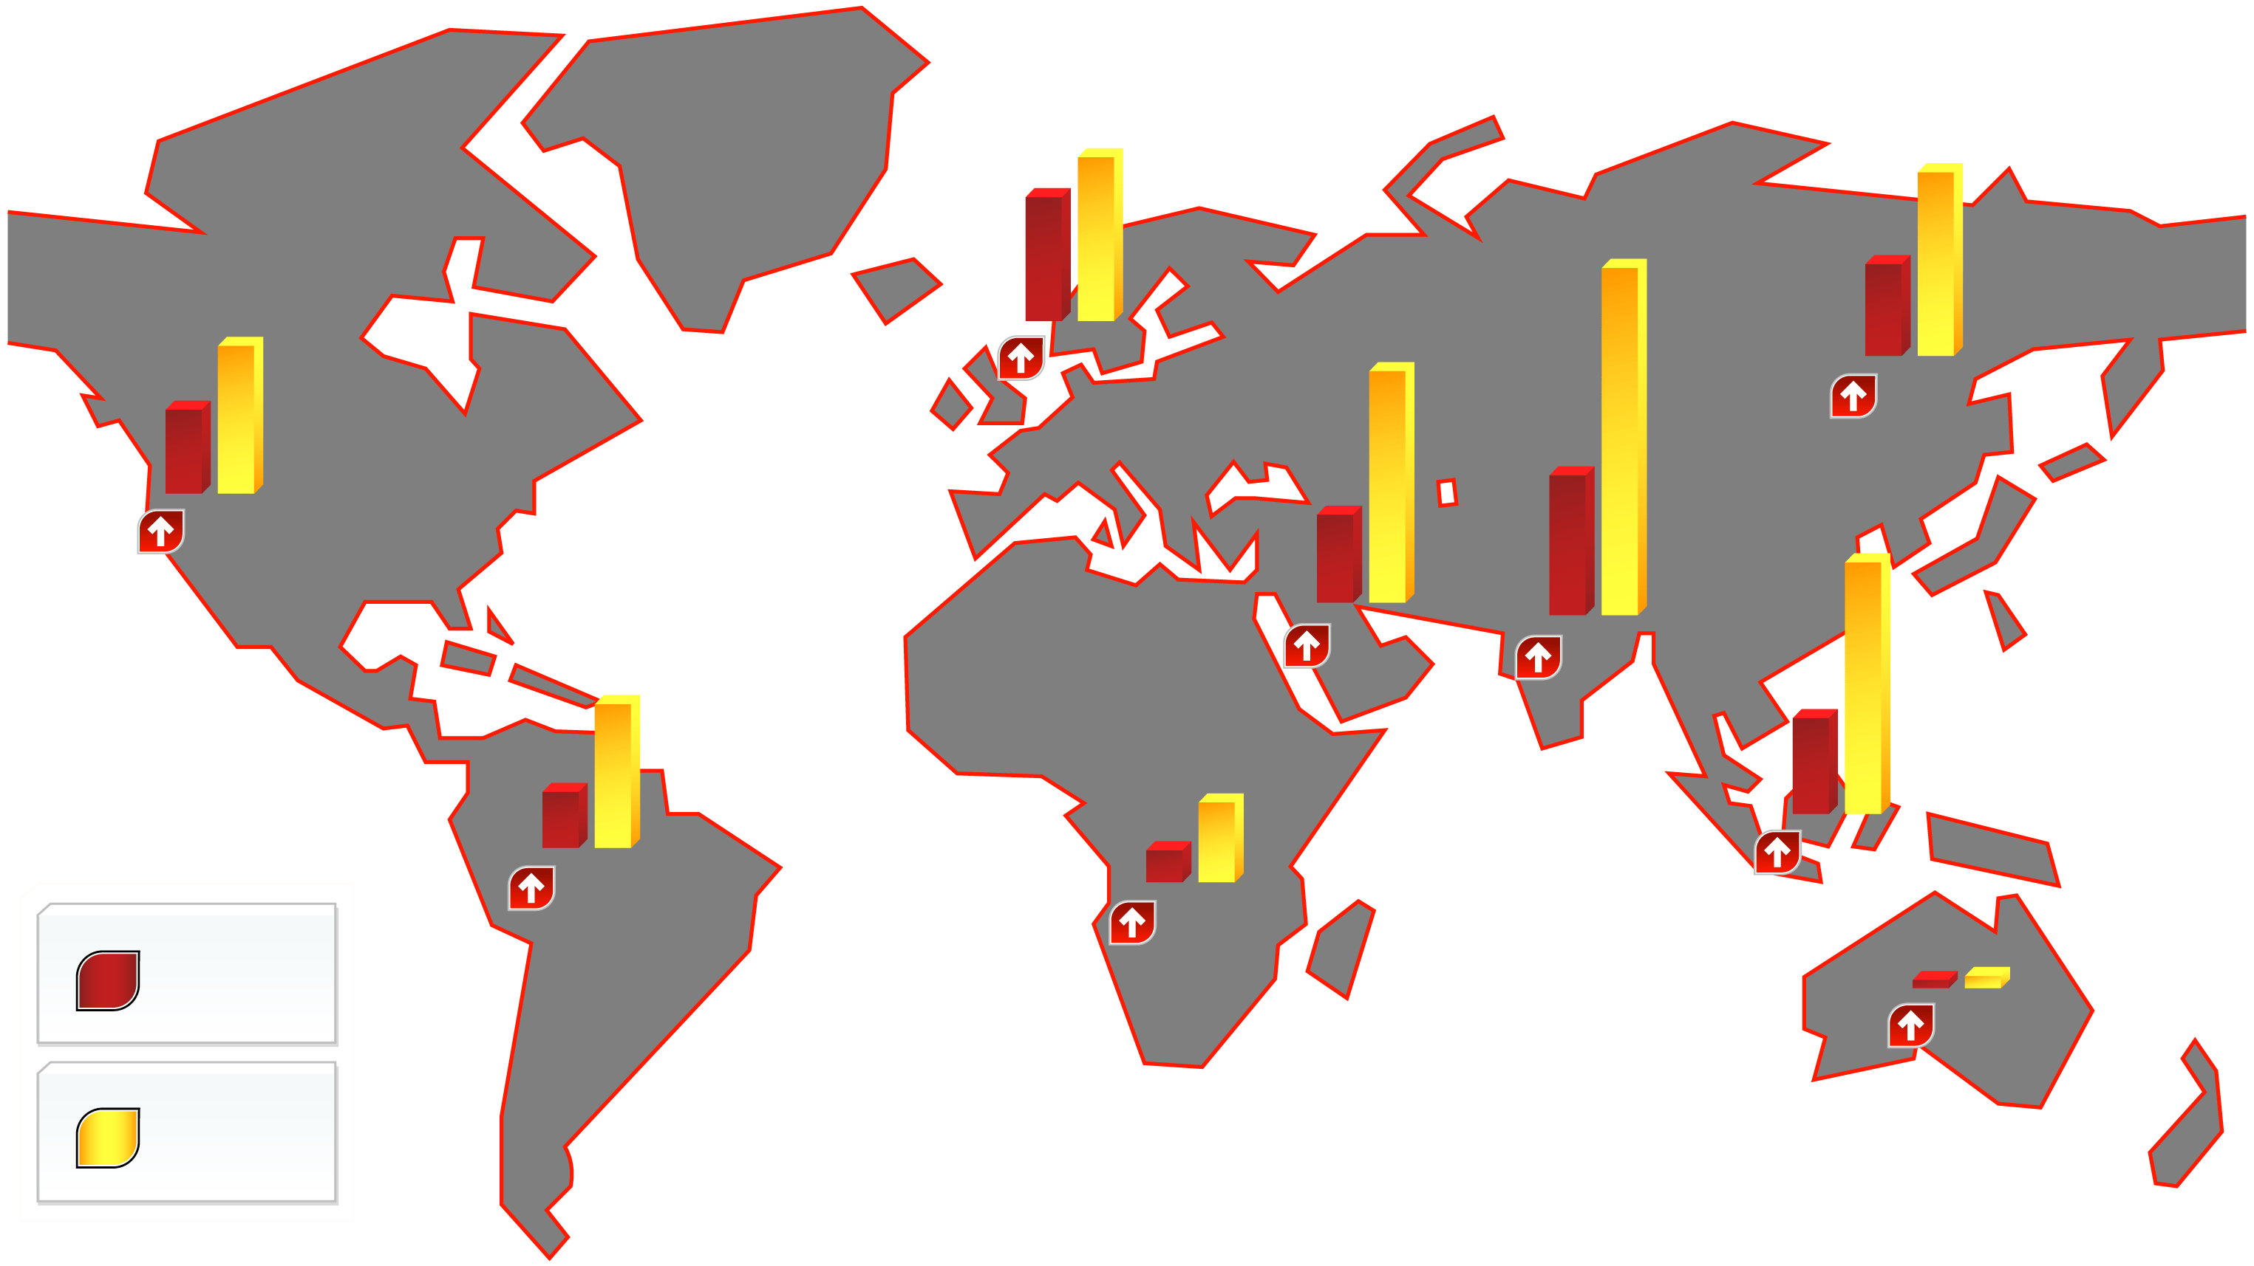
WORLDWIDE PREVALENCE OF DIABETES IN 2000 AND ESTIMATES FOR THE YEAR 2030 (IN MILLIONS)
28.3
37.4
20.7
42.3
31.7
79.4
19.7
33.9
32%
20.0
52.8
China
Europe
Middle East
104%
United States and Canada
72%
22.3
58.1
Sub-Saharan Africa
164%
150%
Southeast Asia
13.3
33.0
India
7.1
18.6
161%
148%
Latin America and Carabbean
162%
0.9
1.7
2000
89%
2030
Australia
Adapted from Hossain P et al. N Engl J Med 2007; 356: 213-5

Slide 6
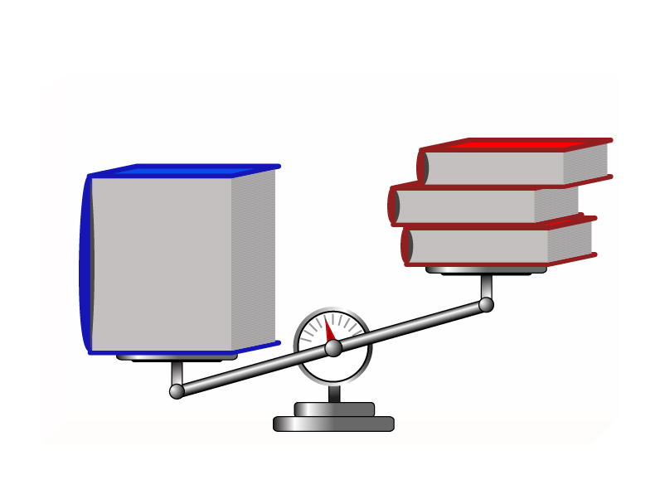
THE CONCEPT OF POSITIVE ENERGY BALANCE
Energy Intake
Energy Expenditure
Resting
(e.g. sleeping)
Physical activity
(including exercise)
Thermic effect
of food
Calories consumed
(eating)

Slide 7
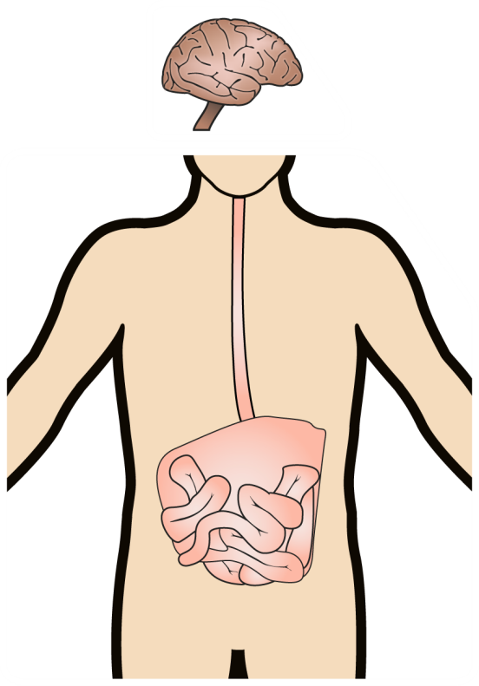
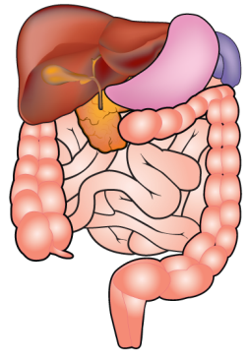
SUMMARY OF THE INTERACTIONS BETWEEN PERIPHERAL ORGANS, THE CENTRAL NERVOUS SYSTEM, AND BEHAVIOUR IN REGULATING FOOD INTAKE
Cultural, psychological, and physiological
influences of food on energy intake
Conceptual nervous system
Religious taboos, economic factors, cuisine life events, learned experience, education cognitive effects
Food
Cognitions and beliefs
Moods
Subjective hunger,
appetite, preference
Physical structure
Nutritional composition
Learned preferences
Aversions
Eating
Central nervous system
Food and energy intake
Meal size and frequency
Nutrient selection
Neurotransmitters
Neuro modulators
CNS-PNS relays
Postingestional
feedback
Ingestion
Digestion
Specific nutrient
Absorption
Liver
Energy flux
Lean body mass
Fat stores
CHO stores
Nutrient stores
Adapted from Bray GA et al. Handbook of Obesity 1998 pp.427-460

Slide 8
COMPONENTS OF TOTAL ENERGY EXPENDITURE IN AN INITIALLY SEDENTARY MAN EATING 2800 KCAL/DAY (A), WHO INCREASES PHYSICAL ACTIVITY (B); WHO ADDS DAILY PHYSICAL EXERCISE (C)
2800 kcal
3000 kcal
3200 kcal
6.3%
200 kcal
100
30%
840 kcal
34.7%
1040 kcal
32.5%
1040 kcal
80
10%
280 kcal
9.3%
280 kcal
8.7%
280 kcal
60
% Total Energy Expenditure
40
60%
1680 kcal
56%
1680 kcal
52.5%
1680 kcal
20
0
Sedentary individual
Physically active individual who does not exercise
Physically active individual who does exercise
A
B
C
Resting Metabolic Rate
Thermic Effect of Food
Physical Activity
Exercise

Slide 9
CLASSIFICATION OF BLOOD PRESSURE FOR ADULTS
Systolic Blood Pressure
Diastolic Blood Pressure
“Normal” Stage
<120 mmHg
<80 mmHg
“Prehypertension” Stage
120-139 mmHg
80-89 mmHg
Stage 1
140-159 mmHg
90-99 mmHg
Stage 2
≥160 mmHg
≥100 mmHg

Slide 10
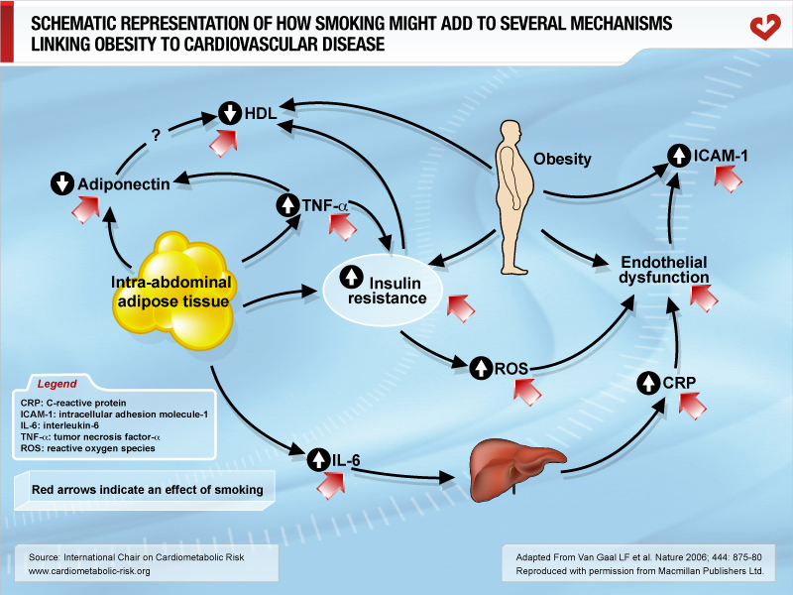

Slide 11
AGE-ADJUSTED PREVALENCE OF CORONARY HEART DISEASE (CHD) IN THE U.S. POPULATION OVER 50 YEARS OF AGE, CATEGORIZED BY PRESENCE OF METABOLIC SYNDROME (MS) AND TYPE 2 DIABETES
19.2%
13.9%
8.7%
CHD Prevalence (%)
7.5%
No MS /
No Type 2 Diabetes
MS /
No Type 2 Diabetes
Type 2 Diabetes
/ No MS
Type 2 Diabetes
/ MS
54.2%
28.7%
2.3%
14.8%
Copyright© 2003 American Diabetes Association
From Diabetes®, Vol. 52, 2003; 1210-1214
Reprinted with permission from The American Diabetes Association.

Slide 12
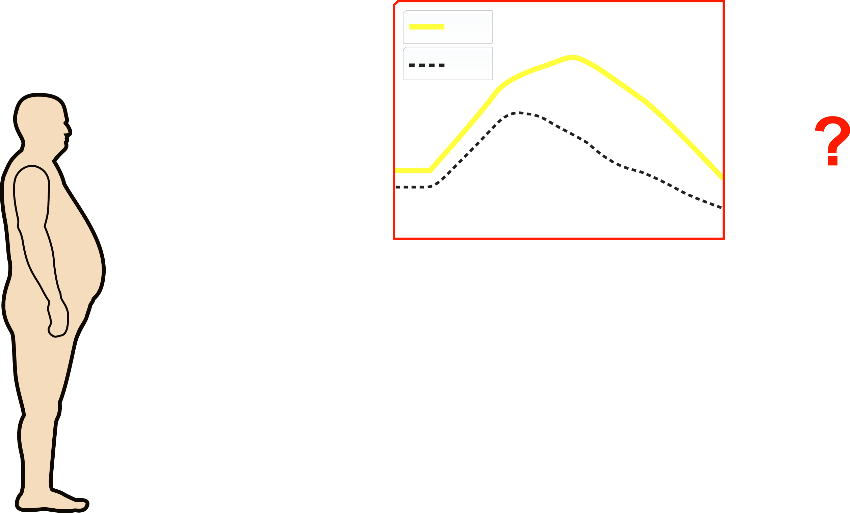
RESPECTIVE CONTRIBUTION OF TYPE 2 DIABETIC HYPERGLYCEMIA VERSUS THE CLUSTERING OF ABDOMINAL OBESITY-RELATED RISK FACTORS (METABOLIC SYNDROME) TO THE INCREASED CORONARY HEART DISEASE (CHD) RISK IN DIABETES
IGT
NGT
Glycemia
75g OGTT
Time
CHD RISK
Metabolic
Syndrome
Abdominal Obesity
Insulin Resistance
Atherogenic Dyslipidemia
Impaired Fibrinolysis
Pro-thrombotic State
Patient with
Abdominal Obesity
and Type 2 Diabetes
Inflammation
Increased Blood Pressure

Slide 13
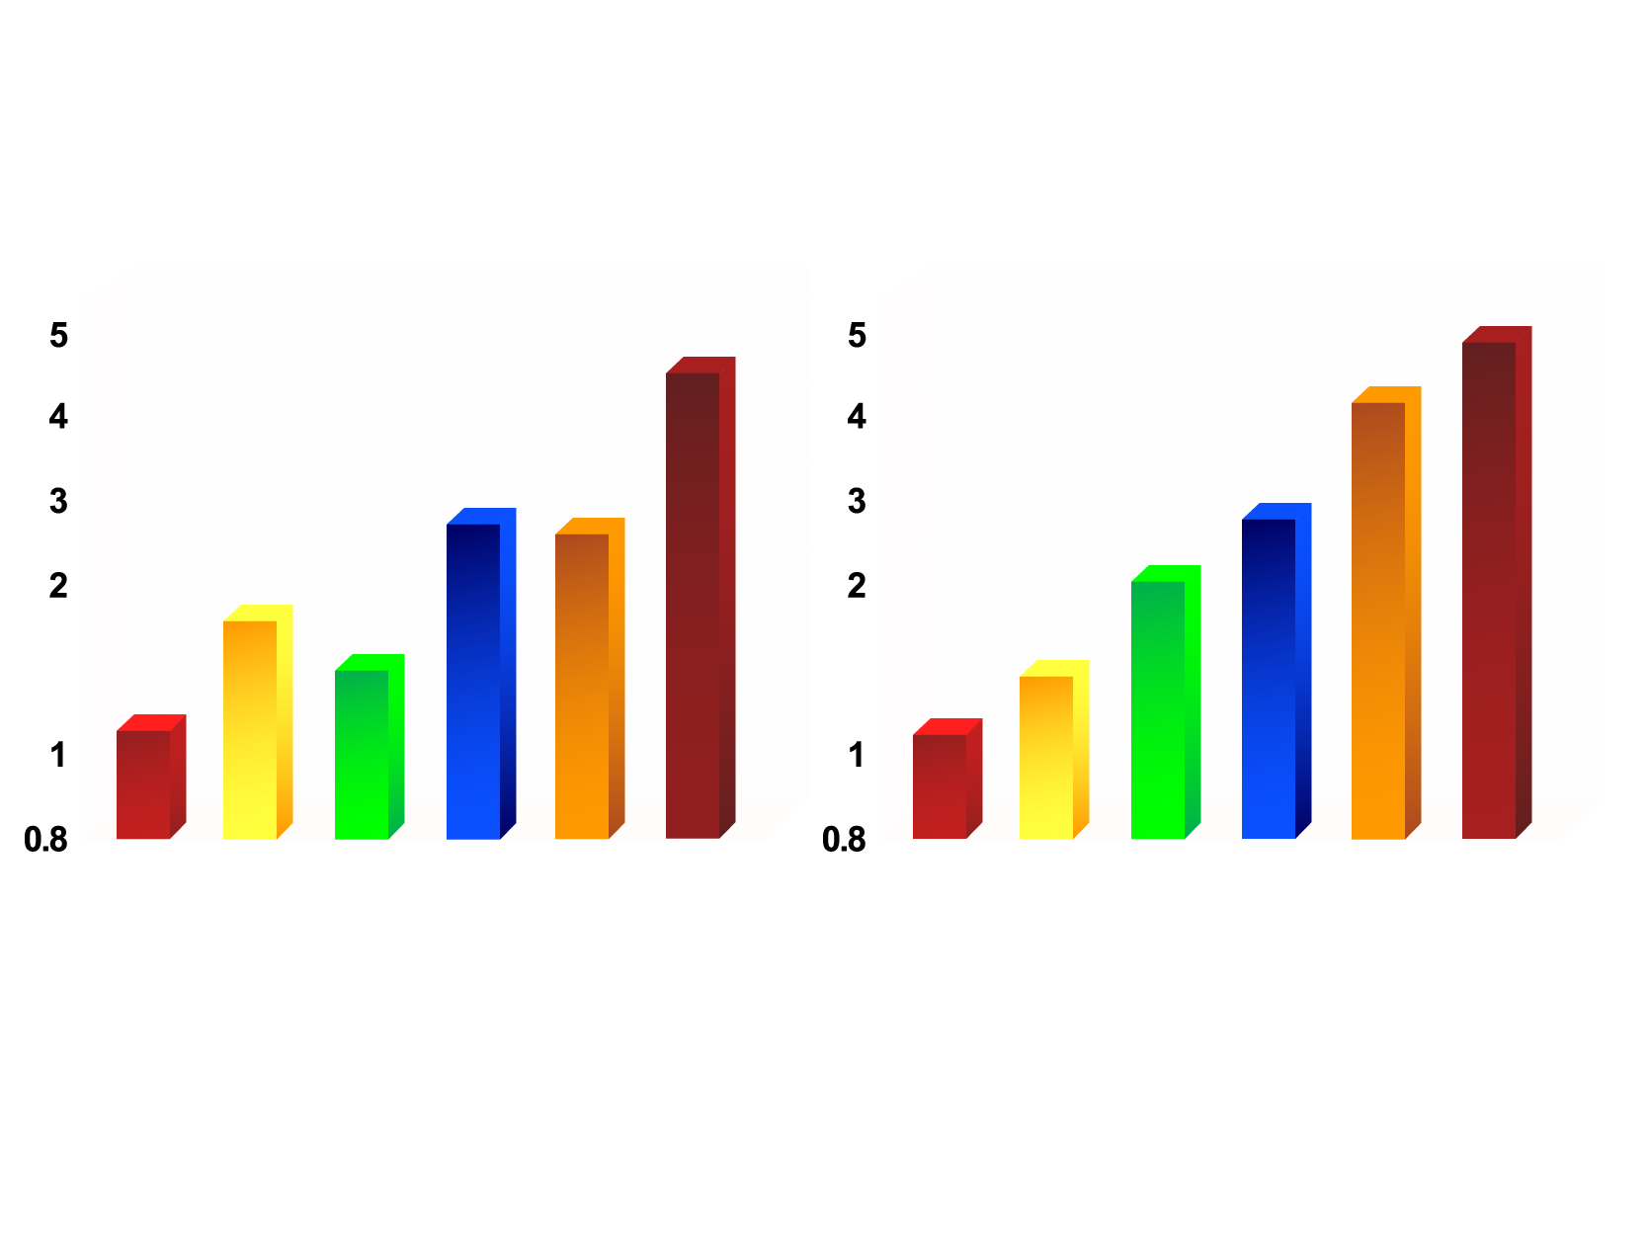
NUMBER OF METABOLIC SYNDROME ABNORMALITIES BY NCEP-ATP III CLINICAL CRITERIA, DIABETES, AND PREVALENT CVD AND HAZARD RATIOS OF 10-YEAR RISK OF FATAL AND NON-FATAL CVD
0
1
2
NCEP-ATP III
Type 2 Diabetes
CVD
0
1
2
NCEP-ATP III
Type 2 Diabetes
CVD
Men
Women
From Dekker JM et al. Circulation 2005; 112: 666-73
Reproduced with permission

Slide 14
RISK OF CORONARY HEART DISEASE (CHD) IN U.S. ADULTS ACCORDING TO SUBGROUPS OF METABOLIC SYNDROME (MS) COMPONENTS
5.02
2.87
2.10
Hazard Ratio
1.0
No MS
Risk Factors
1-2 MS
Risk Factors
Metabolic Syndrome (all)
No Diabetes
Diabetes
Adapted from Malik S et al. Circulation 2004; 110: 1245-50

Slide 15
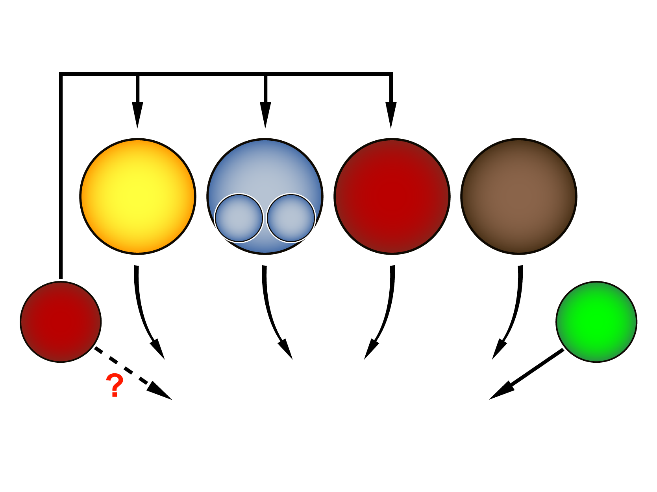
OBESITY AS A MODIFIABLE CARDIOVASCULAR DISEASE (CVD) RISK FACTOR
Cholesterol
Hypertension
Diabetes
Smoking
LDL
HDL
Obesity
BMI
Others
Global CVD risk

Slide 16
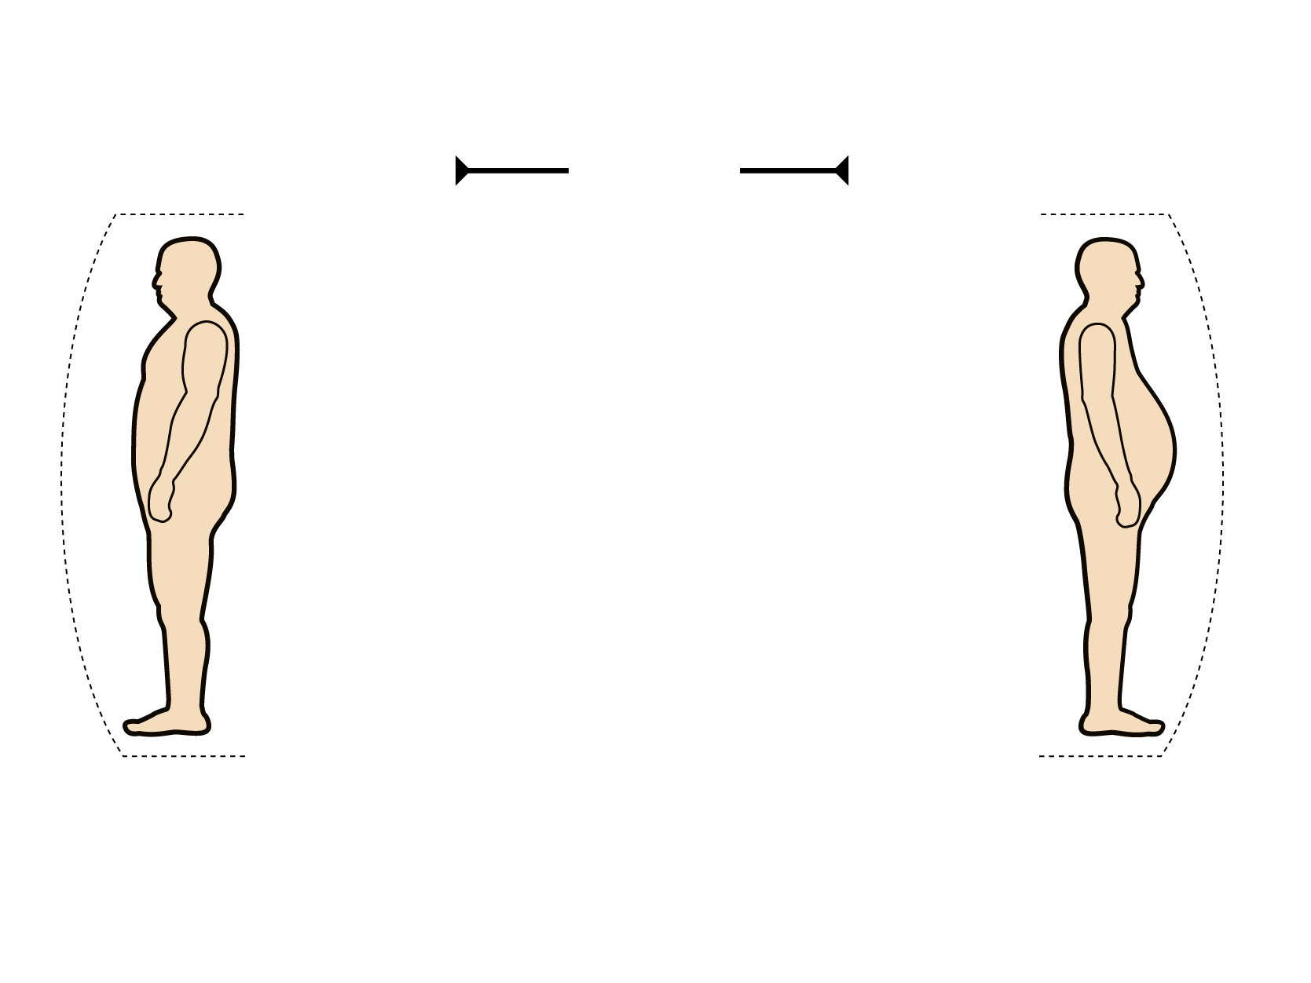
OBESE INDIVIDUALS WITH A PREFERENTIAL ACCUMULATION OF INTRA-ABDOMINAL ADIPOSE TISSUE (AT): SUBGROUP AT HIGH CVD RISK
Same BMI
>30 kg/m²
Gynoid Obesity
Android Obesity
Intra-abdominal AT
Intra-abdominal AT
Subcutaneous AT
Subcutaneous AT
Normal Metabolic Profile
Altered Metabolic Profile
- Low Trlglycerides
- Normal HDL Cholesterol
- Insulin Sensitive
- Normal Glucose Tolerance
- Normal lnflammatory and
Thrombotic Profile
- Hypertriglyceridemia
- Low HDL Cholesterol
- Insulin Resistance
- Glucose Intolerance
- Pro-inflammatory and
Pro-thrombotic Profile
NO METABOLIC SYNDROME
METABOLIC SYNDROME
CVD RISK
CVD RISK

Slide 17
BODY MASS INDEX AND RELATIVE RISK OF TYPE 2 DIABETES IN WOMEN FOLLOWED FOR 14 YEARS IN THE NURSES' HEALTH STUDY
93.2
Relative Risk of Type 2 Diabetes
54.0
40.3
27.6
15.8
4.3
5.0
8.1
1.0
2.9
Body Mass Index (kg/m²)
Adapted from Colditz GA et al. Ann Intern Med 1995; 122: 481-6

Slide 18
PERCENTAGE PROBABILITY OF DEVELOPING TYPE 2 DIABETES IN 792 MEN FOLLOWED FOR 13.5 YEARS, ACCORDING TO TERTILES OF BODY MASS INDEX (BMI) AND WAIST-TO-HIP RATIO (WHR)
15.2
9.1
9.1
9.1
Percentage Probability of Developing
Type 2 Diabetes
2.9
2.9
0.5
0.5
0.5
WHR
Tertiles
BMI Tertiles (kg/m²)
Copyright© 1985 American Diabetes Association
From Diabetes®, Vol. 34, 1985; 1055-1058
Reprinted with permission from the American Diabetes Association

Slide 19
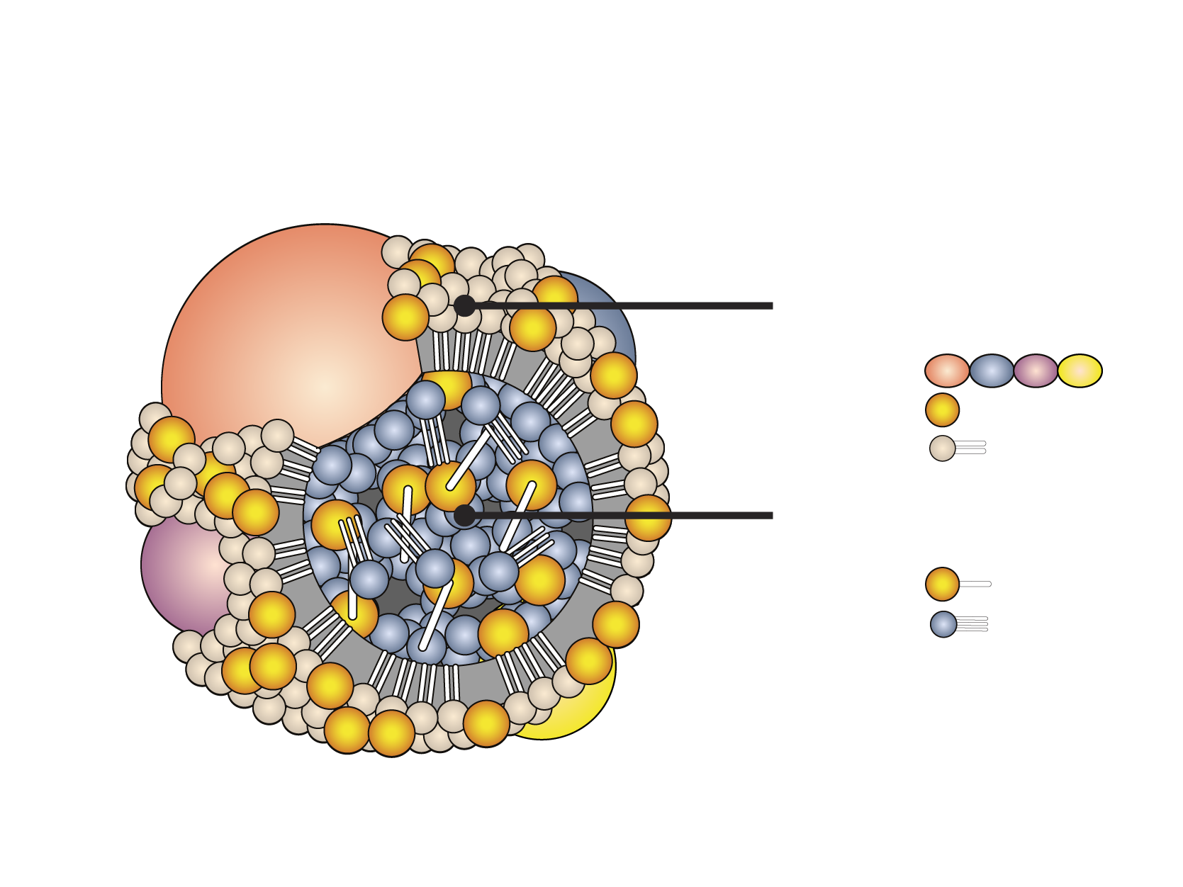
GENERAL STRUCTURE OF A LIPOPROTEIN
Polar surface envelope
Apolipoprotein
Free cholesterol
Phospholipid
Neural lipid core
Cholesteryl ester
Triglyceride

Slide 20
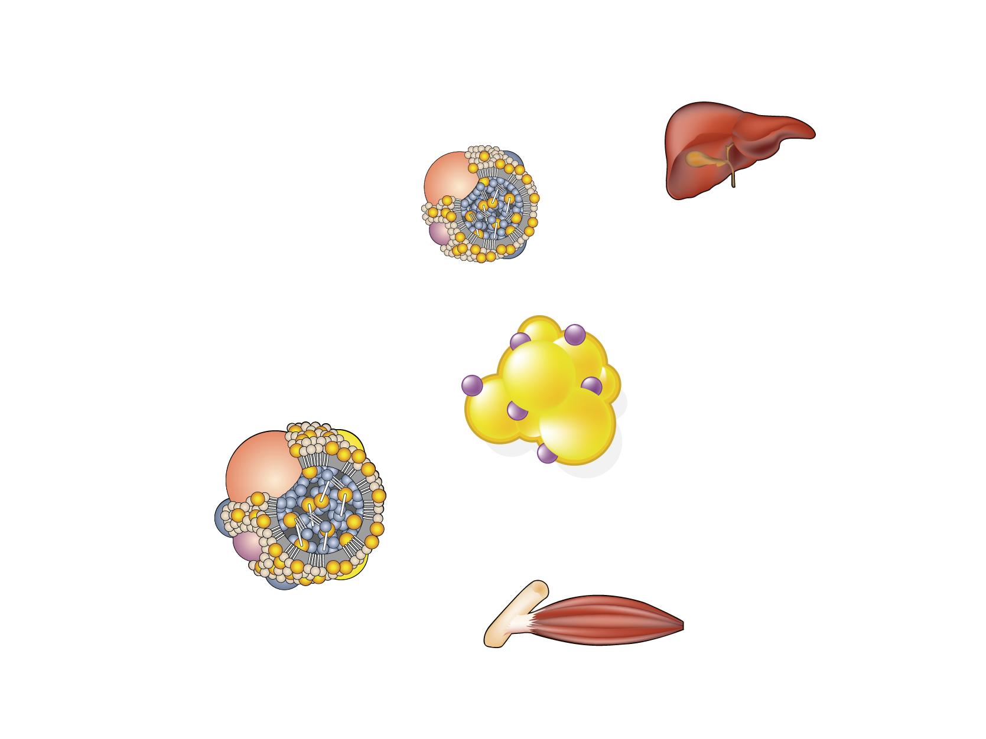
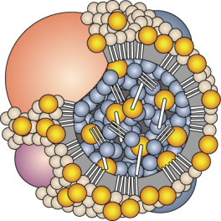
TRIGLYCERIDE TRANSPORT AND METABOLISM
Liver
Intestinal
lumen
Acetyl-CoA
Fatty acids
Dietary
triglycerides
Enterocyte
VLDL
Triglycerides
Fatty acids
Triglycerides
Adipose tissue
Albumin
Fatty acids
Triglycerides
LPL
Fatty acids
Oxidation
Chylomicron
Muscle
Legend
LPL=lipoprotein lipase

Slide 21
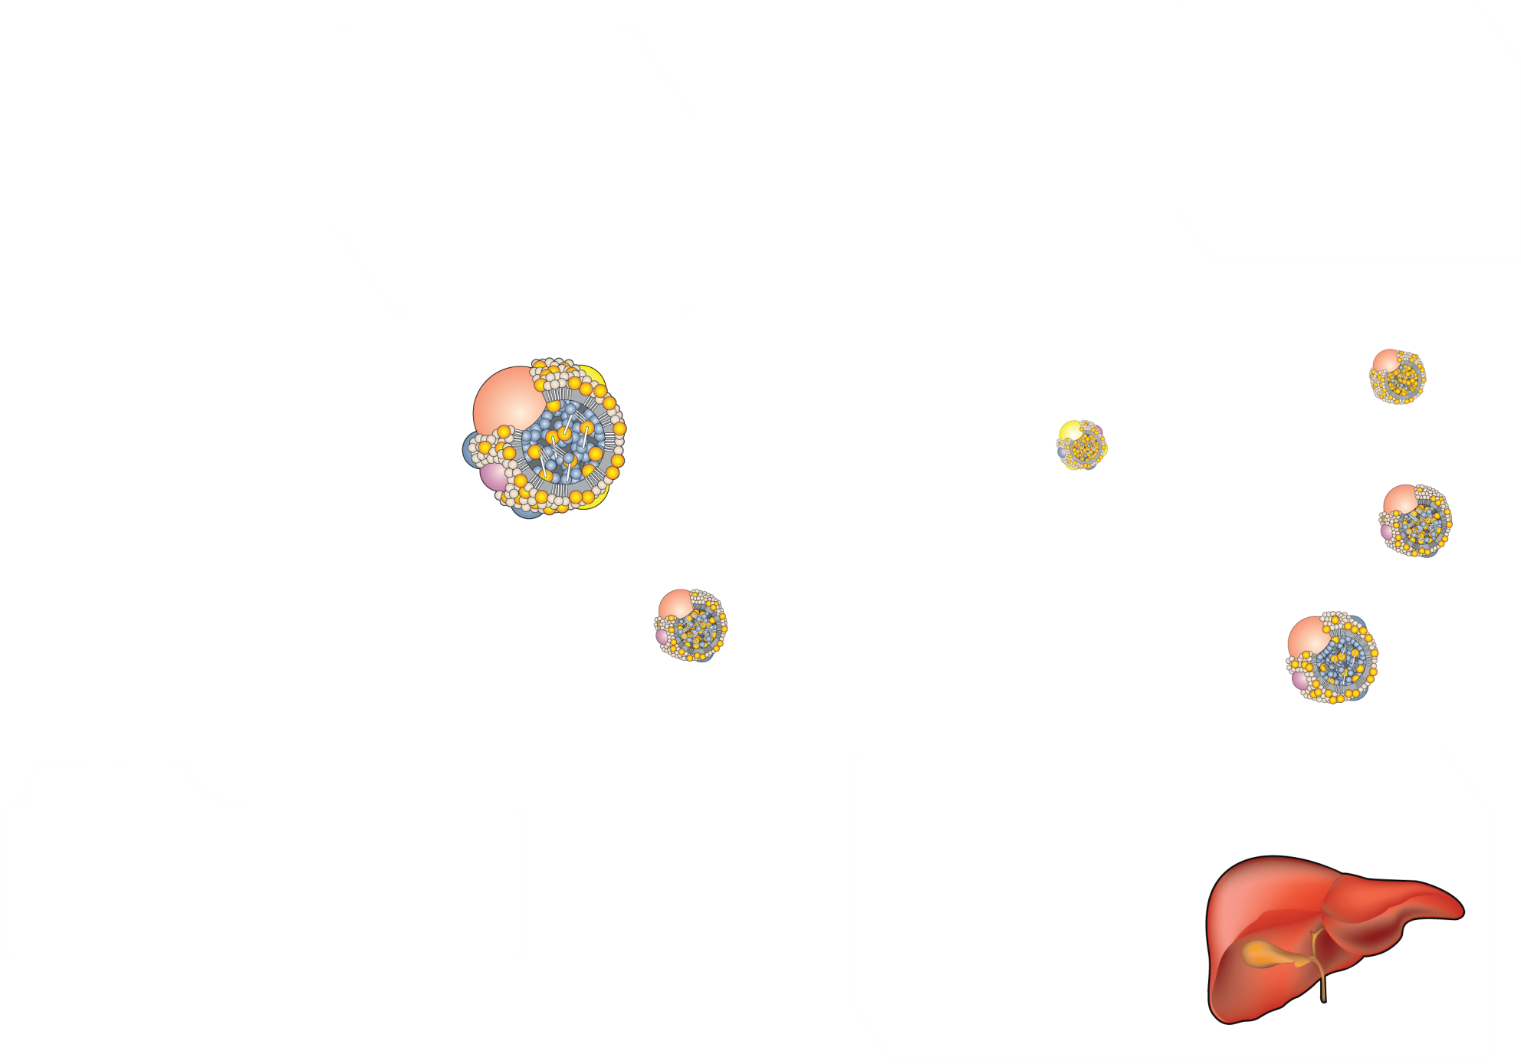
CHOLESTEROL TRANSPORT AND METABOLISM
Intestinal
lumen
Enterocyte
Tissues
Acetyl-CoA
Acetyl-CoA
Dietary
cholesterol
Cholesterol
Cholesterol
LCAT
LDL
Chylomicron
HDL
HTGL
LPL
VLDL
remnant
Bile
CETP
LPL
Chylomicron remnant
VLDL
Excretion
Legend
Cholesterol
CETP = cholesteryl ester transfer protein
HTGL = hepatic triglyceride lipase
LCAT = lecithin cholesterol acyltransferase
LPL = lipoprotein lipase
Acetyl-CoA
Bile salts
Cholesterol
Liver

Slide 22
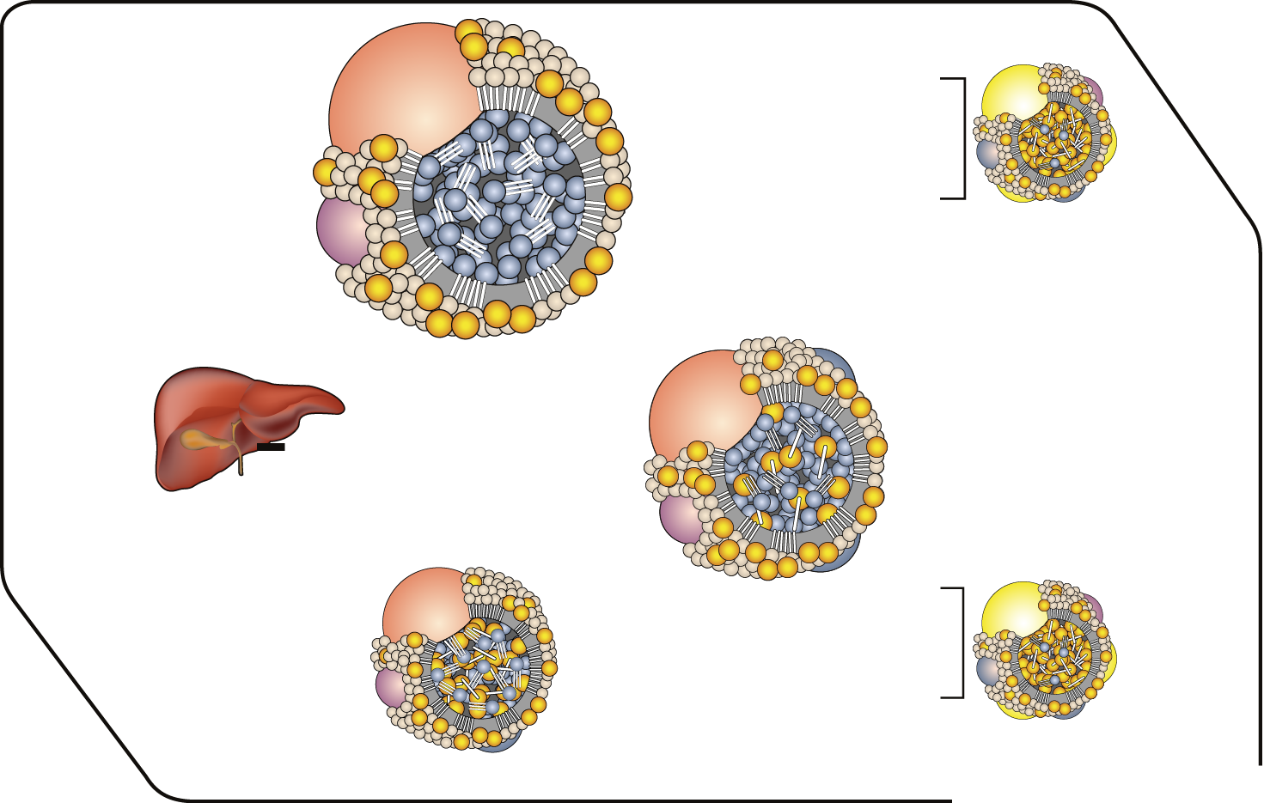
INTRAVASCULAR VLDL METABOLISM
Nascent VLDL
Cholesteryl
esters
Apo CII, CIII
HDL
Apo E
Liver
Apo B/E
receptor
Mature VLDL
LDL
LPL
Apo E
VLDL remnant
Apo CII, CIII
HDL
Fatty acids
Phospholipids
Tissues
(adipose, muscle)
Legend
LPL = lipoprotein lipase

Slide 23
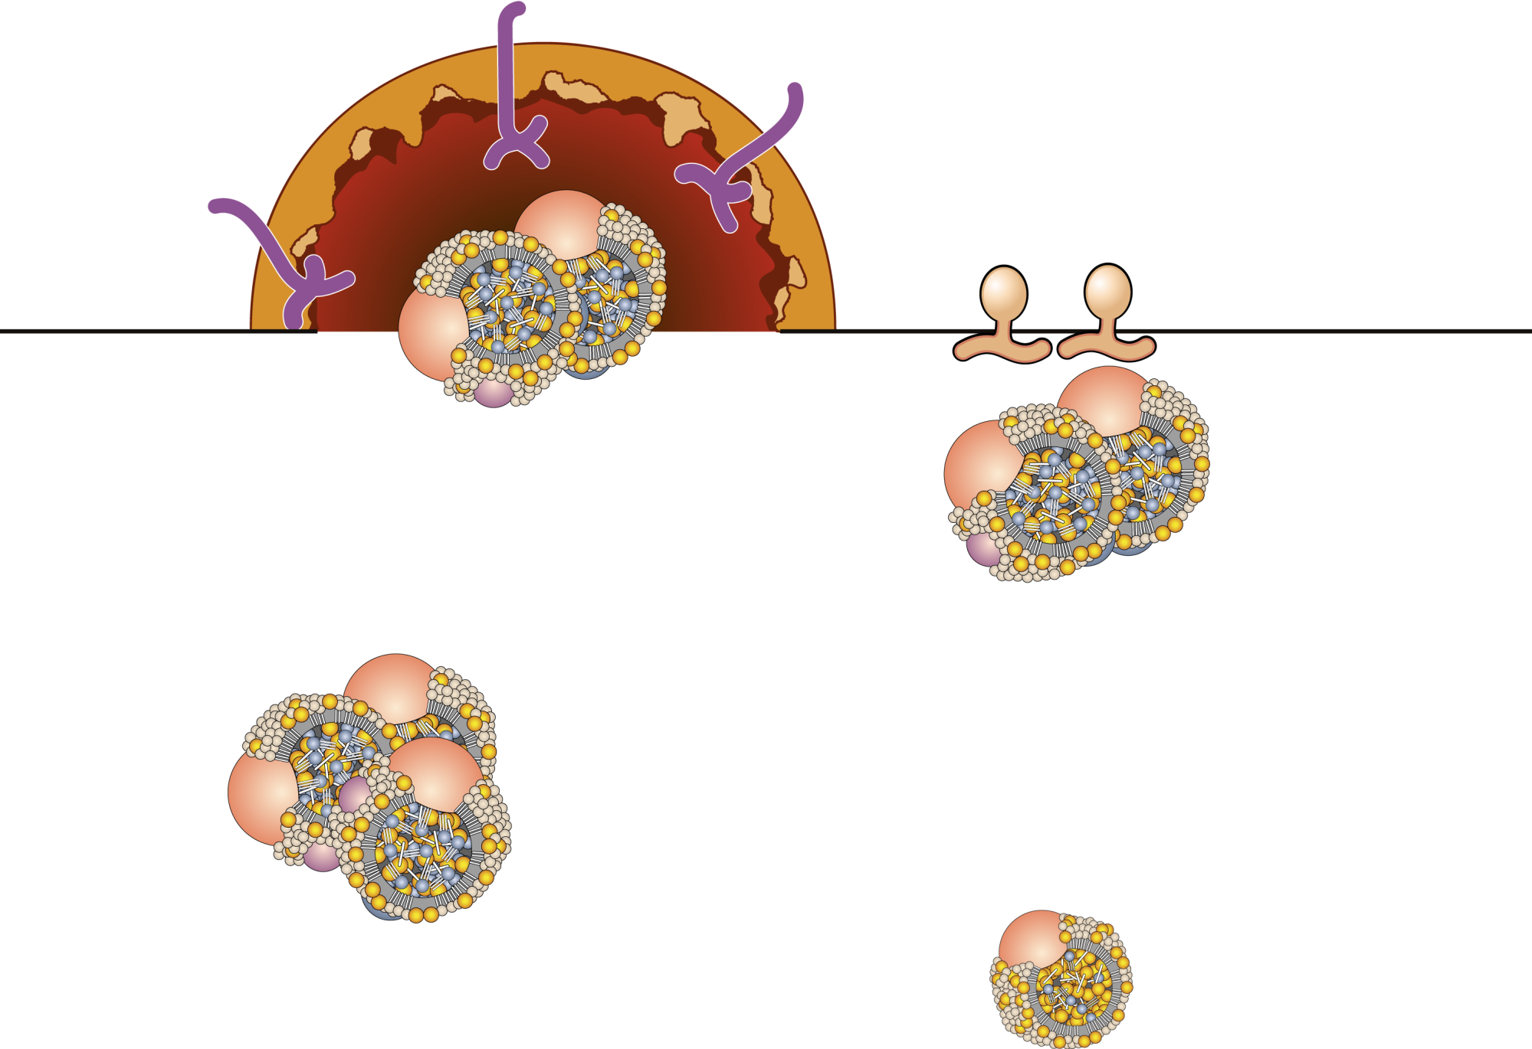
VLDL REMNANT METABOLISM
Liver uptake
(LDL receptor)
Apo B/E receptor
HTGL
Uptake by hepatic LDL receptors (60%-70%)
VLDL remnants
Hydrolysis by HTGL
(30%-40%)
Fatty acids
Apo C’s
LDL formation
Apo E’s
Legend
HTGL = hepatic triglyceride lipase
LDL

Slide 24
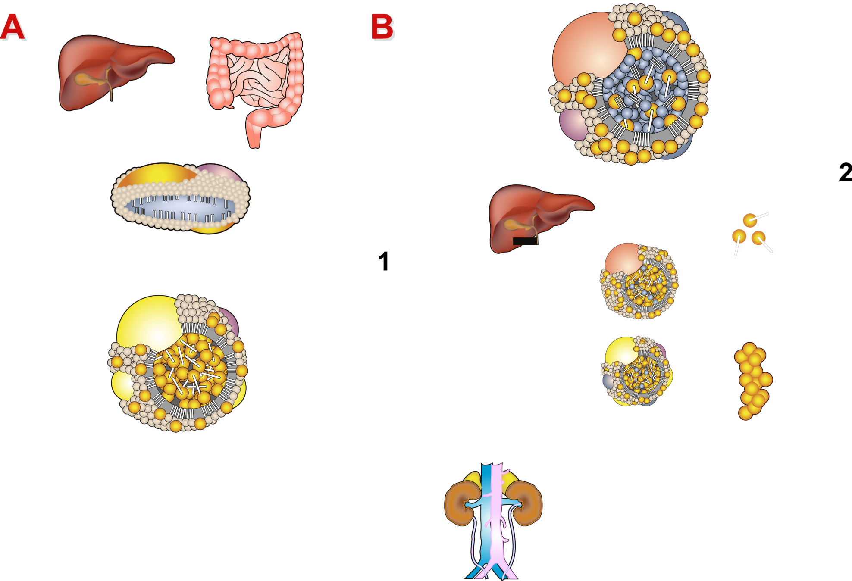
HDL METABOLISM: GENESIS (A) AND ROLE IN REVERSE CHOLESTEROL TRANSPORT (B)
A
Liver
Intestine
B
VLDL
Liver
Nascent HDL
Transfer of cholesteryl esters to VLDL via CETP
SR-B1 receptor
Remnant
LCAT
Apo AI
Apo E
Direct liver uptake of
cholesteryl esters by
SR-B1 receptor
LDL
HDL3
HTGL
Acquisition of free
cholesterol by HDL and
esterification by LCAT
Apo AI
Apo AII
Lipid-depleted
apo AI is catabolized
mainly In the kidney
HDL
Uptake of free cholesterol (from cells
surface of TG-rlch lipoproteins)
Esterification of free cholesterol by
LCAT
Migration from surface to core of HDL
Legend
CETP = cholesteryl ester transfer protein
HTGL = hepatic triglyceride lipase
LCAT = lecithin cholesterol acyltransferase
TG = triglyceride

Slide 25
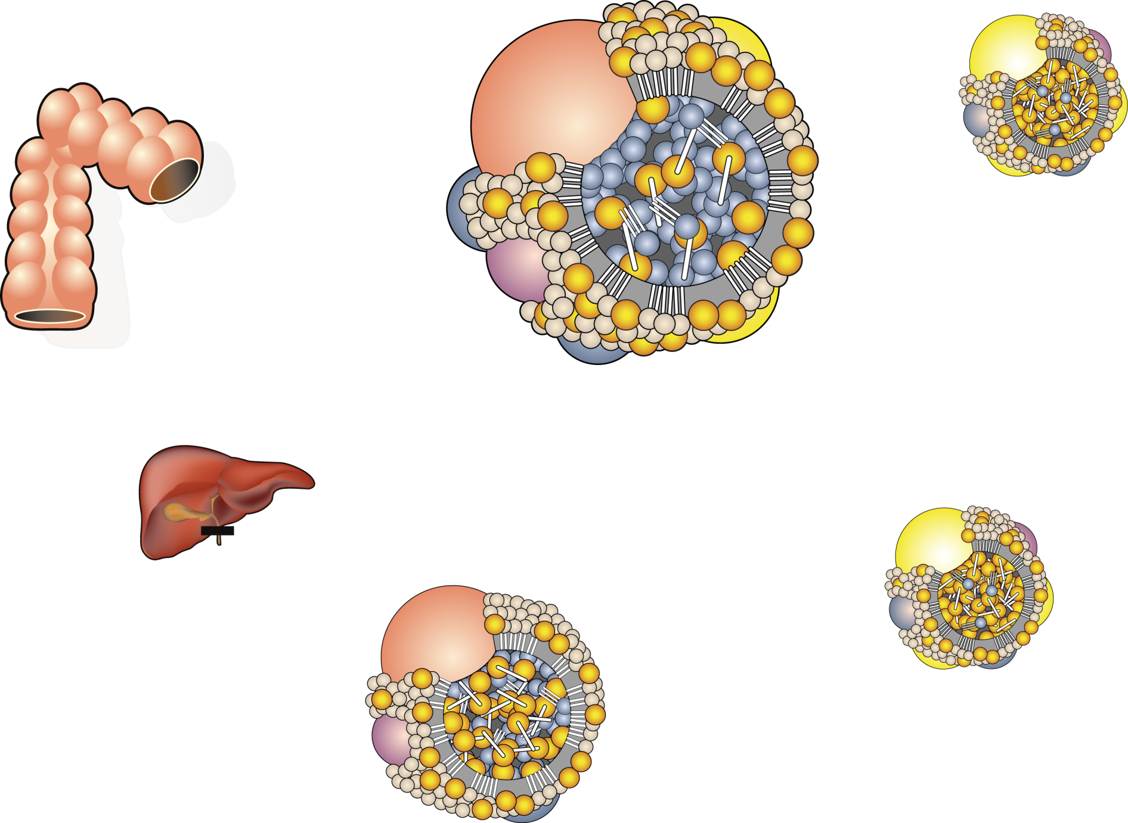
CHYLOMICRON METABOLISM: THE FATE OF DIETARY FAT
Apo AI
Triglyceride
Apo B48
Apo CII
Apo CIII
Apo E
Gut
HDL
Cholesteryl ester
Apo CII
Apo E
Chylomicron
Apo CIII
Fatty acids
Liver
Tissues
(adipose, muscle)
Remnant
receptor (LRP)
LPL
Apo AI, AIV
HDL
Apo CII, CIII
Chylomicron remnant
Legend
LPL = lipoprotein lipase

Slide 26
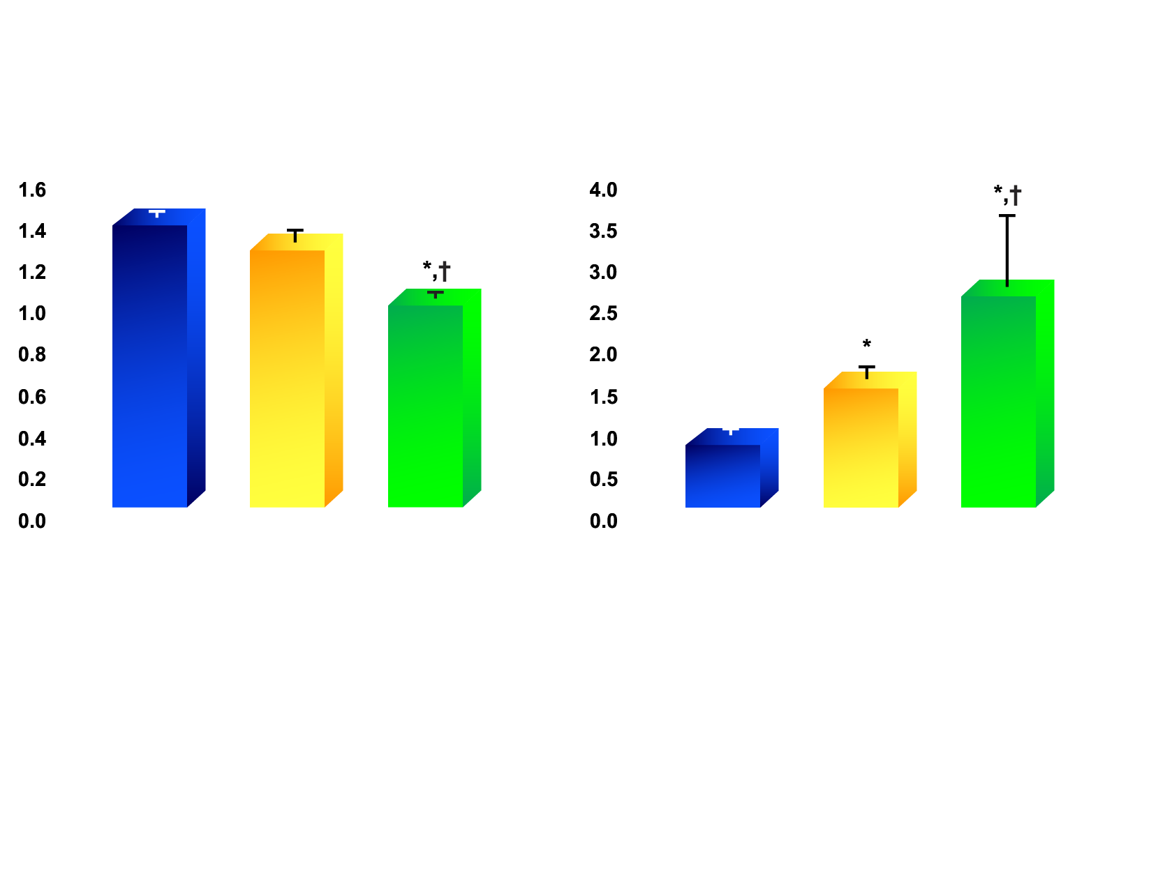
TRIGLYCERIDE AND HDL CHOLESTEROL LEVELS IN NON-OBESE WOMEN AND IN OBESE WOMEN WITH LOW OR HIGH LEVELS OF INTRA-ABDOMINAL ADIPOSE TISSUE
HDL cholesterol (mmol/l)
Triglycerides (mmol/l)
Non-obese
(N=25)
Obese with low levels of intra-abdominal fat (N=10)
Obese with high levels of intra-abdominal fat (N=10)
Non-obese
(N=25)
Obese with low levels of intra-abdominal fat (N=10)
Obese with high levels of intra-abdominal fat (N=10)
Legend
* Significantly different from non-obese women
† Significantly different from obese women with
low levels of intra-abdominal fat, p<0.05
Adapted from Després JP et al. Arteriosclerosis 1990; 10: 497·511

Slide 27
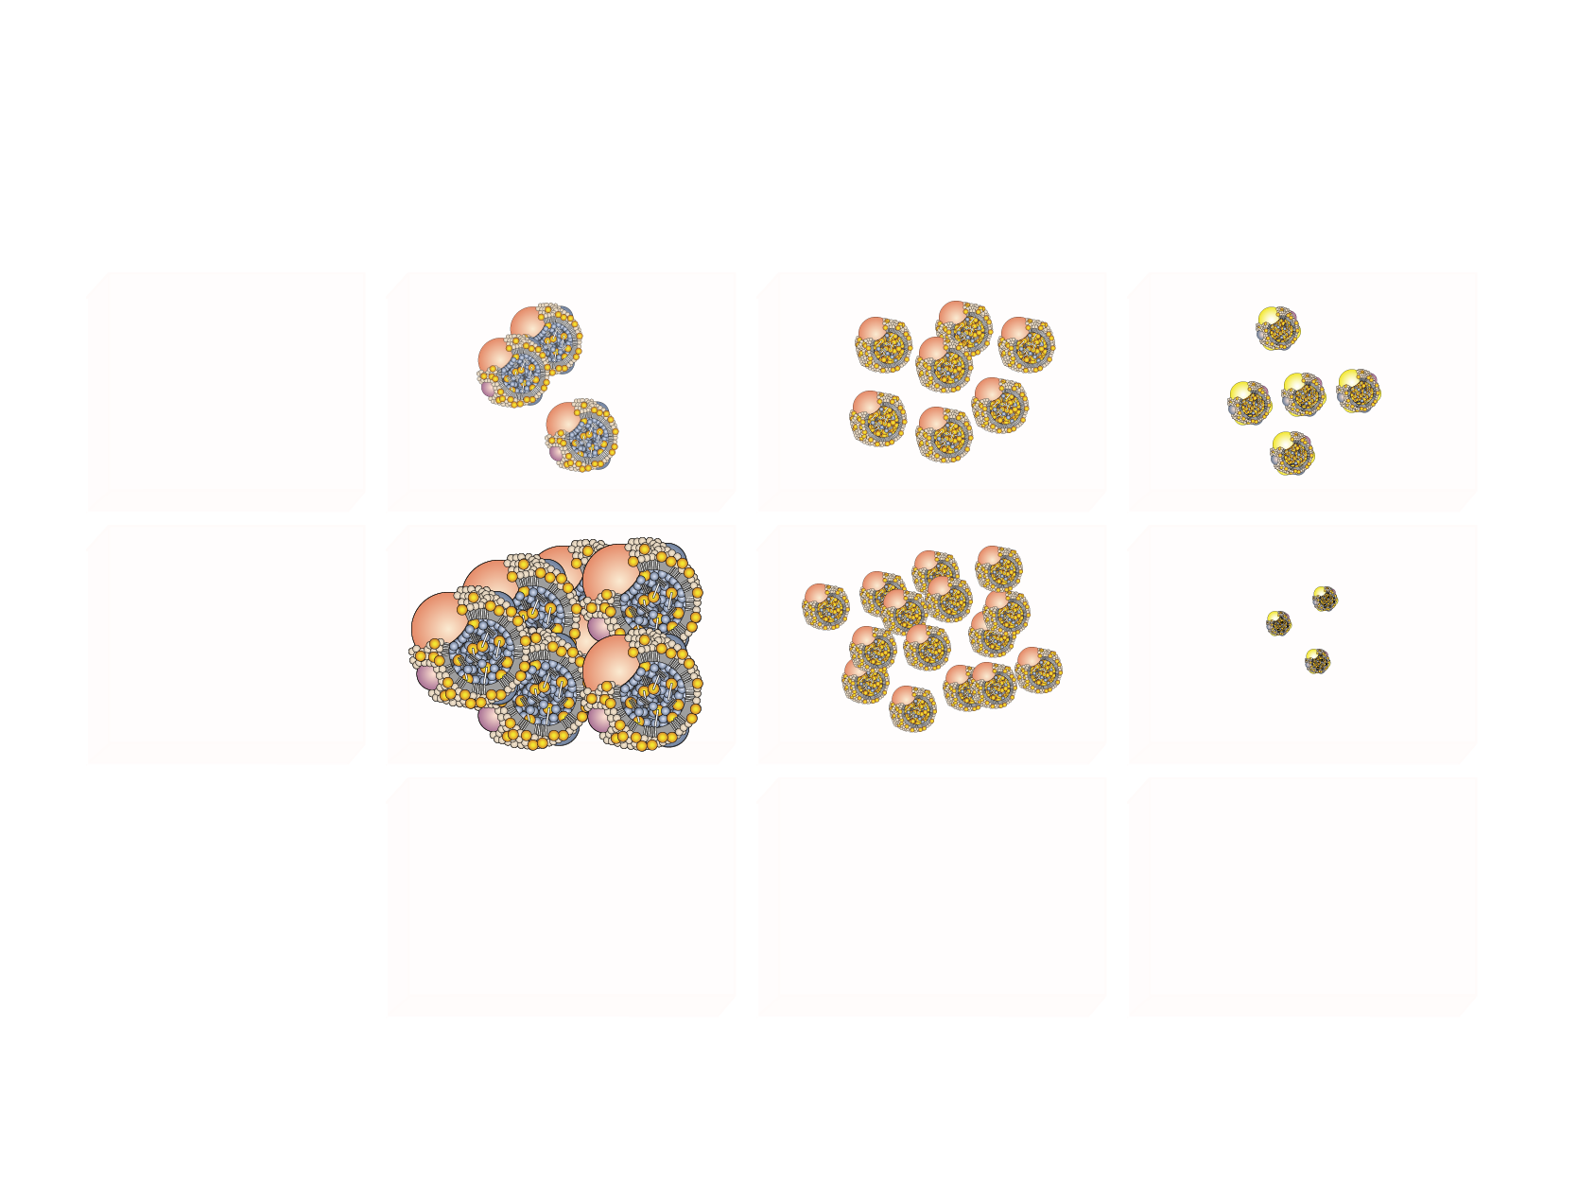
THE DYSLIPIDEMIA OF INTRA-ABDOMINAL OBESITY AND THE METABOLIC SYNDROME
VLDL
LDL
HDL
NORMAL
INSULIN
RESISTANCE
↓ HDL₂ cholesterol
↓ Number
↓ Size (small, dense)
↑ VLDL triglycerides
↑ VLDL apo B
↑ Number
↑ Size
⁼ LDL cholesterol
↑ LDL apo B
↑ LDL apo B/LDL
↑ Number
↓ Size (small, dense)

Slide 28
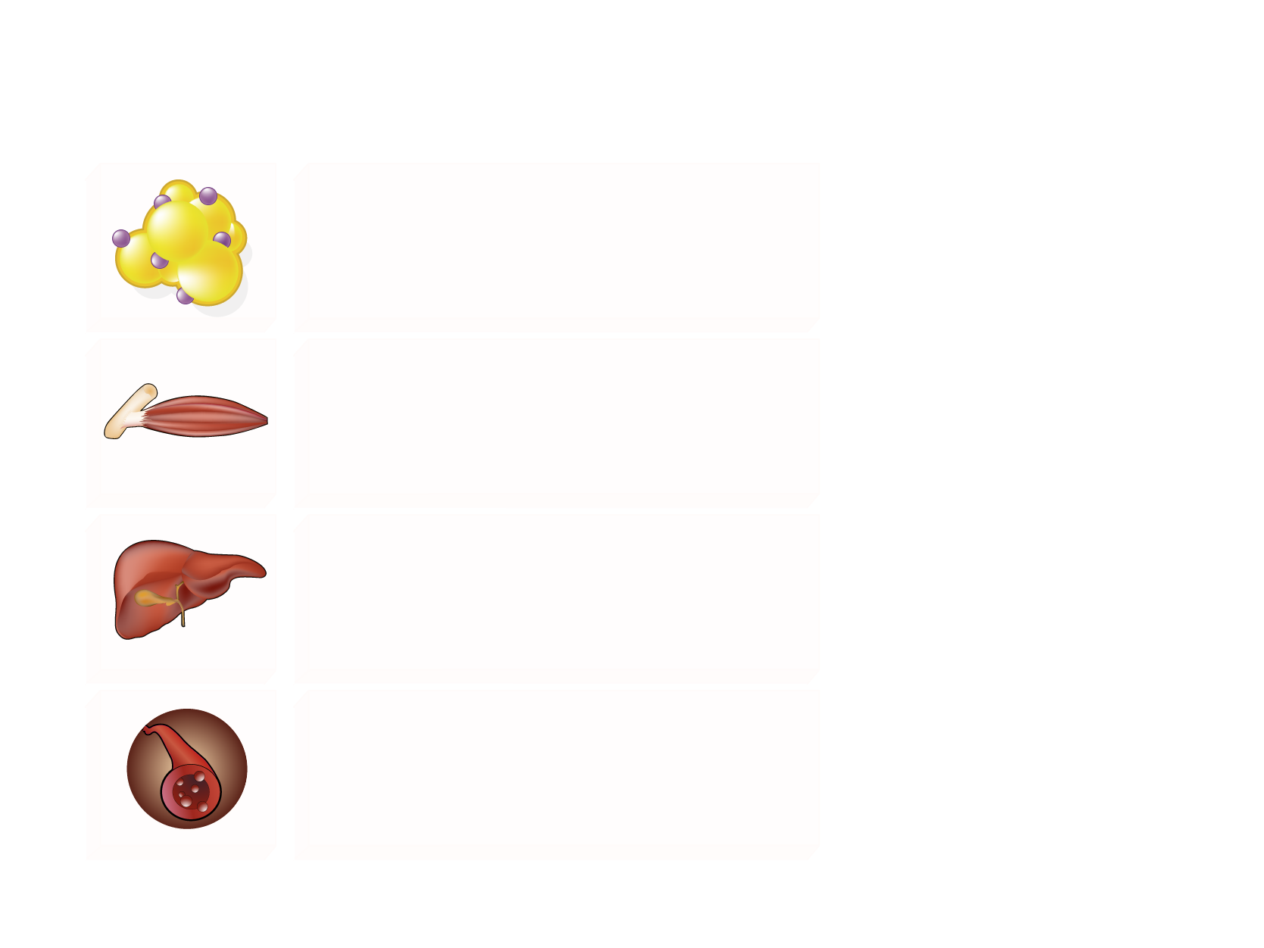
THE MANY FUNCTIONS OF INSULIN IN LIPID METABOLISM
Insulin resistance
Adipose LPL (triglyceride clearance)
Lipolysis (VLDL-triglyceride precursors)
Legend
The arrows indicate whether insulin
increases (upward green) or decreases
(downward red) the corresponding process under normal conditions of insulin sensitivity. The red Xs indicate the insulin actions that are lost in the insulin resistant state. In this condition, liver lipid synthesis is the sole insulin action maintained and is therefore exacerbated by hyperinsulinemia.
LPL = lipoprotein lipase
CETP = cholesteryl ester transfer protein
Muscle LPL (triglyceride clearance)
De novo lipid synthesis
Apo B degradation
LDL-receptor expression
VLDL assembly
VLDL secretion
Apo CIII expression
Intravascular CETP-mediated lipid transfer

Slide 29
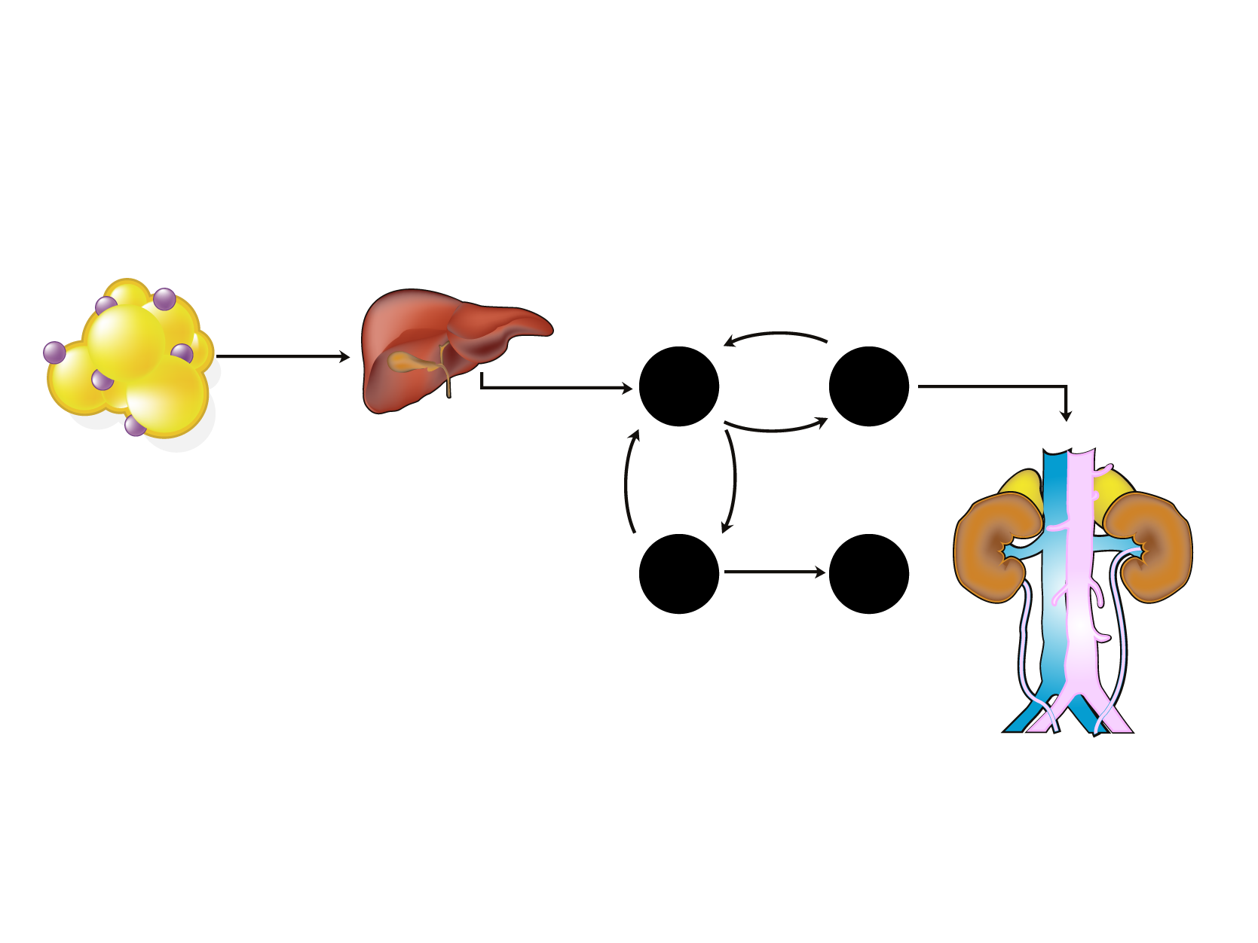
HOW INSULIN RESISTANCE AND DYSLIPIDEMIA ARE LINKED
Adipose tissue*
Liver*
Blood
Kidney
Shorter HDL Half-life
CE
Fatty acids Adipokines
HTGL
VLDL
CETP
HDL
TG
Apo B
VLDL
Small HDL
Apo AI
TG
Hypertriglyceridemia
CE
CETP
TG
LDL
LDL
HTGL
Small LDL
Legend
* Insulin resistance
CE = cholesteryl ester
CETP = cholesteryl ester transfer protein
HTGL = hepatic triglyceride lipase
TG = triglyceride

Slide 30
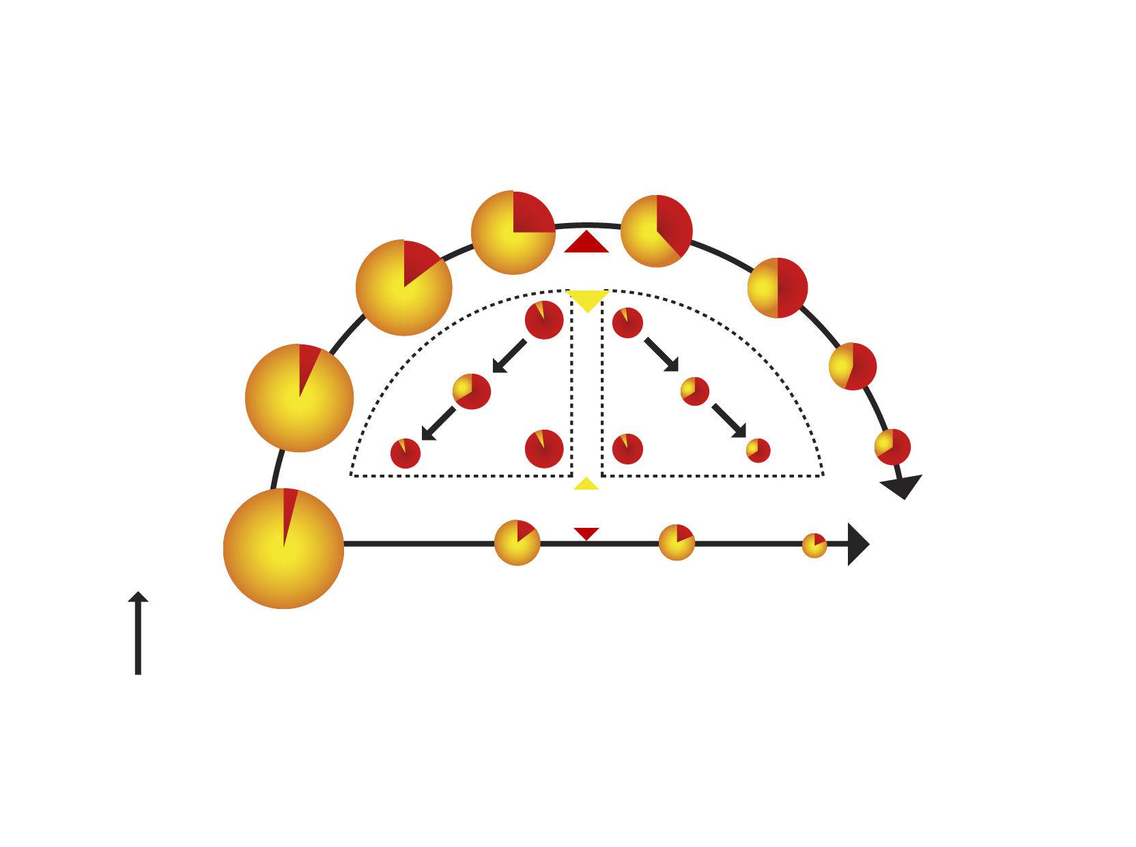
LINK BETWEEN HYPERTRIGLYCERIDEMIA AND SMALL, DENSE LDL AND LOW HDL
Inefficient triglyceride metabolism
Triglycerides
Cholesterol
LPL
Atherogenic
remnant
CETP
HTGL
LDL
HDL
HTGL
Atherogenic
Short ½ life
CETP
Chylomicrons VLDL
Remnant uptake
LPL
Efficient triglyceride metabolism
Fatty acids
Legend
CETP = cholesteryl ester transfer protein
HTGL = hepatic triglyceride lipase
LPL = lipoprotein lipase

Slide 31
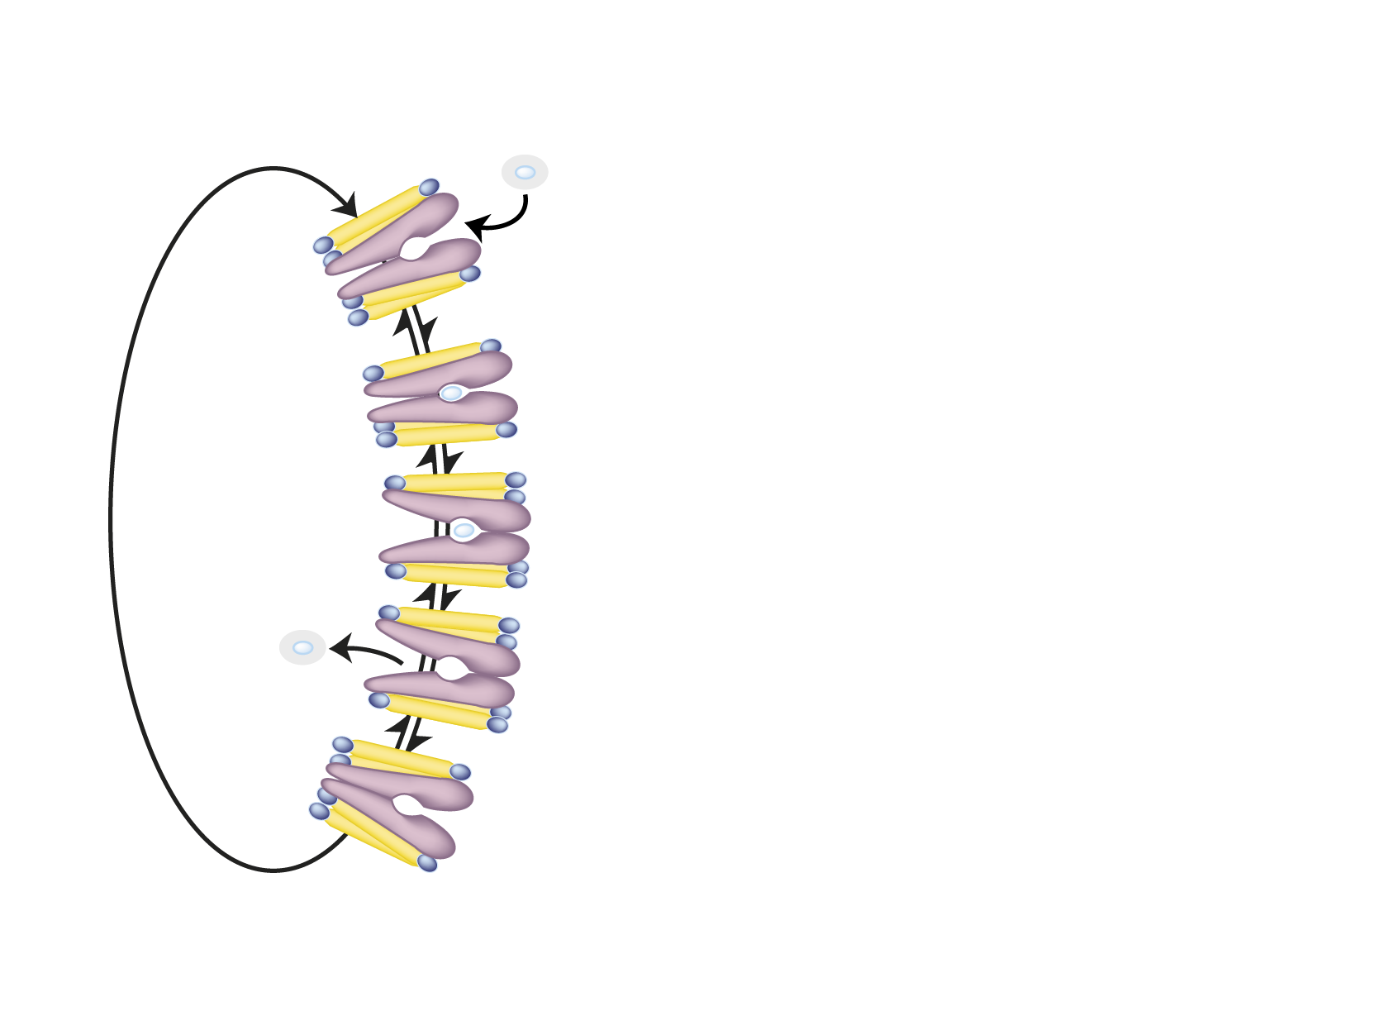
GLUCOSE TRANSPORTERS (GLUT)
D-Glucose
Organ
Transporter
Blood-brain
barrier
GLUT 1
Step 1
Brain
GLUT 3
Intestine
GLUT 5
Inside
Step 2
Liver
GLUT 2
Adipose tissue
GLUT 4*
(GLUT 1)
Step 3
Muscle
GLUT 4*
(GLUT 1)
Pancreas
GLUT 2
Step 4
*Insulin-sensitive
Outside

Slide 32
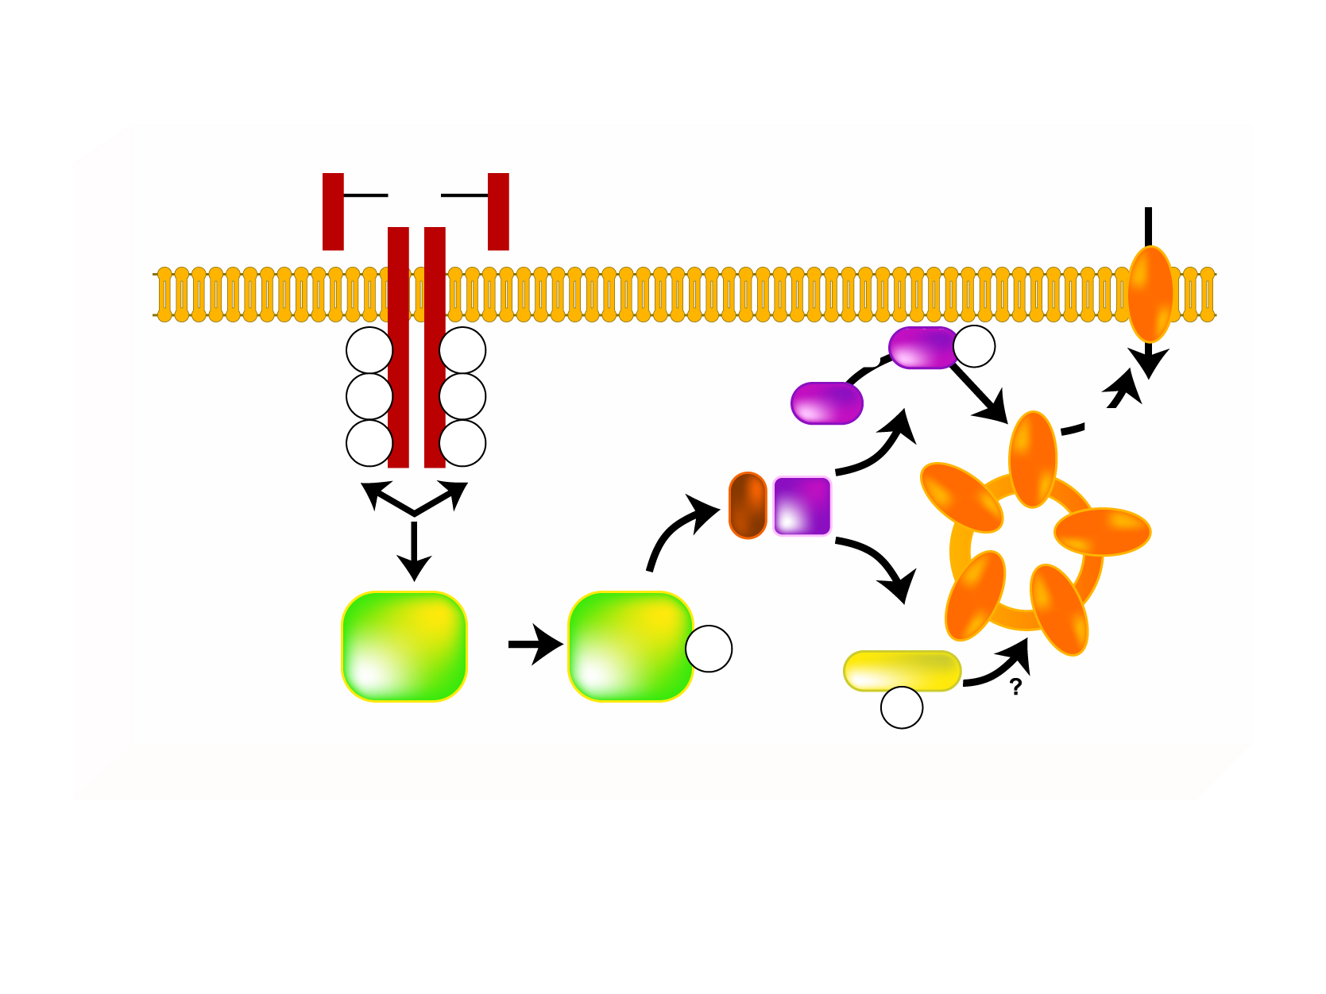
SIMPLIFIED SCHEME OF INSULIN ACTION ON GLUCOSE TRANSPORT
INSULIN
ss
GLUCOSE
ss
ss
GLUT 4
pY
pY
PDK
Akt
pS/T
pY
pY
PIP3
Akt
pY
pY
AS160
PI3K
IRS
Y
IRS
PIP3
pY
PKC-ξ/λ
pT
Legend
Akt = protein kinase PI3K= phosphatidylinositol [3,4,5) kinase
AS160 = Akt substrate of 160 kDa PKC = protein kinase C
GLUT = glucose transporter pS/T = serine/threonine phosphorylation
IRS = insulin receptor substrate-1/2 pT = threonine phosphorylation
PDK = phosphoinositide-dependent protein kinase pY = tyrosine phosphorylation
PIP3 = phosphatidylinositol 3 triphosphate

Slide 33
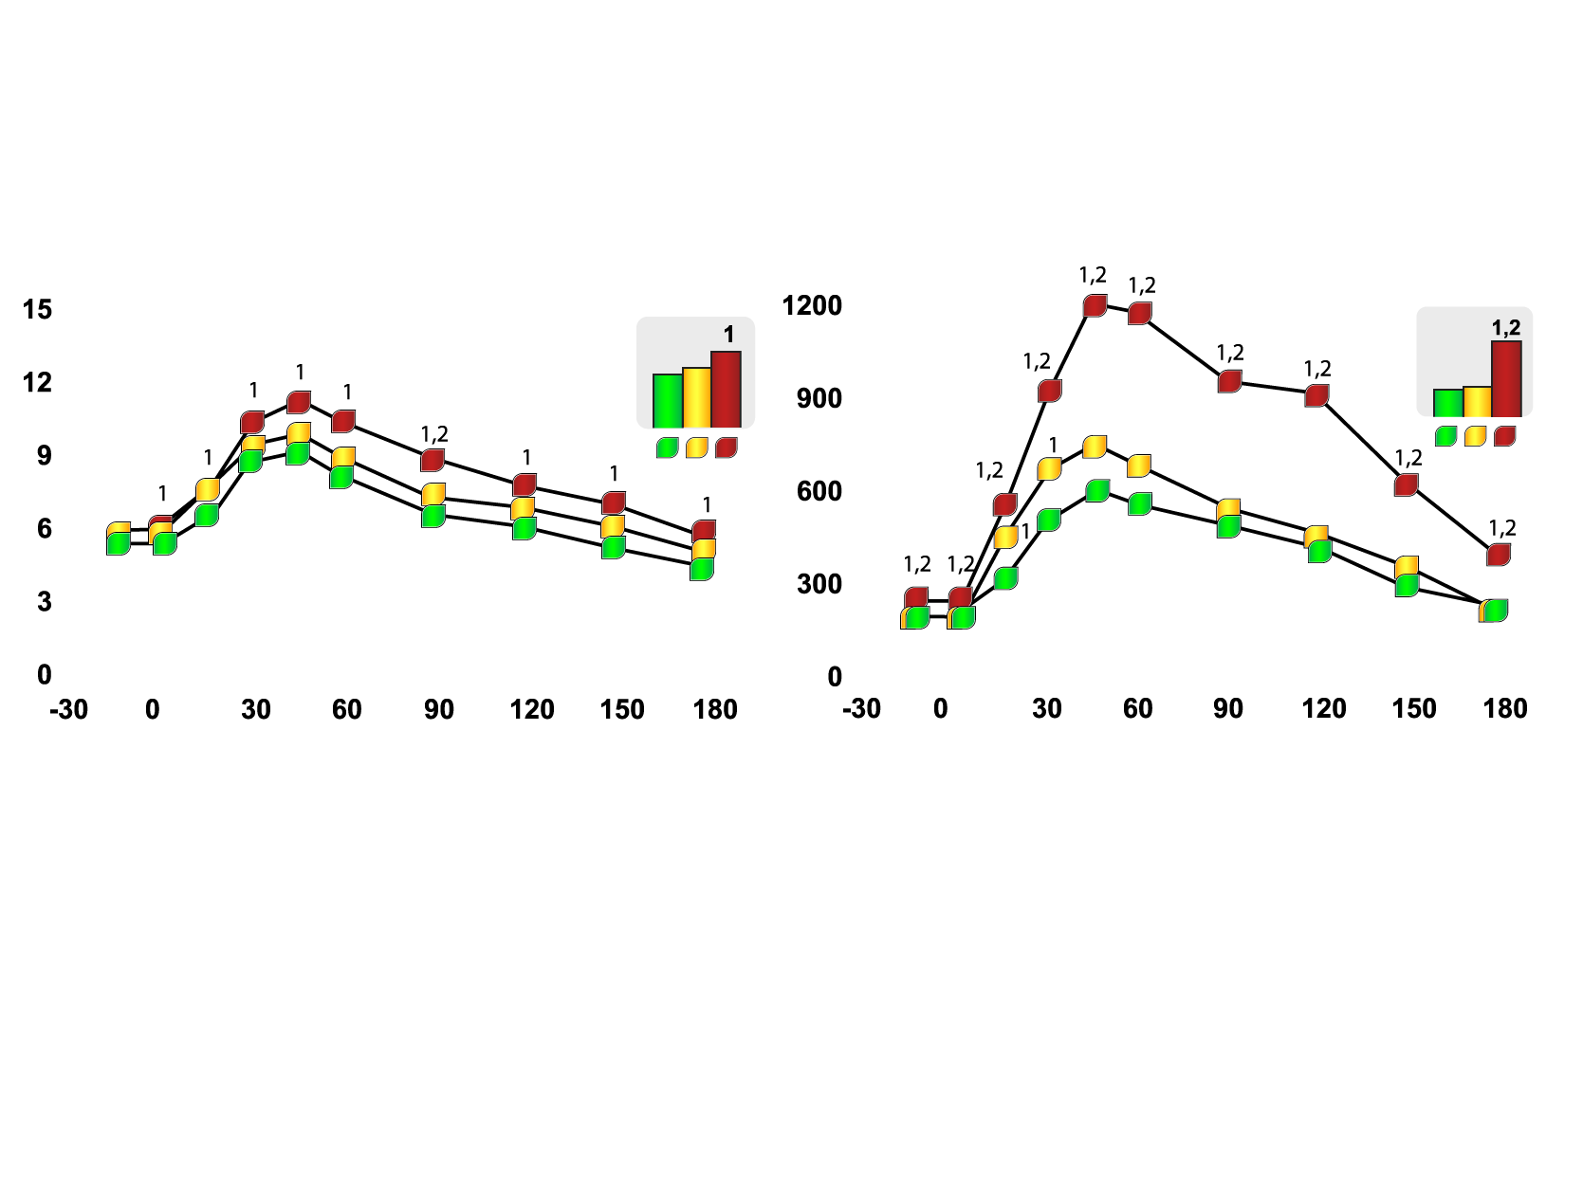
IMPACT OF INTRA-ABDOMINAL FAT ON PLASMA GLUCOSE-INSULIN HOMEOSTASIS
Glucose (mmol/l)
Insulin (pmol/l)
Glucose area
Insulin area
Time (minutes)
Time (minutes)
Non-obese
Obese with low intra-abdominal fat accumulation
Obese with high intra-abdominal fat accumulation
Legend
1 different from non-obese subjects (p<0.05)
2 different from obese subjects with
low intra-abdominal fat (p<0.05)
Copyright© 1992 American Diabetes Association
From Diabetes®, vol. 41, 1992; 826-834
Reprinted with permission from the American Diabetes Association

Slide 34
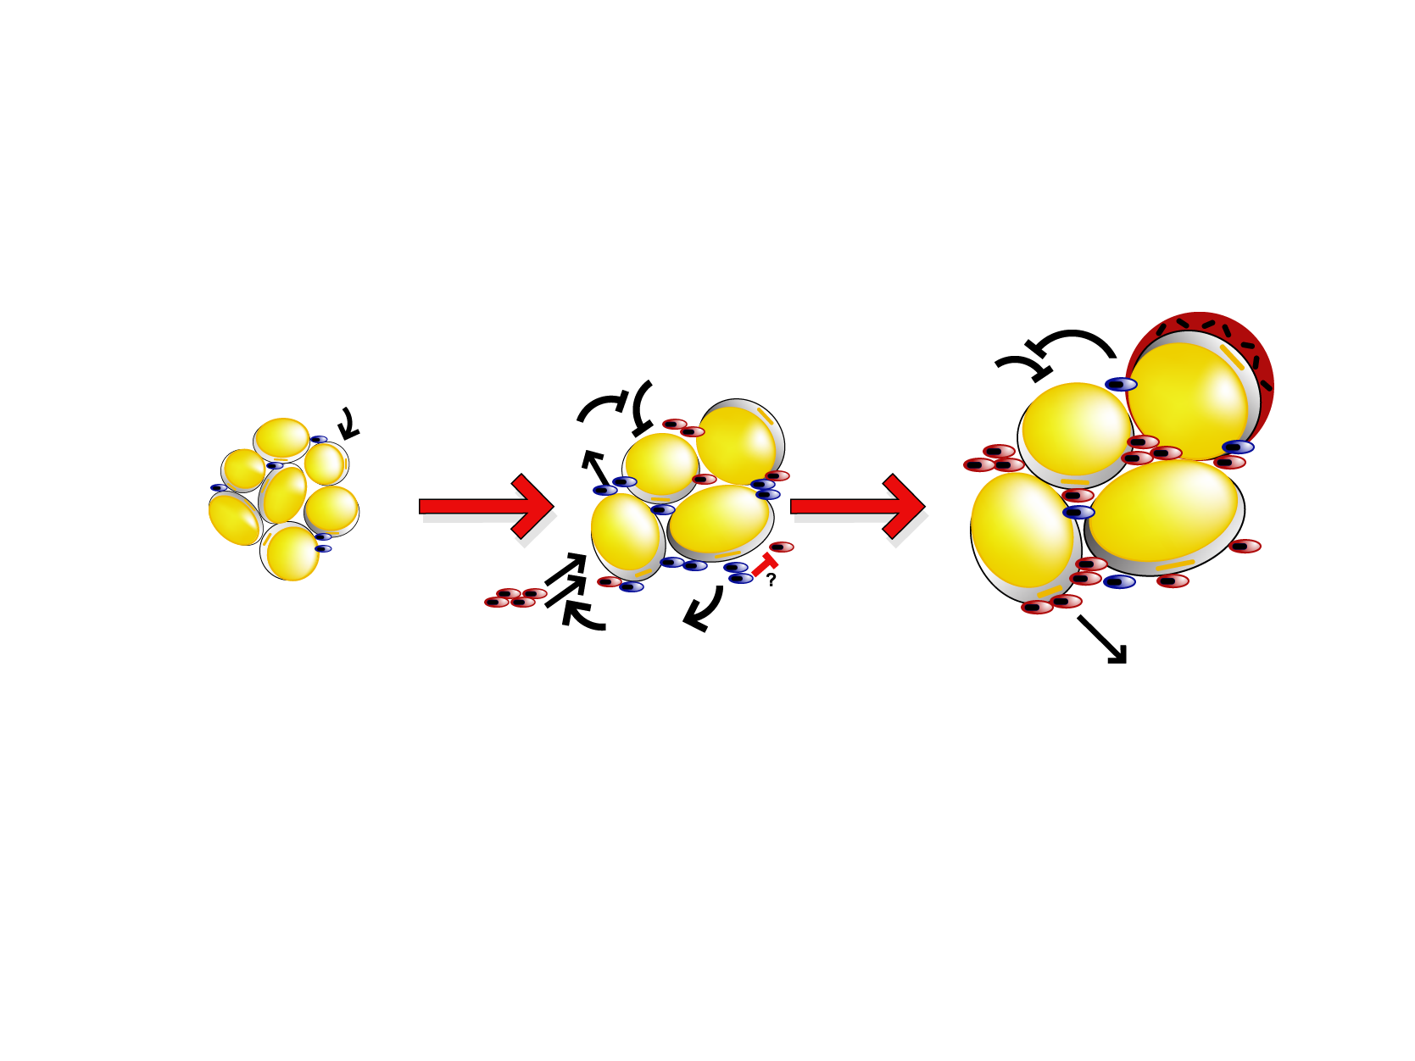
MODEL FOR ADIPOSE TISSUE MACROPHAGE POLARIZATION AND ITS FUNCTION IN ADIPOSE TISSUE WITH PROGRESSIVE OBESITY
Leanness
Insulin-sensitive
Mild Obesity
Insulin-sensitive
Severe Obesity
Insulin-resistant
↑ iNOS
↑ TNF-α
↑ IL-6
↓ IL-10
CLS
↑Arginase
↑ IL-10
↑↑ iNOS
↑↑ TNF-α
↑↑ IL-6
Insulin
resistance
↑Arginase
↑ IL-10
DIO
DIO
JNK
NF-κB
CCR2⁺
MCP-1
FFA
Inflammatory
adipo-cytokines
Legend
Arginase: less NO production
IL-10: anti-inflammatory
ATM = adipose tissue macrophage
CLS = crownlike structures
DIO = diet-induced obesity
FFA = free fatty acids
IL = interleukin
iNOS = inducible nitric oxide synthase
JNK = C-jun N-terminal kinase
MCP-1 = monocyte chemoattractant protein-1
NF-κB = nuclear factor-кB
NO = nitric oxide
TNF-α = tumor necrosis factor-α
M2 ATM
CX3CR1^{high}CCR2⁻
Tissue repair
Less NO production
M1 ATM
CX3CR1^{low}CCR2⁺
Pro-inflammatory
More NO production
Adapted from Lumeng CN et al. J Clin Invest 2007; 117: 175-84
Reproduced with permission

Slide 35
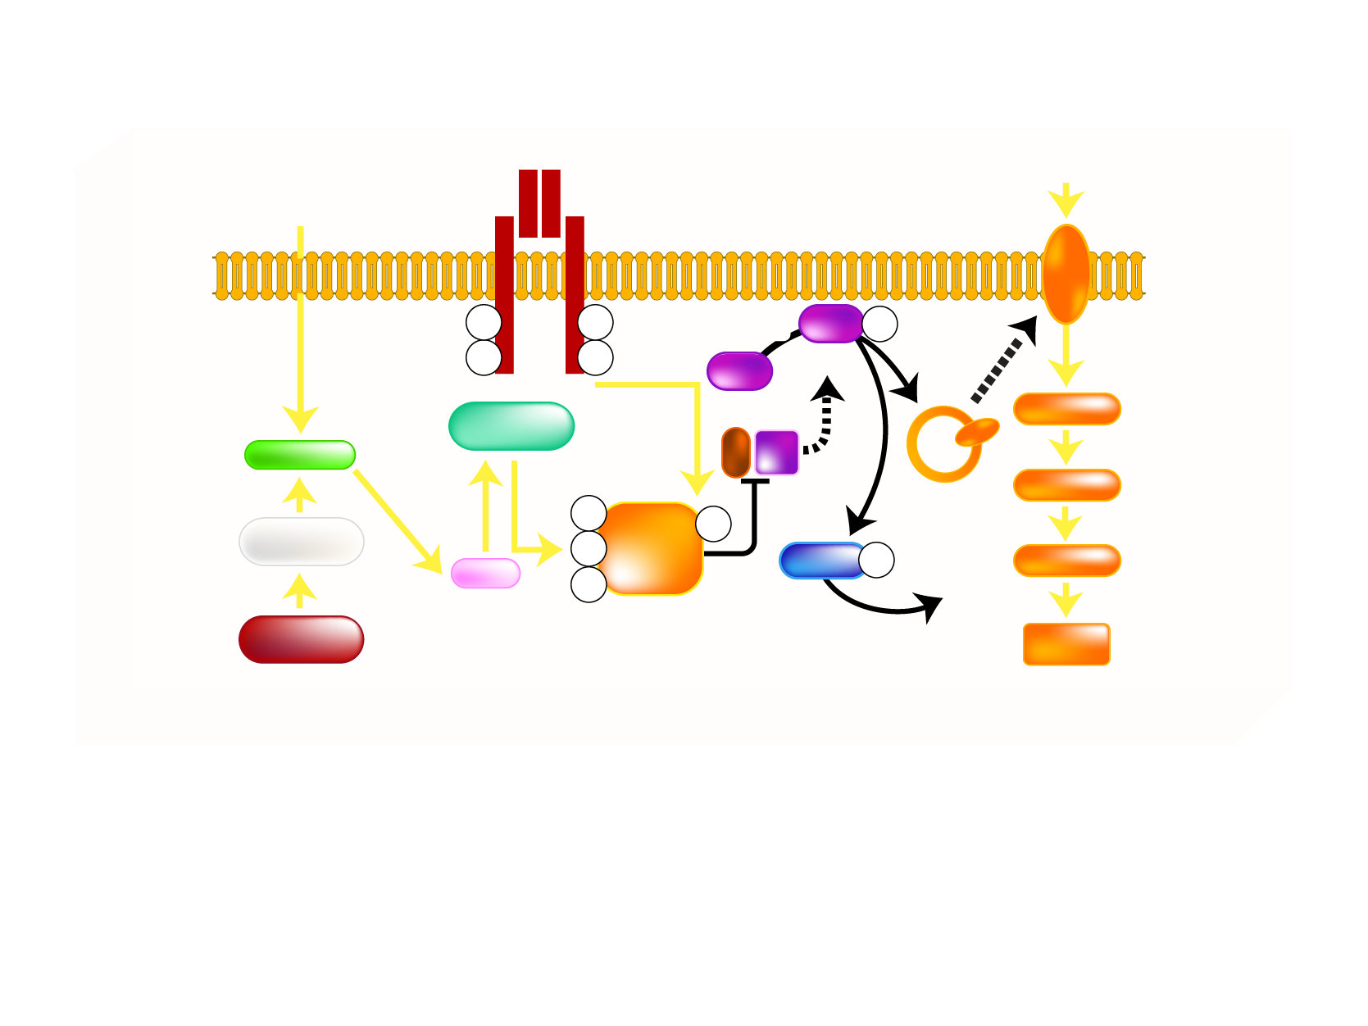
MECHANISM OF FATTY ACID-INDUCED INSULIN RESISTANCE IN SKELETAL MUSCLE
Insulin Receptor
GLUCOSE
Fatty Acid
FATPs
GLUT 4
pY
pY
PDK
Akt
pS/T
pY
pY
PIP3
Translocation
Akt
PKC-θ
Ser/Thr kinase
PI3K
Glucose
LCCoA
G6P
pS
pY
β-oxidation
pS
IRS-1
GSK3
pS/T
UDP-glucose
DAG
pS
GS activity
Mitochondrial
Density
Glycogen
Synthesis
Legend
Akt = protein kinase B
DAG = diacylglycerol
FATPs = fatty acid transport proteins
G6P = glucose 6-phosphate
GLUT = glucose transporter
GS = glycogen synthase
GSK3 = glycogen synthase kinase-3
IRS-1 = insulin receptor substrate-1
LCCoA = long-chain acylcoenzyme A
PDK = phosphoinositide-dependent protein kinase
PKC = protein kinase C
PI3K = phosphatidylinositol [3,4,5] kinase
PIP3 = phosphatidylinositol 3 triphosphate
pS = serine phosphorylation
pS/T = serine/threonine phosphorylation
pY = tyrosine phosphorylation
Ser/Thr = serine/threonine
UDP = uridine diphosphate glucose
Adapted from Savage DB et al. Physiol Rev 2007; 87: 507-20

Slide 36
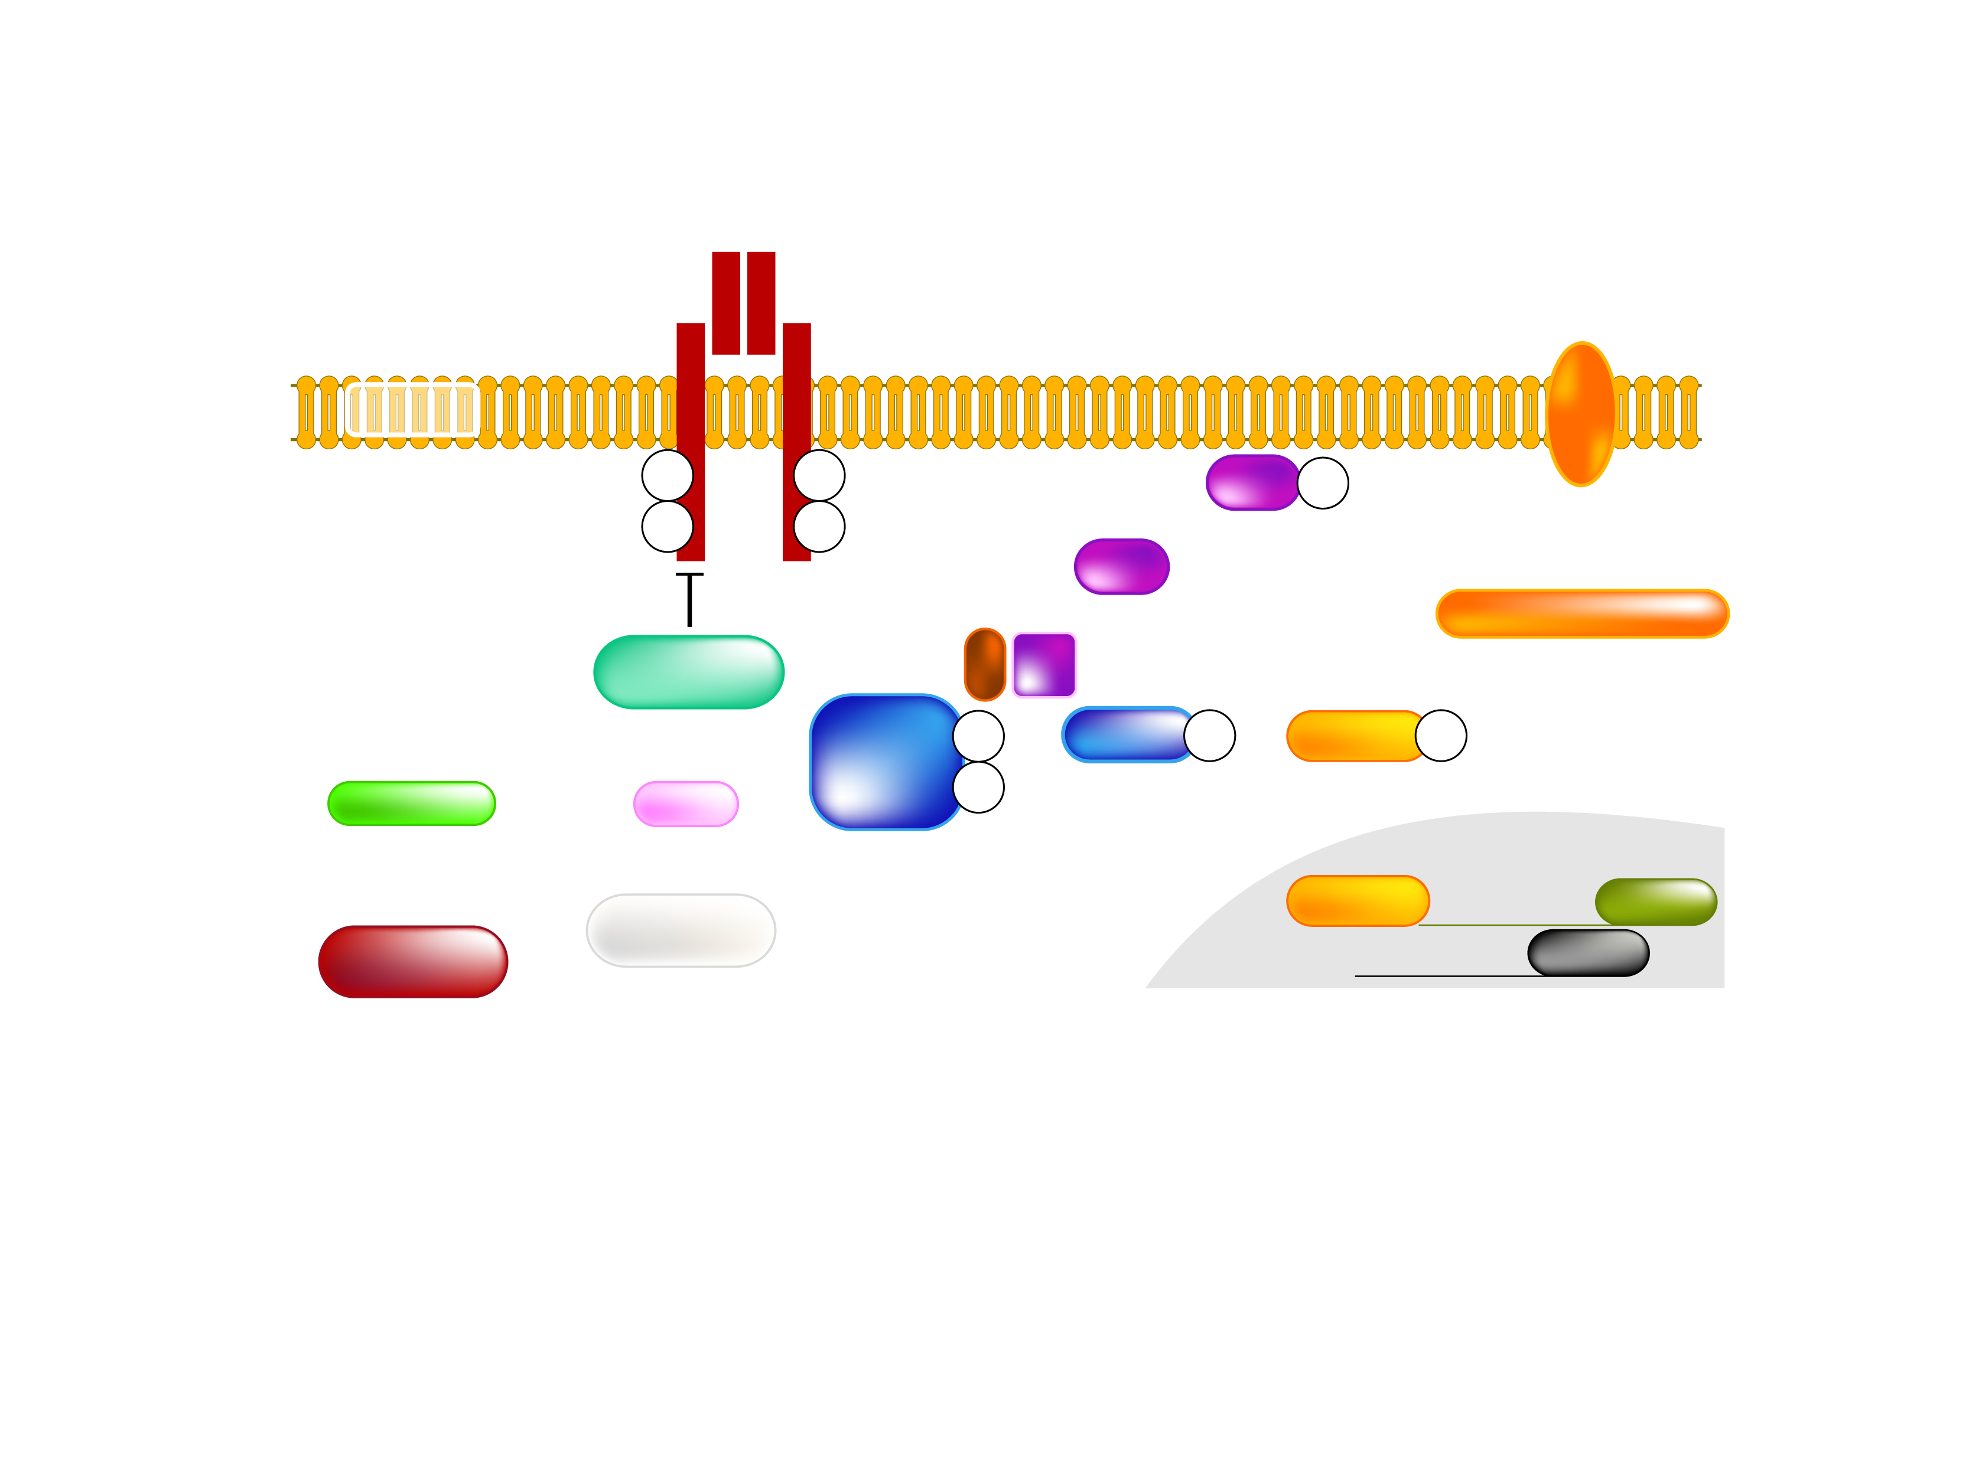
MECHANISM OF FATTY ACID-INDUCED INSULIN RESISTANCE IN LIVER
Insulin Receptor
GLUCOSE
Fatty Acid
FATPs
GLUT 2
pY
pY
PDK
Akt
pS/T
pY
pY
PIP3
Akt
PI3K
Gluconeogenesis
PKC-ε
Ser/Thr kinase
IRS-2
pY
GSK3
pS/T
FOXO
pS/T
LCCoA
DAG
pY
Glycogen Synthesis
β-oxidation?
FOXO
PEPCK
de novo lipid synthesis
NUCLEUS
G6Pase
Legend
Akt = protein kinase B
DAG = diacylglycerol
FATPs = fatty acid transport proteins
FOXO = forkhead box protein O
G6P = glucose 6-phosphate
GLUT = glucose transporter
GSK3 = glycogen synthase kinase-3
IRS-2 = insulin receptor substrate-2
LCCoA = long-chain acylcoenzyme A
PDK = phosphoinositide-dependent protein kinase
PKC = protein kinase C
PEPCK = phosphoenolpyruvate carboxykinase
PI3K = phosphatidynositol [3,4,5] kinase
PIP3 = phosphatidylinositol 3 triphosphate
pS/T = serine/threonine phosphorylation
pY = tyrosine phosphorylation
Ser/Thr = serine/threonlne
Adapted from Savage DB et al. Physiol Rev 2007; 87: 507-20

Slide 37
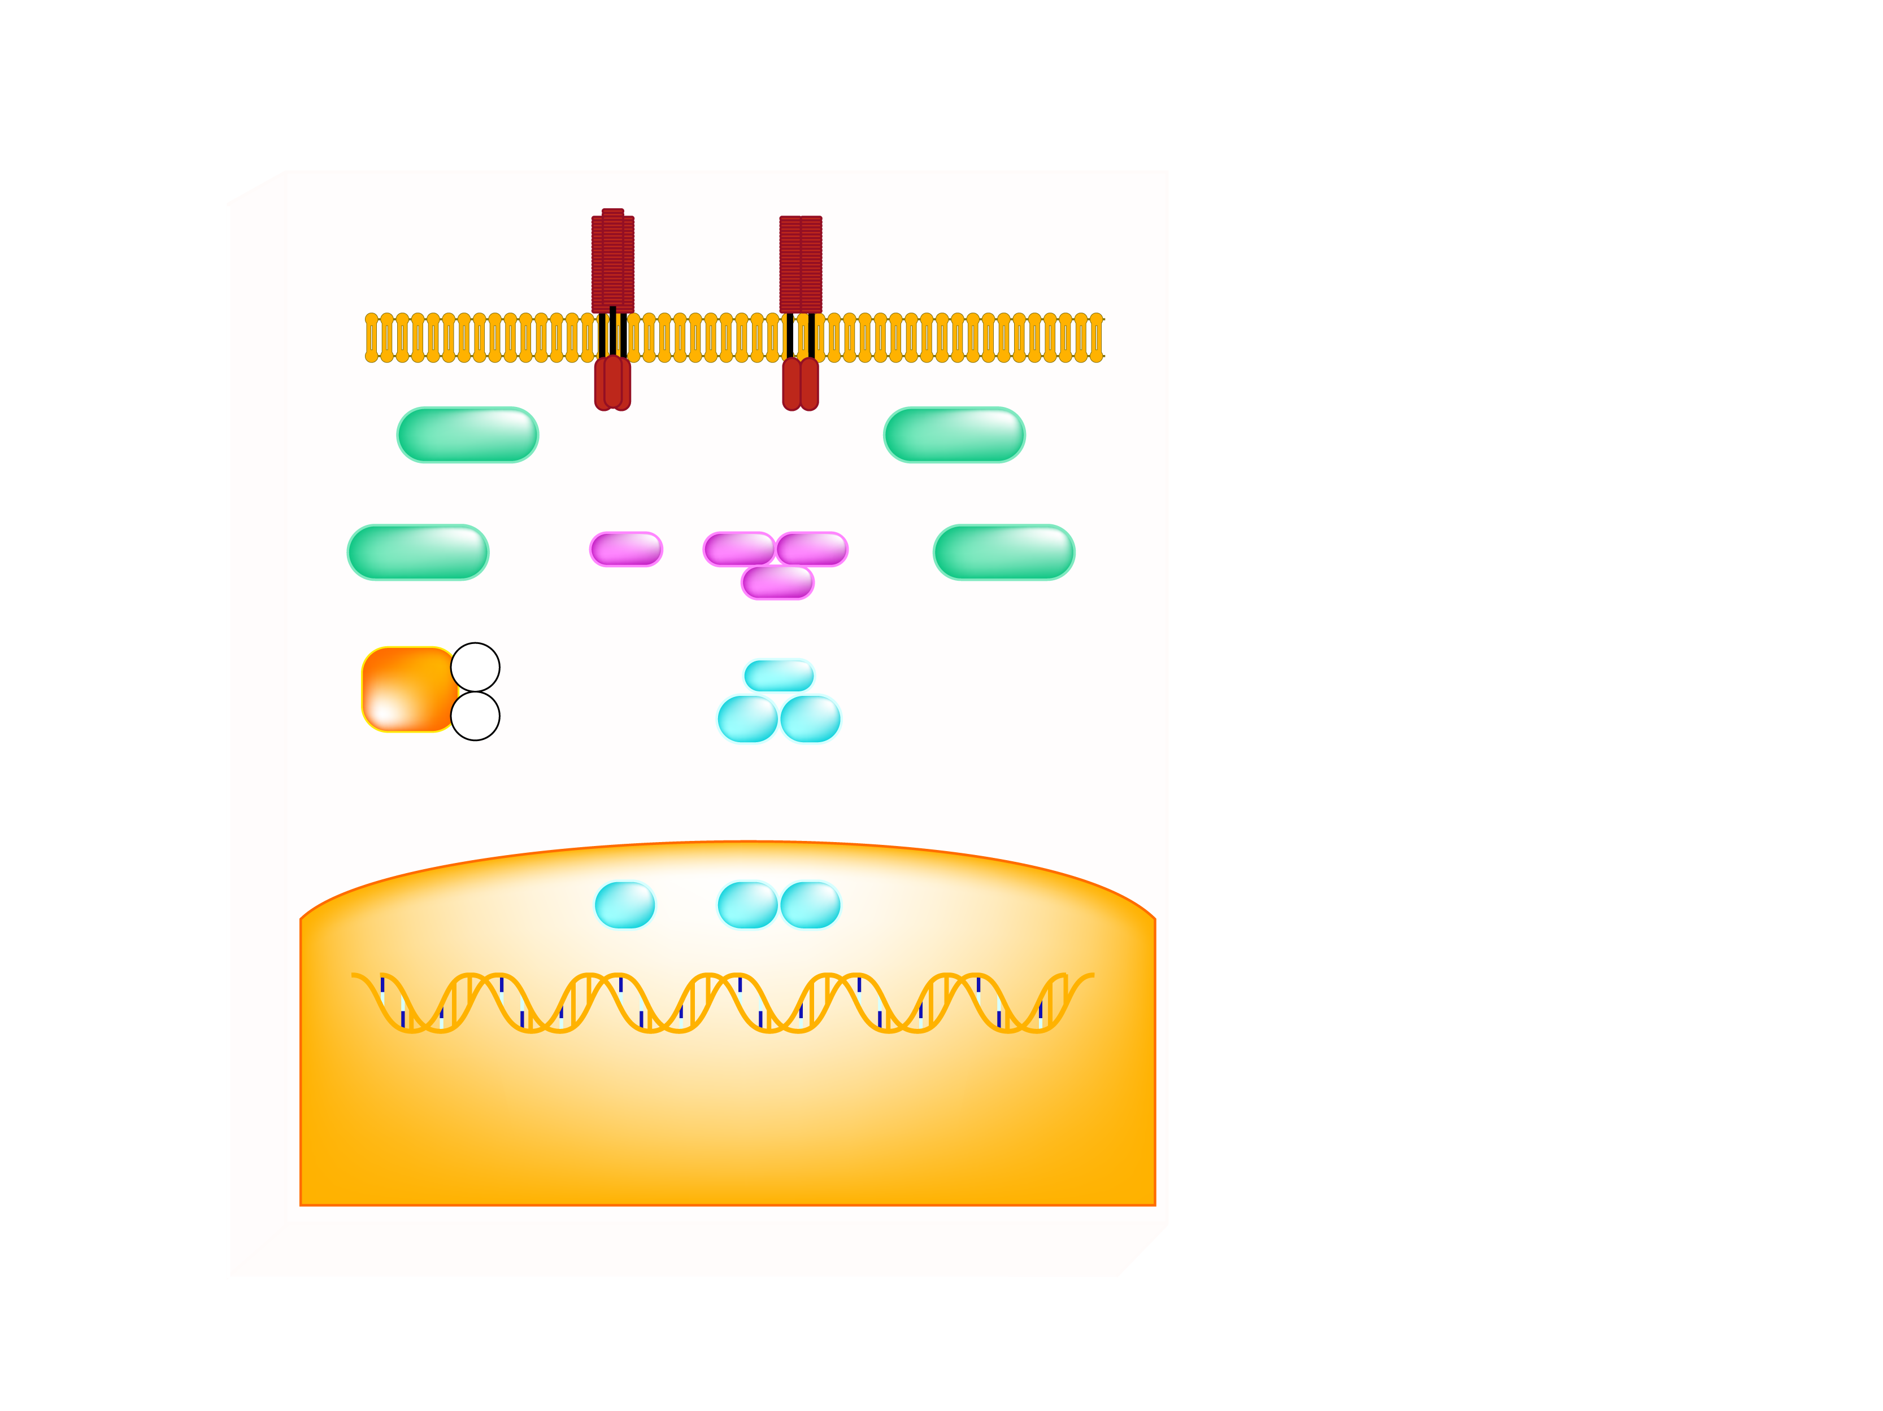
POTENTIAL CELLULAR MECHANISMS FOR ACTIVATING INFLAMMATORY SIGNALING
Legend
TNFR, RAGE
TLRs, IL-1R
AP-1 = activator protein-1
ER = endoplasmic reticulum
IKK = IкB kinase
IL-1 R = interleukin-1 receptor
INOS = inducible nitric oxide
synthase
IRS-1 = insulin receptor substrate-1
JNK = C-jun N-terminal kinase
NF = nuclear factor
PKC = novel protein kinase
RAGE = receptor of advanced
glycation endproducts
ROS = reactive oxygen species
TLR = toll-like receptor
TNFR = tumor necrosis factor
receptor
TZD = thiazolidinediones
Plasma Membrane
Ceramide
PKCs
ROS
JNK
IKKα
IKKβ
ER stress
IKKγ
Salicylates, TZDs, and statins
IRS-1
pS
IκBα
pS
?
p65
p50
NF-κB
AP-1
NF-кB
iNOS and other inflammatory mediators
p65
p50
Nucleus
Insulin Resistance
Adapted from Shoelson SE et al. J Clin Invest 2006; 116: 1793-1801

Slide 38
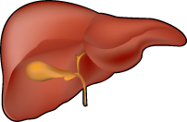
SUMMARY OF THE EFFECTS OF INSULIN ON GLUCOSE AND LIPID METABOLISM IN VARIOUS TISSUES AND THE COMPONENTS AFFECTED BY INSULIN RESISTANCE
Insulin action is reduced in obesity
Glucose
Lipids
Uptake
Uptake from blood triglycerides
Glucose → Glycerol → Triglycerides
Glucose → Fatty acids → Triglycerides
Release (anti-lipolytic)
Hyperglycemia, Delayed triglyceride clearance, Increased fatty acid output
Uptake
Storage (glycogen)
Oxidation
Oxidation
Lesser use of glucose
Storage (glycogen)
Oxidation
Gluconeogenesis
Secretion
Glucose → Fatty acids → Triglycerides
VLDL secretion
Hyperglycemia, Hypertriglyceridemia
Legend
Green upward arrow = stimulation by insulin
Red downward arrow = inhibition by insulin
Red x mark = loss of insulin action in insulin resistance

Slide 39
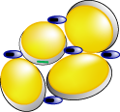
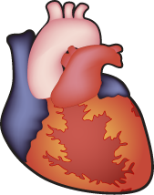
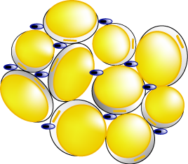
POTENTIAL MECHANISMS FOR OBESITY-INDUCED INFLAMMATION
Lean
Nutrient excess
Expansion of fat mass
Adipocyte production of cytokines and chemokines
Insulin resistance
Endothelial cell expression
of adhesion molecules
Pro-inflammatory and
post-atherogenic mediators
Monocyte recruitment
and differentiation
Atherosclerosis
Macrophage infiltration
and cytokine production
Obese

Slide 40
ADIPOSE TISSUE AS AN ENDOCRINE ORGAN
Adiponectin
FFA
Leptin
Visfatin, Resistin
Adipsin/ASP
Several soluble receptor
PAI-1
Complement factors
Sex hormones
IL-6
Glucocorticoids
TNF-α
Retinol-blinding protein
Adipose
Tissue
IL-1β
PGI₂/PGF_{2α}/PGE₂
IL-8
Haptoglobulin
IL-10
Serum amyloid A
IGF-1
Agouti
TGF-β
MCP-1
Agiotensin 2/RAS
MIF
NGF
TF
VEGF
Apolipoprotein E
FIAF
HGF
Legend
ASP= Acylation-stimulating protein
FFA= Free fatty acid
FIAF= Fasting-induced adipose factor
HGF= Hepatocyte growth factor
IGF-1 = Insulin-like growth factor-1
IL= Interleukin
MCP-1= Monocyte chemoattractant protein-1
MIF= Macrophage migration inhibitory factor
NGF= Nerve growth factor
PAI-1= Plasminogen activator inhibitor-1
PGE₂= Prostaglandin E₂
PGF_{2α}= 8-iso-prostaglandin F_{2α}
PGI₂= Prostaglandin I₂
RAS= Renin-angiotensin system
TF= Tissue factor
TGF-β= Transforming growth factor-β
TNF-α= Tumor necrosis factor-α
VEGF= Vascular endothelial growth factor

Slide 41
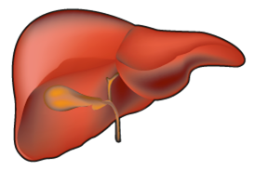
INFLAMMATION: THE LINK BETWEEN ABDOMINAL OBESITY AND GLOBAL CARDIOMETABOLIC RISK (CVD RISK)
Inflammation
Adipose
Tissue
IL-6
CRP
?
?
(-)
TNF-α
FFA
Macrophage
Apo B
(-)
Risk of CVD
Adiponectin
Legend
Glucose
FFA: Free Fatty Acids
Apo B: Apolipoprotein B
CRP: C-Reactive Protein
IL: Interleukln
TNF-α : Tumor Necrosis
Factor -α
Abdominal Obesity
Triglycerides
Insulin
Atherogenic, insulin
resistant dysmetabolic
milieu
Adapled from Després JP Int J Obes Metab Disord 2003; 27: 5224

Slide 42
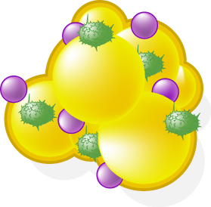
ADIPOSE TISSUE AND SOME OF THE ADIPOKINES/FACTORS INVOLVED IN THE PRO-THROMBOTIC STATE OF INTRA-ABDOMINAL OBESITY
Adipose
Tissue
Leptin
PAI-1
Platelet aggregation
IL-6
Inhibitor of fibrinolysis
(-)
Tissue
factor
Adiponectin
TNF-α
CRP
Initiation of coagulation cascade
Nitric oxide
Inflammation
Liver
Factor VII
and VIII
Oxidative Stress
Hyperactivity of platelets
Hypofibrinolysis
Fibrinogen
Pro-thrombotic
and
Hypofibrinolytic
State
Endothelial dysfunction
Hypercoagulability
Fibrin formation
Platelet aggregation
Thrombotic events
Plasma viscosity

Slide 43
TRADITIONAL RISK FACTORS AND EMERGING MARKERS CONTRIBUTING TO CARDIOMETABOLIC RISK
(
Atherogenic
Dyslipidemia
Pro-thrombotic
Profile
(
Emerging Markers
Abdominal
Obesity
Insulin
Resistance
Inflammatory
State
Cardiometabolic
Risk
(
Age
BLOOD
PRESSURE
Lipid Profile
(
Traditional Risk
Factors
Gender
Type 2 Diabetes
(hyperglycemia)
Smoking

Slide 44
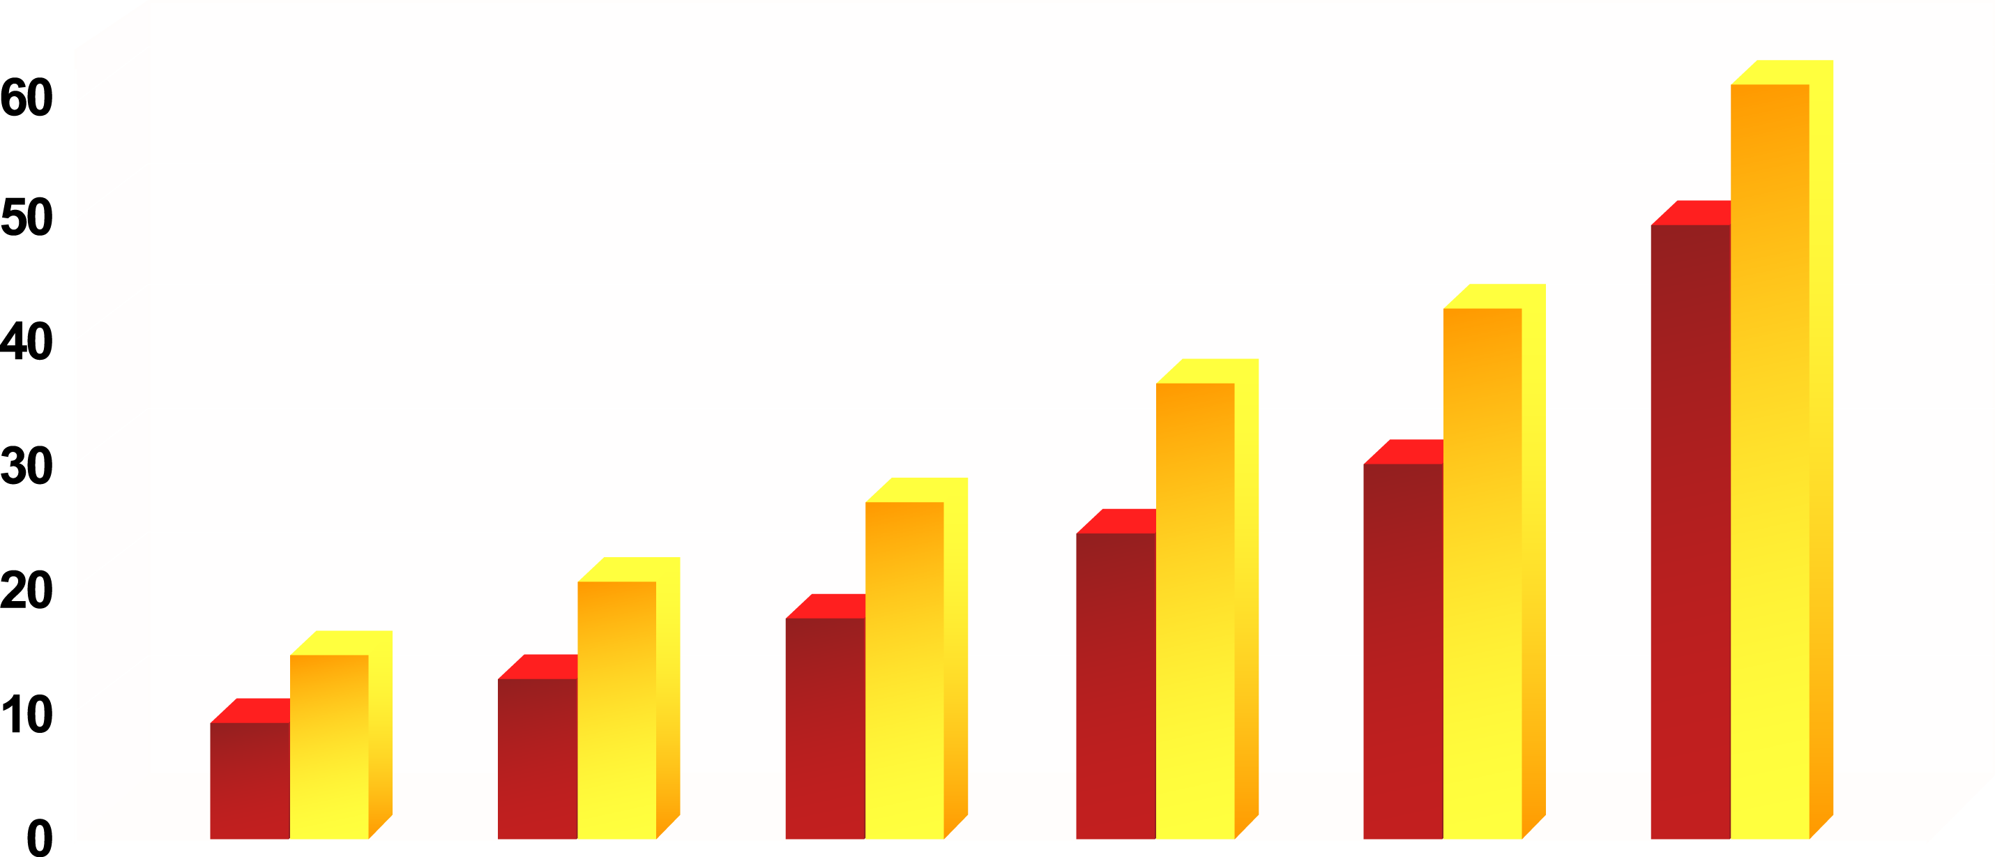
TEN-YEAR RISK OF CORONARY HEART DISEASE (CHD) BY SYSTOLIC BLOOD PRESSURE (SBP) AND PRESENCE OF OTHER RISK FACTORS
SBP 120
SBP 180
10-Year Risk of CHD (%)
Cholesterol
180
240
240
240
240
240
HDL
50
50
35
35
35
35
Smoking
No
No
No
Yes
Yes
Yes
Diabetes
No
No
No
No
Yes
Yes
LVH*
No
No
No
No
No
Yes
*Left Ventricular Hypertrophy
From Chobanian AV et al. Hypertension 2003; 42: 1206-52
Reproduced with permission

Slide 45
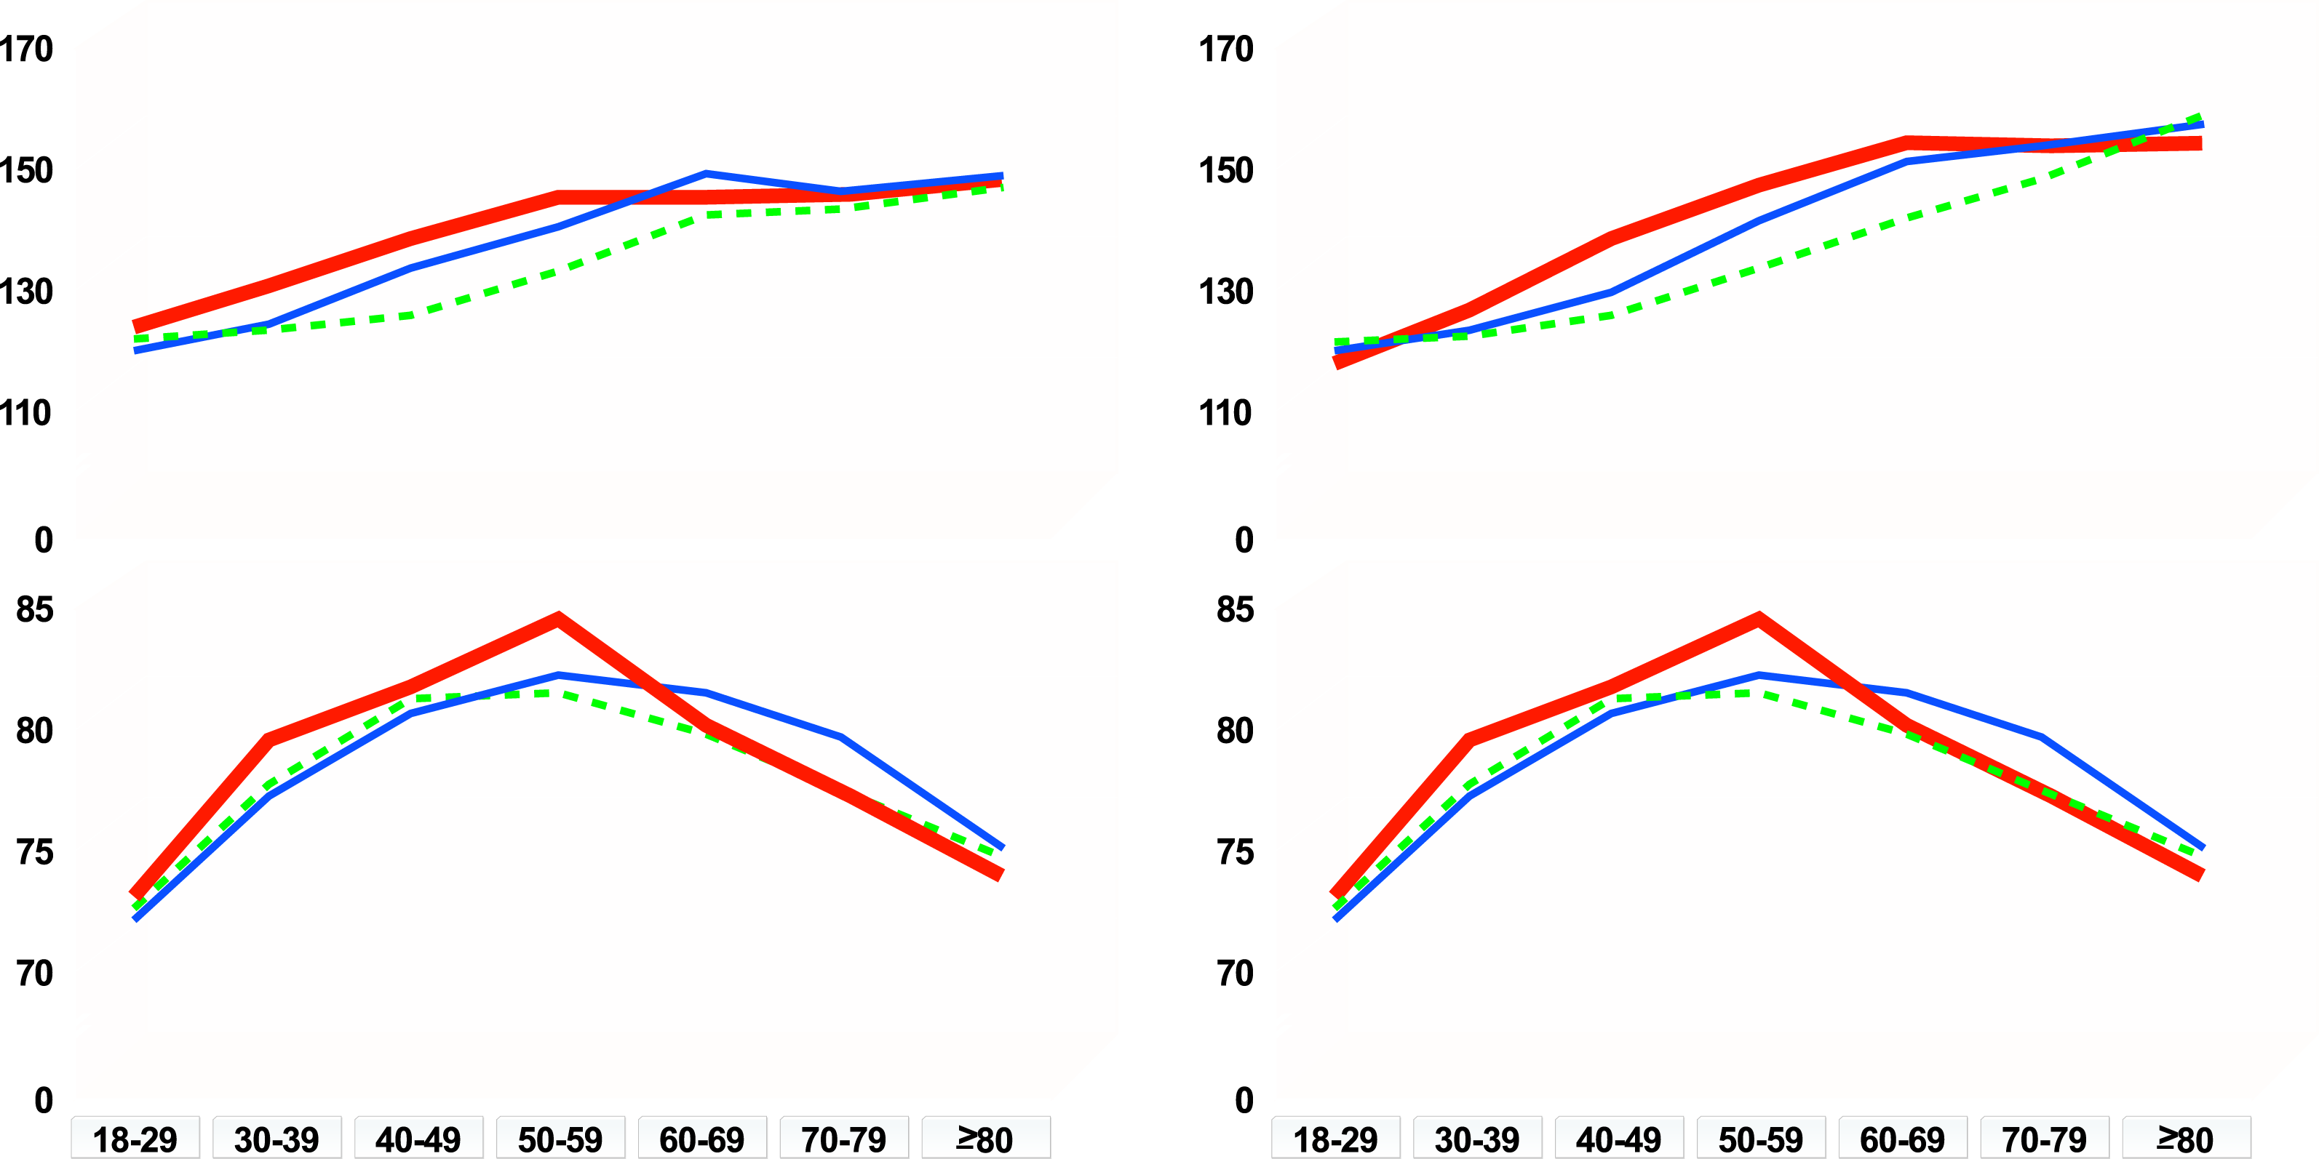
CHANGES IN BLOOD PRESSURE WITH AGE
Non-Hispanic black
Non-Hispanic white
Mexican American
Men
Women
Systolic blood pressure
Systolic blood pressure
Diastolic blood pressure
Diastolic blood pressure
Age
Age
From Burt VL et al. Hypertension 1995; 25: 305-13
Reproduced with permission

Slide 46
LINKS BETWEEN HYPERTENSION AND CARDIOVASCULAR DISEASE IN INSULIN RESISTANCE AND OBESITY
Genetic Factors
Environmental Factors
Abdominal Obesity
Impact on the Heart, Kidney
and Vasculature
Insulin Resistance /
Hyperinsulinemia
Abnormal Lipid
Profile
Vasoconstriction Cardiac Output
Blood Pressure
Cardiovascular Risk

Slide 47
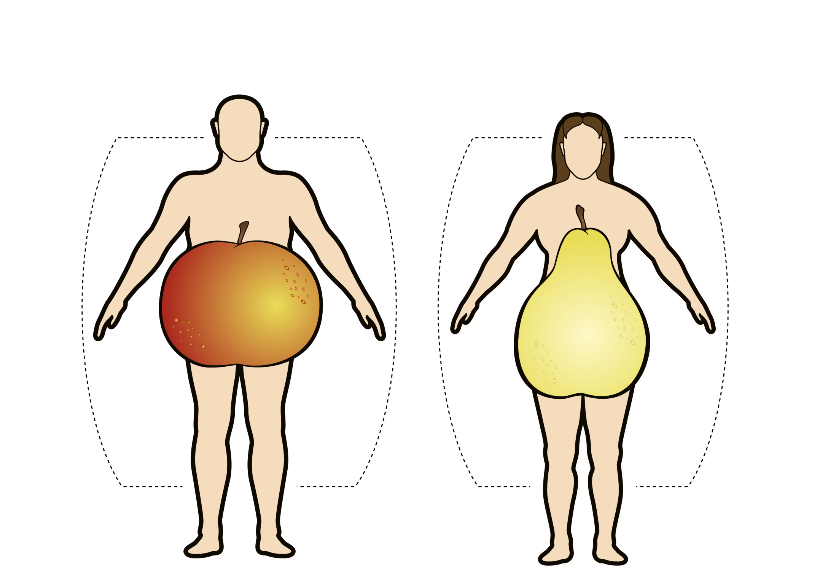
ADIPOSE TISSUE DISTRIBUTION IN MEN AND WOMEN
Android Obesity
Gynoid Obesity
Adapted from Vague J Presse Med 1947; 30: 339-40

Slide 48
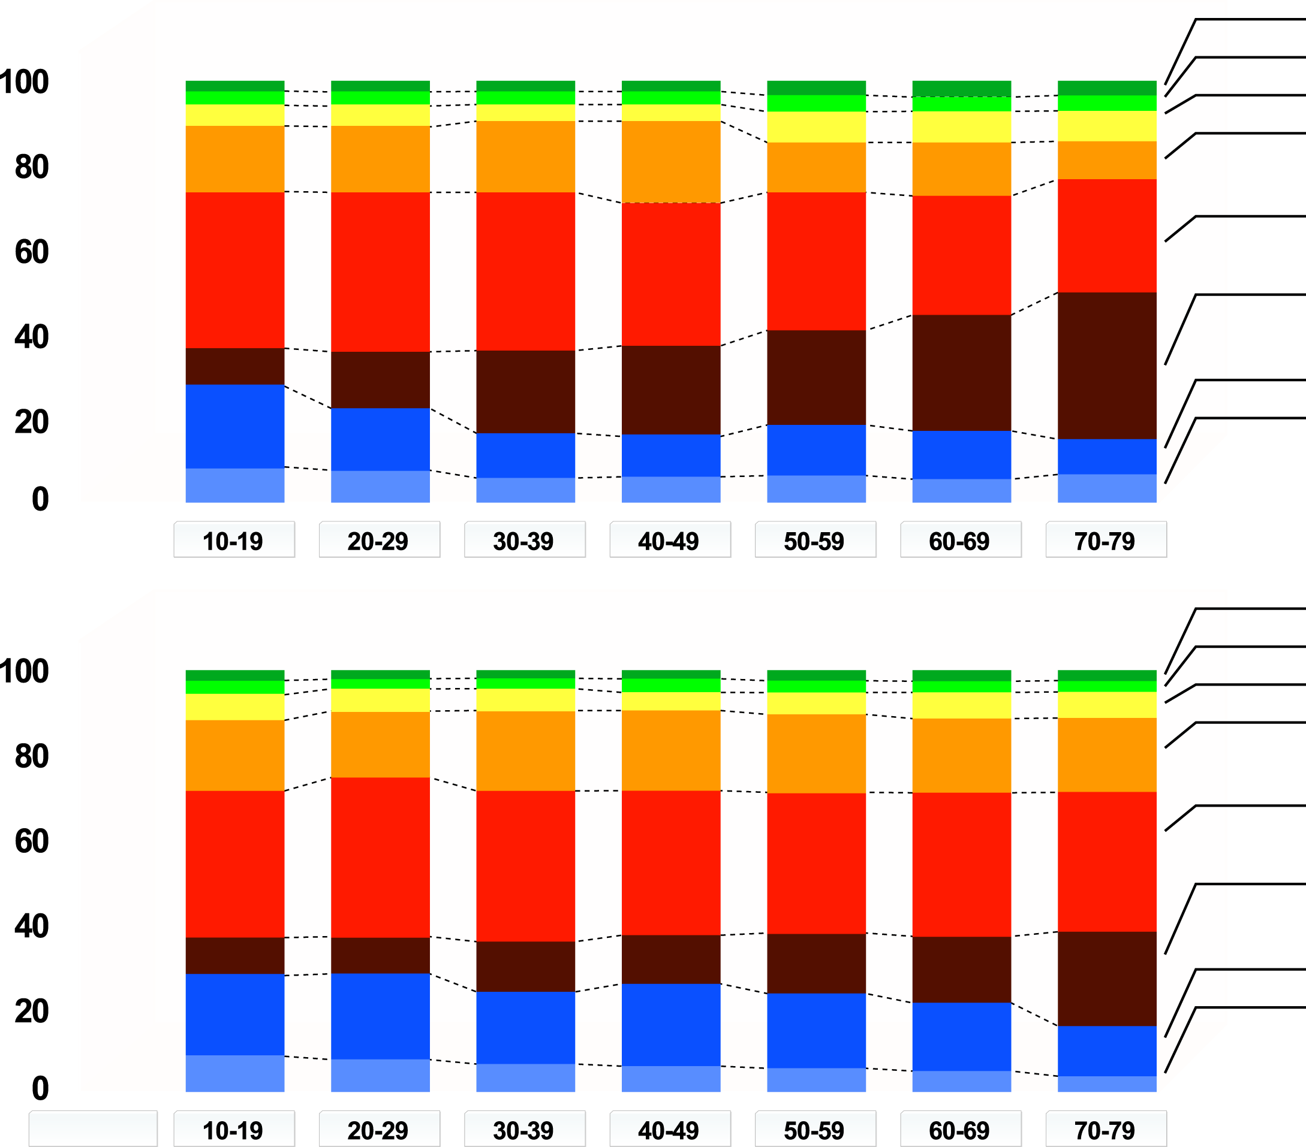
AGE-RELATED CHANGES IN INTRA-ABDOMINAL ADIPOSE TISSUE DISTRIBUTION IN (a) MEN AND (b) WOMEN
(a)
Head
Forearm
Upper arm
Chest
Abdomen
(subcutaneous)
Abdomen
(intra-abdominal)
Thigh
Calf
Age (years)
Relative segmental fat volume (%)
(b)
Head
Forearm
Upper arm
Chest
Abdomen
(subcutaneous)
Abdomen
(intra-abdominal)
Thigh
Calf
Age (years)
From Kotani K et al. Int J Obes 1994; 18: 207-12
Reproduced with permission

Slide 49
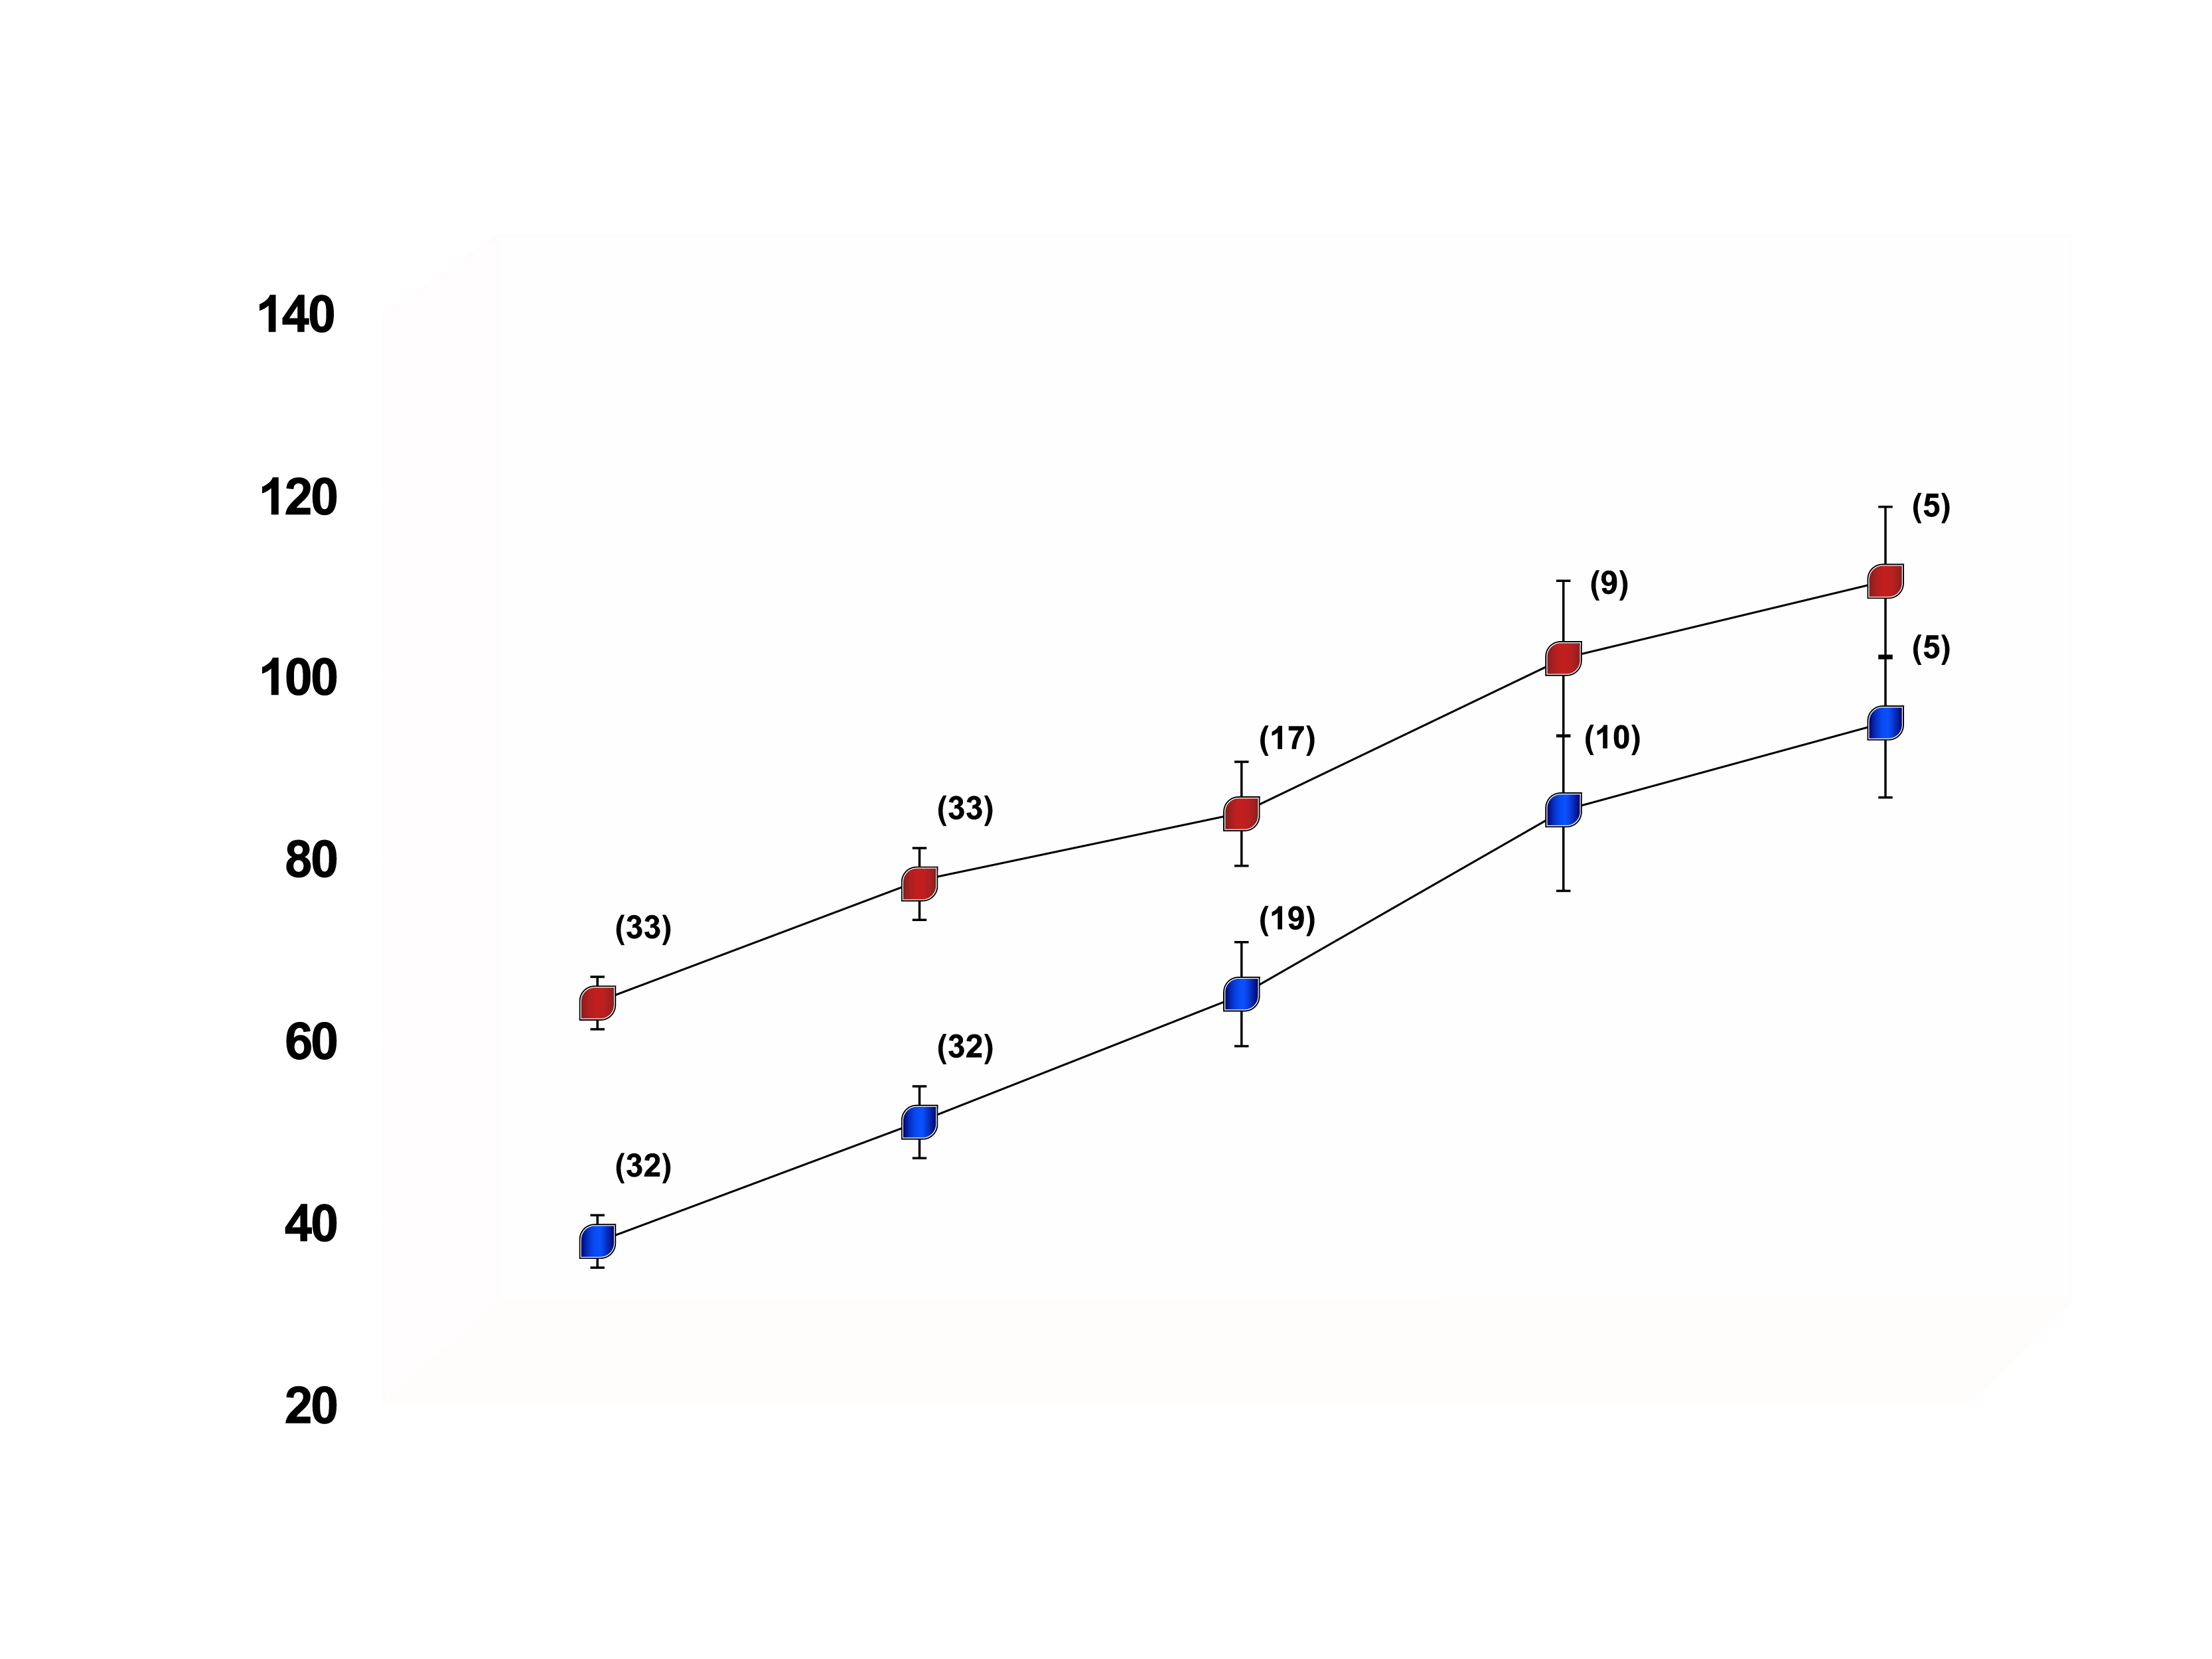
FOUR-YEAR CHANGES IN INTRA-ABDOMINAL ADIPOSE TISSUE IN WHITE VS. AFRICAN-AMERICAN WOMEN
White women
African-American
women
(n): Number of subjects
Intra-abdominal adipose tissue (cm²)
p<0.01 for time effect
p<0.001 for race effect
Baseline
Year 1
Year 2
Year 3
Year 4
From Lara-Castro C et al. Obes Res 2002; 10: 868-74
Reproduced with permission

Slide 50
SEVEN-YEAR CHANGES IN BMI (a), WAIST CIRCUMFERENCE (b) AND INTRA-ABDOMINAL ADIPOSE TISSUE (c) IN PRE-MENOPAUSAL WOMEN (N=32)
a) BMI (kg/m²)
b) Waist
circumference (cm)
c) Intra-abdominal
adipose tissue (cm²)
NS
p<0.05
p<0.01
31.8
93.0
30.5
134.5
88.9
102.7
Adapted from Lemieux S et al. Diabetes Care 1996; 19: 983-91

Slide 51
INCREASE IN INTRA-ABDOMINAL ADIPOSE TISSUE (AT) ACCUMULATION ASSOCIATED WITH MENOPAUSE
a) BMI (kg/m²)
b) Body fat mass (kg)
NS
NS
c) Subcutaneous AT (cm²)
d) Intra-abdominal AT (cm²)
NS
p=0.04
Adapted from Tchernof A et al. J Clin Endocrinol Metab 2004; 89: 3425·30

Slide 52
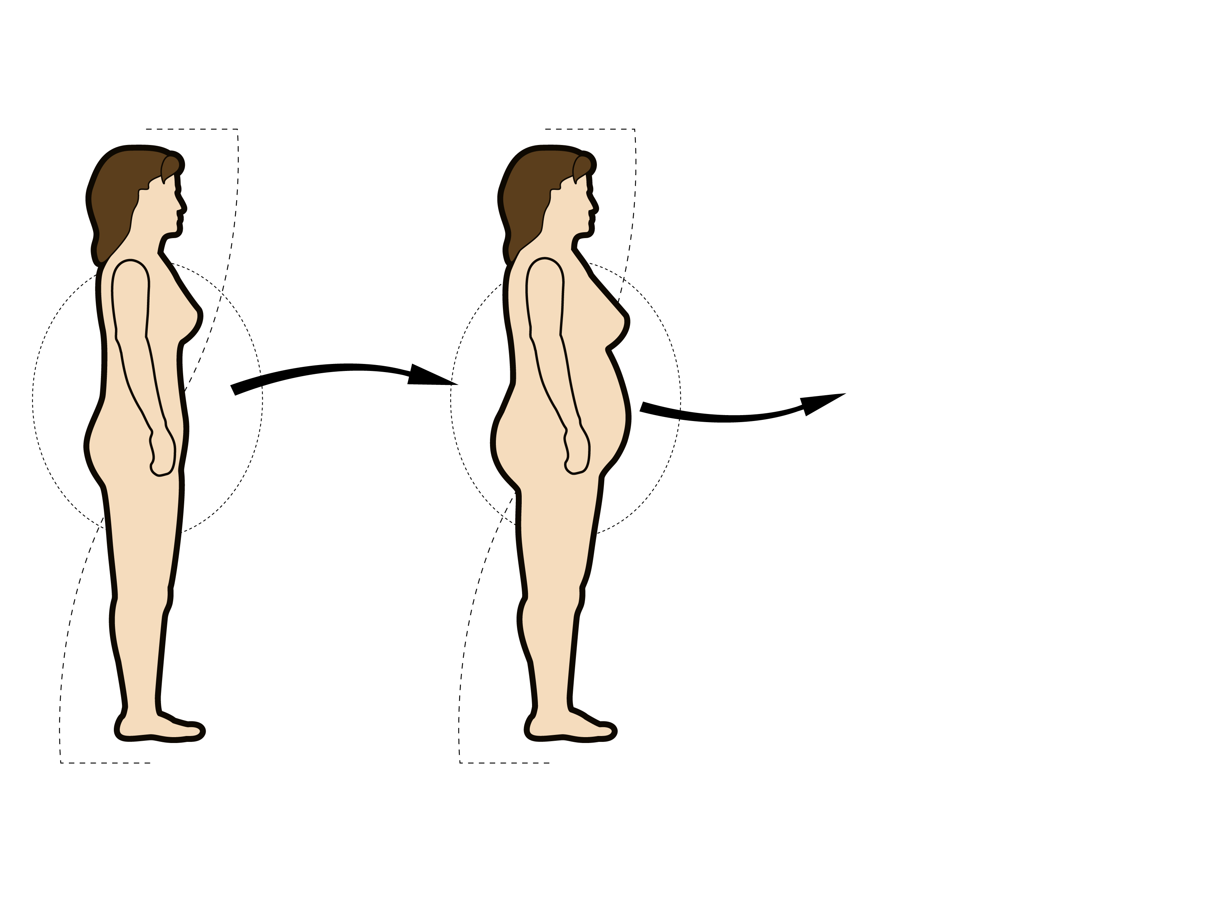
DEVELOPMENT OF AN ATHEROGENIC PROFILE ASSOCIATED WITH MENOPAUSE-RELATED GAIN IN INTRA-ABDOMINAL ADIPOSITY
Insulin resistance
Apolipoprotein B
Menopause
CHD risk
Triglycerides
HDL cholesterol
LDL size
Pre-menopausal women
Post-menopausal women

Slide 53
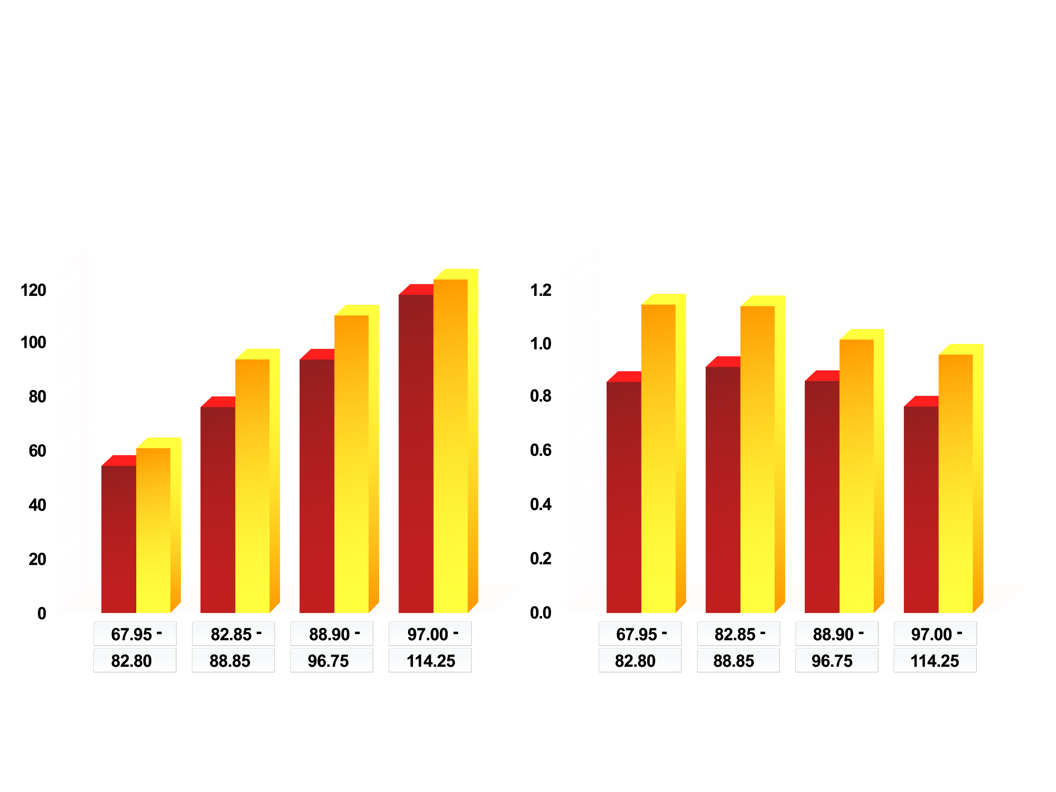
EVIDENCE FOR A GREATER RELATIVE ACCUMULATION OF INTRA-ABDOMINAL ADIPOSE TISSUE (AT) IN JAPANESE THAN IN CAUCASIAN AMERICANS
Caucasian (N=177)
Japanese (N=239)
Intra-abdominal adipose tissue (cm²)
Intra-abdominal / subcutaneous AT ratio
p<0.001
p<0.001
p=0.001
p<0.001
p=0.026
p=0.001
Waist girth quartiles (cm)
Waist girth quartiles (cm)
Adapted from Kadowaki T et al. Int J Obes 2006; 30: 1163-5

Slide 54
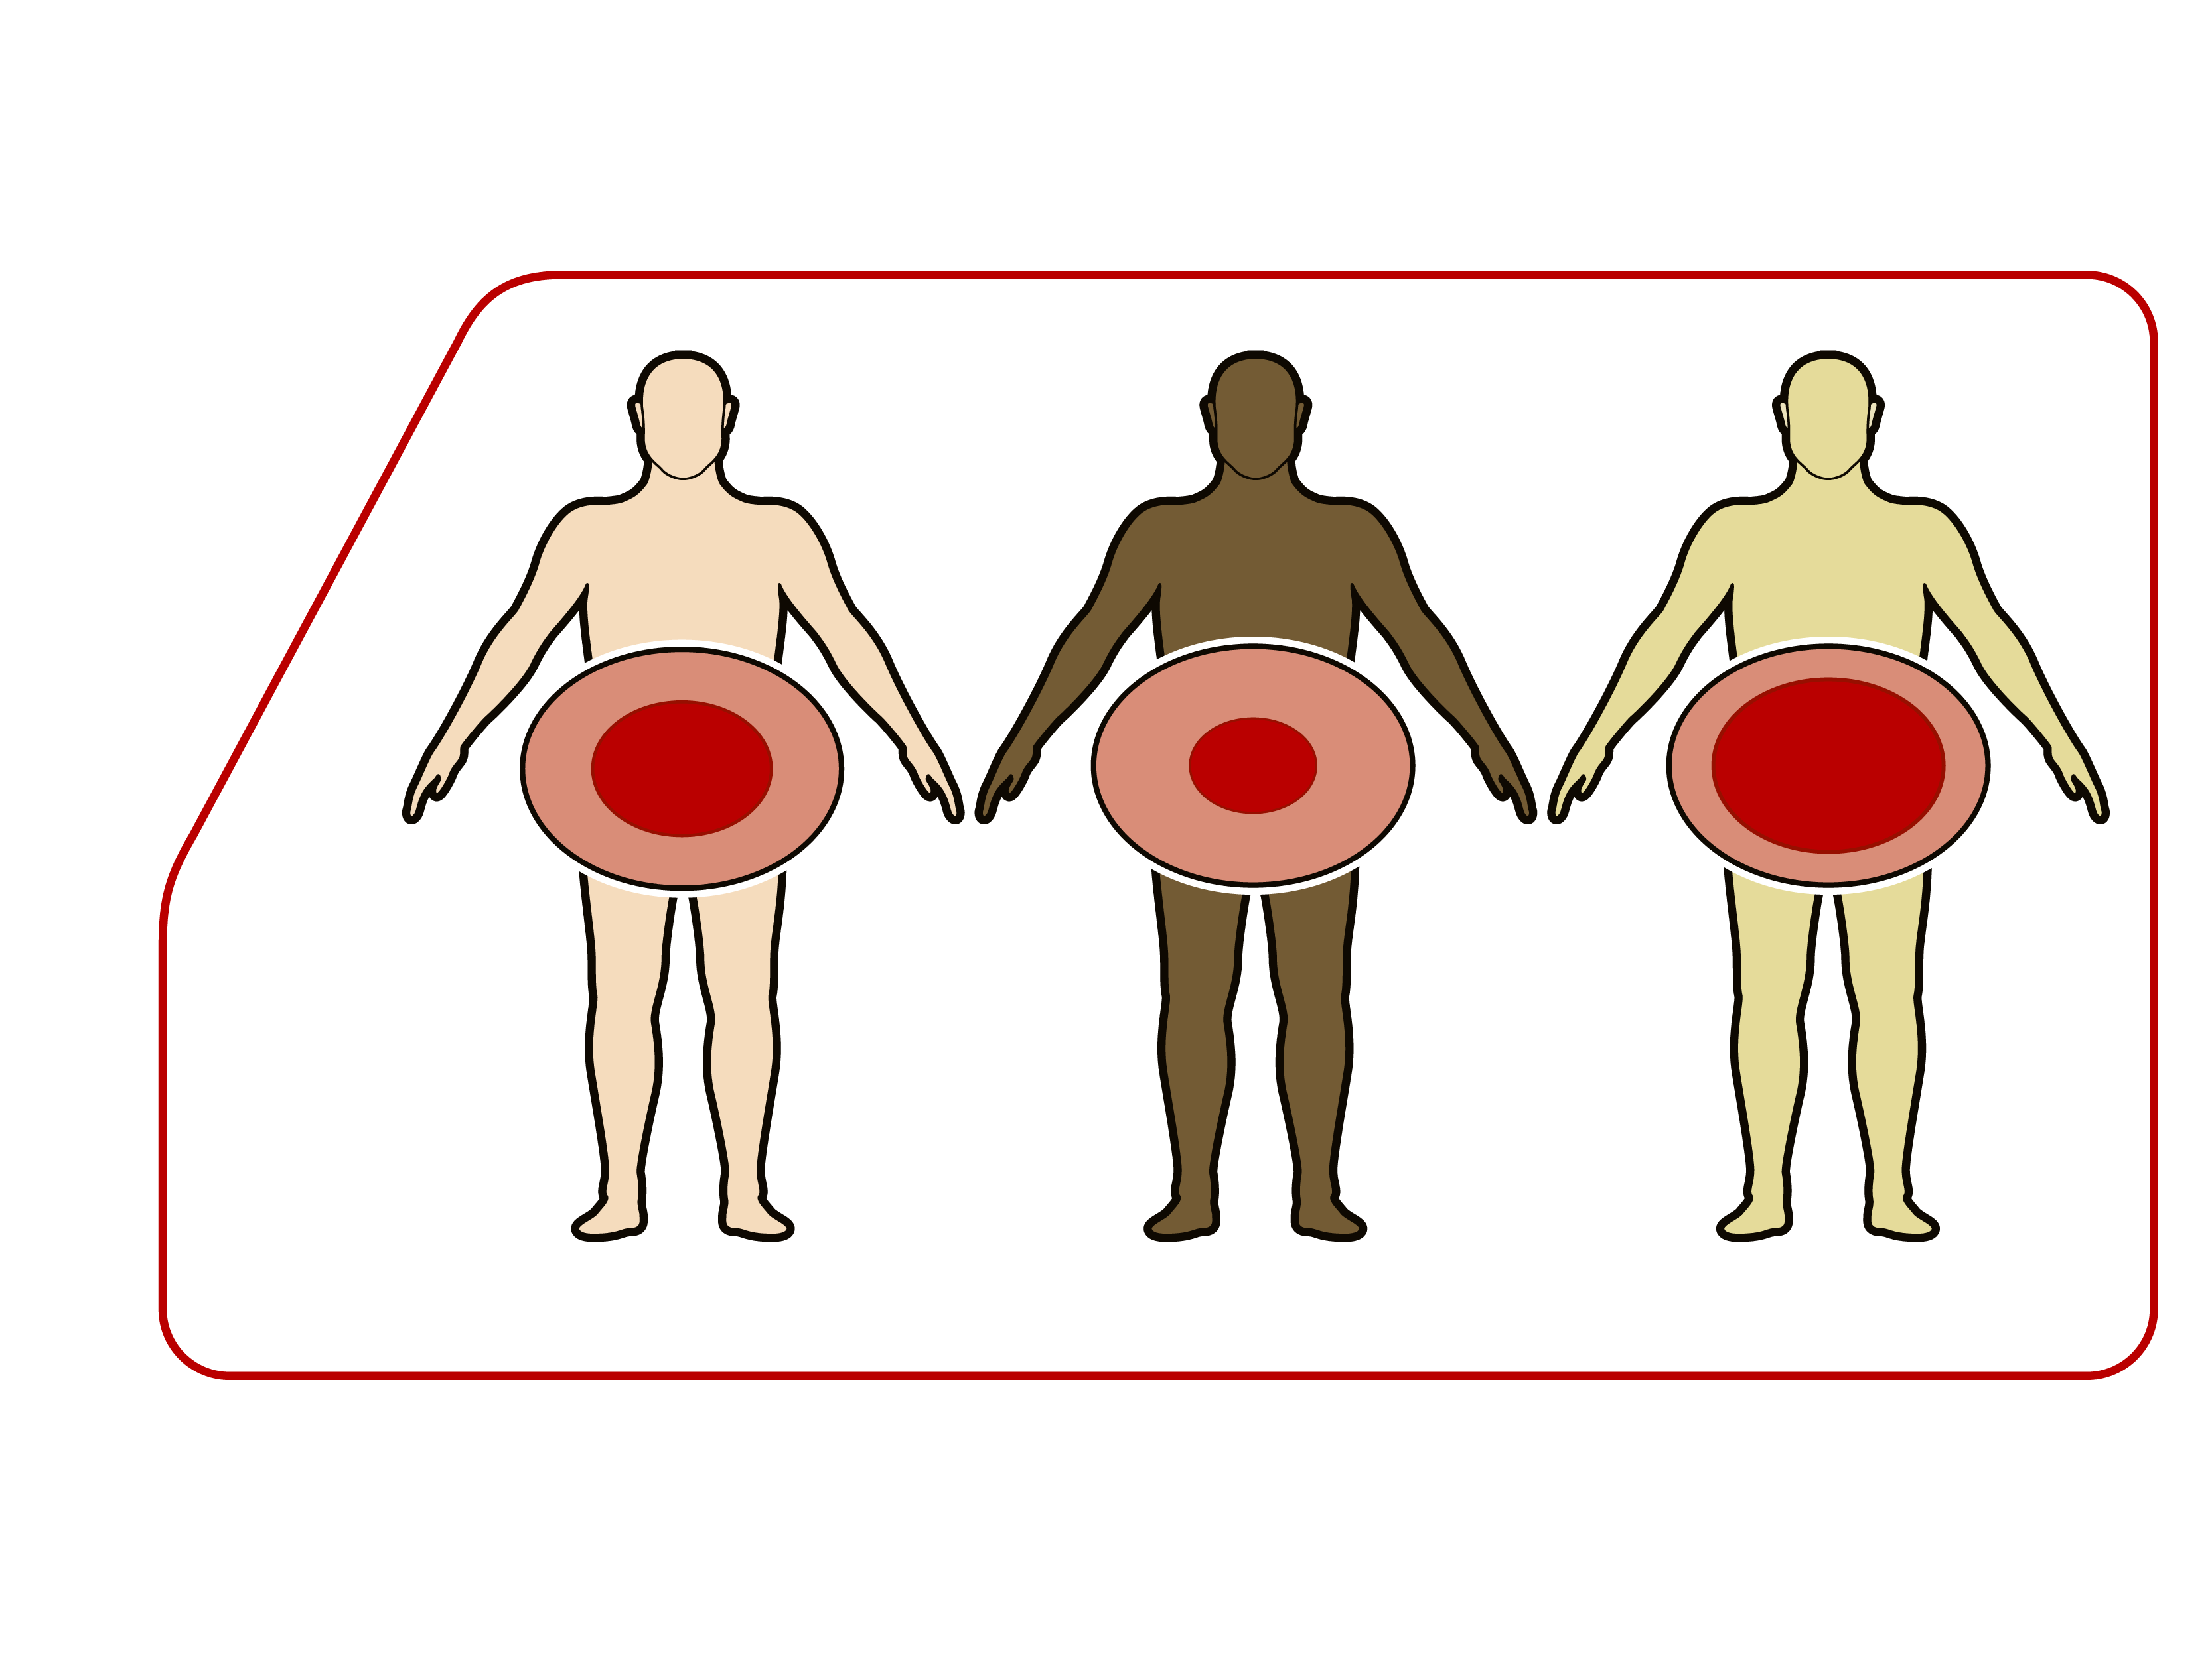
RELATIVE ACCUMULATION OF INTRA-ABDOMINAL VS. SUBCUTANEOUS DEPOT ACCORDING TO ETHNICITY
Intra-abdominal
depot
Subcutaneous
depot
Caucasians
Blacks
Asians

Slide 55
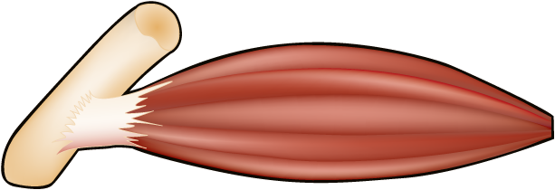
LIPID OVERFLOW HYPOTHESIS FOR THE PATHOGENESIS OF LIVER FAT
Caloric Intake
and/
or
Energy Expenditure
Positive Energy Balance
Lipid overflow into liver,
muscle or epicardium
Buffering of excess
energy in healthy
adipose tissue
Exhaustion of
buffering capacity of
adipose tissue
Metabolic Abnormalities

Slide 56
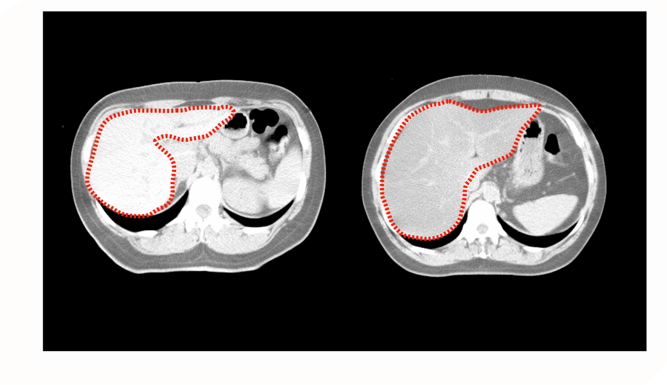
COMPUTED TOMOGRAPHY IMAGING OF A NORMAL AND FATTY LIVER
Normal liver
Fatty liver
CT Liver (CTL) = 79.44 HU
CT Liver (CTL) = 14.82 HU
The normal liver is free of lipid storage, denser and therefore has a higher Hounsfield unit (HU)
and appears bright in contrast. On the other hand, lipid infiltration as seen in the fatty liver
reduces the density of the liver tissue, thus the HU is lower and the image appears darker.

Slide 57
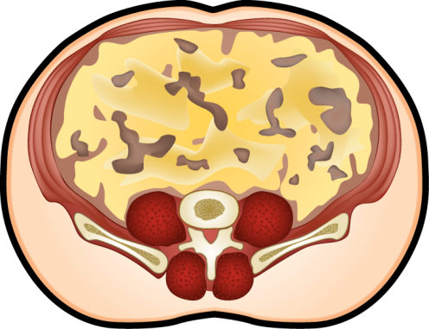
SIMPLIFIED MODEL OF THE "PORTAL" THEORY
FFA
FFA
Release of
free fatty acids (FFA) from
an expanded, and highly
active intra-abdominal
adipose tissue depot
Products released from the
intra-abdominal depot are
drained via the portal vein,
leading directly to
the liver
Increased exposure to FFA
leads to hepatic insulin
resistance, fat deposition,
lipotoxicity and metabolic
derangements

Slide 58
INDEPENDENT ASSOCIATIONS BETWEEN LIVER FAT, INTRA-ABDOMINAL FAT AND CARDIOMETABOLIC RISK
Increased liver fat
deposition
Positive
Energy
Balance
Cardiometabolic
Risk
?
Expanded intra-abdominal
fat depot

Slide 59
www.cardiometabolic-risk.org

