Slide 1
Metabolic Syndrome and Adipose Tissue
Yuji Matsuzawa, MD, PhD Director and Professor Emeritus
Osaka University, Sumitomo Hospital, Osaka, Japan

Slide 2
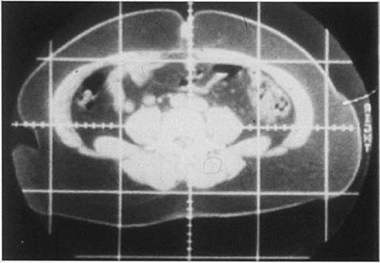
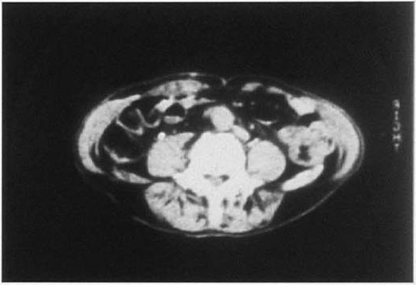
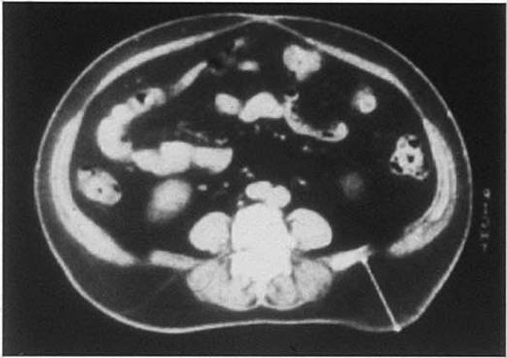
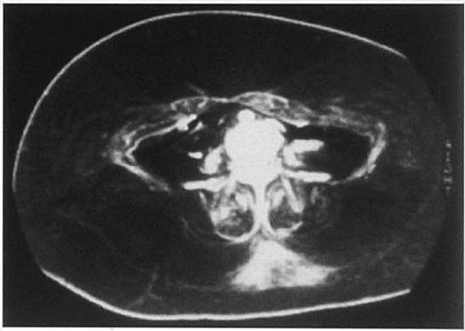
A Novel Technique for the Determination of Body Fat by Computed Tomography
From Tokunaga K et al. Int J Obes 1983; 7: 437-45
Reproduced with permission
Notes:
Fat distribution varies widely between the subcutaneous and intra-abdominal (visceral) cavity.

Slide 3
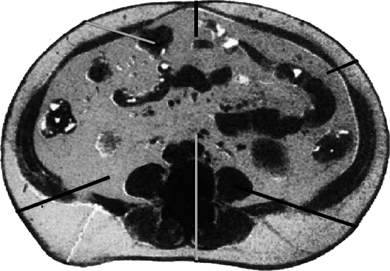
Visceral Fat Accumulation is an Important Determinant of Metabolic and Cardiovascular Disease
Type 2 Diabetes
Dyslipidemia
Insulin Resistance
Fujioka S et al.
Metabolism 1987; 36: 54-9
Left Ventricular
Dysfunction
Yamashita S et al. Diabetes Care 1996; 19: 287-91
Nakajima T et al.
Am J Cardiol 1989; 64: 369-73
Hypertension
Sleep Apnea Syndrome
Kanai H et al.
Hypertension 1990; 16: 484-90
Kanai H et al.
Hypertension 1996; 27: 125-9
Shinohara E et al.
J Intern Med 1997; 241: 11-8
Coronary Artery Disease
Nakamura T et al. Int J Obes Relat Metab Disord 1997; 21: 580-6
Nakamura T et al. Atherosclerosis 1994; 107: 239-46
Notes:
Visceral fat accumulation is a important determinant for metabolic and cardiovascular diseases.

Slide 4
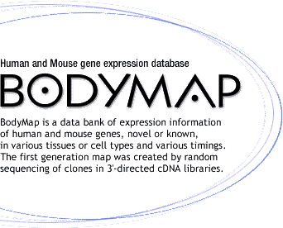
Gene Expression Profile of Human Adipose Tissue
30
Visceral
Fat
Growth factors
Cytokines
Complement factors
etc.
20
Frequency (%)
10
0
Ribosomal
proteins
Secretory
proteins
Cytoplasmic
proteins
Nuclear
proteins
Mitochondrial
proteins
Membrane
proteins
Cytoskeleton
proteins
Signal
transduction
Energy
production
0
10
Frequency (%)
20
Subcutaneous Fat
30
Adapted from Matsuzawa Y et al.
Arterioscler Thromb Vasc Biol 2004; 24: 29-33
Reproduced with permission
Notes:
Random sequence analysis of expressed genes in adipose tissue revealed that adipose tissue, especially intra-abdominal (visceral) adipose tissue, abundantly expresses the genes encoding bioactive substances such as growth factors, cytokines and complements.

Slide 5
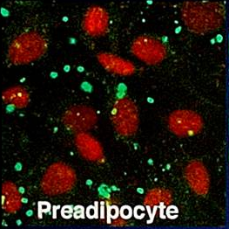
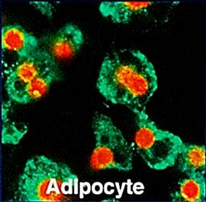
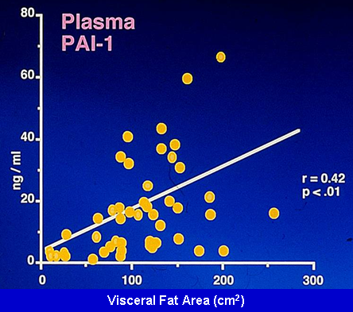
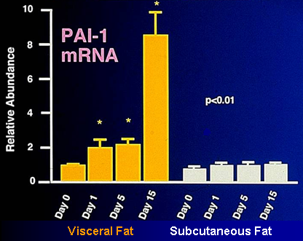
Enhanced Expression of PAI-1 in Visceral Fat
PAI-1: plasminogen activator inhibitor-1
From Shimomura I et al. Nat Med 1996; 2: 800-3
Reproduced with permission
Notes:
PAI-1 mRNA expression increases in step with intra-abdominal (visceral) fat in an obese animal model, and PAI-1 in human plasma correlate with visceral fat area.

Slide 6
Decreased Plasma Adiponectin in Visceral Obesity
μg/ml
ng/ml
20
Plasma adiponectin
80
Plasma PAI-1
15
60
10
40
5
20
0
0
0
100
200
300
0
100
200
300
Visceral Fat Area (cm²)
Visceral Fat Area (cm²)
PAI-1: plasminogen activator inhibitor-1
Adapted from Matsuzawa Y et al. Arterioscler Thromb Vasc Biol 2004; 24: 29-33
Notes:
Plasma adiponectin decreased with intra-abdominal (visceral) fat accumulation.

Slide 7
Adiponectin, an Independent Risk Factor of Coronary Artery Disease (CAD)
Case-Control Study (CAD prevalence)
Prospective Study
(myocardial infarction development)
2.1
1.0
1.0
Relative Risk
Relative Risk
0.7
Low
High
Low
High
Adapted from Kumada M et al.
Arterioscler Thromb Vasc Biol 2003; 23: 85-9
Adapted from Pischon T et al. JAMA 2004; 291: 1730-7
Plasma Adiponectin Levels
Notes:
Case-control study in Japanese subjects and prospective study among American subjects demonstrated that adiponectin had a preventive effect on cardiac events.

Slide 8
Effect of Adiponectin on Vascular Cells
Endothelial Cells
Smooth Muscle Cells
Macrophages
-
+
-
+
-
+
Adiponectin
Adiponectin
Adiponectin
NF-κB
p-ERK
Scavenger Receptor
PDGF-BB 10 ng/ml
VCAM-1 mRNA
Cell Proliferation
Cholesteryl Ester (%)
Adapted from Ouchi N et al.
Circulation 2000; 102: 1296-301
Adapted from Arita Y et al.
Circulation 2002; 105: 2893-8
Adapted from Ouchi N et al.
Circulation 2001; 103: 1057-63
VCAM-1: vascular cell adhesion molecule-1
NF-κB: nuclear transcription factor-κB
p-ERK: p-extracellular signal-related kinase
PDGF-BB: platelet-derived growth factor-BB
Notes:
Adiponectin inhibits the expression of VCAM-1 in endothelial cells by inhibiting NFkappaB activation. Adiponectin inhibit smooth muscle cell proliferation by inhibiting the p-ERK pathway. Adiponectin also inhibits cholesteryl ester accumulation by inhibiting scavenger receptor expression.

Slide 9
Mechanisms of Anti-atherogenicity of Adiponectin
Adipose
Tissue
TNF-α: tumor necrosis factor-α
TIMP-1: tissue inhibitor of metalloproteinase-1
HB-EGF: heparin-binding EGF-like growth factor
Adiponectin
Monocyte
Adhesion Molecules
Plaque
Rupture
Endothelial Cells
↑ TIMP-1
HB-EGF
TNF-α
Macrophages
v
Smooth Muscle Cells
v
v
Adapted from Matsuzawa Y et al.
Arterioscler Thromb Vasc Biol 2004; 24: 29-33
Notes:
The working hypothesis is that adiponectin has anti-atherogenic properties. Adiponectin protects against monocyte adhesion to endothelial cells by inhibiting expression of adhesion molecules. It also protects against smooth muscle cell proliferation by inhibiting platelet-derived growth factor (PDGF) activity, foam cell formation by inhibiting scavenger receptor expression in macrophages, and plaque rupture by inducing TIMP-1.

Slide 10
Type 2 Diabetes
Hypertension
Atherosclerosis
Cardiac Dysfunction
Non-alcoholic steatohepatitis
Cancers
Visceral Fat
Accumulation
Hypo-
adiponectinemia
Genetic Variations
Notes:
Hypoadiponectinemia may play a key role in the development of obesity-related diseases.

Slide 11
www.cardiometabolic-risk.org

