Slide 1
Metabolic Syndrome:
An Asian Perspective
Juliana C N Chan
MBChB, MD, FRCP
Professor of Medicine & Therapeutics
Director, Hong Kong Institute of Diabetes and Obesity
The Chinese University of Hong Kong
Hong Kong, China

Slide 2
General Outline
Obesity and metabolic syndrome – a public health perspective
Ethnicity, obesity and cardio-renal complications
Hormonal dysregulation in metabolic syndrome
Genetics of a multifaceted syndrome
Emerging role of mesenteric fat as the linking factor
Power of weight reduction on risk profiles
The way forward – from risk stratification to structured care

Slide 3



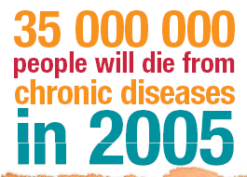
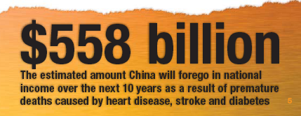


Economic and humanistic burden of chronic diseases
http://www.who.int/chp/chronic_disease_report/en/index.html

Slide 4








Common risk factors for chronic diseases
Deaths from 4 chronic diseases
Tobacco
Poor diet
Lack of exercice
3 risk factors
Deaths from all other causes
50% of all deaths
Cardiovascular
Chronic respiratory disease
Type 2 diabetes
Cancer
4 chronic diseases
Oxford Health Alliance 2003

Slide 5
Same Body Mass Index, Higher Risk for Diabetes in Asians
1970-1989
Obesity
1990-2005
Overweight
Prevalence of type 2 diabetes (%)
Prevalence of type 2 diabetes (%)
Multiplication factor for increased
prevalence of type 2 diabetes
Prevalence of type 2 diabetes (%)
Adapted from Yoon KH et al. Lancet 2006; 368: 1681-8
Reproduced with permission

Slide 6
% of Asian Population Having at Least One Risk Factor Stratified by Body Mass Index
Hong Kong
Philippines
Women
Men
Population with >1 risk factor (%)
Taiwan
Korea
Body mass index (kg/m²)
Adapted from Lancet WHO expert consultation 2004; 363: 157-63
Reproduced with permission

Slide 7
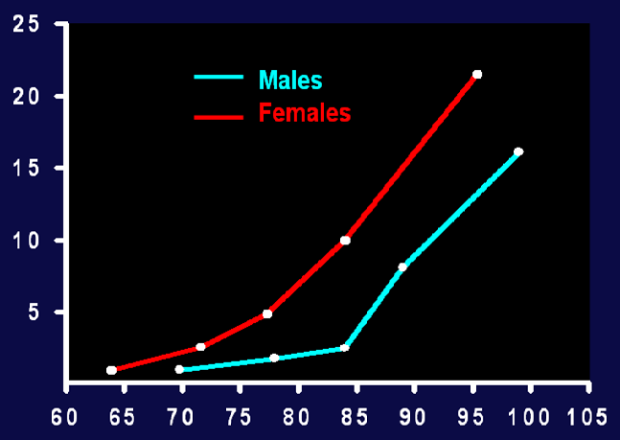
Obesity, Type 2 Diabetes, Hypertension or Dyslipidemia
Relative risk
0
Waist circumference (cm)
Adapted from Lee ZSK et al. Obes Rev 2002; 3: 173-82 and
Ko GT et al. Int J Obes Relat Metab Disord 1997; 21: 995-1001

Slide 8
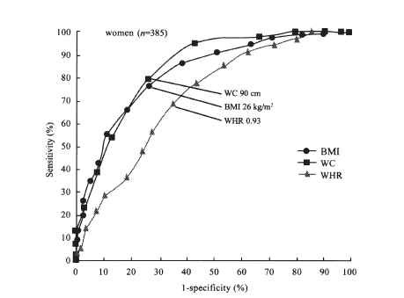
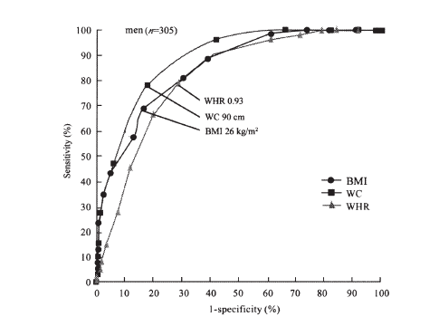

Prediction of Intra-abdominal (Visceral) Obesity from Body Mass Index, Waist Circumference and Waist-to-Hip Ratio in Chinese Adults
Receiver Operating Characteristics (ROC) curves analysis
ROC curves of BMI, WC and WHR for the determination of abdominal visceral obesity (≥ 100 cm²)
BMI: body mass index
WC: waist circumference
WHR: waist-to-hip ratio
From Jia WP et al. Biomed Environ Sci 2003; 16: 206-11
Reproduced with permission

Slide 9
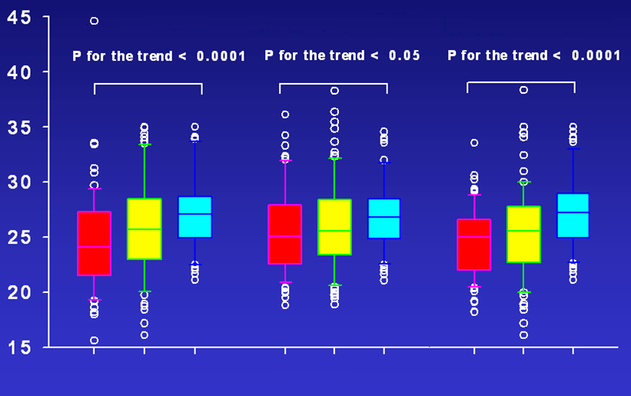
Comparisons of Body Mass Index Between Patients with Increasing Number of Morbidity Condition(s)
Type 2 diabetes
Hypertension
Dyslipidemia
Body mass index (kg/m²)
0
1
≥2
0
1
≥2
0
1
≥2
Number of morbidity condition(s)
Morbidity conditions included type 2 diabetes, hypertension, dyslipidemia and albuminuria
Adapted from Lee ZSK et al. Obes Rev 2002; 3: 173-82

Slide 10
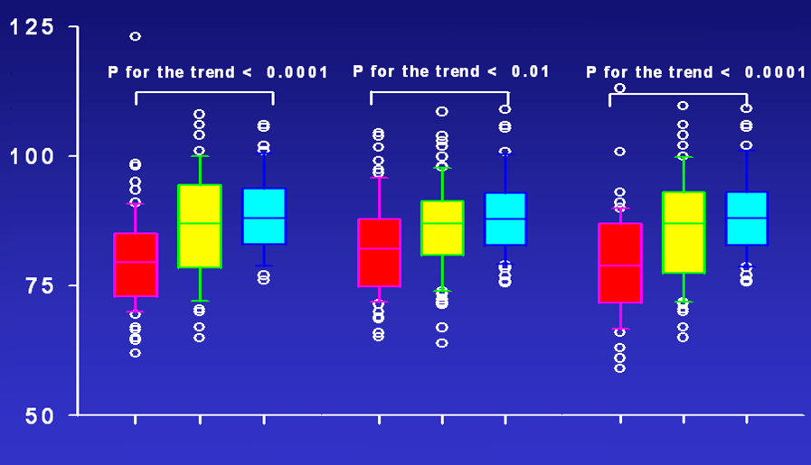
Comparisons of Waist Circumference Between Patients with Increasing Number of Morbidity Condition(s)
Type 2 diabetes
Hypertension
Dyslipidemia
Number of morbidity conditions
Waist circumference (cm)
0
1
≥2
0
1
≥2
0
1
≥2
Number of morbidity condition(s)
Morbidity conditions included type 2 diabetes, hypertension, dyslipidemia and albuminuria
Adapted from Lee ZSK et al. Obes Rev 2002; 3: 173-82

Slide 11
Additive Odds Ratios of Waist Circumference (WC) and Body Mass Index (BMI) on Cardiometabolic Risk Factors in 2,895 Hong Kong Chinese
BMI† | Quartile 1 | Quartile 2 | Quartile 3 | Quartile 4
Hypertension | 1.0 | 1.2 (0.8 to 1.8) | 1.5 (0.9 to 2.3) | 2.7 (1.6 to 4.6)
Dyslipidemia | 1.0 | 1.5 (1.1 to 2.0) | 1.8 (1.3 to 2.5) | 2.2 (1.4 to 3.2)
Diabetes | 1.0 | 1.3 (0.9 to 1.8) | 1.8 (1.2 to 2.5) | 2.0 (1.3 to 3.0)
WC‡ | Quartile 1 | Quartile 2 | Quartile 3 | Quartile 4
Hypertension | 1.0 | 1.1 (0.7 to 1.9) | 1.8 (1.1 to 2.9) | 1.8 (1.1 to 3.1)
Dyslipidemia | 1.0 | 1.8 (1.3 to 2.5) | 3.0 (2.1 to 4.4) | 3.6 (2.3 to 5.7)
Diabetes | 1.0 | 1.1 (0.8 to 1.6) | 2.2 (1.5 to 3.3) | 3.6 (2.2 to 5.7)
Obesity types* | Nonobese | BMI obese alone | Waist obese alone | BMI and waist obese
Hypertension | 1.0 | 1.7 (1.2 to 2.5) | 1.3 (0.7 to 2.3) | 4.8 (3.7 to 6.2)
Dyslipidemia | 1.0 | 2.4 (1.8 to 3.0) | 3.2 (2.1 to 5.1) | 3.1 (2.5 to 3.8)
Diabetes | 1.0 | 2.2 (1.7 to 2.9) | 3.2 (2.0 to 5.2) | 3.9 (3.1 to 4.8)
Quartile ranges for BMI are: (1) 14.78-20.56, (2) 20.57-22.10, (3) 22.11-23.52, and (4) 23.53-25.00 kg/m² Quartile ranges for WC are: (1) 49.8-68.0, (2) 68.3-73.1, (3) 73.3-78.3, and (4) 78.5-89.8 cm
† Adjusted for WC
‡ Adjusted for BMI
* Adjusted for gender
Adapted from Thomas GN et al. Obes Res 2004; 12: 1805-13
Reprinted by permission from Macmillan Publishers Ltd, © 2004

Slide 12
Metabolic Syndrome – A Multifaceted Syndrome
Inflammatory markers
High
blood
pressure
Heart disease
Stroke
Kidney failure
Depression?
Cancer?
Urine
protein
Abnormal
lipid levels
High
blood glucose
Obesity

Slide 13
Predictors for Diabetes in US Japanese Men
Variables | OR (95% CI) | P value
Age | 1.4 (1.0 – 2.0) | 0.065
Female gender | 1.8 (0.8 – 4.2) | 0.176
IGT at baseline | 4.5 (2.3 – 9.0) | <0.001
Family history of diabetes | 1.9 (1.0 – 3.3) | 0.040
Intra-abdominal (visceral) fat | 1.6 (1.1 – 2.4) | 0.023
Body mass index | 0.8 (0.5 – 1.2) | 0.251
Fasting C-peptide | 1.4 (1.1 – 1.8) | 0.016
Incremental insulin response | 0.5 (0.3 – 0.9) | 0.022
IGT: impaired glucose tolerance
OR: odds ratio
Adapted from Boyko EJ et al. Diabetes Care 2000; 23: 465-71

Slide 14
Intra-abdominal (Visceral) Fat and Coronary Heart Disease (CHD) in Japanese
 | Incident CHD status
Baseline variables | CHD absent | CHD present | P value | P value*
n | 125 | 50 | _ | _
Weight (kg) | 69.8 ± 0.9 | 71.6 ± 1.2 | 0.25 | 0.24
Body mass index (kg/m²) | 25.4 ± 0.3 | 25.8 ± 0.4 | 0.37 | 0.34
Computed tomography fat area (cm²)
Total | 417.1 ± 14.0 | 465.9 ± 20.8 | 0.063 | 0.052
Chest subcutaneous | 92.7 ± 4.1 | 104.0 ± 5.6 | 0.13 | 0.14
Abdomen subcutaneous | 129.3 ± 5.7 | 146 ± 7.9 | 0.11 | 0.068
Intra-abdominal (visceral) | 108.9 ± 4.7 | 133.0 ± 7.6 | 0.0075 | 0.016
Left thigh subcutaneous | 43.1 ± 1.5 | 40.8 ± 2.1 | 0.39 | 0.72
*Adjusted for baseline diabetes
Adapted from Fujimoto WY et al. Diabetes Care 1999; 22: 1808-12

Slide 15
Predictors for Coronary Heart Disease in US Japanese Men
Variables (1 SD) | OR (95% CI) | P value
Intra-abdominal (visceral) fat area | 1.7 (1.11-2.23) | 0.009
Fasting glucose | 1.91 (1.36-2.68) | 0.0002
2-hour glucose | 1.73 (1.25-2.4) | 0.008
HDL cholesterol | 0.60 (0.44-0.88) | 0.0086
HDL₂ cholesterol | 0.65 (0.44-0.87) | 0.03
HDL₃ cholesterol | 0.65 (0.46-0.94) | 0.018
Fasting triglycerides | 1.56 (1.09-2.13) | 0.013
Systolic blood pressure | 1.83 (1.28-2.6) | 0.0007
Diastolic blood pressure | 2.05 (1.4-3.1) | 0.002
After adjustment for age, sex and body mass index
Adapted from Fujimoto WY et al. Diabetes Care 1999; 22: 1808-12

Slide 16
Metabolic Syndrome and Chronic Kidney Disease
Adapted from Chen J et al. Ann Intern Med 2004; 140: 167-74

Slide 17
Glomerular Filtration Rate (GFR) Predicts All-cause Mortality, Cardiovascular and Renal Endpoints in 4,421 Chinese Type 2 Diabetic Patients (3.5-year Follow-up)
Adapted from So WY et al. Diabetes Care 2006; 29: 2046-52

Slide 18
Metabolic Syndrome - A Unifying Hypothesis
Family history
(Genetics or
shared environment)
Psychosocial
stress
Aging
↓GH and IGF-1
↓Testosterone (M)
↑Testosterone (F)
↑Cortisol
Visceral fat
Activated immunity
Adipocytokines & FFA
Insulin resistance
↑TG and
↓HDL cholesterol
↑SNS
↓ß cell function
↑RAAS
↑BP
↑BG
CVS and renal complications
Adapted from Björntorp P. Obes Res 1993; 1: 206-22 and Chan JCN et al. Diabetes Care 1995; 18: 1013-6. Luk A and Chan JCN Diabetes Res Clin Pract 2008: 82 Suppl 1:S15-20
Notes:
BP: blood pressure
BG: blood glucose
CVS: cardiovascular system
FFA: free fatty acids
GH: growth hormone
IGF-1: insulin-like growth factor-1
RAAS: renin-angiotensin-aldosterone system
SNS: sympathetic nervous system
TG: triglycerides

Slide 19
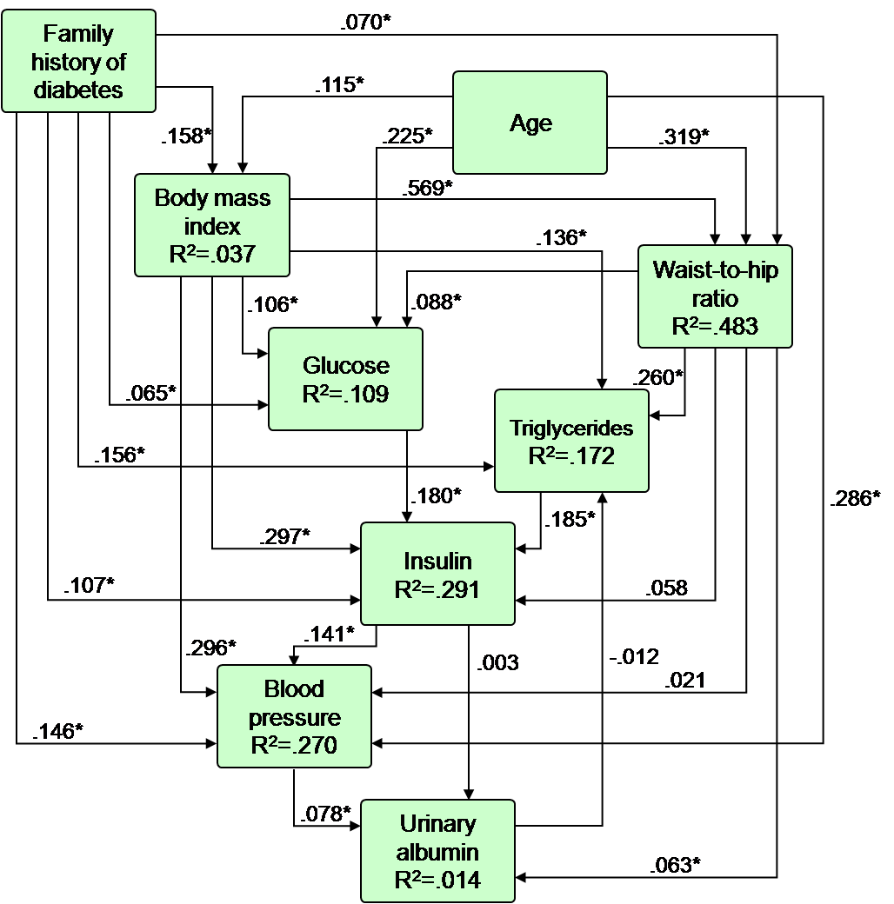
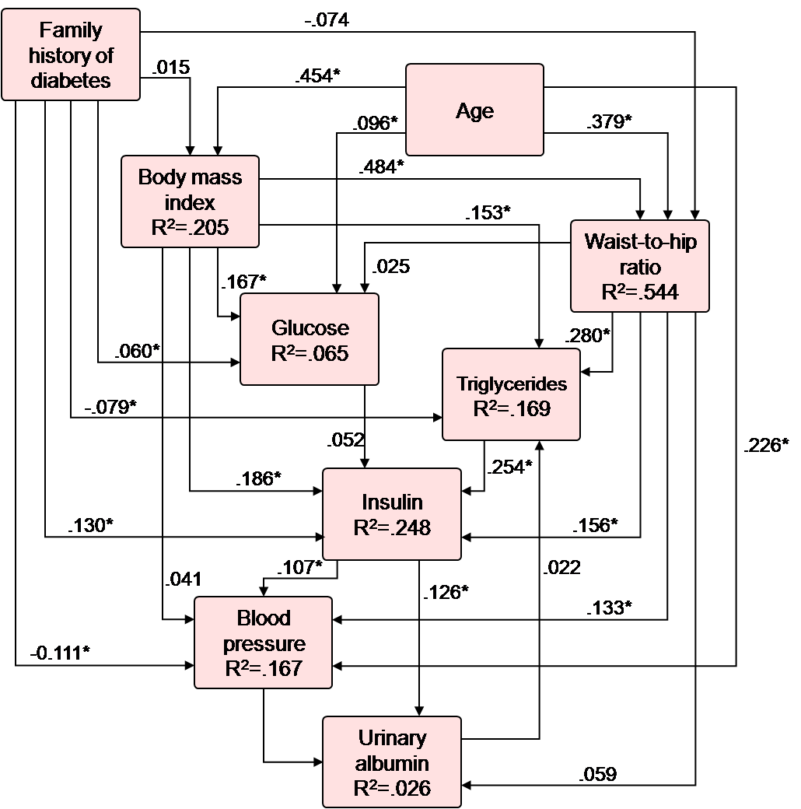
Age, Family History of Diabetes and Obesity are Major Explanatory Variables of Metabolic Syndrome in Hong Kong Chinese
Male model
Female model
*p<0.05
Copyright © 1999 American Diabetes Association
Adapted from Diabetes Care ®, Vol. 19, 1996; 953-9
Reprinted with permission from The American Diabetes Association

Slide 20
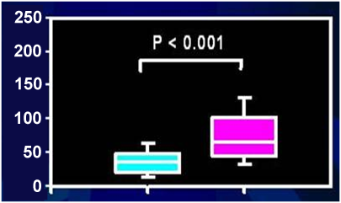
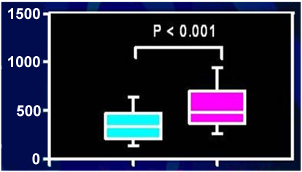
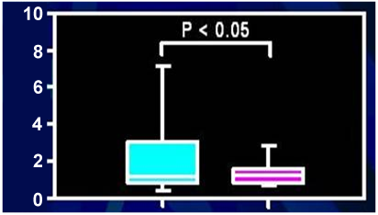
Growth Hormone (GH) and Cortisol in Young Patients with Type 2 Diabetes
Controls (n=104)
Type 2 diabetics (n=90)
Plasma insulin
(pmol/l)
Plasma cortisol
(nmol/l)
Plasma GH
(ng/ml)
Copyright © 1999 American Diabetes Association
Adapted from Diabetes Care ®, Vol. 22, 1999; 1450-7
Reprinted with permission from The American Diabetes Association

Slide 21
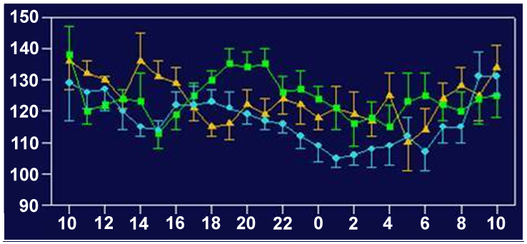
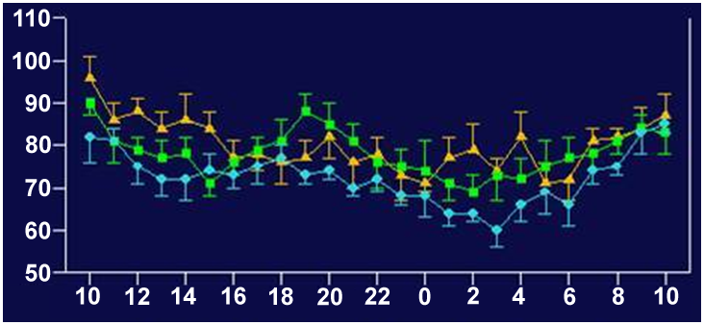
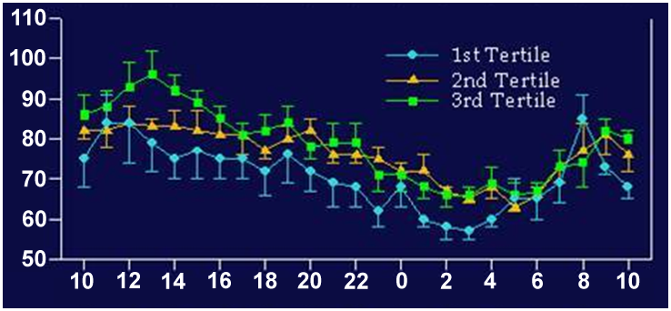
Intra-abdominal (Visceral) Fat Area Tertiles and 24-hour Ambulatory Blood Pressure and Pulse Rate in Chinese Type 2 Diabetic Patients
Mean SBP (mmHg)
Clock time (hours)
Mean DBP (mmHg)
Clock time (hours)
Mean HR (bpm)
DBP: diastolic blood pressure
HR: heart rate
SBP: systolic blood pressure
Clock time (hours)
Copyright © 1997 American Diabetes Association
Adapted from Diabetes Care ®, Vol. 20, 1997; 1854-8
Reprinted with permission from The American Diabetes Association

Slide 22
Central Obesity, Insulin Cortisol, Growth Hormone and 24-hour Urinary Catecholamines in 100 Young Type 2 Diabetic Patients and 90 Control Subjects
Insulin*
p for the trend <0.001
pmol/l
Noradrenaline*
p for the trend <0.01
Growth hormone
p for the trend <0.05
nmol/day
ng/ml
Adrenaline*
p for the trend <0.001
Cortisol*
p for the trend <0.01
nmol/l
Quartile 1
58-67
Quartile 2
68-74
Quartile 3
75-84
Quartile 4
85-123
Waist circumference (cm)
Quartile 1
58-67
Quartile 2
68-74
Quartile 3
75-84
Quartile 4
85-123
Waist circumference (cm)
Dates are expressed as * geometric means and ** means
Adapted from Lee ZSK et al. Diabetes Care 1999; 22: 1450-7 and Lee ZSK et al. Metabolism 2001; 50: 135-43

Slide 23
Insulin-like Growth Factor-1 (IGF-1), High Sensitivity C-Reactive Protein (hs-CRP), Testosterone and Metabolic Syndrome in Chinese Men
A
Subjects with metabolic syndrome (%)
B
Total testosterone
IGF-1
Subjects with metabolic syndrome (%)
Total testosterone
hs-CRP
Adapted from Tong PCY et al. J Clin Endocrinol Metab 2005; 90: 6418-23
Reproduced with permission
Copyright 2005, The Endocrine Society

Slide 24
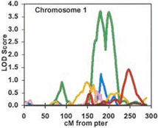
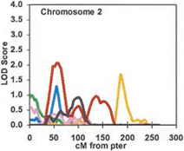
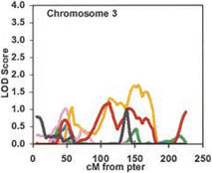
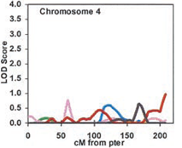
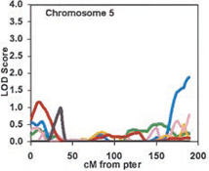
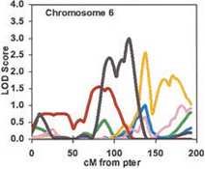
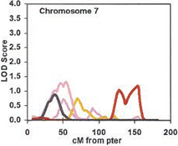
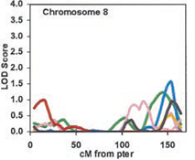
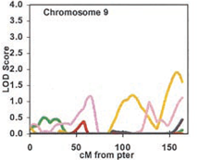
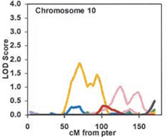
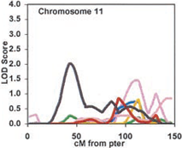
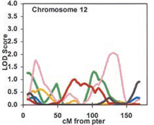
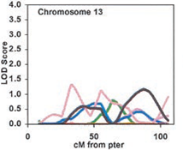
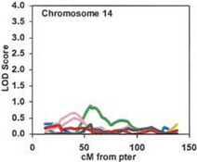
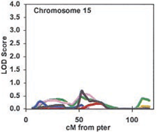
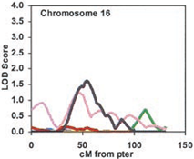
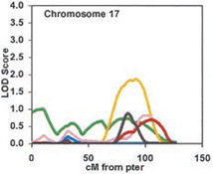
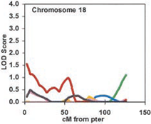
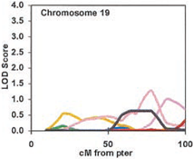
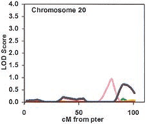
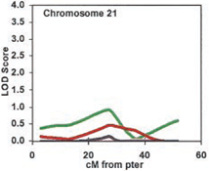
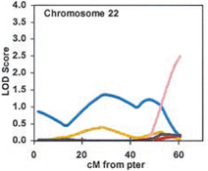
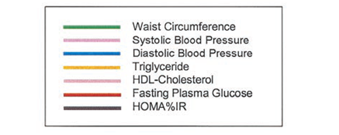
Multipoint Linkage Analyses for Metabolic Syndrome-related Quantitative Traits in 178 Families
The horizontal axis is cM from p-terminus
Copyright © 2004 American Diabetes Association
Adapted from Diabetes®, Vol. 53, 2004; 2676-83
Reprinted with permission from The American Diabetes Association

Slide 25
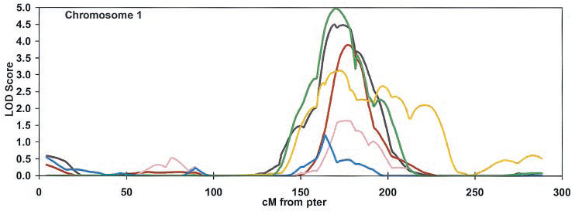
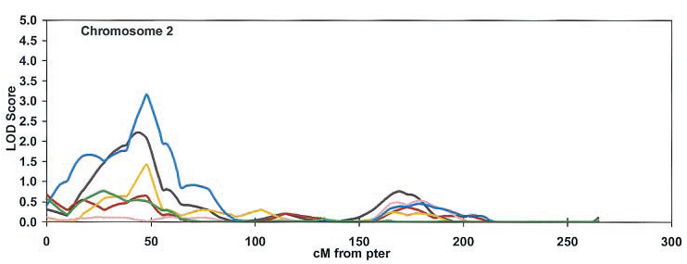
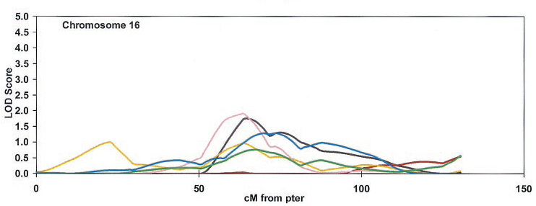

Multipoint Linkage Analyses on Chromosomes 1, 2 and 16 for Metabolic Syndrome and its Component in 53 Families
Major gene(s) for metabolic syndrome in chromosome 1q
The number of affected relative pairs included in each analysis is indicated in parentheses
The horizontal axis is cM from p-terminus
Copyright © 2004 American Diabetes Association
Adapted from Diabetes®, Vol. 53, 2004; 2676-83
Reprinted with permission from The American Diabetes Association

Slide 26
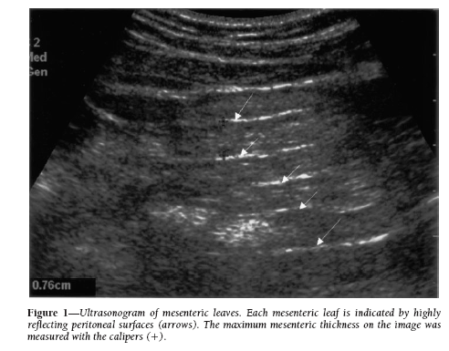
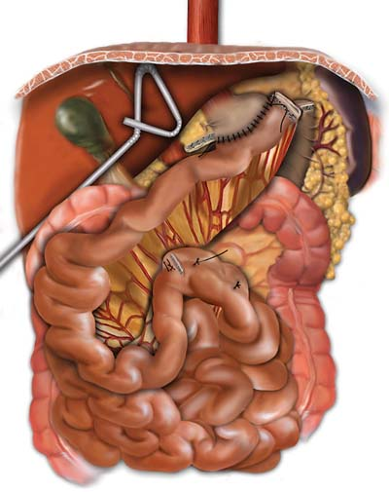
Are All Fat Depots the Same?
Figure - Ultrasonogram of mesenteric leaves. Each mesenteric leaf is indicated by highly reflecting peritoneal surfaces (arrows). The maximum mesenteric thickness on the image was measured with the calipers (+).
Correlation between intra-abdominal (visceral) fat volume and mesenteric fat = 0.8
From Liu KH et al. Int J Obes Relat Metab Disord 2003; 27: 1267-73
Reproduced with permission

Slide 27
Predictors of Fatty Liver in Chinese Men
Variables | Odds ratio (95% CI) | P value
Model 1
Mesenteric fat thickness | 1.50 (1.27-1.77) | <0.001
Triglycerides | 2.64 (1.40-4.99) | 0.003
HOMA | 1.06 (1.00-1.12) | 0.036
Model 2
Mesenteric fat thickness | 1.34 (1.12-1.60) | 0.002
Triglycerides | 2.35 (1.19-4.63) | 0.013
Body mass index | 1.51 (1.26-1.82) | <0.001
Adapted from Liu KH et al. Int J Obes Relat Metab Disord 2006; 30: 787-93

Slide 28
Multivariate Logistic Regression Analysis to Identify Independent Determinant(s) of the Metabolic Syndrome in 290 Chinese Apparently Healthy Subjects
 | β±SE | P value | Odds ratio (95% Cl)
Mesenteric fat thickness | 0.30 ± 0.11 | 0.004 | 1.35 (1.10-1.66)
Preperitoneal fat thickness | -0.058 ± 0.07 | 0.41 | 0.94 (0.82-1.08)
Subcutaneous fat thickness | 0.01 ± 0.034 | 0.77 | 1.01 (0.95-1.08)
HOMA-IR | 0.33 ± 0.17 | 0.059 | 1.05 (1.00-1.10)
Sex | 0.088 ± 0.61 | 0.885 | 1.09 (0.28-3.02)
Age | 0.01 ± 0.034 | 0.775 | 1.01 (0.94-1.08)
Using receiver-operating characteristic curve analysis, the cutoff value of 10 mm of mesenteric fat thickness had 70% sensitivity and 75% specificity to predict metabolic syndrome
β: regression coefficient
SE: standard error
Adapted from Liu KH et al. Diabetes Care 2006; 29: 379-84

Slide 29
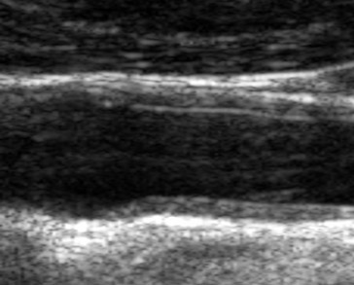
Mesenteric Fat Thickness and Carotid Intima-Media Thickness (IMT)
From Liu KH et al. Atherosclerosis 2005; 179:299-304
Reproduced with permission
Mesenteric fat≥10 mm
Mesenteric fat<10 mm
Adapted from Liu KH et al. Diabetes Care 2006; 29: 379-84

Slide 30
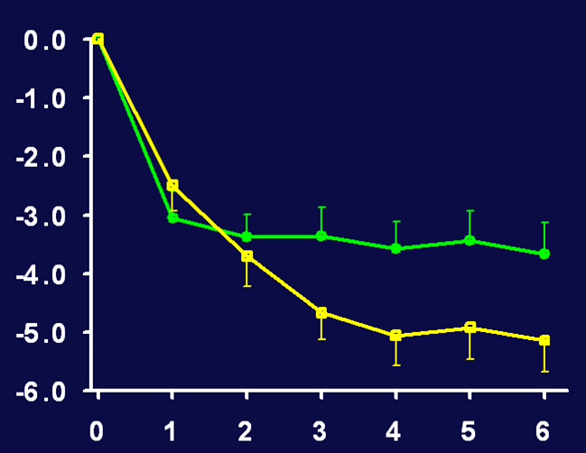

Structured Weight Management Program and Waist Circumference
Obese patients with type 2 diabetes
Obese patients without diabetes
% Change in waist circumference
Months of anti-obesity drug
Adapted from Tong PCY et al. Arch Intern Med 2002; 162: 2428-35
Reproduced with permission
Copyright © 2002, American Medical Association. All rights reserved.

Slide 31
Insulin Resistance Index (HOMA-IR) Between Baseline and End of 6-month Weight Management Program
Obese patients with type 2 diabetes
Obese patients without diabetes
125
p=0.026
p=0.006
100
75
- 11.7 %
HOMA-IR
50
- 19.5 %
25
0
Baseline
Month 6
Baseline
Month 6
Adapted from Tong PCY et al. Arch Intern Med 2002; 162: 2428-35

Slide 32
Change in Risk Factors after 6 Months of Weight Management Program in Hong Kong Chinese
BMI
WC
Body fat
FPG
HbA1c
TG
SBP
FPI
% change
BMI: body mass index
FPG: fasting plasma glucose
FPI: fasting plasma insulin
HbA1c: glycosylated hemoglobin
SBP: systolic blood pressure
TG: triglycerides
WC: waist circumference
Adapted from Tong PCY et al. Arch Intern Med 2002; 162: 2428-35

Slide 33
A Holistic View of Obesity and Diabetes
Genes
Environment
Psycho-socio-cognitive-behavioral changes
e.g. overeating, physical withdrawal, slow learning,
depression, socioeconomical deprivation…
Disease state
Adaptation through education
Improved clinical outcomes

Slide 34
Treat to Target and Stay on Target
Obese subjects
(30% of population)
Diabetic patients
(10% of population)
Risk stratification program
Weight management
program
(lifestyle ± medication)
Diabetes comprehensive
care program
(self care ± medication)

Slide 35
Conclusion
Obesity, diabetes and metabolic syndrome are running rampant in Asia
Asians develop cardiometabolic risk factors at a considerably lower body mass index and waist circumference values
Obesity is a major predictor for cardio-renal complications in Asian population
Genetics, age and stress-related hormonal changes causing obesity may be particularly relevant to Asian populations
Risk stratification and structured program reduce obesity and associated risk factors in Chinese population

Slide 36
www.cardiometabolic-risk.org

