Slide 1
Impact of Obesity on Cardiometabolic Risk: Will We Lose the Battle?
Richard Nesto, MD, FACC, FAHA
Chair, Department of Cardiovascular Medicine Lahey Clinic Medical Center, Burlington, MA
Associate Professor of Medicine Harvard Medical School, Boston, MA

Slide 2
Effect of Risk Factors and Treatments on Coronary Heart Disease (CHD) Mortality
CHD deaths prevented or postponed by risk factor changes and treatments in England and Wales, 1981 to 2000
10,000
e.g. diabetes, obesity
Risk factors: worse 13%
0
–10,000
Risk factors: better 58%
e.g. smoking,
cholesterol, blood pressure
–20,000
Deaths prevented or postponed in 2000
–30,000
Treatments 42%
–40,000
68,230 fewer deaths in 2000
e.g. secondary prevention,
heart failure treatments
–50,000
2,888 more deaths due to diabetes
2,662 more deaths due to physical inactivity
2,097 more deaths due to obesity
–60,000
–70,000
1981
Year
2000
Adapted from Unal B et al. Circulation 2004; 109: 1101–7

Slide 3
Increasing Burden of Diabetes on Acute Myocardial Infarction (MI) in New York City: Are We Going Backwards?
Rate per
100,000
Days
(1,000)
MI
Hospitalization For MI
160
Diabetes
1988-1992
140
No Diabetes
1998-2002
120
100
80
60
40
20
0
‘88
‘90
‘92
‘94
‘96
‘98
‘00
‘02
Year
Copyright © 2006 American Diabetes Association
Adapted from Diabetes®, Vol. 55, 2006; 768-73
Reprinted with permission from The American Diabetes Association

Slide 4
CARDS: “Low Dose” Atorvastatin Reduces Mortality in Diabetes
Placebo
82 deaths
8
Hazard ratio = 0.73 (95% CI, 0.52-1.01)
Relative risk reduction 27%
p=0.059
6
Cumulative hazard (%)
4
Atorvastatin
61 deaths
Residual risk
still high
2
0
0
1
2
3
4
4.75
Years
Placebo
1,410
1,395
1,370
1,094
709
332
Atorva-statin
1,428
1,418
1,401
1,110
730
351
Adapted from Cofhoun HM et al. Lancet 2004; 364: 685-96

Slide 5
Metabolic Syndrome as a Predictor of Coronary Heart Disease (CHD) and Diabetes in WOSCOPS
CHD death/nonfatal myocardial infarction
Onset of new type 2 diabetes
% with event
Relative risk
% with event
Relative risk
14
12
4/5 factors
3.65
4/5 factors
24.40
3 factors
3.19
3 factors
12
2 factors
10
2 factors
1 factor
1 factor
10
0 factor
2.25
8
0 factor
1.79
6
6
1.00
7.26
4
4
4.50
2
2
2.36
1.00
0
0
0
1
2
3
4
5
6
0
1
2
3
4
5
6
Years
Years
Adapted from Sattar N et al. Circulation 2003; 108: 414-9

Slide 6
Metabolic Syndrome and Acute Myocardial Infarction (MI) in the Young (<45 years)
AT LAHEY CLINIC:
165 consecutive patients <45 years of age with acute MI and transferred for emergency percutaneous coronary intervention
Overall 96 or 59% met National Cholesterol Education Program (NCEP) clinical criteria for metabolic syndrome
  8 had prior type 2 diabetes
  16 had new diagnoses of type 2 diabetes at MI or within 3 months
  Mean Framingham 10-year risk score = 5% in metabolic syndrome (in absence of diabetes)
60% had metabolic syndrome
and the most common feature was obesity

Slide 7
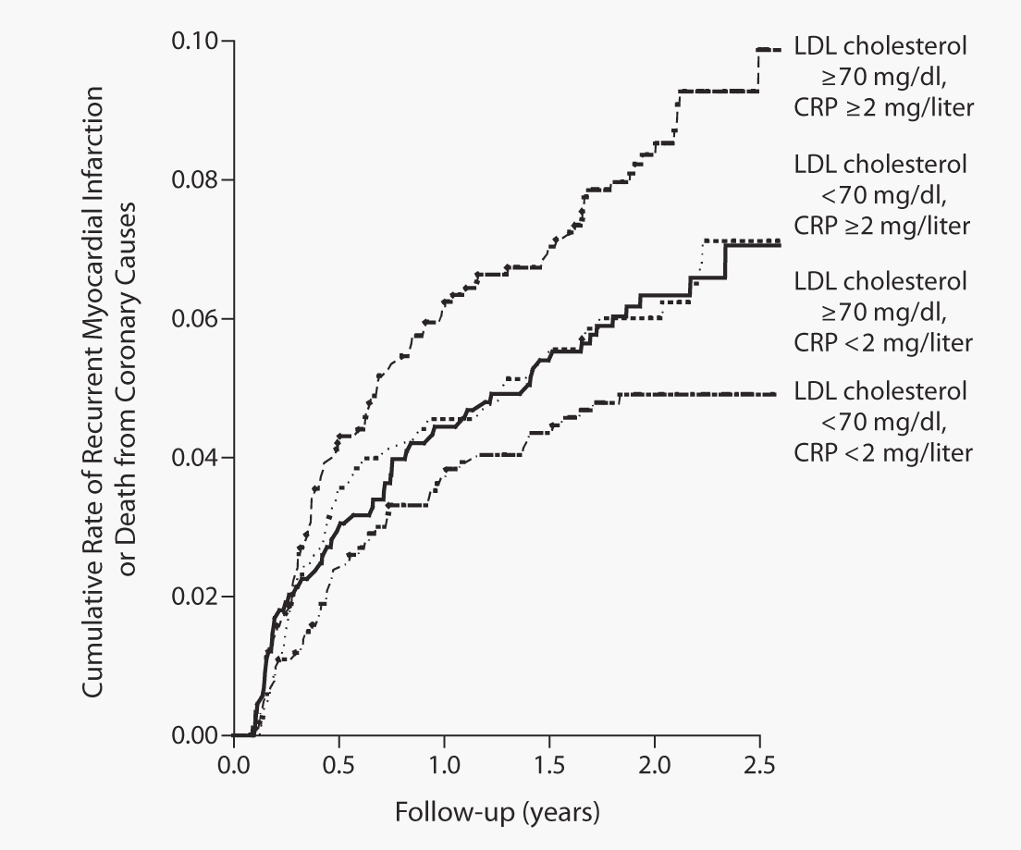
Best Outcomes Following an Acute Coronary Syndrome (ACS) are Secured by Achieving Low LDL and C-Reactive Protein (CRP) Levels: PROVE-IT
N=3,745
Recent ACS
Randomized to
40 mg pravastatin vs. 80 mg atorvastatin
3-year follow-up
From Ridker PM et al. N Engl J Med 2005; 352: 20-8
Reproduced with permission
Copyright © Massachusetts Medical Society. All rights reserved.

Slide 8
Who are the Patients with Higher C-Reactive Protein (CRP) Levels in PROVE-IT after 4 Months of Statin Therapy?
Month 4
Log (CRP)
Month 4 Glucose
Month 4
Log (CRP)
Month 4 Triglycerides
Month 4
Log (CRP)
Month 4 HDL
0.9
1.0
1.4
0.8
0.8
1.2
0.7
1.0
0.6
0.6
0.8
0.5
0.4
0.6
0.4
NCEP-ATP III cutpoint for
metabolic syndrome
0.2
NCEP-ATP III cutpoint for
metabolic syndrome
0.4
NCEP-ATP III cutpoint for
metabolic syndrome
in men
NCEP-ATP III cutpoint for metabolic syn-drome in women
0.3
0.0
0.2
80
90
100
110
120
130
140
50
100
150
200
250
300
350
20
30
40
50
60
70
Glucose (mg/dl)
Triglycerides (mg/dl)
HDL (mg/dl)
Month 4
Log (CRP)
Month 4
Log (CRP)
Month 4 Systolic
blood pressure
Month 4
Log (CRP)
Month 4 Diastolic
blood pressure
Body mass index
1.2
1.4
1.0
0.8
1.2
0.8
1.0
0.6
0.6
0.8
0.4
0.4
0.6
0.2
WHO cutpoint
for overweight
WHO cutpoint
for obesity
NCEP-ATP III cutpoint for
metabolic syndrome
0.4
NCEP-ATP III cutpoint for
metabolic syndrome
0.0
0.2
0.2
20
25
30
35
40
100
110
120
130
140
60
65
70
75
80
85
90
Body mass index (kg/m²)
Systolic blood pressure (mmHg)
Diastolic blood pressure (mmHg)
Adapted from Ray KK et al. J Am Coll Cardiol 2005; 46: 1417-24

Slide 9
Serum Concentrations of Adiponectin and Risk of Type 2 Diabetes and Coronary Heart Disease (CHD) in Apparently Healthy Middle-Aged Men
18-year follow-up of a large cohort from Southern Germany
p<0.0001
Incident type 2 diabetes
Incident CHD
2.63
p=0.0062
1.91
p=0.60
p=0.78
1.17
1.08
Hazard ratio (95% CI)
p=0.33
p=0.63
1.29
1.15
Ref.
Ref.
T1
≤ 44.1 mg/dl
T1
≤ 43.7 mg/dl
T2/T3
> 44.1 mg/dl
T2/T3
> 43.7 mg/dl
HDL cholesterol
T1
≤ 5 μg/ml
T2/T3
> 5 μg/ml
T1
≤ 4.98 μg/ml
T2/T3
> 4.98 μg/ml
Adiponectin
Adapted from Koenig W et al. J Am Coll Cardiol 2006; 48: 1369-77
Copyright 2006, with permission from Elsevier

Slide 10
Impact of Midlife Obesity on Risk for Coronary Heart Disease and Diabetes in Older Age
Coronary heart disease mortality
100
Normal weight
Overweight
Obese
10
1.0
0.1
Diabetes listed on death certificate
100
Normal weight
Overweight
Obese
10
1.0
0.1
Low risk
Moderate risk
Intermediate risk
Elevated risk
Highest risk
Risk category
Adapted from Yan LL et al. JAMA 2006; 295: 190-8

Slide 11
Atherosclerosis in Youth is Linked to Obesity and “Early” Insulin Resistance
Fatty streaks
Men: Age 15-24
Fatty streaks
Body mass index (kg/m²)
Aortic Strips
Surface area involved (%)
<25
<25 25-30 >30
25-30
Body mass index (kg/m²)
>30
Raised lesions
Raised lesions
Men: Age 15-24
Surface area involved (%)
<25
25-30
<25 25-30 >30
Body mass index (kg/m²)
>30
Yellow bars indicate panniculus thickness ≤ median for sex and BMI. Blue bars, panniculus thickness
> median for sex and BMI.
Adapted from McGill HC Jr et al. Circulation 2002; 105: 2712-8
Reproduced with permission

Slide 12
Risk Factors Identified in Childhood and Decreased Carotid Artery Elasticity in Adulthood - The Cardiovascular Risk in Young Finns Study
Cross-sectional study in 3,596 subjects followed from 1980 to 2001
Examined childhood and adult
cardiovascular risk factors and relative contribution to coronary artery compliance
Assessed body mass index, blood pressure, LDL, HDL, triglycerides, glucose, insulin, smoking
Carotid artery compliance (%/10 mmHg)
24 27 30 33 36 39
Age
p<0.001
Carotid artery compliance (%/10 mmHg)
Predictors of arterial disease:
- Childhood obesity
- Blood pressure
0 1 2 3 or more
Number of childhood risk factors
Adapted from Juonala M et al. Circulation 2005; 112: 1486-93

Slide 13
Prediabetes is Associated with Accelerated Atherosclerosis: Mexico City Diabetes Study
Common carotid artery
Internal carotid artery
0.9
*
*
Adjusted for age and sex
Adjusted for age, sex, body mass index, total cholesterol, HDL, systolic blood pressure, smoking
* p<0.05
*
*
0.8
*
Intima-media thickness (mm)
*
*
*
0.7
0.6
Nondiabetic
subjects
n=1,127
Prediabetic
subjects
n=66
Diabetic
subjects
n=303
Nondiabetic
subjects
n=979
Prediabetic
subjects
n=63
Diabetic
subjects
n=258
Adapted from Hunt KJ et al. Arterioscler Thromb Vasc Biol 2003; 23: 1845-50

Slide 14
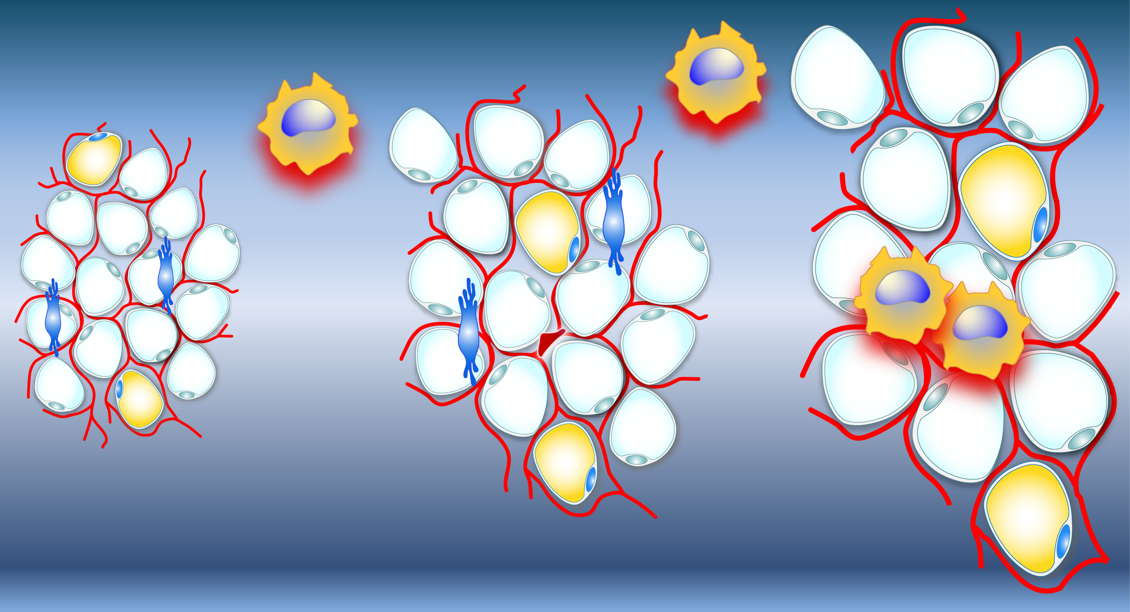
Intra-abdominal (Visceral) Fat is a Metabolically Active Organ Infiltrated by Inflammatory Cells
Macrophage
recruitment
Macrophage
Macrophage
recruitment
Adipocyte
Insulin
resistance
Leptin
VEGF
JNK
NF-кB
Preadipocyte
TNF-α
Angiogenesis
Il-6
IL-1β
TNF-α
Weight gain
Endothelial
cell
Weight gain
Physical stress/oxidative
damage to endothelium?
MCP-1
MCP-1
FFA
FFA: free fatty acids
IL-1β: interleukin-1β
IL-6: interleukin-6
JNK: jun N-terminal kinase
MCP-1: monocyte chemotactic protein-1
NF-κB: nuclear factor-κB
TNF-α: tumor necrosis factor-α
VEGF: vascular endothelial growth factor
Adapted from Tilg H and Moschen AR Nat Rev Immunol 2006; 6: 772-3
and Wellen KE and Hotamisligil GS J Clin Invest 2003; 112: 1785-8

Slide 15
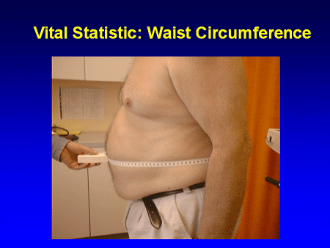
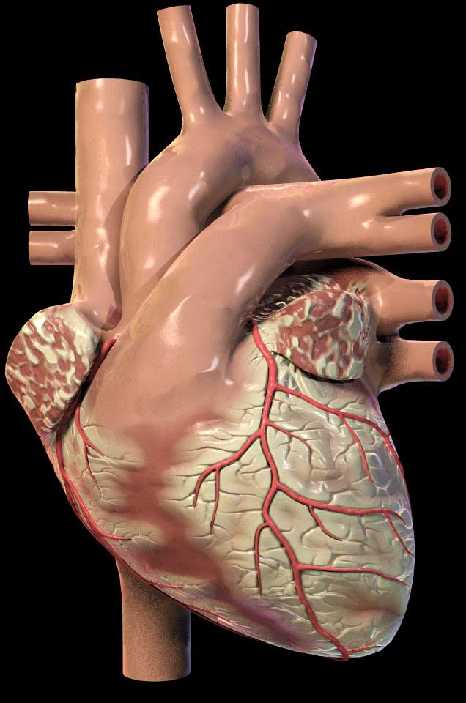
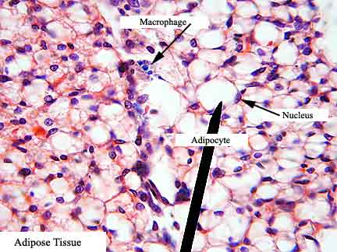
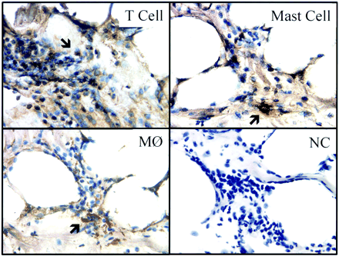
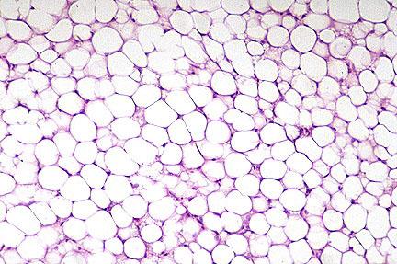
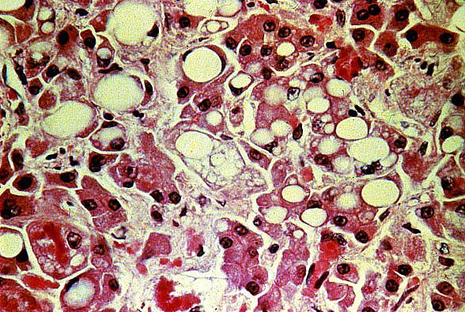
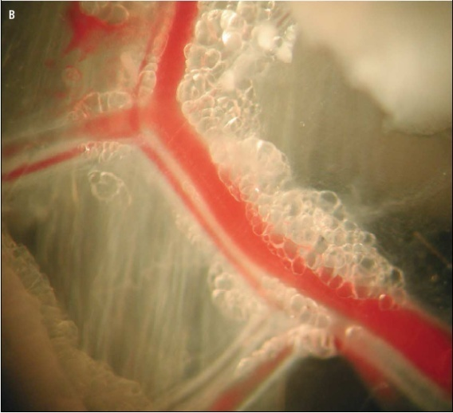
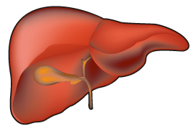
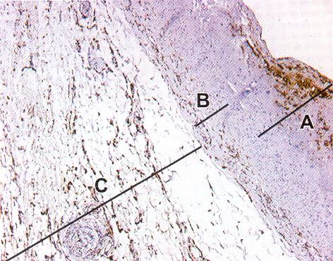
Adipose Tissue and Cardiometabolic Risk
Adapted from Yudkin JS et al. Lancet 2005; 365: 1817-20
Copyright 2005, with permission from Elsevier

Slide 16
Adverse Cardiometabolic Effects of Intra-abdominal (Visceral) Adipocytes
↑
Hypertension
Lipoprotein lipase
Inflammation
↑
↑
Interleukin-6
Angiotensinogen
↑
↑
Atherogenic dyslipidemia
C-reactive protein
Insulin
↑
FFA
↑
Tumor necrosis
factor-α
↑
Resistin
↑
↑
Leptin
Adipsin
(Complement D)
↑
Lactate
Insulin resistance and
type 2 diabetes
↑
Adiponectin
Plasminogen
activator
inhibitor-1
↑
Atherosclerosis
Thrombosis
Adapted from Lyon CJ et al. Endocrinology 2003; 144: 2195-200 |
Trayhurn P and Wood IS Br J Nutr 2004; 92: 347-55 |
Eckel RH et al. The Lancet 2005; 365: 1415-28

Slide 17
Relation Between Adiponectin Levels and Risk of Myocardial Infarction (MI)
>18,000 men in Health Professionals Follow-up Study free of cardiovascular disease, aged 40-75 years and 6-year follow-up
Risk of MI for highest vs. lowest quintile of adiponectin
1.0
0.8
0.6
0.4
0.2
0.0
p<0.001
p<0.001
p=0.02
Relative risk (95% CI)
Adjusted for age,
date of blood
draw, smoking
+ Adjusted for family
history, alcohol,
exercise
+ Adjusted for HbA1c,
CRP, HDL, LDL
CRP: C-reactive protein
HbA1c: glycosylated hemoglobin
Adapted from Pischon T et al. JAMA 2004; 291: 1730-7

Slide 18

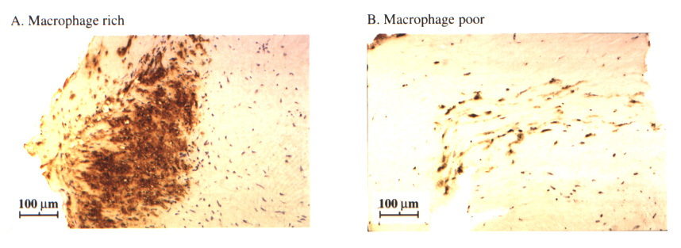
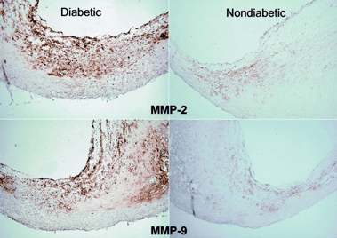
Pro-Inflammatory Milieu in Coronary Atheromas of Insulin Resistant Syndromes
Insulin
resistance
1
2
JNK
NF-кB
Il-6
IL-1β
TNF-α
MCP-1
AGE deposition
Receptors (AGEs)
Plaque neovascularization
3
AGE: advanced glycation end products
IL-1β: interleukin-1β
IL-6: interleukin-6
JNK: jun N-terminal kinase
MCP-1: monocyte chemotactic protein-1
MMP-2: matrix metalloproteinase-2
MMP-9: matrix metalloproteinase-9
NF-κB: nuclear factor-κB
TNF-α: tumor necrosis factor-α
Adapted from :
1-Tilg H and Moschen AR Nat Rev Immunol 2006; 6: 772-3
and Wellen KE and Hotamisligil GS J Clin Invest 2003; 112: 1785-8
2- Moreno PR et al. Circulation 2000; 102: 2180-4
3- Cipollone F et al. Circulation 2003; 108: 1070-7
Figures 2 and 3 reproduced with permission

Slide 19
Obesity is Independently Associated with Coronary Endothelial Dysfunction in Mild Coronary Artery Disease
Obesity is associated with endothelial
cell dysfunction in coronary microvasculature
Higher fasting plasma glucose, higher triglycerides and lower HDL in BMI>25 kg/m² groups
No difference in coronary diameter between groups with Ach
p=0.009
n=397
% ΔCBF Ach
<25 25-30 >30
%ΔCBF Ach: % change of coronary blood flow in response to acetylcholine
BMI: body mass index
BMI (kg/m²)
From Al Suwaidi J et al. J Am Coll Cardiol 2001; 37: 1523-8
Copyright 2001, with permission from Elsevier

Slide 20
Body Mass Index (BMI): Risk Factor for Unstable Angina and Myocardial Infarction (MI) in Angiographically Confirmed CAD
Obesity is associated with a more malignant form of CAD
n=382
UNIVARIATE analysis: BMI, C-reactive protein, blood pressure, prior MI, insulin resistance, fibrinogen, and CAD extent as predictors of unstable angina
MULTIVARIATE analysis: BMI an independent predictor of unstable angina with odds ratio of 1.49
N=382
Odds ratio
20 25 30 35 40
BMI (kg/m²)
CAD: coronary artery disease
Adapted from Wolk R et al. Circulation 2003; 108: 2206-11
Reproduced with permission

Slide 21
Obesity is a Dominant Risk Factor for
Cardiovascular Disease Across All Age Groups
Factor Analysis of Clustered Cardiovascular Risks in Adolescence: Obesity is the Predominant Correlate of Risk Among Youth
Goodman E et al. Circulation 2005; 111: 1970-7
Association of Intra-abdominal (Visceral) Adipose Tissue with Incident Myocardial Infarction in Older Men and Women
The Health, Aging and Body Composition Study
Nicklas BJ et al. Am J Epidemiol 2004; 160: 741-9

Slide 22
www.cardiometabolic-risk.org

