Slide 1
Sugar-Sweetened Beverage
Consumption in Relation to Diabetes and
Cardiovascular Disease
Frank B. Hu, MD, PhD
Professor of Nutrition and Epidemiology Harvard School of Public Health
Channing Laboratory, Harvard Medical School and Brigham and Women’s Hospital
Boston, MA, USA

Slide 2
Soft Drink Ingredients
Energy: 12-14 kcal/30 ml (1 oz) or ~144 kcal/can of 360 ml (12 oz)
Sugars: 3.1-3.6 g/30 ml (1 oz) or ~10 tsp/can of 360 ml (12 oz)
Glycemic index: 63 (with glucose as reference)

Slide 3
Nurses’ Health Study (n=121,700)
Study Design of Nurses' Health Study and Health Professionals Follow-Up Study
1976
1978
1980
1982
1984
1986
1988
1990
1992
1994
1996
1998
2000
Diet
Diet
Diet
Diet
Diet
Diet
Health Professionals Follow-up Study (n=52,000)
1986
1988
1990
1992
1994
1996
1998
2000
Diet
Diet
Diet
Diet
Nurses’ Health Study II (n=116,000)
1989
1991
1993
1995
1997
1999
Diet
Diet
Diet
Investigators: Frank Speizer, Walter Willett, Bernie Rosner, Meir Stampfer, Graham Colditz, David Hunter, JoAnn Manson, Sue Hankinson, Frank Hu, Eric Rimm, Edward Giovannucci, Alberto Ascherio, Gary Curhan, Charlie Fuchs, Fran Grodstein, Michelle Holmes.

Slide 4
Methods - Nurses’ Health Study II
Study population
91,249 nurses from Nurses' Health Study II
26 to 46 years old in 1991
741 incident cases
exclusions:
history of diabetes, cancer (except non-melanoma skin cancer) or cardiovascular disease
Dietary assessment
133-food item semiquantitative food frequency questionnaire in 1991, similar questionnaires in 1995 and 1999
3 items for regular and for diet soft drinks:
cola with caffeine
cola without caffeine
other carbonated beverages

Slide 5
Change in Energy Intake Between 1991 and 1995
400
300
200
100
Change in energy intake
(kcal/day)
0
-100
-200
-300
-400
≤1 drink/week
consistent
≥1 drink/day
consistent
≤1 drink/week
to
≥1 drink/day
≥1 drink/day
to
≤1 drink/week
other
Change in soft drink consumption
Sugar-sweetened soft drinks
All other foods
Adapted from Schulze MB et al. JAMA 2004; 292: 927-34

Slide 6
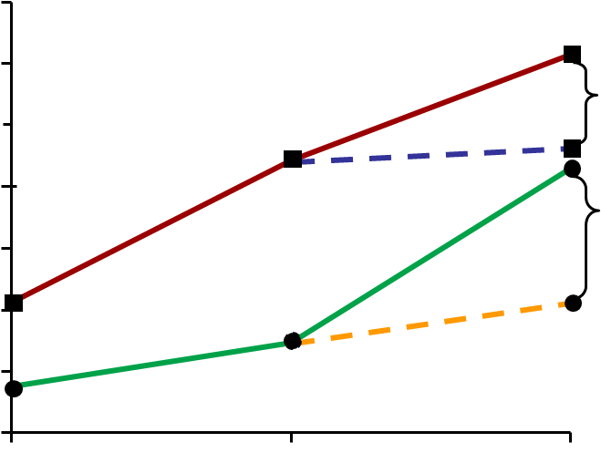
Mean Body Weight in 1991, 1995 and 1999
Regular
soft drink intake
'91 – '95 – '99
80
78
low-high-high
p=0.022
76
low-high-low
74
high-low-high
Body weight (kg)
p=0.021
high-low-low
72
70
Low: ≤1 drink/week
High: ≥1 drink/day
68
66
1991
1995
1999
Year
Adjusted for characteristics at each time point.
Adapted from Schulze MB et al. JAMA 2004; 292: 927-34

Slide 7
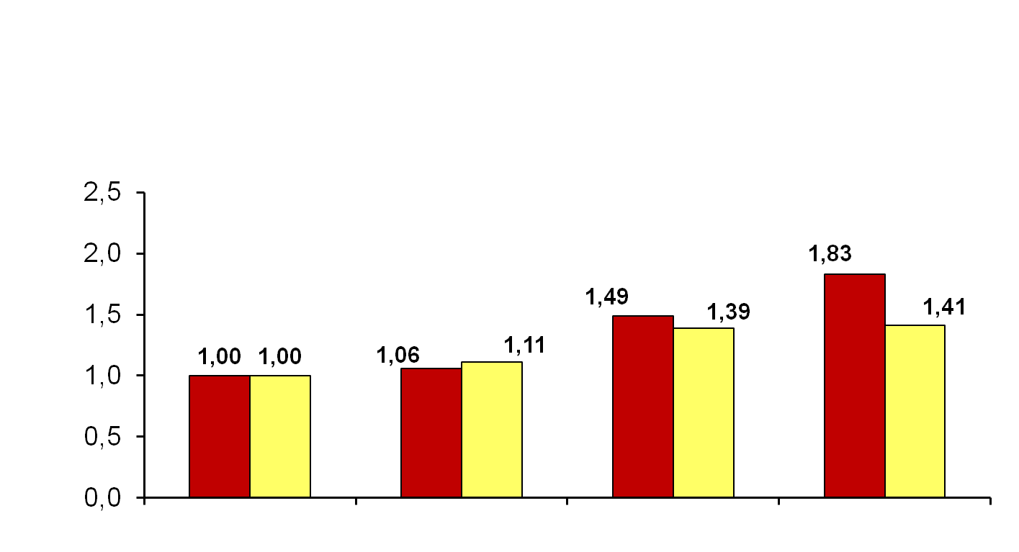
Sugar-Sweetened Soft Drinks and Type 2 Diabetes Nurses' Health Study II 1991-1998
p<0.001 for trend
Relative risk
<1/month
1-4/month
2-6/week
≥1/day
Sugar-sweetened soft drink consumption
Multivariate adjusted
Multivariate + body mass index
Adapted from Schulze MB et al. JAMA 2004; 292: 927-34

Slide 8
Relative Risk (RR) of Gestational Diabetes Mellitus in Relation to Sugar-Sweetened Beverage (SSB) Consumption
 | SSB consumption
 | 0-3/month | 1-4/week | ≥5/week | 1 serving increment | p for trend
All SSB
Case/person-years | 323/185,682 | 229/173,189 | 208/185,757
RR1* (95% CI) | 1.00 | 1.01 | 1.23 | 1.25 (1.07-1.45) | 0.005
RR2† (95% CI) | 1.00 | 1.02 | 1.17 | 1.18 (1.01-1.37) | 0.04
RR3‡ (95% CI) | 1.00 | 1.06 | 1.23 | 1.23 (1.05-1.43) | 0.01
Sugar-sweetened cola
Case/person-years | 544/332,516 | 168/113,899 | 148/98,214
RR1* (95% CI) | 1.00 | 1.12 | 1.39 | 1.39 (1.16-1.67) | <0.001
RR2† (95% CI) | 1.00 | 1.07 | 1.26 | 1.25 (1.04-1.51) | 0.02
RR3‡ (95% CI) | 1.00 | 1.11 | 1.29 | 1.29 (1.07-1.55) | 0.007
n=13,475; cases=860
*Model 1 adjusted for age and parity.
†Model 2 adjusted for variables in model 1 plus race/ethnicity, cigarette smoking status, family history of diabetes in a first-degree relative, alcohol intake and physical activity.
‡Model 3 adjusted for variables in model 2 plus body mass index.
Adapted from Chen L et al. Diabetes Care 2009; 32: 2236-39

Slide 9
Multivariate-Adjusted* Relative Risk for Cumulative Averaged Intake of Fruits and Vegetables and Incidence of Type 2 Diabetes
 | Quintile 3 (95% CI) | Quintile 5 (95% CI) | p for linear trend
Fruit juices | 1.29 (1.17-1.42) | 1.35 (1.22-1.50) | <0.001
All fruits | 0.99 (0.90-1.09) | 0.90 (0.80-1.00) | 0.008
Green, leafy vegetables | 1.02 (0.93-1.11) | 0.90 (0.82-1.00) | 0.01
*Adjusted for cumulatively updated body mass index, physical activity, family history of diabetes, post-menopausal hormone use, alcohol use, smoking, whole grains, nuts, processed meats, coffee, soft drinks and total energy intake.
Adapted from Bazzano LA et al. Diabetes Care 2008; 31: 1311-17

Slide 10
Black Women's Health Study
 | Diabetes cases | Person-years | Age-adjusted incidence rate ratio (IRR) | Multivariable IRR* (95% CI)
Sugar-sweetened soft drinks
<1/month | 733 | 96,266 | 1.00 | 1.00
1-7/month | 783 | 111,418 | 1.01 | 0.96 (0.87-1.06)
2-6/week | 656 | 78,319 | 1.24 | 1.14 (1.02-1.27)
1/day | 280 | 29,273 | 1.43 | 1.27 (1.12-1.47)
≥2/day | 261 | 23,608 | 1.76 | 1.51 (1.31-1.75)
Sweetened fruit drinks†
<1/month | 506 | 60,701 | 1.00 | 1.00
1-7/month | 637 | 79,119 | 1.11 | 1.11 (0.99-1.25)
2-6/week | 775 | 102,311 | 1.11 | 1.13 (1.00-1.26)
1/day | 421 | 53,154 | 1.20 | 1.21 (1.06-1.39)
≥2/day | 315 | 36,782 | 1.37 | 1.37 (1.18-1.58)
*Adjusted for age, family history of diabetes, physical activity, cigarette smoking, years of education and each of the 2 other types of drinks.
† Includes fortified fruit drinks, Kool-Aid and fruit juices other than orange or grapefruit juice.
Adapted from Palmer JR et al. Arch Intern Med 2008; 168: 1487-92

Slide 11
Change in Soft Drink Consumption and Magnitude of Weight Gain
Intake |  | Sugar-sweetened soft drinks
1995 | 2001 | N | Mean weight gain* in kg (standard deviation)
≤1/week | ≥1/day | 880 | 6.8 (0.28)
≥1/day | ≥1/day | 2,032 | 5.8 (0.19)
≤1/week | ≤1/week | 14,246 | 4.9 (0.07)
≥1/day | ≤1/week | 1,472 | 4.1 (0.22)
All others |  | 11,057 | 5.5 (0.08)
*Adjusted for baseline age; cigarette smoking; years of education; physical activity; family history of diabetes; baseline body mass index; intake of red meat, processed meat, cereal fibre and coffee; glycemic index; changes in physical activity; cigarette smoking; dietary factors from 1995 to 2001; and the other type of drink.
Adapted from Palmer JR et al. Arch Intern Med 2008; 168: 1487-92

Slide 12
Cross-Sectional Relationships of Soft Drink Consumption With Prevalence of Metabolic Syndrome
Soft drink consumption, (servings/day) | Metabolic syndrome, n | No. at risk (person-observations) | Age- and sex-adjusted odds ratio (OR) (95% CI) | Multivariable adjusted OR* (95% CI)
Model I: any soft drink (regular or diet); data from all 3 examinations (4,5 and 6; n=8,997)
None | 1,697 | 5,840 | Referent | Referent
1 | 618 | 1,918 | 1.18 (1.06-1.33) | 1.38 (1.19-1.61)
≥2 | 462 | 1,239 | 1.43 (1.24-1.66) | 1.67 (1.38-2.01)
≥1 | 1,080 | 3,157 | 1.26 (1.14-1.40) | 1.48 (1.30-1.69)
Model II: regular vs. diet soft drink; data from food frequency questionnaire at examinations 5 and 6 (n=5,031)†
Diet or regular (<1/week) | 650 | 2,129 | Referent | Referent
Diet (1 to 6/week) | 359 | 882 | 1.72 (1.45-2.03) | 1.81 (1.48-2.22)
Diet (≥1/day) | 328 | 819 | 1.87 (1.57-2.23) | 1.80 (1.45-2.25)
Regular (1 to 6/week) | 235 | 671 | 1.33 (1.09-1.61) | 1.20 (0.94-1.53)
Diet and regular (1 to 6/week) | 106 | 239 | 1.79 (1.35-2.38) | 1.99 (1.40-2.83)
Regular (≥1/day) | 130 | 291 | 2.31 (1.77-3.01) | 1.81 (1.28-2.56)
*Adjusted for age, sex, physical activity index, smoking, dietary consumption of saturated fat, trans fat, fibre, magnesium, total calories and glycemic index (No. eligible for multivariable models: model I, any soft drink, n=5,350; model II, for regular vs. diet soft drink, n=3,493).
†Individuals who reported drinking both diet and regular soft drinks ≥1/day (n=16) were included in the regular ≥1/day category.
Adapted from Dhingra R et al. Circulation 2007; 116: 480-8

Slide 13
Multiple Logistic Regression Analysis Examining the Relations of Incidence of Individual Components of Metabolic Syndrome According to Soft Drink Consumption (1/2)
Soft drink consumption, (servings/day) | Incident, n | No. at risk (person-observations) | Age- and sex-adjusted odds ratio (OR) (95% CI) | Multivariable adjusted OR* (95% CI)
Incidence of obesity (body mass index ≥30 kg/m²)
None | 327 | 4,665 | Referent | Referent
1 | 130 | 1,420 | 1.29 (1.04-1.60) | 1.21 (0.90-1.62)
≥2 | 91 | 853 | 1.51 (1.18-1.94) | 1.50 (1.06-2.11)
≥1 | 221 | 2,273 | 1.37 (1.14-1.65) | 1.31 (1.02-1.68)
Incidence of increased waist circumference (≥102 cm for men and ≥88 cm for women)
None | 840 | 3,665 | Referent | Referent
1 | 281 | 1,113 | 1.29 (1.10-1.51) | 1.25 (1.02-1.54)
≥2 | 181 | 645 | 1.55 (1.28-1.88) | 1.40 (1.08-1.83)
≥1 | 462 | 1,758 | 1.38 (1.20-1.58) | 1.30 (1.09-1.56)
Incidence of impaired fasting glucose (≥5.5 mmol/l or diabetes)
None | 898 | 4,264 | Referent | Referent
1 | 322 | 1,359 | 1.20 (1.03-1.39) | 1.21 (0.99-1.47)
≥2 | 206 | 836 | 1.28 (1.07-1.53) | 1.32 (1.03-1.69)
≥1 | 528 | 2,195 | 1.23 (1.08-1.39) | 1.25 (1.05-1.48)
*Ajusted for baseline level of the metabolic syndrome component and age, sex, physical activity index, smoking, dietary consumption of saturated fat, trans fat, fibre, magnesium, total calories and glycemic index.
Adapted from Dhingra R et al. Circulation 2007; 116: 480-8

Slide 14
Multiple Logistic Regression Analysis Examining the Relations of Incidence of Individual Components of Metabolic Syndrome According to Soft Drink Consumption (2/2)
Soft drink consumption, (servings/day) | Incident, n | No. at risk (person-observations) | Age- and sex-adjusted odds ratio (OR) (95% CI) | Multivariable adjusted OR* (95% CI)
Incidence of high blood pressure (≥135/85 mm Hg or on treatment)
None | 631 | 3,055 | Referent | Referent
1 | 232 | 1,043 | 1.23 (1.03-1.46) | 1.16 (0.92-1.47)
≥2 | 141 | 654 | 1.20 (0.97-1.49) | 1.20 (0.90-1.60)
≥1 | 373 | 1,697 | 1.22 (1.05-1.41) | 1.18 (0.96-1.44)
Incidence of hypertriglyceridemia (≥1.7 mmol/l or on treatment)
None | 695 | 4,258 | Referent | Referent
1 | 250 | 1,317 | 1.24 (1.05-1.46) | 1.35 (1.09-1.67)
≥2 | 148 | 807 | 1.20 (0.98-1.46) | 1.09 (0.82-1.44)
≥1 | 398 | 2,124 | 1.22 (1.07-1.41) | 1.25 (1.04-1.51)
Incidence of low HDL cholesterol (<1.03 mmol/l for men or <1.3 mmol/l for women or on treatment)
None | 460 | 3,878 | Referent | Referent
1 | 183 | 1,201 | 1.28 (1.06-1.54) | 1.38 (1.08-1.77)
≥2 | 96 | 684 | 1.13 (0.89-1.43) | 1.21 (0.87-1.68)
≥1 | 279 | 1,885 | 1.22 (1.04-1.44) | 1.32 (1.06-1.64)
*Ajusted for baseline level of the metabolic syndrome component and age, sex, physical activity index, smoking, dietary consumption of saturated fat, trans fat, fibre, magnesium, total calories and glycemic index.
Adapted from Dhingra R et al. Circulation 2007; 116: 480-8

Slide 15
Sweetened Beverage Consumption and Risk of Coronary Heart Disease in Women
 | Consumption level
 | <1/month | 1-4/month | 2-6/week | 1 to <2/day | ≥2/day | p for trend
Median intake (servings/day) | 0 | 0.1 | 0.4 | 1.2 | 2.6
No. of cases | 883 | 723 | 1,198 | 218 | 83
Person-years | 574,814 | 494,831 | 745,176 | 134,933 | 52,455
Age-adjusted | 1 | 0.94 (0.85-1.03) | 1.08 (0.99-1.18) | 1.51 (1.30-1.75) | 1.93 (1.54-2.43) | <0.001
Multivariate-adjusted* | 1 | 0.97 (0.88-1.07) | 1.06 (0.97-1.16) | 1.27 (1.09-1.47) | 1.39 (1.11-1.75) | <0.001
Multivariate-adjusted + diet† | 1 | 0.96 (0.87-1.06) | 1.04 (0.95-1.14) | 1.23 (1.06-1.43) | 1.35 (1.07-1.69) | <0.001
*Adjusted for age (continuous), smoking [never, past, or current cigarette use (1-14/day, 15-24/day, ≥25/day, or missing)], alcohol intake (0, <5, 5-15, or >15 g/day), family history (yes or no), physical activity (quintiles), aspirin use (<1, 1-2, 3-6, 7-14, or ≥15/week), menopausal status and postmenopausal hormone use (premenopausal, never, past, or current hormone use), and history of hypertension and high blood cholesterol. Relative risks were computed from a Cox proportional hazard model.
†Additionally adjusted for the Alternate Healthy Eating Index (quintiles).
Adapted from Fung TT et al. Am J Clin Nutr 2009; 89: 1037-42

Slide 16
Multivariate Relative Risks (RR) for 2-Serving Increase in Specific Sugar-Sweetened Beverages (SSB) and Coronary Heart Disease
Beverage type | RR (95% CI) | p value
Total SSB | 1.28 (1.14 - 1.44) | <0.001
Colas | 1.35 (1.15 - 1.57) | <0.001
Carbonate non-sodas | 1.27 (0.87 - 1.86) | 0.22
Fruit drinks/punch | 1.33 (1.03 - 1.71) | 0.03
Model adjusted for age (continuous), smoking, alcohol intake, family history, physical activity, aspirin use, menopausal status and postmenopausal hormone use, history of hypertension and high blood cholesterol and the Alternate Healthy Eating Index.
Adapted from Fung TT et al. Am J Clin Nutr 2009; 89: 1037-42

Slide 17
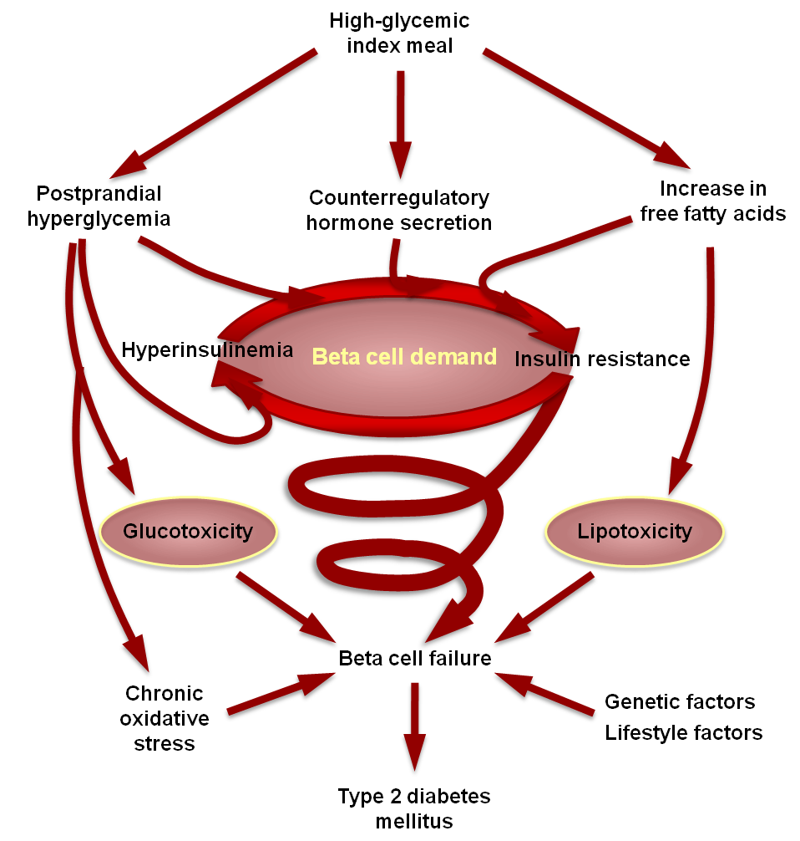
Potential Mechanisms: High-Glycemic Index Diet and Risk of Type 2 Diabetes Mellitus
Adapted from Ludwig DS JAMA 2002;287: 2414-23

Slide 18
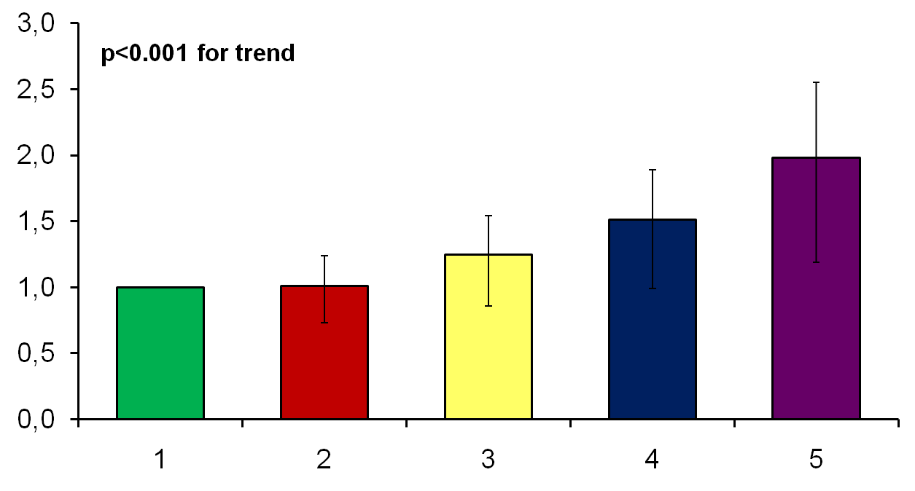
Risk of Coronary Heart Disease (CHD) According to Glycemic Load - Nurses' Health Study 1984-1994
Relative risk of CHD
Glycemic load quintiles
Model adjusted for age; body mass index; cigarette smoking; alcohol intake; family history of myocardial infarction before the age of 60 years; self-reported history of hypertension or history of high cholesterol; menopausal status; aspirin use; use of multiple vitamin or vitamin E supplement; physical activity; protein intake; dietary fibre, vitamin E, and folate intakes; total energy intake; and additional adjustment for all fats.
Adapted from Liu S et al. Am J Clin Nutr 2000; 71: 1455-61

Slide 19
Summary
Consumption of sugar-sweetened beverages is associated with increased risk of diabetes, metabolic syndrome and coronary heart disease.
These associations are not completely explained by obesity and weight gain.
High sugar load in sugar-sweetened beverages may contribute to both increased insulin resistance and beta-cell dysfunction.

Slide 20
www.cardiometabolic-risk.org

