Slide 1
Ectopic Fat:
An Important Feature of Intra-Abdominal Obesity in Type 2 Diabetes
Marja-Riitta Taskinen, MD, PhD
Professor of Medicine, Division of Cardiology
Helsinki University Hospital
Helsinki, Finland

Slide 2
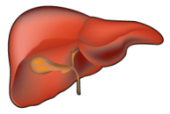
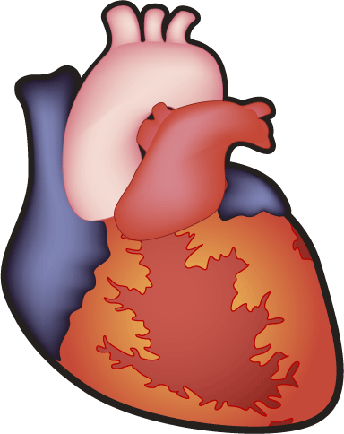


What Is Ectopic Fat Accumulation?
Caloric intake
and/
or
Energy expenditure
Positive energy balance
Lipid overflow into liver,
pancreas, muscle and heart
FFA
Inflamed
adipose
tissue
Imbalance between loading and export of lipids results
in ectopic fat accumulation at organs
FFA: free fatty acids
Notes:
Positive energy balance leads to expansion of adipose tissue via hypertrophy and hyperplasia of adipose cells. Adipose tissue expandability is restricted and this results in overflow of lipids in other tissues. Ectopic fat is defined as fat accumulation in organs that do not usually store excess fat. These include liver, muscle, pancreas and heart.

Slide 3
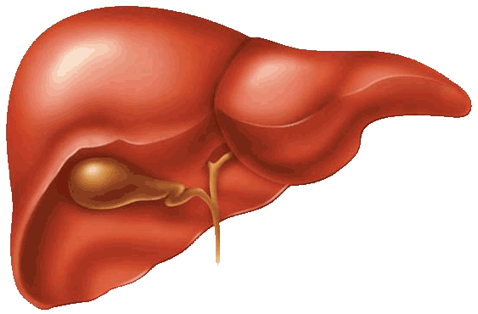
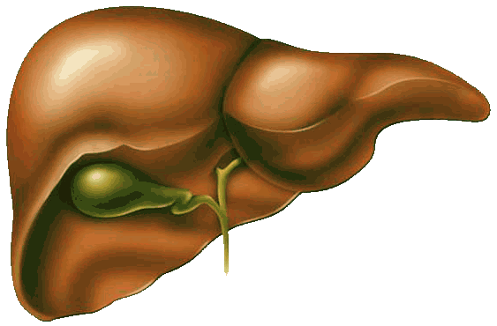
Why Is the Fatty Liver Dangerous for Cardiovascular Health Risk?
Glucose
VLDL
HDL
ALT
The fatty liver :
overproduction of
cardiometabolic
risk factors
Fibrinogen
Obesity
Genetic predisposition
Fat in the diet?
Fructose?
CRP
PAI-1
FVII
ALT: alanine aminotransferase
CRP: C-reactive protein
FVII: factor VII
PAI-1: plasminogen activator inhibitor-1
Notes:
Nonalcoholic fatty liver disease (NAFLD) is defined as excess accumulation of fat in the liver. The fatty liver overproduces a plethora of known cardiovascular risk factors. NAFLD is associated with an increased risk of cardiovascular disease (CVD). This raises the question, Is NAFLD associated with cardiovascular due to the shared effect of CVD risk factors or does NAFLD per se associate with CVD?

Slide 4
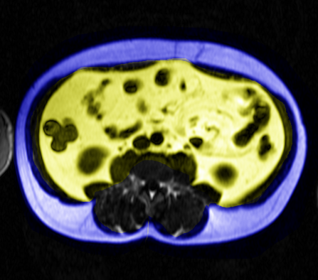
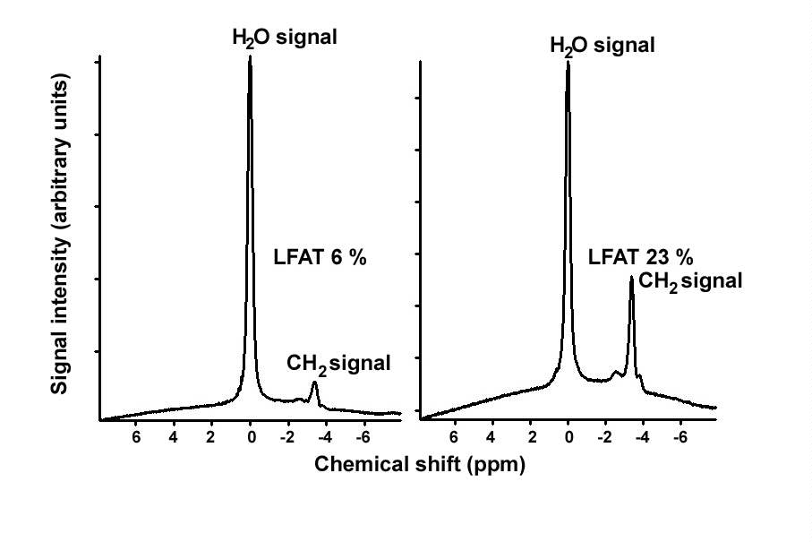
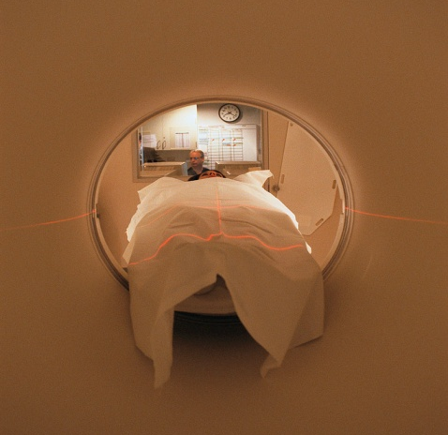
Determination of Liver Fat Content Using Magnetic Resonance Spectroscopy
Water peak
Liver fat 6%
Liver fat 28%
Triglyceride peak
Reproduced by permission of the American Diabetes Association. Copyright© 2000 American Diabetes Association. From Ryysy L et al. Diabetes 2000;49:749-58
Notes:
The golden standard measure to quantify liver fat content is the use of magnetic resonance spectroscopy that is a non-invasive method without any radiation risk.

Slide 5
Regulation of Lipid Metabolism in the Liver
Free fatty
acid flux
De novo lipogenesis
Fatty acid
oxidation
VLDL assembly
Dietary
fatty acids
VLDL
secretion
Notes:
The regulation of liver fat is a complex process. The influx of fatty acids to the liver includes the systemic free fatty acid pool, dietary fats and de novo lipogenesis. The export of fat from the liver can account via beta oxidation and VLDL secretion. The imbalance between the input and export results in excess fat accumulation in hepatocytes.

Slide 6
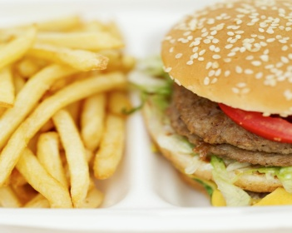
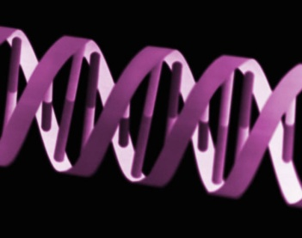
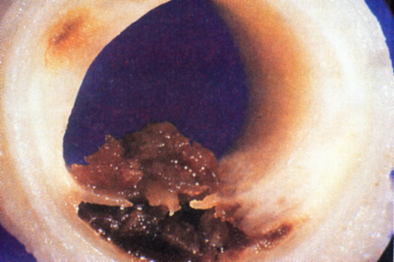
The Atherogenic Lipoprotein Triad
Lifestyle
Large
VLDL
Insulin resistance
Type 2 diabetes
FCH subjects
Low HDL subjects
Genes
Small,
dense
LDL
HDL
Increased
CAD Risk
CAD: coronary artery disease
FCH: familial combined hyperlipidemia
Notes:
The atherogenic lipoprotein triad comprises elevation of large VLDL and small, dense LDL particles concomitantly with lowering of HDL particles. This dyslipidemia is common in insulin resistance, type 2 diabetes, familial combined hyperlipidemia and familial low HDL subjects. There is a close metabolic connection between the lipid abnormalities, the elevation of large LDL particles being the driving force for the formation of small, dense LDL particles and lowering of HDL cholesterol and HDL particle size.

Slide 7
Relationship Between VLDL1 Production Rate and Plasma VLDL1 Triglyceride (TG) Pools
600
r=0.62, p<0.001
400
VLDL1 TG production (mg/kg/day)
200
0
0
10
20
30
40
50
60
VLDL1 TG pool (mg/kg)
VLDL1 TG production rate is the predictor for VLDL1 TG pool size
Adapted from Adiels M et al. Arterioscler Thromb Vasc Biol 2005;25:1697-703
Notes:
The use of stable isotopes allows to track the synthesis and catabolism of VLDL particles in vivo in humans. These studies have demonstrated that VLDL1 triglyceride production rate is a major predictor of the VLDL1 pool size in plasma i.e., the elevation of VLDL triglyceride concentration.

Slide 8
VLDL1 Triglyceride (TG) Production Is Linked With Detrimental Changes of LDL Size and HDL Cholesterol
600
600
r=-0.56, p<0.005
r=-0.64, p<0.001
500
500
400
400
VLDL1 TG production (mg/kg/day)
VLDL1 TG production (mg/kg/day)
300
300
200
200
100
100
0
0
22
23
24
25
26
27
28
29
30
0.7
0.9
1.1
1.3
1.5
1.7
LDL size (nm)
HDL cholesterol (mmol/l)
Adapted from Adiels M et al. Diabetologia 2006;49:755-65
Notes:
VLDL1 triglyceride overproduction has adverse effects on both LDL and HDL particles. The higher is the VLDL1 triglyceride production, the smaller is LDL size and the lower is HDL cholesterol concentration. The data suggest that one factor involved in the development of the atherogenic lipoprotein triad is the overproduction of large VLDL1 particles.

Slide 9
Relationship Between VLDL1 Triglyceride (TG) Production and Liver Fat Assessed Using Proton Spectroscopy
600
r=0.58, p<0.01
400
VLDL1 TG production
(mg/kg/day)
200
0
0
5
10
15
20
25
Liver fat (%)
Liver fat content is the driving force for VLDL-TG overproduction
Adapted from Adiels M et al. Diabetologia 2006;49:755-65
Notes:
Liver fat content is positively associated with VLDL1 triglyceride production rate in univariate analyses as shown in the slide. Importantly, in a multivariate analysis including glucose, insulin, HOMA index and adiponectin, liver fat and glucose remain the significant factors. The data suggest that liver fat content is the driving force for VLDL triglyceride production. Similarly, liver fat content is also the predictor of VLDL apolipoprotein B100. The data indicates that fatty liver produces increased number of VLDL particles.

Slide 10
Defective Regulation of VLDL Metabolism by Insulin in Type 2 Diabetic Patients
1000
VLDL1 apo B production
FFA
Oxidation
De novo lipogenesis
mg/day
-51%
500
FA
Remnants
TG
CE
0
Controls
Type 2
diabetes
Degradation
MTP
VLDL1
VLDL2
LPL
Apo B
Apo B: apolipoprotein B
CE: cholesteryl ester
FA: fatty acid
FFA: free fatty acids
HL: hepatic lipase
LPL: lipoprotein lipase
MTP: microsomal triglyceride transfer protein
TG: triglycerides
LPL
LPL
VLDL2
IDL
HL
Insulin fails to suppress VLDL1 apo B production.
Accumulation of VLDL1 particles.
IDL
LDL
HL
LDL
Small, dense
Adapted from Malmströn R et al.
Arterioscler Thromb Vasc Biol 1997;17:1454-64
LDL
Notes:
This slide illustrates the metabolic pathways for VLDL particles. The assembly of VLDL particles comprises several steps and starts with the lipidation of apolipoprotein B100, the major structural protein of VLDL particles. Microsomal transfer protein (MTP) is a key regulator of this lipidation process. In the second step, pre-VLDL particles are further lipidated to produce mature VLDL particles and secreted as smaller VLDL2 particles or converted to larger VLDL1 particles by addition of more lipids. Substantial evidence indicate that VLDL1 and VLDL2 production rates are independently regulated. VLDL1 and VLDL2 particles released in the circulation are metabolized through parallel pathways into IDL and LDL particles. The red arrows indicate potential sites for insulin action in this process. The insert shows that in normal subjects acute hyperinsulinemia during euglycemic insulin clamp suppresses VLDL particle production by about 50%. In contrast insulin fails to suppress VLDL1 apolipoprotein B production in type 2 diabetic subjects.

Slide 11
Characteristics of the Subjects
Low liver fat (n=10)
High liver fat (n=10)
Body mass index (kg/m²)
Subcutaneous fat (cm³)
Intra-abdominal (visceral) fat (cm³)
Liver fat (%)
M value (mg/kg/min)
Fasting triglycerides (mmol/l)
HDL cholesterol (mmol/l)
LDL size (nm)
26.0
2150
1600
2.1
6.4
1.4
1.4
26.6
±
±
±
±
±
±
±
±
2.9
730
880
1.5
1.8
0.5
0.2
0.8
28.4
2420
2480
11.4
4.0
2.0
1.1
25.3
±
±
±
±
±
±
±
±
3.6
520
860*
4.5***
2.1*
0.8
0.3**
1.1**
* p<0.05
** p<0.01
*** p<0.001
Adapted from Adiels M et al. Diabetologia 2007;50:2356-65
Notes:
To explore the relationship between liver fat content and suppression of VLDL1 production by insulin we studied two groups of subjects. Low liver fat (defined ≤5.5%) and high liver fat (defined >5.5%). As expected subjects with high liver fat have features of the atherogenic lipoprotein triad with elevation of serum triglycerides, low HDL cholesterol and smaller LDL size.

Slide 12
High Liver Fat: Lack of VLDL1 Suppression in Response to Insulin
VLDL1 triglyceride production rate
100
Δ 61%, p<0.01
Low liver fat <5.5%
75
High liver fat >5.5%
% of total VLDL at baseline
50
25
0
0
200
400
600
Time (minutes)
Adapted from Adiels M et al. Diabetologia 2007;50:2356-65
Notes:
This slide shows that suppression of VLDL1 triglyceride production rate by insulin during an 8-hour euglycemic insulin clamp is robust in subjects with low liver fat content in agreement with our previous data (Malmströn R et al. Arterioscler Thromb Vasc Biol 1997; 17: 1454-64). The novel finding is that insulin failed to suppress VLDL1 production rate in subjects with high liver fat content.

Slide 13
Normal Production and Suppression of VLDL1 Particles in Normal Healthy Subjects by Insulin
Low liver fat
Insulin
Apo B: apolipoprotein B
MTP: microsomal triglyceride transfer protein
TG: triglycerides
TG
MTP
VLDL1
Apo B
VLDL2
VLDL2
Adapted from Adiels M et al. Diabetologia 2007;50:2356-65
Notes:
This slide highlights the role of insulin as a regulator of VLDL metabolism in the liver. Insulin regulates the maturation of smaller VLDL particles into large VLDL particles i.e., incorporation of lipids into the particles to produce large VLDL1 particles via actions on microsomal triglyceride transfer protein that promotes assembly of apolipoprotein B and lipids. This concept suggests that the physiological action of insulin suppresses the production of large VLDL1 particles in situations like postprandial state when lipid influx to the circulation is coming from intestine as chylomicrons and there is need to transport lipids in VLDL particles to peripheral tissues as energy source.

Slide 14
Overproduction and Dysregulation of VLDL1 Particles in Type 2 Diabetes
High liver fat
Insulin
Apo B: apolipoprotein B
TG: triglycerides
TG
VLDL1
Apo B
VLDL2
VLDL2
High liver fat is linked with hepatic insulin resistance and
overproduction of large VLDL particles
Adapted from Adiels M et al. Diabetologia 2007;50:2356-65
Notes:
There is dysregulation of VLDL metabolism in people with high liver fat who are linked to hepatic insulin resistance. In this situation, insulin fails to suppress VLDL1 production in the liver and there is overflow of VLDL1 particles into the circulation despite the influx of chylomicrons. This abnormality contributes to the postprandial lipemia seen in subjects with metabolic syndrome and type 2 diabetes who commonly have high liver fat content. The exact molecular mechanism underlying this defect remains to be resolved. The concept suggests that hepatic insulin resistance covers not only glucose metabolism but also lipid metabolism.

Slide 15
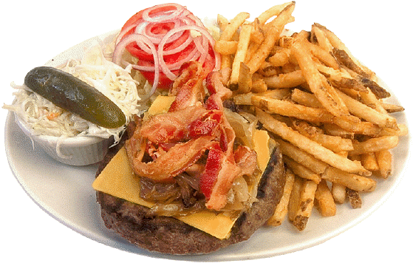

Why People With a Big Waist do not all Have Dyslipidemia?
Metabolic syndrome?
Elevated VLDL1
concentrations
Insulin resistance?
Insulin resistance
Normal
lipid
profile
The
atherogenic
triad
Intra-abdominal
(visceral) obesity
Intra-abdominal
(visceral) obesity
Low HDL
Small, dense
LDL particles
Notes:
Recent data suggest that about 20% of obese subjects with a large waist circumference have a healthy metabolic phenotype. The key question is, Why these people do not develop dyslipidemia and other cardiometabolic risk factors?

Slide 16
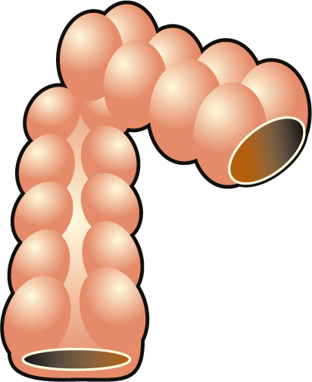
Sources of Fatty Acids for Liver and VLDL Triglycerides (TG)
FFA
POOL
1
STORAGE?
CM
FA
2
β-ox
TG
LIVER
TG
4
2
DNL
Apo B
VLDL
TG
5
Apo B: apolipoprotein B
β-ox: β-oxidation
CM: chylomicron
DNL: de novo lipogenesis
FA: fatty acids
FFA: free fatty acids
3
GLUCOSE
INSULIN
Adapted from Adiels M et al. Arterioscler Thromb Vasc Biol 2008;28:1225-36
Notes:
The main sources of fatty acids for liver and VLDL triglycerides. The major source for the systemic free fatty acid (FFA) pool (1) is derived from the adipose tissue. Other sources of FFA include dietary fat (2) and de novo lipogenesis (DNL) (3). Importantly DNL is directly regulated by both glucose and insulin via transcription factors (sterol regulatory element binding protein-1 [SREBP-1], and carbohydrate response regulatory element binding protein [ChREBP]) that stimulate the key enzyme of lipogenesis in hepatocyte (Postic C and Girard J Diabetes Metab. 2008; 34: 643-8). The contribution of DNL to liver and VLDL triglycerides is elevated in nonalcoholic fatty liver disease (NAFLD) patients averaging about 20-25% (Donnelly KL et al. J Clin Invest 2005; 115; 1343-51). Thus, the contribution of DNL to liver fat may be a neglected issue and needs to be established. The beta oxidation (4) and secretion of VLDL (5) are responsible for the export of lipids from the liver. A current concept is that failure of the liver to export extra lipids as VLDL will result in fat deposition i.e., NAFLD (Fabbrini E et al. Hepatology 2010; 51; 679-89).

Slide 17
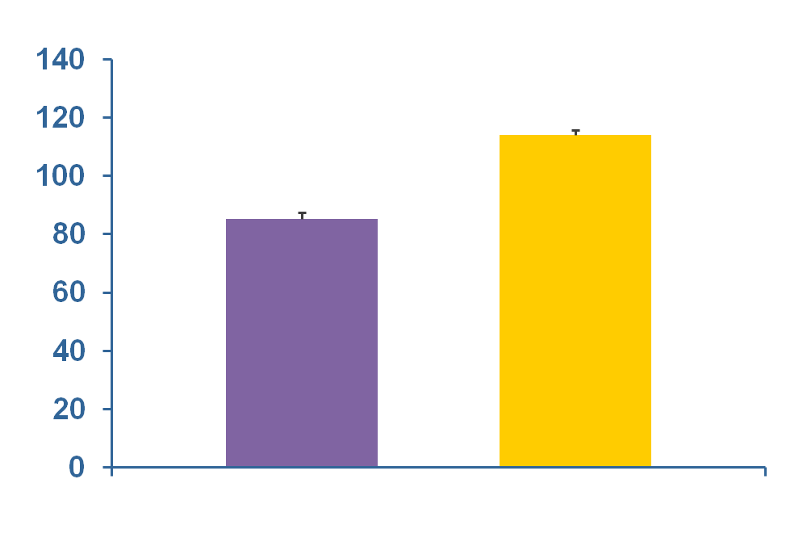
Whole-Body Palmitate Rate of Appearance in Obese Subjects Without and With Nonalcoholic Fatty Liver Disease (NAFLD)
*
Normal IHTG
NAFLD
Palmitate rate of appearence
(µmol/minute)
n=14
n=14
Liver fat (%)
3.4 ± 0.4
22.7 ± 2.0
36.8 ± 1.2
BMI (kg/m²)
35.3 ± 1.3
*Significantly different from the normal IHGT group, p<0.05
IHTG: intrahepatic triglycerides
The rate of the release of fatty acids from adipose tissue is increased
in obese subjects with NAFLD
Adapted from Fabbrini E et al. Gastroenterology 2008;134:424-31
Notes:
Excess liver fat content in obese subjects is associated with an increased rate of whole body palmitate appearance in systemic pool i.e., release of free fatty acids from adipose tissue into circulation as compared to subjects with normal liver fat content.

Slide 18
VLDL Triglyceride (TG) Secretion Rate Is Increased in Obese Subjects With Nonalcoholic Fatty Liver Disease (NAFLD)
30
*
Systemic plasma FFA
25
Nonsystemic fatty acids
*
20
(µmol/minute)
15
10
5
*
0
Normal IHGT
NAFLD
BMI: body mass index
FFA: free fatty acids
IHTG: intrahepatic triglycerides
Liver fat (%)
3.4 ± 0.4
35.3 ± 1.3
22.7 ± 2.0
36.8 ± 1.2
BMI (kg/m²)
*Significantly different from the normal IHGT group, p<0.05
Fatty acids derived from nonsystemic sources are the major factors responsible for the increase in VLDL TG secretion
Adapted from Fabbrini E et al. Gastroenterology 2008;134:424-31
Notes:
Subjects with nonalcoholic fatty liver disease show increased rate of hepatic VLDL triglyceride secretion. This is caused by 3-fold increase in incorporation of nonsystemic fatty acids (de novo lipogenesis [DNL] and/or lipolysis of intrahepatic and intra-abdominal [visceral] fat) whereas the increase of systemic free fatty acid incorporation is increased only by one third. The data highlight the potential role of DNL into VLDL production in subjects with high liver fat content.

Slide 19
Sources of Fatty Acids for Liver Fat and VLDL Triglycerides
Increased rate of free fatty acid flux from adipose tissue results in increased rate of hepatic free fatty acid uptake.
Intrahepatic de novo lipogenesis is enhanced in subjects with nonalcoholic fatty liver disease (NAFLD).
The production and secretion of large VLDL particles correlate with liver fat content.
Basal hepatic lipid oxidation seems to be unaltered in subjects with NAFLD.
Overproduction of VLDL particles is NOT able to adequately compensate for increase of hepatic triglyceride production liver fat accumulation
Notes:
In summary, fluxes play a central role in the pathogenesis of liver fat accumulation. VLDL production is considered to be a main compensatory mechanism to prevent triglyceride accumulation in liver fat as the regulation of beta oxidation is less flexible. If this mechanism fails the end result is a fatty liver (nonalcoholic fatty liver disease).

Slide 20
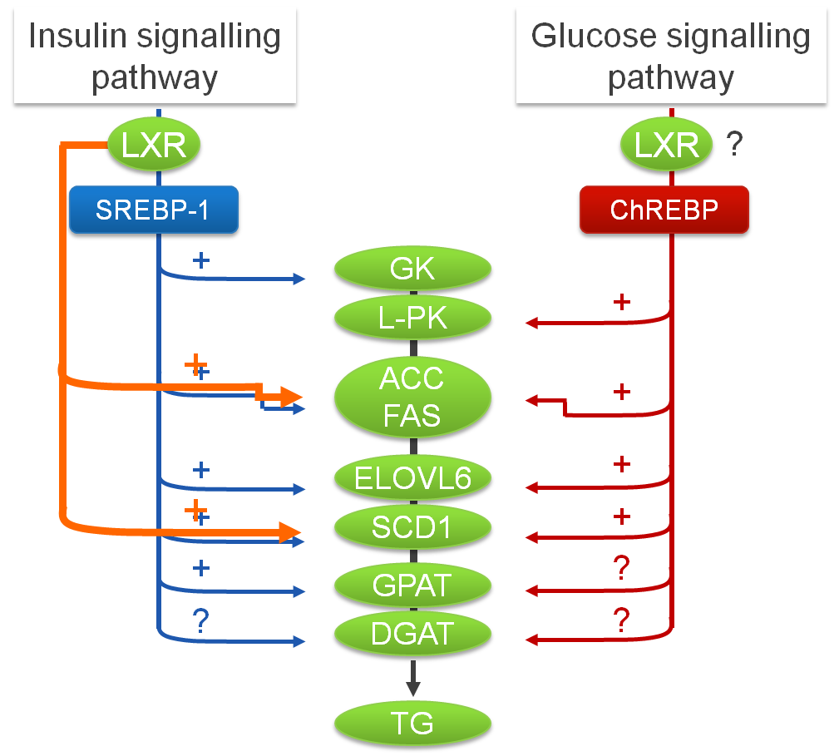
Regulation of DNL by SREBP1-C, ChREBP and LXRs in Liver
ACC: acetyl-CoA carboxylase
ChREBP: carbohydrate-responsive element-binding protein
DGAT: diacylglycerol acyltransferase
DNL: de novo lipogenesis
ELOVL6: long-chain elongase
FAS: fatty acid synthase
GK: glucokinase
GPAT: mitochondrial glycerol 3-phosphate acyltransferase
L-PK: liver-pyruvate kinase
LXR: liver X receptors
SCD1: stearoyl-CoA desaturase
SREBP-1: sterol regulatory element-binding protein 1
TG: triglycerides
Adapted from Postic C and Girard J. J Clin Invest 2008;118:829-38
Notes:
The transcription factors play a central role in the regulation of de novo lipogenesis in the liver, the two pathways are parallel and modified by insulin (sterol regulatory element-binding protein 1 [SREBP-1] pathway) and by a glucose carbohydrate-responsive element-binding protein (ChREBO) pathway. In addition, LXR is modifying the activity of lipogenesis pathway by SREBP-1 and also at several levels.

Slide 21
Mechanisms Leading to Insulin Resistance in the Liver
Akt: protein kinase B
DAG: diacylglycerol
FA: fatty acids
LPA: lysophosphatidic acid
mTOR: mammalian target of rapamycin
NFkB: nuclear factor-kappa B
PA: phosphatidic acid
PKC: protein kinase C
TG: triglycerides
Acylcarnitine
FA
TG
Fatty acyl-CoA
β-oxidation
FA
Acetyl-CoA
CO2
Fatty acyl-CoA
Ceramide
Ketones
Acylcarnitines
G-3-P
LPA
Akt
NFĸB
PKC
mTOR
?
Fatty
acyl-CoA
PA
Insulin resistance
DAG
Fatty
acyl-CoA
TG
Adapted from Fabbrini E et al. Hepatology 2010;51:679-89
Notes:
Intracellular metabolism of fatty acid intermediate products associated with activation of molecules (NFkB, PCK and mTOR) interfering with insulin signalling mechanism and potentially leading to insulin resistance. Fatty acyl-CoA is located at a crossroad and it has several metabolic routes. The generation of ketone bodies may also have adverse effects on insulin action. Overall the association between fatty acid metabolism and insulin resistance is complex and poorly understood.

Slide 22
Consequences of Ectopic Fat Accumulation: Insulin Resistance, Dyslipidemia, NAFLD and Left Ventricular Dysfunction
FFA
Glucose production
Glucose
Subcutaneous
fat
Oxidation
ChREBP
SREBP-1c
Intra-abdominal (visceral) fat
FFA
DNL
TG
FFA
TG
Insulin
Atherogenic
dyslipidemia
VLDL
LV dysfunction
CAD risk factor?
CAD: coronary artery disease
ChREBP-1c: carbohydrate-responsive element-binding protein-1c DNL: de novo lipogenesis
FFA: free fatty acids
NAFLD: nonalcoholic fatty liver disease
SREBP-1: sterol regulatory element-binding protein 1
TG: triglycerides
Glucose uptake
Adapted from Fabbrini E et al. Hepatology 2010;51:679-89
Notes:
Ectopic fat accumulation at different organs have multiple but diverse adverse functional effects that are associated with an increased cardiovascular disease risk.

Slide 23
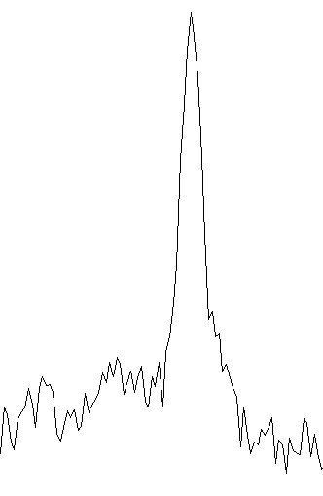
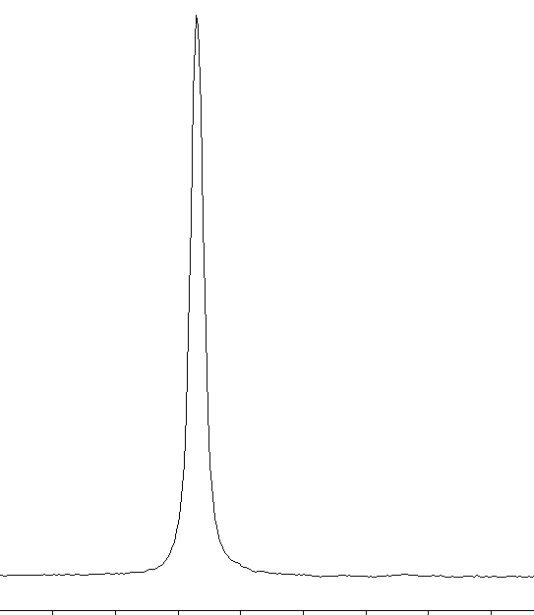
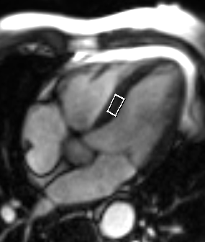
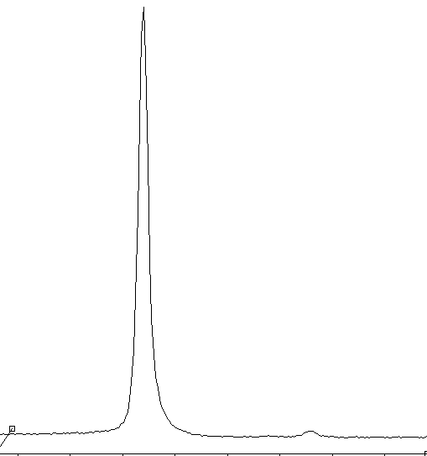
Fat in Cardiomyocyte
Low myocardial TG content
High myocardial TG content
Adapted from McGavock JM et al. Circulation 2007; 116: 1170-5
CH₂
H₂O
H₂O
CH₃
x 50
CH₂ + CH₃
6
5
4
3
2
1
0
6
5
4
3
2
1
0
ppm
ppm
TG: triglycerides
Notes:
Fat content in cardiomyocytes can in analogy to liver be measured by using proton spectroscopy but the technique is challenging and so far only for research purposes.

Slide 24
Cardiac Steatosis – a Component of Ectopic Fat
Lean
Obese
Impaired glucose tolerance
Type 2 diabetes
*
*
Myocardial triglycerides (fat/water )
Intra-abdominal
(visceral) fat (cm²)
54
±
39
120
±
53*
132
±
36*
160
±
65*
1.1
±
0.9
4.3
±
5.2
8.3
±
11.1*
8.9
±
Hepatic fat (fat/water)
8.8*
*p<0.05 vs. lean
Adapted from McGavock JM et al. Circulation 2007;116:1170-5
Notes:
Recent data report that cardiac steatosis is increased in subjects with impaired glucose tolerance and type 2 diabetes in parallel with liver fat.

Slide 25
Myocardial Fat and Coronary Heart Disease
Proton magnetic resonance spectroscopy is technically challenging but a powerful research tool.
Is accumulation of myocardial triglycerides related to diastolic dysfunction? - More rigorous characterization of diastolic function needed.
No data available on the relationship between myocardial fat and coronary heart disease.
Determinants of myocardial triglyceride accumulation are largely unknown.
Data on responses of myocardial triglycerides to pharmacological interventions are non-existing.

Slide 26
Why Is Ectopic Fat Accumulation a Health Hazard?
Caloric intake
and/
or
Energy expenditure
Positive energy balance
Lipid overflow into liver,
pancreas, muscle and epicardium
FFA
Inflamed
adipose
tissue
Ectopic fat accumulation results in lipotoxicity at organ levels with deleterious consequences at cardiovascular disease health.
FFA: free fatty acids
Notes:
Ectopic fat accumulation results in disruption of metabolic homeostasis at specific organs including liver, muscle and pancreas and has adversed effects on myocardial function. Lipotoxicity is seen at organ level and it activates several pathways of inflammation and apoptosis with tissue damage and deleterious consequences at functional levels.

Slide 27
My Warmest Thanks to my Collaborators
"Current players"
Anne Hiukka
Eeva Leinonen
Sakari Mänttäri
Aino Soro-Paavonen
Sanni Söderlund
Jukka Westerbacka
Hannele Yki-Järvinen
Gothenburg
Martin Adiels
Jan Boren
Sven-Olof Olofsson
Glasgow
Muriel Caslake
Chris J. Packard
Philip Steward
"The ladies of the lab"
Hannele Hilden
Virve Naatti
Helinä Perttunen-Nio
Imaging team
Nina Lundbom
Jesper Lundbom
Antti Hakkarainen

Slide 28


