Slide 1
Physical Activity in the Management of Abdominal Obesity
Robert Ross, PhD
School of Kinesiology and Health Studies,
Department of Medicine, Division of Endocrinology and Metabolism
Queen’s University
Kingston, Ontario, Canada

Slide 2
Overview
Challenge (1) Overweight and obese is now the normal phenotype
Opportunity Understand the importance of waist circumference in management of obesity
Challenge (2) Understanding that weight loss is not the optimal outcome for managing obesity
Opportunity Redefine treatment targets – focus on causal behaviours
Challenge (3) Sustaining healthy lifestyle behaviours
Opportunity Reorganize health care teams – understand environmental challenges

Slide 3
Prevalences of Adult Overweight and Obesity in Canada, 2004
 | BMI (kg/m²) | Prevalence
Underweight | <18.5 | 2%
“Normal” | 18.5 – 24.9 | 39%
Overweight | 25.0 – 29.9 | 36%
Obese | ≥30 | 23%
59%
Adapted from Tjepkema M Nutrition (Statistics Canada, Catalogue 82-620-MWE) 2005;1:1-32

Slide 4
Prevalence of Diabetes Across Waist Categories
and Body Mass Index (BMI) subgroups in 99 Thousand Women
Frequency (%)
≥30
25-30
BMI category (kg/m²)
<25
Waist circumference tertile (cm)
The percentage of patients in each of the 9 groups is shown.
Adapted from Balkau B et al. Circulation 2007;116:1942-51

Slide 5
Waist Circumference (WC) Predicts Diabetes Beyond Commonly Evaluated Cardiometabolic Risk Factors
Odds ratio for diabetes
High WC
Moderate WC
Low WC
Number of cardiometabolic risk factors
p trend <0.001 for both WC and risk factors
Adapted from Janiszewski PM et al. Diabetes Care 2007;30:3105-9

Slide 6
Add Waist Circumference to Routine Allied Health Care
To help identify the high-risk, abdominally
obese patient.

Slide 7
Health Risk in Adults According to Body Mass Index (BMI) and Waist Circumference
 | BMI (kg/m²) | Waist circumference
 |  | <102 cm Men <88 cm Women |  | ≥102 cm Men ≥88 cm Women
Normal | 18.5 – 24.9 | Least |  | Increased
Overweight | 25.0 – 29.9 | Increased |  | High
Obese | ≥30 | High |  | Very High

Slide 8
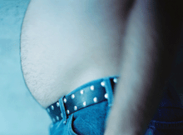
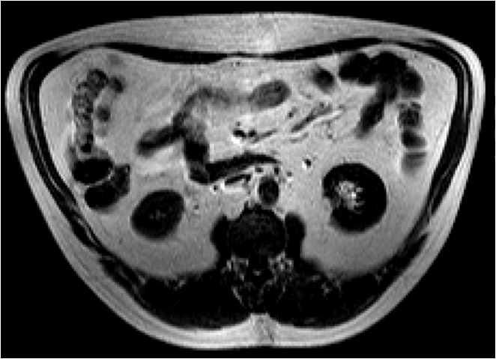
Abdominal Obesity and Cardiometabolic Risk
OUTSIDE
INSIDE
Intra-abdominal or visceral fat
Waist circumference
Intra-abdominal fat
Intra-abdominal fat is a
strong correlate of cardiometabolic risk

Slide 9
Waist circumference and intra-abdominal (visceral) fat
should be primary targets for strategies designed to reduce obesity and related comorbidities.

Slide 10
Overview
Challenge (1) Overweight and obese is now the normal phenotype
Opportunity Understand the importance of waist circumference in management of obesity
Challenge (2) Understanding that weight loss is not the optimal outcome for managing obesity
Opportunity Redefine treatment targets – focus on causal behaviours
Challenge (3) Sustaining healthy lifestyle behaviours
Opportunity Reorganize health care teams – understand environmental challenges

Slide 11
Question
Is it possible to observe meaningful reduction in waist circumference, intra-abdominal (visceral) fat and insulin resistance in response to exercise with substantial (>5%) weight loss?
YES
Is it also possible to observe meaningful reduction in
waist circumference, intra-abdominal fat and insulin resistance in response to exercise with no change in
body weight?

Slide 12
Effects of Diet or Exercise With or Without Weight Loss on Abdominal Obesity and Insulin Resistance
Treatment
1. Control
2. Diet weight loss
3. Exercise weight loss
4. Exercise without weight loss
Subject
recruitment
Random
allocation
Abdominally obese men and women (age ≈45 years): 14-16 weeks
Intervention ≈50 minutes of daily walking on treadmill under supervision
All participants: balanced diet, no caloric restriction

Slide 13
Effects of Diet or Exercise with or Without Weight Loss on Abdominal Obesity and Insulin Resistance
Control
Diet weight loss
Exercise weight loss
Exercise without weight loss
MEN
WOMEN
1
1
0
0
-1
-1
-2
-2
-3
Weekly weight loss (kg)
Weekly weight loss (kg)
-4
-3
-5
-4
-6
-5
-7
(≈7.5 kg)
-6
(≈6 kg)
-8
-7
0
2
4
6
8
10
12
0
2
4
6
8
10
12
14
Week
Week
Adapted from Ross R et al. Ann Intern Med 2000;133:92-103
and Ross R et al. Obes Res 2004;12:789-98

Slide 14
Effects of Aerobic Exercise (4 Months) With or Without Weight Loss on Waist Circumference in Obese Men and Women
Obese men
Obese women
†
Change in
waist circumference (cm)
Change in
waist circumference (cm)
†
*
*
*
Control
Weight
loss
No weight
loss
Control
Weight
loss
No weight
loss
Exercise
Exercise
No change
in BMI
No change
in BMI
* Significant treatment differences (pre vs. post) compared with control (p<0.05)
† Significant treatment differences (pre vs. post) compared with exercise weight loss (p<0.05)
Adapted from Ross R et al. Ann Intern Med 2000;133:92-103
and Ross R et al. Obes Res 2004;12:789-98

Slide 15
Influence of Equivalent Diet- or Exercise-Induced Weight Loss on Abdominal Fat (MRI) in Obese Women
Abdominal subcutaneous fat
Intra-abdominal (visceral) fat
*
Change in abdominal fat (kg)
‡
*
Change in abdominal
subcutaneous and visceral fat (kg)
*
*
*
*
*
*
†
*
C
DWL
EWL
EWW
†
C
DWL
EWL
EWW
NO DIFFERENCE
NO DIFFERENCE
* Significant treatment differences (pre vs. post) compared with control (p<0.05)
† Significant treatment differences (pre vs. post) compared with diet weight loss (p<0.05)
‡ Significant treatment differences (pre vs. post) compared with exercise weight loss (p<0.05)
C: control
DWL: diet weight loss (6 kg)
EWL: exercise weight loss (6 kg)
EWW: exercise without weight loss
MRI: magnetic resonance imaging
Adapted from Ross R et al. Obes Res 2004;12:789-98

Slide 16
Exercise Without Weight Loss is an Effective Strategy for Obesity Reduction in Men With and Without Type 2 Diabetes (T2D)
Abdominal subcutaneous adipose tissue
Intra-abdominal (visceral) adipose tissue
Absolute change (kg)
Relative change (%)
Lean
Obese
T2D
Lean
Obese
T2D
*
*
*
*
*
*
* †
*
*
* †
*
* Significant treatment differences (pre vs. post) within group, p<0.01
† Significantly greater reduction in intra-abdominal fat by comparison to the lean group, p<0.01
Balanced diet, no caloric restriction, no weight loss
Adapted from Lee S et al. J Appl Physiol 2005;99:1220-5

Slide 17
Exercise With or Without Weight Loss on Skeletal Muscle Mass in Obese Men and Women
Obese men
Obese women
†
Change in skeletal muscle (kg)
Change in skeletal muscle (kg)
*
C
DWL
EWL
EWW
C
DWL
EWL
EWW
C: control
DWL: diet weight loss (6 kg)
EWL: exercise weight loss (6 kg)
EWW: exercise without weight loss
MRI: magnetic resonance imaging
* Significant treatment differences (pre vs. post) compared with control (p<0.05)
† Significant treatment differences (pre vs. post) compared with diet weight loss (p<0.05)
Adapted from Ross R et al. Ann Intern Med 2000;133:92-103
and Ross R et al. Obes Res 2004;12:789-98

Slide 18
Effect of Acute Exercise on Insulin Sensitivity in Men and Women
*
27%
Insulin sensitivity (mg/kg/min)
Baseline
Acute
(1 Day)
*p=0.05 compared to baseline
Adapted from Perseghin G et al. N Engl J Med 1996;335:1357-62

Slide 19
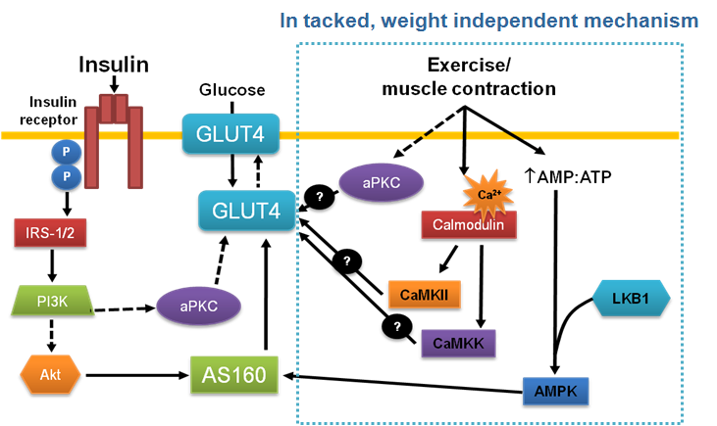
Proposed Model for the Signalling Pathways Mediating Insulin and Contraction-Induced Skeletal Muscle Glucose Transport
Akt: protein kinase B
AMPK: AMP-activated protein kinase
AMT: ATP: adenosine monophosphate and adenosine-5'-triphosphate ratio
aPKC: atypical protein kinase C
AS160: Akt substrate of 160 kDa
CaMKII: Ca²⁺/calmodulin-dependent protein kinase II
CaMKK: Ca²⁺/calmodulin-dependent protein kinase kinase
GLUT 4: glucose transporter 4
IRS-1/2: insulin receptor substrate 1/2
LBK1: serine/threonine kinase
P: phosphorylation
PI3K: phosphatidylinositol 3-kinase
Adapted from Röckl KS et al. IUBMB Life 2008;60:145-53

Slide 20
The Future of Obesity Reduction: Beyond Weight Loss
Exercise with or without weight loss on glucose metabolism
Change in glucose disposal
(mg/kg muscle/min)
Decrease in OGTT-insulin AUC (UI)
Control
+4
to 0
-0.1
to -3
-3.1
to -5
-5.1
to -8
-8.1
to -10
Control
+4
to 0
-0.1
to -3
-3.1
to -5
-5.1
to -8
-8.1
to -10
Weight change (%)
Weight change (%)
Adapted from Ross R and Bradshaw A Nat Rev Endocrinol 2009;5:319-25

Slide 21
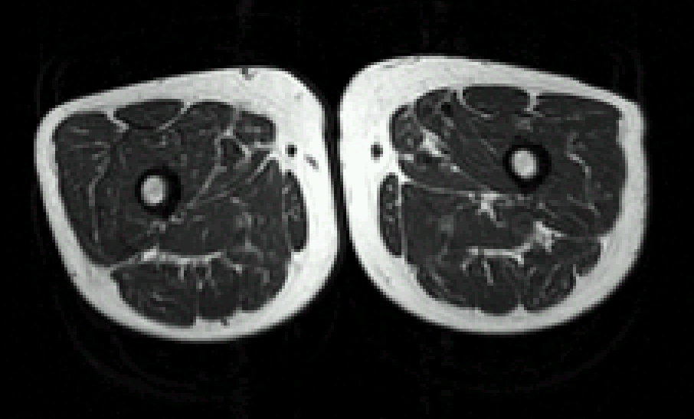
Obese Elderly: The Merging of Two Epidemic Trends
Intra-abdominal (visceral) fat
Upper Body
Cardiovascular
disease risk
Lower Body
Skeletal muscle
Subcutaneous fat

Slide 22
Effects of Exercise Modality on Insulin Resistance and Functional Capacity in Aging: A Randomized Controlled Trial
Treatment groups
1. Control (n=28)
2. Resistance exercise (n=36)
3. Aerobic exercise (n=37)
4. Resistance and aerobic (n=35)
Random
allocation
Abdominally obese men and women (age ≈68 years):
6-month exercise intervention, without caloric restriction.
Adapted from Davidson LE et al. Arch Intern Med 2009;169:122-31

Slide 23
Effects of Exercise Modality on Body Weight and Waist Circumference in Older Men and Women
Resistance
exercise
Aerobic
exercise
Aerobic and
resistance
exercise
Control
1
0
-1
-2
Percent change (%)
-3
* †
*
* †
-4
Body weight
*
-5
Waist circumference
* †
-6
* Change significantly greater than the control group p<0.05
† Change significantly greater than the resistance exercise group p<0.05
Adapted from Davidson LE et al. Arch Intern Med 2009;169:122-31

Slide 24
Effects of Exercise Modality on Intra-Abdominal Fat, Total Fat and Skeletal Muscle in Older Men and Women
* †
* †
Skeletal muscle
Intra-abdominal (visceral) fat
Abdominal fat
Total fat
Percent change (%)
* ‡
* ‡
*
*
*
*
Control
Resistance
exercise
Aerobic
exercise
Aerobic and
resistance
exercise
* Change significantly greater than the control group p<0.05
† Change significantly greater than the resistance exercise group p<0.05
‡ Change significantly greater than the aerobic exercise group p<0.05
Adapted from Davidson LE et al. Arch Intern Med 2009;169:122-31

Slide 25
Effects of Exercise Modality on Insulin Sensitivity in Older Men and Women
* †
*
Percent change in insulin sensitivity (%)
Control
Resistance
exercise
Aerobic
exercise
Resistance and
aerobic exercise
* Change significantly greater than the control group p<0.05
† Change significantly greater than the resistance exercise group p<0.05
Adapted from Davidson LE et al. Arch Intern Med 2009;169:122-31

Slide 26
Principal Finding
150 minutes of weekly exercise
Reduction of abdominal and intra- abdominal (visceral) fat
Increase in skeletal muscle mass
Improvement in insulin resistance
Improvement in cardiorespiratory fitness
Balanced diet, exercise, no weight loss
Adapted from Davidson LE et al. Arch Intern Med 2009;169:122-31

Slide 27
For Reducing Obesity and Related Comorbidities, Exercise Without (Minimal) Weight Loss is Not a Failure
Obese men and women
8
Winner!
6
Decrease in abdominal and intra-
abdominal (visceral) fat
Waist circumference reduction
4
Decrease in waist circumference
2
Benefits
Increase in skeletal muscle mass
0
Control
Weight
loss
No weight
loss
Increase in cardiorespiratory fitness
Exercise
Increase in insulin sensitivity
No change
in BMI
Adapted from Ross R and Bradshaw AJ Nature Rev Endocrinol 2009;5:319-26

Slide 28
Rethink our Treatment Targets
For management of obesity and related health risk,
we must look beyond weight loss as the only indicator of therapeutic/treatment success.

Slide 29
Add Waist Circumference to Routine Allied Health Care
To help identify the high-risk, abdominally obese patient.
To follow the utility of strategies designed to reduce obesity and related health risk.

Slide 30
Overview
Challenge (1) Overweight and obese is now the normal phenotype
Opportunity Understand the importance of waist circumference in management of obesity
Challenge (2) Understanding that weight loss is not the optimal outcome for managing obesity
Opportunity Redefine treatment targets – focus on causal behaviours
Challenge (3) Sustaining healthy lifestyle behaviours
Opportunity Reorganize health care teams – understand environmental challenges

Slide 31
Reduction in the Incidence of Type 2 Diabetes with Lifestyle Intervention or Metformin
Placebo
28.8%
Metformin
21.7%
Lifestyle
Cumulative incidence of diabetes (%)
Major findings:
The lifestyle intervention reduced incidence by 58% and metformin by 31% compared with placebo.
The lifestyle intervention was more effective than metformin.
14.4%
Study year
Adapted from Knowler WC et al. N Engl J Med 2002;346:393-403

Slide 32
Exercise on Prescription for Women Aged 40-74 Recruited Through Primary Care: Two-Year Randomized Controlled Trial
Objective
To increase proportion of participants achieving at least 150 minutes of moderate intensity physical activity at
12 and 24 months.
Lawton BA et al. BMJ 2008;337:a2509

Slide 33
Timeline of Intervention
9-month intervention: “Lifestyle script”
Pragmatic, cost-effective
V
T
T
T
V
T
T
Baseline
6 months
12 months
Outcome measures
24 months
Outcome measures
V: Visit with primary care nurse: brief counselling to increase physical activity (≈30 minutes)
T: Telephone-based activity counselling from exercise specialist (≈15 minutes)
All counselling based on motivational interviewing techniques.
Adapted from Lawton BA et al. BMJ 2008;337:a2509

Slide 34
Proportion of Participants Achieving at Least 150 minutes of Moderate Intensity Physical Activity at Baseline and 12 and 24 Months
p<0.001
Intervention
Control
Proportion (%)
NO WEIGHT OR WAIST REDUCTION
Adapted from Lawton BA et al. BMJ 2008;337:a2509

Slide 35
Determining Optimal Approaches for Weight Maintenance: a Randomized Controlled Trial
Treatment groups
High-CHO diet + intensive support
(nutritionist + kinesiologist)
2. High-CHO diet + nurse support (“weigh-ins” and telephone)
3. High-fat diet + intensive support
4. High-fat diet + nurse support
Subjects who
lost ≈5% weight
Random
allocation
Adapted from Dale KS et al. CMAJ 2009;180:E39-46

Slide 36
Timeline of Intervention
V
T
V
T
10 minutes, every two weeks
Nurse
K
D
12 months
24 months
2 weeks
11, 1 on 1 sessions 30 minutes (kinesiologist)
Intensive
Baseline
12 months
Outcome measures
24 months
Outcome measures
K: Visit with kinesiologist: brief counselling to increase physical activity
D: Visit with nutritionist to receive instruction on assigned diet
V: Visit with primary care nurse: brief counselling to increase physical activity (≈30 minutes)
T: Telephone-based activity counselling from kinesiologist (≈15 minutes)
Adapted from Dale KS et al. CMAJ 2009;180:E39-46

Slide 37
Differences at Follow-Up in Body Weight and Waist Circumference of Participants of the Nurse-Support and the Intensive-Support Program
 | Nurse |  |  | Intensive
 | Baseline | 12 months | 24 months | Baseline | 12 months | 24 months
Weight (kg) | 85.1 | 83.3 | 83.0 | 86.6 | 85.0 | 84.3
Waist (cm) | 93.3 | 90.9 | 90.1 | 96.3 | 93.3 | 91.6
Adapted from Dale KS et al. CMAJ 2009;180:E39-46

Slide 38
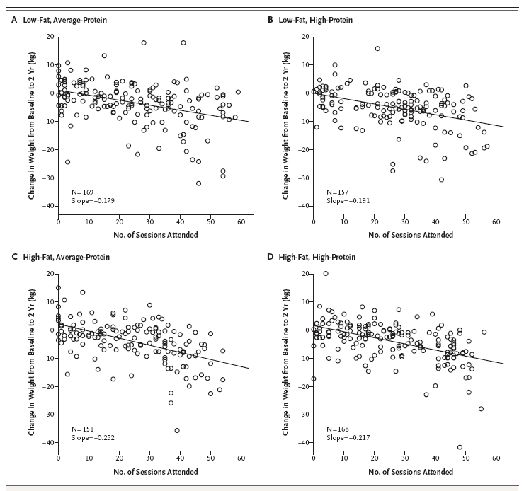
Change in Body Weight According to Attendance at Counselling Sessions for Weight Loss
From Sacks FM et al. N Engl J Med 2009;360:859-73
Reproduced with permission

Slide 39
To Sustain Adoption of Healthy Behaviours…
Self-monitoring and support
It may not be what we (interventionist) say, but how we say it (supportive), and
how often (short and sweet).

Slide 40
Opportunity for Management of Obesity… …Reorganize Health Care Teams
Primary care today
Primary care tomorrow
Physician
Nurse
Physician
Nurse
Nutritionist
Kinesiologist
Barriers to treatment:
Lack reimbursement options
Lack training
Lack time
Lack motivation – unproven strategies
Behavioural
consultant

Slide 41
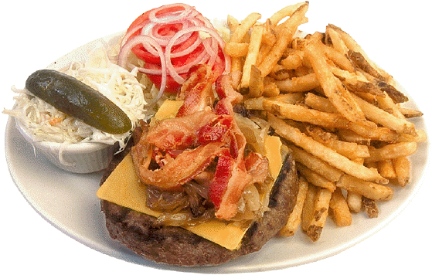
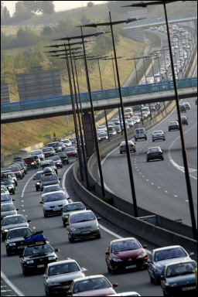
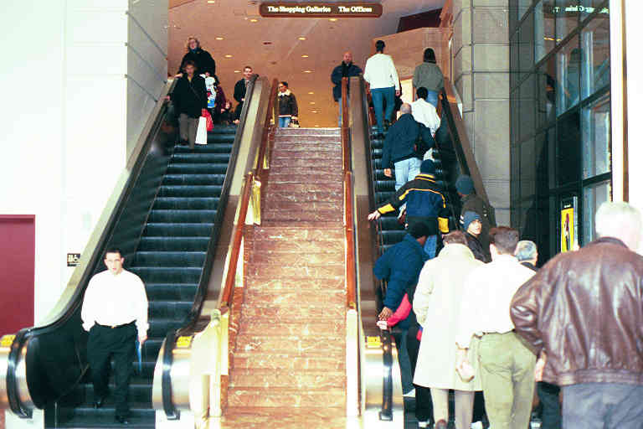
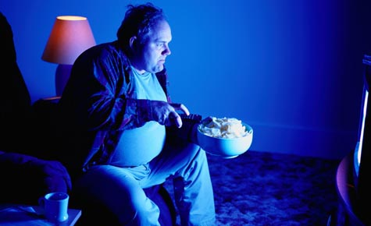
If Physical Activity is the Answer… What is the Problem? A Response, Create Optimal Defaults
Increasing physical activity behaviour in today’s
environment poses a challenge…

Slide 42
Optimal Default…
…Make responsible behaviours the easy choice
“The challenge is to create better defaults. This will be possible
only when we turn from blaming people for irresponsible
actions to giving the nation what it deserves -- conditions
that make responsible behavior the easy choice.”
Kelly Brownell, Yale University, Rudd Center For Food Policy and Obesity

Slide 43
Challenges: Creating Optimal Defaults
Diet is driven by terrible defaults…
Large portion sizes
Schools selling unhealthy foods
Economic policy that makes healthy food cost more than calorie-dense processed foods

Slide 44
Free Gym!!

Slide 45
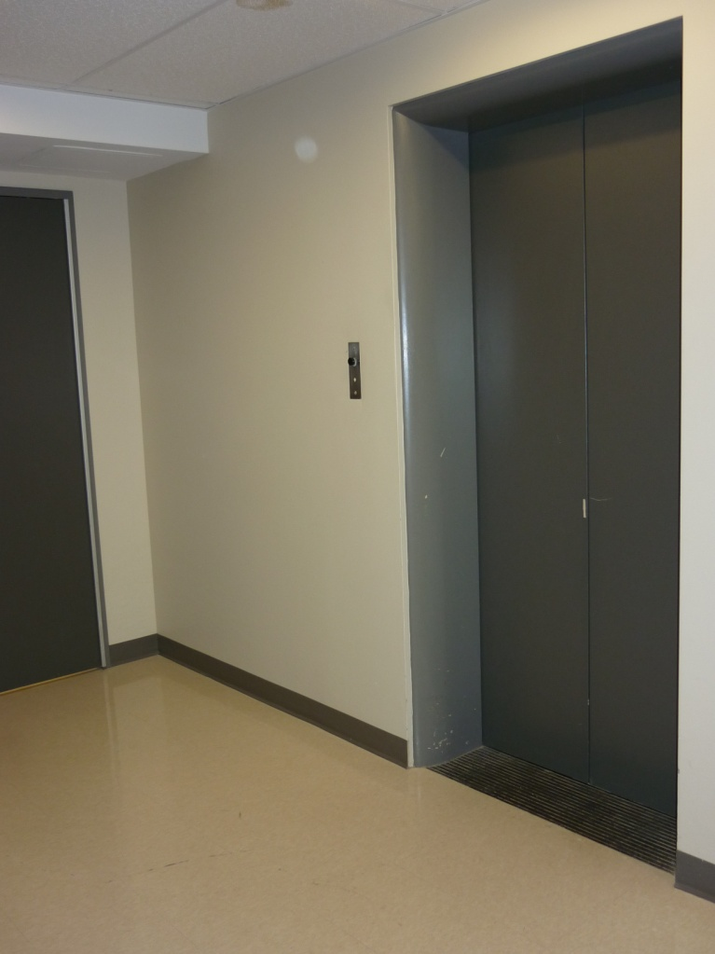
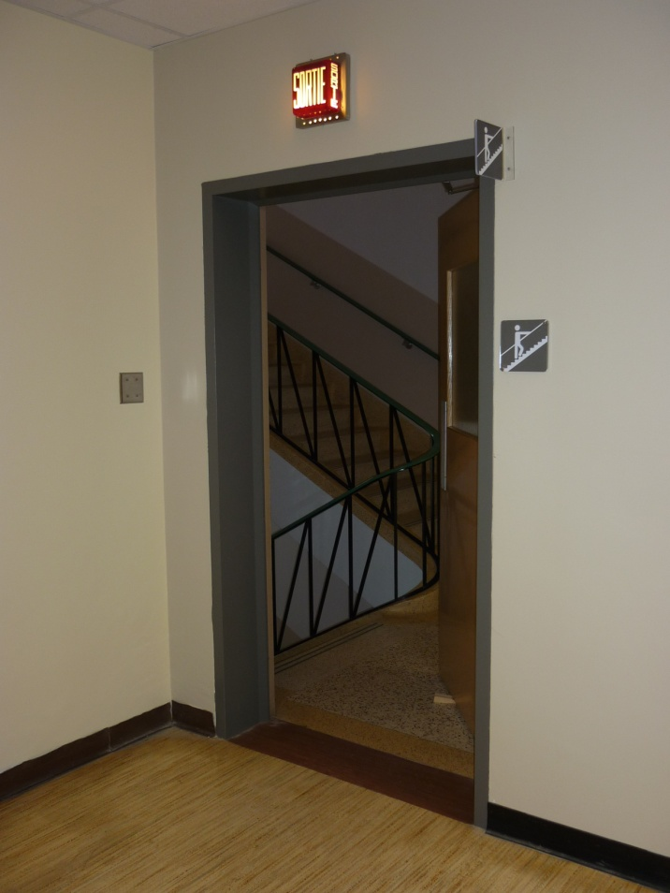
Optimal Default… Make Responsible Behaviours the Easy Choice
Optimal default Easy choice

Slide 46
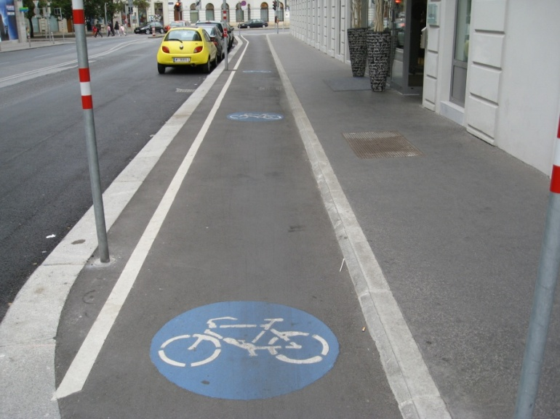
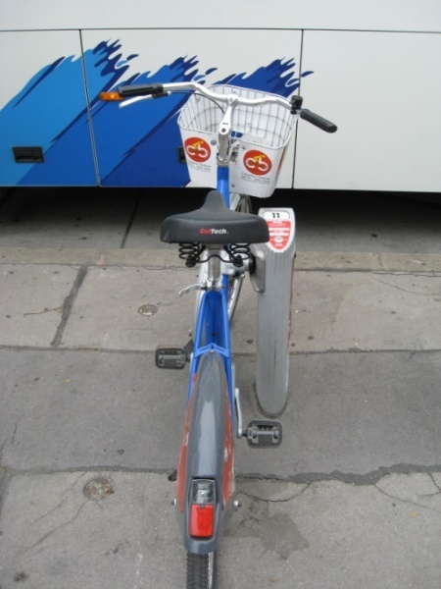
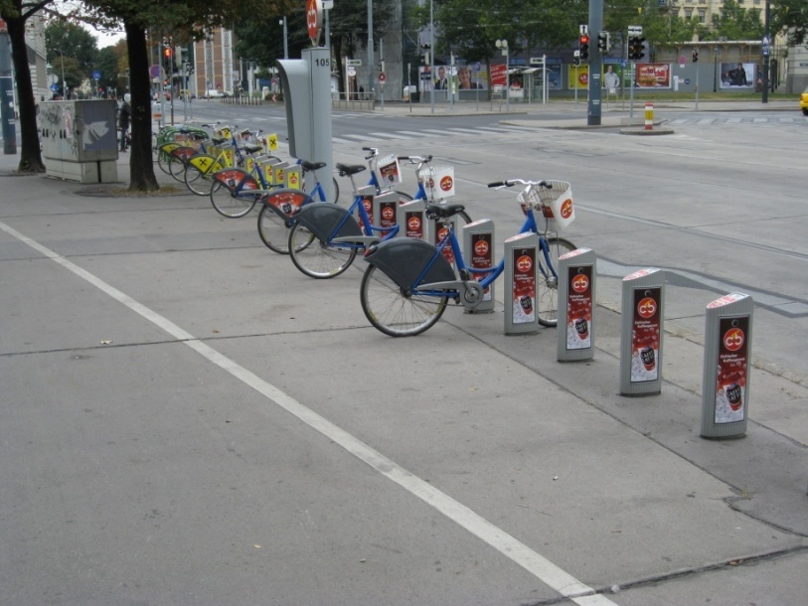
VIENNA

Slide 47
SUMMARY

Slide 48
Overview
Challenge (1) Overweight and obese is now the normal phenotype
Opportunity Understand the importance of waist circumference in management of obesity
Challenge (2) Understanding that weight loss is not the optimal outcome for managing obesity
Opportunity Redefine treatment targets – focus on causal behaviors
Challenge (3) Sustaining healthy lifestyle behaviors
Opportunity Reorganize health care teams – understand environmental challenges

Slide 49
Add Waist Circumference to Routine Allied Health Care
To help identify the high-risk, abdominally obese patient.
To follow the utility of strategies designed to reduce obesity and related health risk.

Slide 50
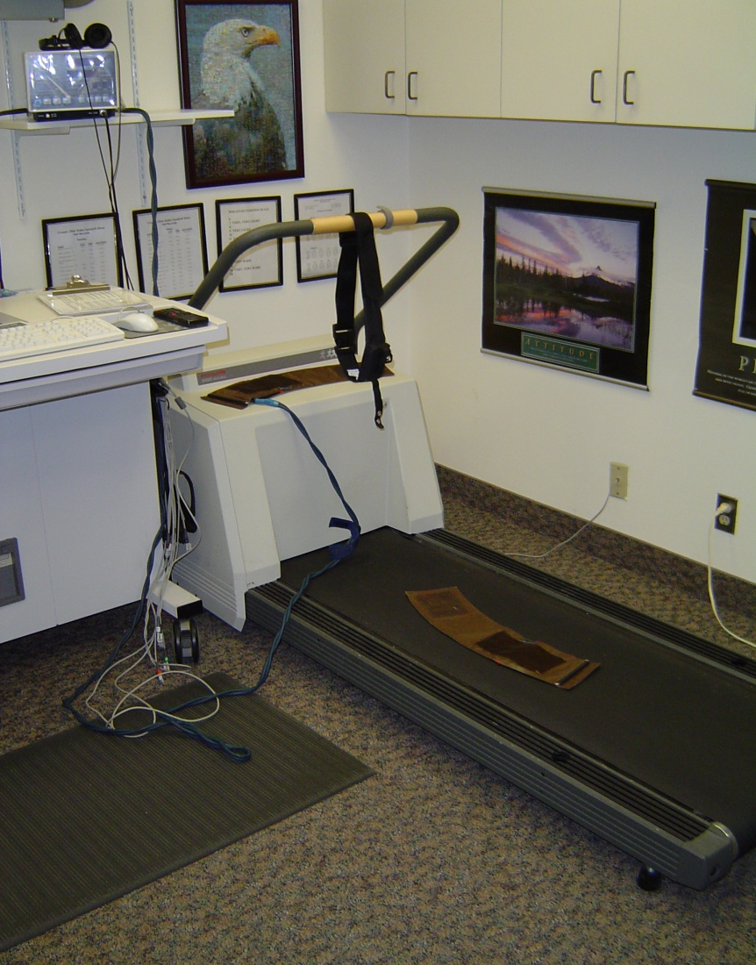
Measure Cardiorespiratory Fitness and/or Physical Activity Level

Slide 51
Brief Physical Activity Assessment Tool Purpose: To Distinguish Inactive From Regularly Active Patients
How many times a week, do you usually do 20 minutes or more of vigorous physical activity that makes you sweat or puff and pant? (for example, jogging, heavy lifting, digging, aerobics, or fast bicycling)
Response Score
a. ≥ 3 times/week 4
b. 1-2 times/week 2
c. none 0
How many times a week, do you usually do 30 minutes or more of moderate physical activity or walking that increases your heart rate or makes you breath harder than normal? (for example, mowing the lawn, carrying light loads, bicycling at a regular pace, or playing doubles tennis)
Response Score
a. ≥ 5 times/week 4
b. 3-4 times/week 2
c. 1-2 times/week 1
Total score 1 + score 2: ______
Score ≥ 4 = ‘‘Sufficiently’’ active (encourage patient to KEEP IT UP)
Score 0–3 = ‘‘Insufficiently’’ active (encourage patient to do MORE)
Adapted from Smith BJ et al. Am J Prev Med 2005;29:256-64
and Marshall AL et al. Br J Sports Med 2005;39:294-7

Slide 52
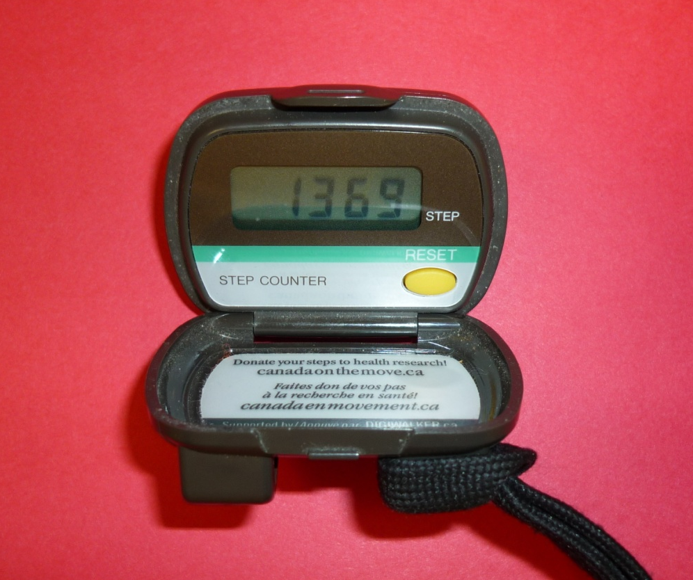
Importance of Self-Monitoring – Role for Pedometers
Accumulate 30-60 minutes per day
3000 to 10,000 extra steps/day

Slide 53
Rethink our Treatment Targets
For management of obesity and related health risk,
we must look beyond weight loss as the only indicator of therapeutic/treatment success.

Slide 54
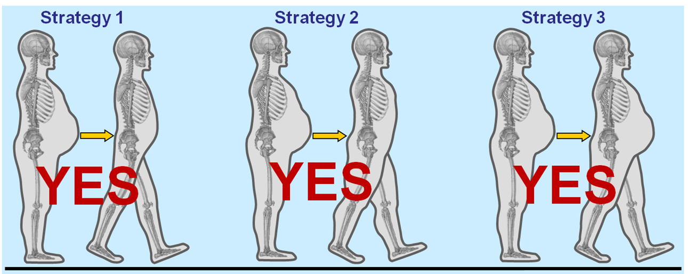
Strategies for Reducing Obesity-Related Diabetes Risk
↓ BMI
↓ WC
↑ CRF
No change in BMI
↓ WC
↑ CRF
No change in BMI
No change in WC
↑ CRF
↓ Mortality and morbidity risk?
↓ Mortality and morbidity risk?
↓ Mortality and morbidity risk?
BMI: body mass index CRF: cardiorespiratory fitness
WC: waist circumference
Adapted from Ross R and Janiszewski PM Can J Cardiol 2008;24:25D-31D

Slide 55
Take Home Messages
When managing obesity and related health risk
Focus on the causal behaviours
Physical inactivity and poor diet

