Slide 1
Global Dimensions of Sugary Beverages in Programmatic and Policy Solutions
Barry Popkin, PhD
Department of Nutrition, School of Public Health and Medicine Department of Economics
The University of North Carolina at Chapel Hill

Slide 2
Outline
How the world changing from water and breast-milk to sweetened and caloric beverages.
Case studies: Mexico and the U.S. with economic research on possible solutions.
Little knowledge on total diabetes-related health benefits of water.
Large-scale programs and policies: Mexico, others.

Slide 3
High Income vs. Transitional and Low Income Countries
Trend toward a higher body mass index (BMI) in higher income countries reaches back a century but major increase seen in the 1980’s to the present.
In contrast, minimal obesity in most of developing and transitional world until the last 20-30 years with very large, rapid shifts upwards in the past 20 years.
Now at a point where the world is fat and the dynamics are leading our dietary and activity patterns and obesity patterns toward some type of convergence, at least for the present!

Slide 4
Sources of Major Global Dietary Shifts
Increased intake of caloric sweeteners, especially beverages.
Increased snacking across the globe, especially salty snacks.
Increased edible oil and animal source food in most of the lower and middle income economies.
Increased intake of processed foods, refined carbohydrates.
Reduced intake of fruits, vegetables and legumes.
Reduced preparation time, increased intake of pre-cooked foods.

Slide 5
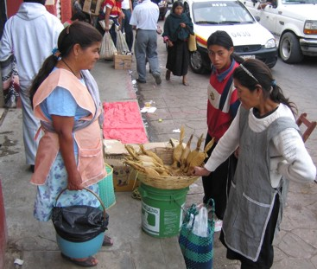
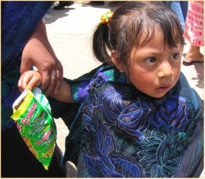
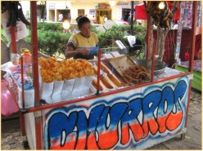
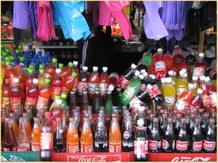
From Traditional to Modern Snacking

Slide 6
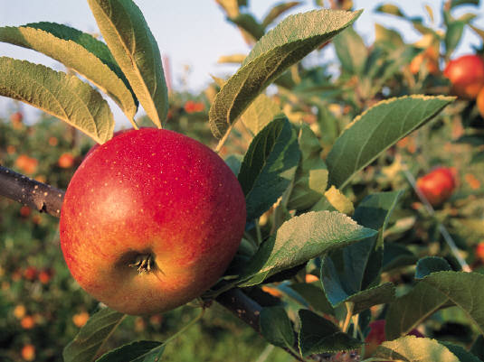
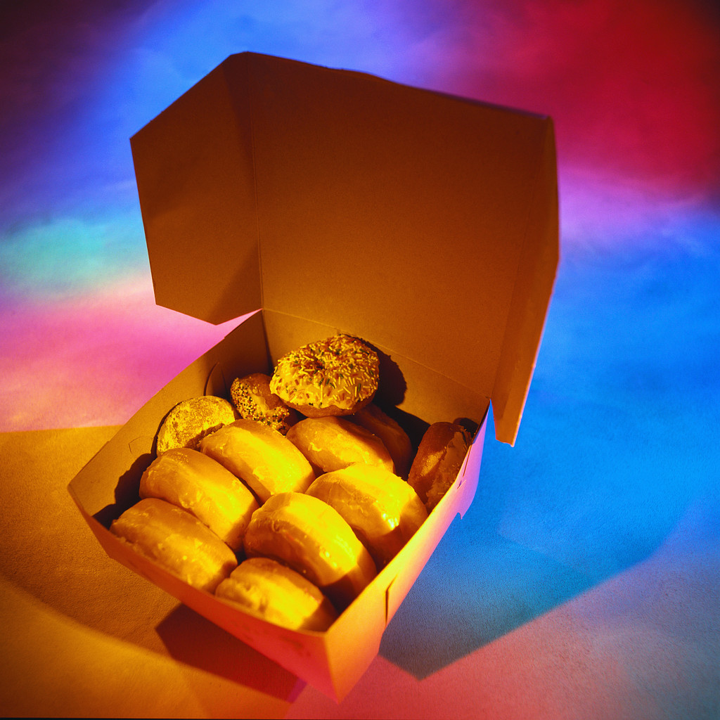
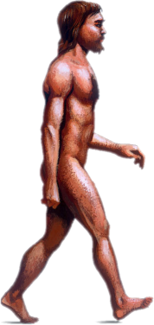
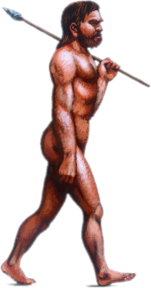
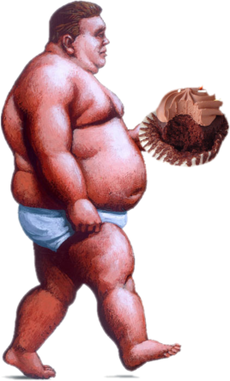
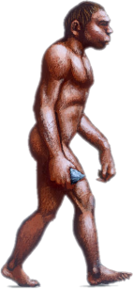
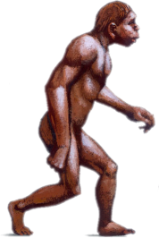
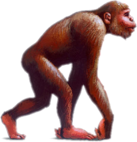
Sweetness Preference was Essential to Survive: Huge Shift in Amounts, Energy Density

Slide 7
Sweetness
Many think that we have inborn biological wisdom but how and why and what role this plays in our food preferences has not achieved consensus. Because sweet foods are naturally good and are safe sources of energy and nutrients, adaptive evolutionary development has resulted in a preference for them. Of the five most widely acknowledged tastes, three generally signal acceptance (sweet, salty, and umami*), while two generally signal avoidance (sour and bitter). These early responses are modified by life experiences, producing adult taste preferences.
* Umami, also referred to as savoriness, is one of the basic tastes sensed by specialized receptor cells present on the human and animal tongue.

Slide 8
Sweetness and Effects on Eating Preferences
Expose infants to sweetness and find several years later desire exists for sweet foods.
Studies on mice, primates replicate this.
Virtually no long-term studies on exposure to sweetness and sweet foods and subsequently how it influences our needs and eating patterns.

Slide 9
Increases in Total Calories From Added Sugar Are Greatest Among Top 20% of Population
 | Q1 | Q2 | Q3 | Q4 | Q5 | Total
1965 | 61 | 162 | 262 | 396 | 701 | 316
1977 | 32 | 114 | 195 | 299 | 560 | 240
1989-91 | 29 | 113 | 206 | 324 | 616 | 258
1999-00 | 62 | 194 | 321 | 491 | 956 | 405
2001-02 | 59 | 176 | 300 | 464 | 882 | 376
2003-04 | 56 | 172 | 295 | 464 | 896 | 377
-8.2%
+27.8%
Adapted from Duffey KJ and Popkin BM Am J Clin Nutr 2008; 88:1722S-32S

Slide 10
Steepest Increase in Calories of Added Sugar From Soda, per Capita and Consumer Estimates
Per capita
Per consumer
Calories from selected food groups
Desserts
Fruit drinks
Soda
Adapted from Duffey KJ and Popkin BM Am J Clin Nutr 2008; 88:1722S-32S

Slide 11
What are the Implications of Drinking Energy and Eating Water on Energy Balance?
General Properties
Hunger – Feeding Sensations that promote attainment of minimal energy needs.
Energy excess Stored
Energy deficit Consequences experienced in weeks or months.
Thirst – Drinking Sensations that promote attainment of minimal hydration needs.
Water excess Excreted
Water deficit Consequences experienced in 2-4 days.

Slide 12
Remarkably Short History for Caloric Beverages: Might the Absence of Compensation Relate to This Historical Evolution?
Earliest possible date
52 gal soda/American (2004)
Definite date
46 gal coffee/American (1946)
Juice Concentrates (1945)
45 gal milk/American (1945)
200,000BCE - 10,000 BCE Origin of humans
Modern beverage era
10,000 BCE - present
Coca-Cola (1886)
Mammals evolve – 200,000 BCE
Pre-homo sapiens
Pasteurization (1860-64)
Carbonation (1760-70)
Liquor (1700-1800)
Lemonade (1500-1600)
Coffee (1300-1500)
Brandy Distilled (1000-1500)
BCE: before common era
CE: common era
Tea (500 BCE)
(206 CE)
Wine, Beer, Juice (8,000 BCE)
Wine (5,400 BCE)
Water, Breast Milk
Beer (4,000 BCE)
Milk (9,000 BCE)
(2,000 BCE)
200,000 BCE Homo sapiens
100,000 BCE
Beginning of Time
200,000 BCE
10,000 BCE
0
BCE
CE
Adapted from Wolf A et al. Obes Rev 2007; 9: 151-64

Slide 13
Daily Beverage Consumption Trends of Mexican Children, 1999-2006
Other
Whole milk
343
Sweetened juice drinks
297
Sodas
190
Calories per capita (kcal)
165
Children aged 1-4
Children aged 5-11
Sweetened juice drinks include 100% fruit juice with sugar added and agua fresca (water, juice, sugar).
Sodas include carbonated and noncarbonated sugar bottled beverages.
Adapted from Rivera JA et al. Salud Publica Mex 2008; 50: 173-95

Slide 14
Beverage Consumption Trends of Mexican Adolescents and Adult Women, 1999 and 2006
High sugar
349
366
High calorie and low benefit
Low calories
Kcal per day
154
145
12-18 years of age
19-49 years of age
High sugar is composed of mainly soft drinks, sweetened juices, agua frescas and alcohol.
High calorie and low benefit is mainly whole milk.
Low calories are slightly sweetened coffee and skim milk.
Adapted from Rivera JA et al. Salud Publica Mex 2008; 50: 173-95

Slide 15
Per Capita Change in Calories From Beverages Between 1965 and 2006 Among U.S. Adults (≥19)
Unsweetened coffee & tea
Whole fat milk
Low fat milk
Alcohol
Diet
Soda/fruit drinks
Juices
Other caloric beverages
450.2
396.5
411.6
248.7
263.7
Calories from beverages per day (kcal)
Adapted from Duffey KJ and Popkin BM Obesity 2007; 15: 2739-47

Slide 16
Per Capita Change in Calories From Beverages Between 1965 and 2006 Among U.S. Children (2-18)
Unsweetened coffee & tea
Whole fat milk
Low fat milk
Alcohol
Diet
Soda/fruit drinks
Juices
Other caloric beverages
450.3
436.6
411.1
384.2
389.5
Calories from beverages per day (kcal)
Adapted from Popkin BM Physiol & Behav 2010;100:4-9
and unpublished data

Slide 17
Little Change in Water Intake, Major Increase in U.S. Intake of Calorically-Sweetened Beverages Among U.S. Adults (≥19)
Water
Diet
Unsweetened coffee & tea
Nutrients
Low fat milk
Caloric
101.0
94.9
94.4
To convert ounces to grams, divide by 0.035 and to convert fluid ounces to milliliters multiply by 29.57.
The water data was collected differently for National Health and Nutrition Examination Survey (NHANES) 2005-6 and is not comparable with earlier water data.
Ounces per day
Adapted from Duffey KJ and Popkin BM Obesity 2007; 15: 2739-47
and unpublished data

Slide 18
So What About Noncaloric Beverages?
Sweetened diet beverages: this is a complex picture. Our work in process suggests it is the diet linked with these beverages that determines the effect and not the diet beverages per se though there are issues unresolved in the sweetener world related to intense noncaloric sweeteners (Mattes RD and Popkin BM Am J Clin Nutr 2009; 89: 1-14).
Water is best! Very limited research. Some studies beginning to suggest important direct calorie replacement and possibly added effects of water on energy intake, weight and metabolic functioning.

Slide 19
The A to Z Study: The Relationship of Water Intake With Adjusted Mean Daily Total Energy Intake
Drinking water
<1 liter/day
>1 liter/day
Total energy intake (kcal/day)
Time (month)
Adapted from Stookey JD et al. Obesity 2007; 15: 3013-22

Slide 20
The A to Z Study: The Relationship of Water Intake With Mean Body Weight
Drinking water
<1 liter/day
>1 liter/day
Body weight (kg)
Time (month)
Adapted from Stookey JD et al. Obesity 2008; 16: 2481-8

Slide 21
The World is Flat and Fat: Globalization Has Occurred for Centuries
Naïve idea that globalization is a phenomena of the past few decades.
Consider how Columbus et al. introduced from the Americas to the cuisines of the world: chili peppers in Asia, potatoes in Europe, and tomatoes in Italy are examples. Or noodles from Asia to Italy.
Recent rapid acceleration in areas such as communications, technology, transportation systems, distribution technologies affect how we eat, move, drink.

Slide 22
Mexico Initiative on Beverages
Remove all whole milk, shifted now to 1.5% and later to skim milk all governmental programs.
Schools: working to ban all sugar-sweetened beverages, provide safe water, allow water, low fat milk to be sold.
Taxation being considered: tax added sugars in beverages per gram, fat in milk.
National media effort. Began February 25th with launch of Mexican Beverage Guidelines.
Adapted from Rivera JA et al. Salud Publica Mex 2008; 50: 173-95

Slide 23
Limitations to Current Studies of Economic Predictors of Dietary Intake in the U.S.
No studies examine the effects of food prices on individual dietary intake in the U.S. except broad ecological relationships done in a cross-sectional manner.
Creation for CARDIA cohort of adults followed over 20 years, food prices linked with the SMSA (Standard Metropolitan Statistical Area) of each adult by our University of North Carolina team.
Fairly detailed quantitative food frequency and clinical exam and fasting blood data.
Focus on prices of beverages and fast foods here.
Adapted from Duffey KJ et al. Arch Intern Med 2010; 170: 420-6

Slide 24
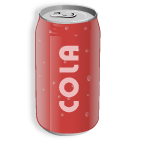
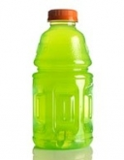
Methods: Price Elasticity of Demand
Elasticity= % change in demand
% change in price
Own-price elasticity
Cross-price elasticity
% Δ $
% $
kcals
Negative
% Δ $
% $
kcals
Negative
or positive

Slide 25
18% Increase in Price of Soda or Pizza Associated With 20-Year Declines in Total Daily Energy Intake
Change in total daily energy intake (kcals)
Soda
Pizza
*Significant, p<0.05 using log-log linear regression model controlling for age, race, gender, income, education, family structure, logged price of complement and replacement foods, cost of living, imputed price, and time.
Adapted from Duffey KJ et al. Arch Intern Med 2010; 170: 420-6

Slide 26
Combined 10% Change in Price Results in Greater Percent Change in Outcomes
Percent change in outcome (%)
Soda
Pizza
Soda & pizza
Total energy
Body weight
HOMA-IR
HOMA-IR: homeostasis model of assessment - insulin resistance
Adapted from Duffey KJ et al. Arch Intern Med 2010; 170: 420-6

Slide 27
Policy Actions – Next Steps
New York state: proposed 18% tax on soft drinks.
Maine: already instituted such a tax.
Calorie labelling of beverages in fast food locations in the U.S. in many states and metropolitan areas.
Banning vending machines in schools (France, UK).
Massachusetts considering beverage tax, also federal health care reform.

Slide 28
Program and Policy Effectiveness: Are We Ready for Preventive Action? Major Research Gap Exists
Macroeconomic options: price changes matter, governments subsidize wrong foods now, excise or value added tax on grams of sugar added would be most effective — cover all sugary beverages.
WCRF (World Cancer Research Fund)/AICR (American Institute for Cancer Research) recommendation for cancer prevention focuses on sugary beverages — confluence of cancer, heart, diabetes, obesity concerns.
Energy conservation: extra water, energy to add sugar and flavourings to water.

Slide 29
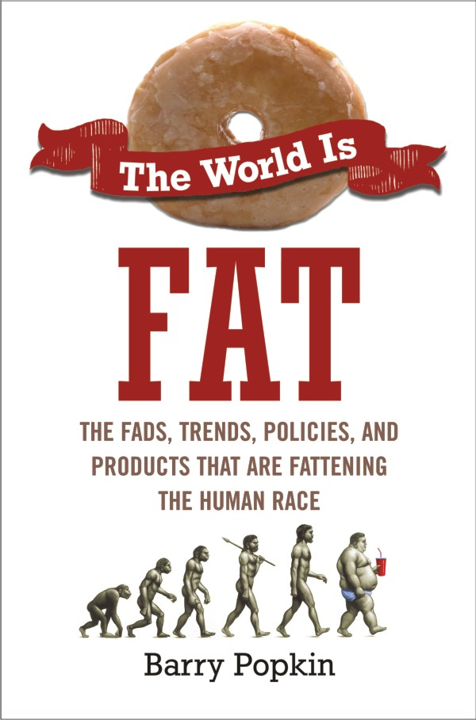
The Book
“The most serious epidemic ever is insidiously engulfing the world. Barry Popkin draws upon his decades of research and experience to describe its origins -and a set of potential solutions. Those interested in the future of mankind should read this book.”
Walter Willett, author of Eat, Drink, and Be Healthy, and Chair, Department of Nutrition, Harvard University

