Slide 1
Clinical Management of CVD Risk in Abdominal Obesity and Type 2 Diabetes
Targeting Blood Pressure
Paul Poirier MD, PhD, FRCPC, FACC, FAHA
Associate Professor, Faculty of Pharmacy, Université Laval
Centre de recherche de l’Institut universitaire de cardiologie et de pneumologie de Québec
Québec, QC, Canada

Slide 2
Leading Causes of Attributable Global Mortality and Burden of Disease, 2004 (WHO)
Attributable Mortality
Attributable DALYs
1
High blood pressure
12.8
1
Childhood underweight
5.9
2
Tobacco use
8.7
2
Unsafe sex
4.6
3
High blood glucose
5.8
3
Alcohol use
4.5
4
Physical inactivity
5.5
4
Unsafe water, sanitation, hygiene
4.2
5
Overweight and obesity
4.8
5
High blood pressure
3.7
6
High cholesterol
4.5
6
Tobacco use
3.7
7
Unsafe sex
4.0
7
Suboptimal breastfeeding
2.9
8
Alcohol use
3.8
8
High blood glucose
2.7
9
Childhood underweight
3.8
9
Indoor smoke from solid fuels
2.7
10
Indoor smoke from solid fuels
3.3
10
Overweight and obesity
2.3
59 million total global deaths in 2004
1.5 billion total global DALYs in 2004
DALYs: disability-adjusted life risk factors
Adapted from GLOBAL HEALTH RISKS: Mortality and burden of disease attributable to selected major risks
WHO Library Cataloguing-in-Publication Data
© World Health Organization 2009

Slide 3
Deaths Attributed to 19 Leading Factors, by Country Income Level, 2004
High blood pressure
Tobacco use
High blood glucose
Physical inactivity
Overweight and obesity
High cholesterol
Unsafe sex
Alcohol use
Childhood underweight
Indoor smoke from solid fuels
Unsafe water, sanitation, hygiene
Low fruit and vegetable intake
Suboptimal breastfeeding
Urban outdoor air pollution
Occupational risks
Vitamin A deficiency
High income
Zinc deficiency
Middle income
Unsafe health-care injections
Low income
Iron deficiency
0
1000
2000
3000
4000
5000
6000
7000
8000
Mortality in thousands (total: 58.8 million)
Adapted from GLOBAL HEALTH RISKS: Mortality and burden of disease attributable to selected major risks
WHO Library Cataloguing-in-Publication Data
© World Health Organization 2009

Slide 4
Percentage of Disability-Adjusted Life Risk Factors, by Country Income Level, 2004 Years (DALYs) Attributed to 19 Leading Factors
Childhood underweight
Unsafe sex
Alcohol use
Unsafe water, sanitation, hygiene
High blood pressure
Tobacco use
Suboptimal breastfeeding
High blood glucose
Indoor smoke from solid fuels
Overweight and obesity
Physical inactivity
High cholesterol
Occupational risks
Vitamin A deficiency
Iron deficiency
Low fruit and vegetable intake
High income
Zinc deficiency
Middle income
Illicit drugs
Low income
Unmet contraceptive need
0
1
2
3
4
5
6
7
Percent of global DALYs (total: 1.53 billion)
Adapted from GLOBAL HEALTH RISKS: Mortality and burden of disease attributable to selected major risks
WHO Library Cataloguing-in-Publication Data
© World Health Organization 2009

Slide 5
Key Findings
High blood pressure is the leading risk factor for mortality, responsible for 13% of deaths globally.
Low fruit and vegetable intake, lack of exercise, alcohol and tobacco use, high body mass index, high cholesterol, high blood glucose, and high blood pressure are risk factors responsible for more than half of the deaths due to heart disease, the leading cause of death in the world.
Adapted from GLOBAL HEALTH RISKS: Mortality and burden of disease attributable to selected major risks
WHO Library Cataloguing-in-Publication Data
© World Health Organization 2009

Slide 6
Key Findings
Being overweight or suffering from obesity is the fifth leading risk factor for death. It is responsible for 7% of deaths globally.
8% in high-income countries
7% in middle-income countries
Adapted from GLOBAL HEALTH RISKS: Mortality and burden of disease attributable to selected major risks
WHO Library Cataloguing-in-Publication Data
© World Health Organization 2009

Slide 7
Physician Attitudes Toward Managing Obesity _{(1 of 2)}
Mail survey of 1,222 physicians.
Six specialties:
Family practice
Internal medicine
Gynecology
Endocrinology
Cardiology
Orthopedics
Beliefs, attitudes and practices regarding obesity.
High concern for the health risks of moderate and morbid obesity (smoking ranked first).
Adapted from Kristeller JL et al. Prev Med 1997;26:542-9

Slide 8
Physician Attitudes Toward Managing Obesity _{(2 of 2)}
Family practitioners, internists, endocrinologists.
Reported treating obesity themselves
Gynecologists, cardiologists, orthopedics.
5 to 29% of patients
Greater interest in referral
Formal referral to weight-loss program.
Unlikely: family practitioners, internists
Referral to a nutritionist: endocrinologists
Providing counselling, giving written information, making a specific plan, scheduling follow-up visits.
Family practitioners
Internists
Endocrinologists
50% of patients
Adapted from Kristeller JL et al. Prev Med 1997;26:542-9

Slide 9
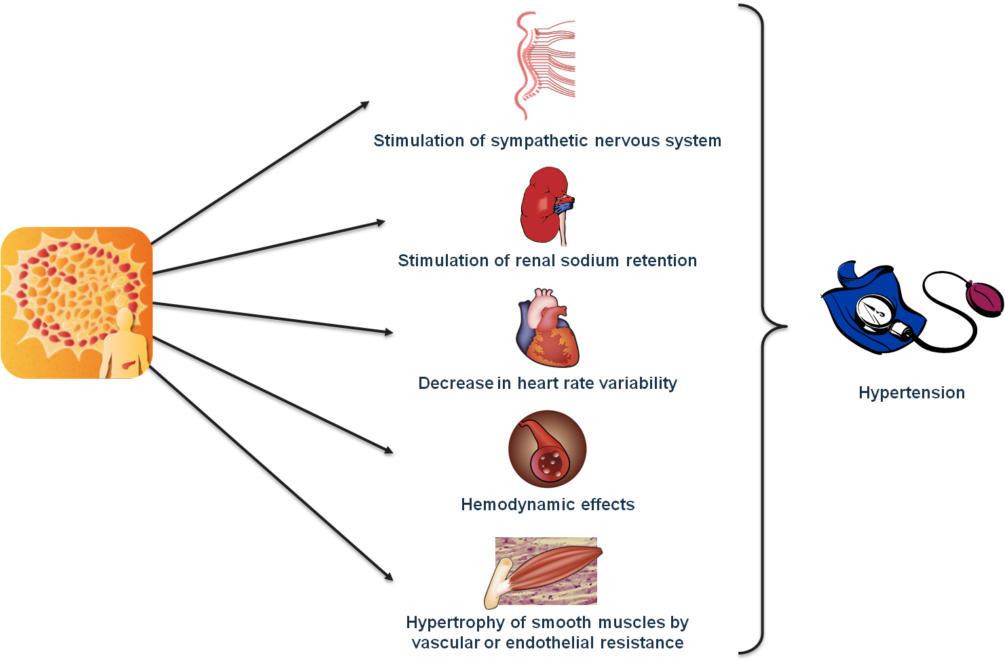
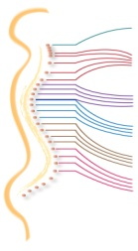
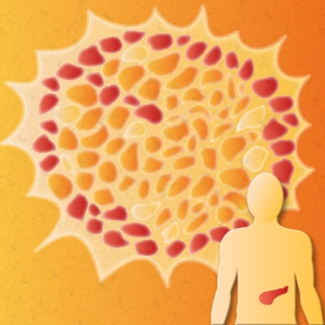
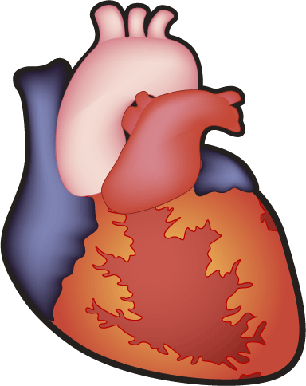
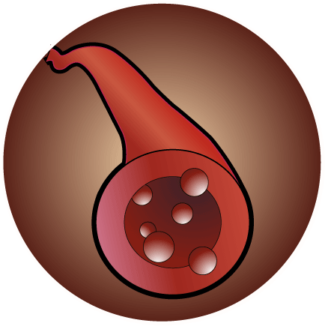

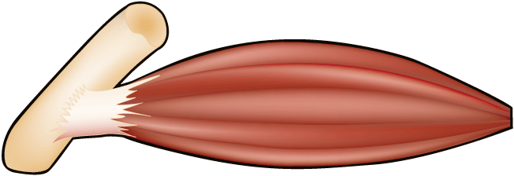
Potential Pathophysiological Pathways of Insulin Leading to Hypertension
Stimulation of sympathetic nervous system
Stimulation of renal sodium retention
Decrease in heart rate variability
Hypertension
Hemodynamic effects
Adapted from Poirier P et al. Therapy 2007;4:575-83
Hypertrophy of smooth muscles by vascular or endothelial resistance

Slide 10
Québec Health Survey
Representative sample of Québec
Institut de la statistique de Québec
95 territories of 40 patients
18 to 74 years (6 groups)
18-34, 35-64, 65-74 years
Men and women
Complete data for 1,844 patients
Adapted from Poirier P et al. Hypertension 2005;45:363-7

Slide 11
Impact of Waist Circumference on Blood Pressure
Men
<88 cm
≥88 cm
82
1,2,3
135
1,2,3
1,3
1,3
1,3
80
130
78
125
Diastolic blood pressure
(mm Hg)
Systolic blood pressure
(mm Hg)
2
76
120
74
115
72
(1)
(2)
(3)
(4)
(5)
(6)
110
(1)
(2)
(3)
(4)
(5)
(6)
<23.2
23.2-26.6
≥26.6
<23.2
23.2-26.6
≥26.6
Tertiles of BMI (kg/m²)
Tertiles of BMI (kg/m²)
1,2,3: significantly different from the corresponding subgroup
Adapted from Poirier P et al. Hypertension 2005;45:363-7

Slide 12
Impact of Waist Circumference on Blood Pressure
Women
<74 cm
≥74 cm
80
135
1,3,4
1,2
78
1
130
3,4,5
76
1
125
Diastolic blood pressure
(mm Hg)
Systolic blood pressure
(mm Hg)
74
1
120
1
72
70
115
68
110
66
(1)
(2)
(3)
(4)
(5)
(6)
105
(1)
(2)
(3)
(4)
(5)
(6)
<21.4
21.4-24.8
≥24.8
<21.4
21.4-24.8
≥24.8
Tertiles of BMI (kg/m²)
Tertiles of BMI (kg/m²)
1,2,3,4,5: significantly different from the corresponding subgroup
Adapted from Poirier P et al. Hypertension 2005;45:363-7

Slide 13
Blood Pressure Lowering in Diabetes: Major Issue
Guidelines recommend reduction of systolic blood pressure to 130-135 mm Hg or lower.
Does this:
Produce additional vascular protection?
Microvascular
Macrovascular

Slide 14
2007 ESH-ESC Practice Guidelines for the Management of Arterial Hypertension
Diabetic patients
Where applicable, intense nonpharmacological measures should be encouraged in all patients with diabetes, with particular attention to weight loss and reduction of salt intake in type 2 diabetes.
ESC: European Society of Cardiology
ESH: European Society of Hypertension
Adapted from 2007 ESH-ESC Guidelines for the management of arterial hypertension
J Hypertens 2007;25:1105-87

Slide 15
Effects of a fixed combination of perindopril and indapamide on macrovascular and microvascular outcomes in patients with type 2 diabetes mellitus (the ADVANCE trial): a randomised controlled trial.
Patel A; ADVANCE Collaborative Group, MacMahon S, Chalmers J, Neal B, Woodward M, Billot L, Harrap S, Poulter N, Marre M, Cooper M, Glasziou P, Grobbee DE, Hamet P, Heller S, Liu LS, Mancia G, Mogensen CE, Pan CY, Rodgers A, Williams B.
Adapted from Patel A et al. Lancet 2007;370:829-40
and http://www.advance-trial.com

Slide 16
The ADVANCE Trial
Blood pressure decrease
165
Mean blood pressure during follow-up
155
145
Systolic
140.3 mm Hg
135
134.7 mm Hg
125
Δ 5.6 mm Hg (95% CI: 5.2-6.0, p<0.0001)
Blood pressure (mm Hg)
115
105
95
85
Diastolic
75
77.0 mm Hg
Δ 2.2 mm Hg (95% CI: 2.0-2.4, p<0.0001)
74.8 mm Hg
65
R
6
12
18
24
30
36
42
48
54
60
N=11,140 patients
Mean follow-up duration 4.3 years
BMI: 28±5 kg/m² in both groups
Follow-up (months)
Placebo
Perindopril-indapamide
Adapted from Patel A et al. Lancet 2007;370:829-40
and http://www.advance-trial.com

Slide 17
Effects on Mortality
All-cause mortality
Cardiovascular death
10
Relative risk reduction 14% p=0.025
10
Relative risk reduction 18% p=0.027
Cumulative incidence (%)
Cumulative incidence (%)
5
5
0
0
0
6
12
18
24
30
36
42
48
54
60
0
6
12
18
24
30
36
42
48
54
60
Follow-up (months)
Follow-up (months)
Placebo
Perindopril-indapamide
Adapted from Patel A et al. Lancet 2007;370:829-40
and http://www.advance-trial.com

Slide 18
Summary – Main Results
Blood Pressure Lowering Comparison
Routine treatment of type 2 diabetic patients with drug therapy resulted in:
14% reduction in total mortality
18% reduction in cardiovascular death
9% reduction in major vascular events
14% reduction in total coronary events
21% reduction in total renal events
No mention of BMI at follow-up
Adapted from Patel A et al. Lancet 2007;370:829-40
and http://www.advance-trial.com

Slide 19
Effects of Intensive Blood Pressure Control on Cardiovascular Events in Type 2 Diabetes Mellitus: the Action to Control Cardiovascular Risk in Diabetes (ACCORD) Blood Pressure Trial
ACCORD Study Group, Cushman WC, Evans GW, Byington RP, Goff DC Jr, Grimm RH Jr, Cutler JA, Simons-Morton DG, Basile JN, Corson MA, Probstfield JL, Katz L, Peterson KA, Friedewald WT, Buse JB, Bigger JT, Gerstein HC, Ismail-Beigi F.
Adapted from the ACCORD study group. N Engl J Med 2010;362:1575-85

Slide 20
The ACCORD Trial – Study Design
Randomized multicentre clinical trial.
Conducted in 77 clinical sites in North America (U.S. and Canada).
Designed to independently test three medical strategies to reduce cardiovascular disease in diabetic patients.
  Blood pressure question: Does a therapeutic strategy targeting systolic blood pressure <120 mm Hg reduce cardiovascular disease events vs. a strategy targeting systolic blood pressure <140 mm Hg in patients with type 2 diabetes at high risk for cardiovascular disease events.
N=4,733 patients
Mean follow-up duration 4.7 years for the primary outcome
Adapted from the ACCORD study group. N Engl J Med 2010;362:1575-85

Slide 21
The ACCORD Trial – Systolic Pressures
Systolic pressures (mean±95% CI)
Standard
Intensive
Average=133.5 Standard vs. 119.3 Intensive, Δ=14.2 mm Hg
N=4,382
N=4,050
N=2,391
N=359
Baseline BMI:
32.2±5.7 vs. 32.1±5.4 kg/m²
Mean number of medications prescribed:
Intensive | 3.2 | 3.4 | 3.5 | 3.4
Standard | 1.9 | 2.1 | 2.2 | 2.3
Adapted from the ACCORD study group. N Engl J Med 2010;362:1575-85
Notes:
21

Slide 22
The ACCORD Trial – Primary and Secondary Outcomes
 | Intensive Events (%/year) | Standard Events (%/year) | Hazard ratio (HR) (95% CI) | p
Primary | 208 (1.87) | 237 (2.09) | 0.88 (0.73-1.06) | 0.20
Total mortality | 150 (1.28) | 144 (1.19) | 1.07 (0.85-1.35) | 0.55
Cardiovascular deaths | 60 (0.52) | 58 (0.49) | 1.06 (0.74-1.52) | 0.74
Nonfatal myocardial infarction | 126 (1.13) | 146 (1.28) | 0.87 (0.68-1.10) | 0.25
Nonfatal stroke | 34 (0.30) | 55 (0.47) | 0.63 (0.41-0.96) | 0.03
Total stroke | 36 (0.32) | 62 (0.53) | 0.59 (0.39-0.89) | 0.01
Also examined fatal/nonfatal heart failure (HR=0.94, p=0.67), a composite of fatal coronary events, nonfatal myocardial infarction and unstable angina (HR=0.94, p=0.50) and a composite of the primary outcome, revascularization and unstable angina (HR=0.95, p=0.40).
Adapted from the ACCORD study group. N Engl J Med 2010;362:1575-85

Slide 23
The ACCORD Trial – Primary Outcome (Nonfatal Myocardial Infarction, Nonfatal Stroke or Cadiovascular Disease Death)
Baseline weight:
92.1±19.4 vs. 91.8±17.7 kg
Follow-up weight:
93.3±21.2 vs. 92.5±20.2 kg
20
HR=0.88
95% CI (0.73-1.06)
15
Patients with events (%)
10
5
0
Standard
0
1
2
3
4
5
6
7
8
Intensive
Years post-randomization
Adapted from the ACCORD study group. N Engl J Med 2010;362:1575-85

Slide 24
The ACCORD Trial – Nonfatal Stroke
Baseline weight:
92.1±19.4 vs. 91.8±17.7 kg
Follow-up weight:
93.3±21.2 vs. 92.5±20.2 kg
20
HR=0.63
95% CI (0.41-0.96)
15
Patients with events (%)
10
5
0
0
1
2
3
4
5
6
7
8
Standard
Intensive
Years post-randomization
Adapted from the ACCORD study group. N Engl J Med 2010;362:1575-85

Slide 25
The ACCORD Trial – Total Stroke
Baseline weight:
92.1±19.4 vs. 91.8±17.7 kg
Follow-up weight:
93.3±21.2 vs. 92.5±20.2 kg
20
HR=0.59
95% CI (0.39-0.89)
15
Patients with events (%)
10
5
0
0
1
2
3
4
5
6
7
8
Standard
Intensive
Years post-randomization
Adapted from the ACCORD study group. N Engl J Med 2010;362:1575-85

Slide 26
Long-Term Effects of Weight-Reducing
Interventions in Hypertensive Patients
Systematic Review and Meta-Analysis
Horvath K, Jeitler K, Siering U, Stich AK, Skipka G, Gratzer TW, Siebenhofer A.
Adapted from Horvath K et al. Arch Intern Med 2008;168:571-80

Slide 27
Diet vs. Usual Care: Changes in Body Weight
Diet group
Control group
Source
Participants
no.
Mean
Standard deviation
Participants
no.
Mean
Standard deviation
WMD (random)
(95% CI)
Weight (%)
WMD
(95% CI)
Croft et al.†
Jalkanen*
DISH
TAIM IG + P vs. CG + P
TAIM IG + A vs. CG + A
TAIM IG + C vs. CG + C
Total
66
24
67
90
88
87
422
-6.50
-4.00
-4.00
-4.40
-3.00
-6.90
(10.65)
(6.96)
(5.00)
(6.64)
(3.75)
(4.66)
64
25
77
90
87
87
430
-0.20
0.00
-0.50
-0.70
0.50
-1.50
(10.65)
(6.96)
(3.60)
(3.79)
(2.80)
(3.73)
4.75
4.24
20.08
17.96
29.50
23.47
100.00
-6.30 (-9.96 to -2.64)
-4.00 (-7.90 to -0.10)
-3.50 (-4.94 to -2.06)
-3.70 (-5.28 to -2.12)
-3.50 (-4.48 to -2.52)
-5.40 (-6.65 to -4.15)
-4.14 (-4.98 to -3.30)
Heterogeneity: Q=7.86 (p=0.16), I²=36.4%
Overall effect: Z score=-9.66 (p=0.000), τ²=0.372
-10.00
-5.00
0.00
5.00
10.00
A: atenolol
C: chlorthalidone
CG: control group
DISH: Dietary Intervention Study of Hypertension
I²: Higgins I²
IG: intervention group
P: placebo
TAIM: Trial of Antihypertensive Interventions and Management
WMD: weighted mean difference
Favours diet
Favours control
The size of the squares represents the weight of studies in meta-analysis (a numerical representation is given in the “Weight (%)” column).
The width of the diamond shapes represents the 95% CI (see also WMD (95% CI) column).
* The standard deviations are calculated on the basis of p=0.05.
† The standard deviations are calculated on the basis of p=0.001.
Adapted from Horvath K et al. Arch Intern Med 2008;168:571-80

Slide 28
Diet vs. Usual Care: Changes in Systolic Blood Pressure
Diet group
Control group
Source
Participants
no.
Mean
Standard deviation
Participants
no.
Mean
Standard deviation
WMD (random)
(95% CI)
Weight (%)
WMD
(95% CI)
Croft et al.*
ODES IG vs. CG
ODES IG + Pa vs. CG + Pa
Total
66
16
24
106
-11.00
-8.40
-8.30
(15.26)
(13.20)
(10.29)
64
12
20
96
-4.00
2.90
-4.10
(15.26)
(15.24)
(8.05)
46.01
10.90
43.09
100.00
-7.00 (-12.25 to -1.75)
-11.30 (-22.08 to -0.52)
-4.20 (-9.62 to 1.22)
-6.26 (-9.82 to -2.70)
-30.00
-15.00
0.00
15.00
30.00
Favours diet
Favours control
Heterogeneity: Q=1.47 (p=0.48), I²=0%
Overall effect: Z score=-3.45 (p=0.001), τ²=0.000
CG: control group
I²: Higgins I²
IG: intervention group
ODES: Oslo Diet and Exercise Study
Pa: physical activity
WMD: weighted mean difference
The size of the squares represents the weight of studies in meta-analysis (a numerical representation is given in the “Weight (%)” column).
The width of the diamond shapes represents the 95% CI (see also WMD (95% CI) column).
* The standard deviations are calculated on the basis of p=0.05.
Adapted from Horvath K et al. Arch Intern Med 2008;168:571-80

Slide 29
Diet vs. Usual Care: Changes in Diastolic Blood Pressure
Diet group
Control group
Source
Participants
no.
Mean
Standard deviation
Participants
no.
Mean
Standard deviation
WMD (random)
(95% CI)
Weight (%)
WMD
(95% CI)
Croft et al.†
ODES IG vs. CG
ODES IG + Pa vs. CG + Pa
TAIM IG vs. CG
Total
66
16
24
265
371
-7.00
-7.10
-7.10
-12.80
(10.15)
(7.20)
(6.37)
(10.00)
64
12
20
264
360
-1.00
-0.40
-5.50
-10.40
(10.15)
(12.47)
(7.60)
(7.80)
24.18
6.64
18.81
50.37
100.00
-6.00 (-9.49 to -2.51)
-6.70 (-14.59 to 1.19)
-1.60 (-5.79 to 2.59)
-2.40 (-3.93 to -0.87)
-3.41 (-5.55 to -1.27)
Heterogeneity: Q=4.7 (p=0.20), I²=36.1%
Overall effect: Z score=-3.12 (p=0.002), τ²=1.759
-20.00
-10.00
0.00
10.00
20.00
Favours diet
Favours control
CG: control group
I²: Higgins I²
IG: intervention group
ODES: Oslo Diet and Exercise Study
Pa: physical activity
TAIM: Trial of Antihypertensive Interventions and Management
WMD: weighted mean difference
The size of the squares represents the weight of studies in meta-analysis (a numerical representation is given in the “Weight (%)” column).
The width of the diamond shapes represents the 95% CI (see also WMD (95% CI) column).
† The standards deviations are calculated on the basis of p=0.001.
Adapted from Horvath K et al. Arch Intern Med 2008;168:571-80

Slide 30
VICTORY Trial – Body Weight
Placebo
100
Rosiglitazone
90
Body weight (kg)
80
70
p=0.36
p=0.10
p=0.02
60
Baseline
2
4
6
8
10
12
p<0.0001 interaction
Months
Adapted from Bertrand OF et al. Atherosclerosis 2010;211:565-73

Slide 31
VICTORY Trial – Body Composition
Placebo
Rosiglitazone
Body fat (DEXA)
Total body water (BIA)
50
35
30
45
Total body composition –
fat mass (kg)
25
Total body water (kg)
40
20
15
p=0.39
p=0.06
p=0.001
35
p=0.81
p=0.15
p=0.11
Baseline
Follow-up
(6 months)
Follow-up
(12 months)
Baseline
2
4
6
12
Months
p<0.0001 interaction
p=0.0007 interaction
DEXA: dual energy X-ray absorptiometry
BIA: bioelectrical impedance analysis
Adapted from Bertrand OF et al. Atherosclerosis 2010;211:565-73

Slide 32
VICTORY Trial – Adipose Tissue Distribution (Computed Tomography)
Placebo
Rosiglitazone
350
400
300
300
250
Visceral adipose tissue (cm²)
Subcutaneous adipose tissue (cm²)
200
200
150
p=0.12
p=0.0003
p<0.0001
p=0.29
p=0.55
p=0.92
100
100
Baseline
Follow-up
(6 months)
Follow-up
(12 months)
Baseline
Follow-up
(6 months)
Follow-up
(12 months)
p<0.0001 interaction
p=0.0003 interaction
Adapted from Bertrand OF et al. Atherosclerosis 2010;211:565-73

Slide 33
VICTORY Trial – Blood Pressure
Placebo
Rosiglitazone
150
90
140
80
130
70
Systolic blood pressure (mm Hg)
Diastolic blood pressure (mm Hg)
120
60
110
50
100
p=0.95
p=0.03
40
Baseline
2
4
6
8
10
12
Baseline
2
4
6
8
10
12
Months
Months
p=0.90 interaction
p=0.70 interaction
Adapted from Bertrand OF et al. Atherosclerosis 2010;211:565-73

Slide 34
Long-Term Effects of a Lifestyle Intervention on Weight and Cardiovascular Risk Factors in Individuals With Type 2 Diabetes Mellitus
Four-Year Results of the Look AHEAD Trial
The Look AHEAD Research Group
Adapted from the Look AHEAD Research Group. Arch Intern Med 2010;170:1566-75

Slide 35
Mean Changes in Weight, Fitness and Cardiovascular Disease Risk Factors in Intensive Lifestyle Intervention (ILI) and Diabetes Support and Education (DES) Groups and the Difference Between Groups Averaged Across 4 Years
Look AHEAD
Measure | Groups, Mean change (95% CI) DES ILI |  | Between-group mean difference (95% CI) | p value of difference†
Weight (% initial weight) | -0.88 (-1.12 to -0.64) | -6.15 (-6.39 to -5.91) | -5.27 (-5.61 to -4.93) | <0.001
Fitness (% METS) | 1.96 (1.07 to 2.85) | 12.74 (11.87 to 13.62) | 10.78 (9.53 to 12.03) | <0.001
Hemoglobin A_{1c} (%)* | -0.09 (-0.13 to -0.06) | -0.36 (-0.40 to -0.33) | -0.27 (-0.32 to -0.22) | <0.001
Systolic blood pressure (mm Hg)* | -2.97 (-3.44 to -2.49) | -5.33 (-5.80 to -4.86) | -2.36 (-3.03 to -1.70) | <0.001
Diastolic blood pressure (mm Hg)* | -2.48 (-2.73 to -2.24) | -2.92 (-3.16 to -2.68) | -0.43 (-0.77 to -0.10) | 0.01
HDL cholesterol (mmol/l)* | 0.05 (0.04 to 0.06) | 0.10 (0.09 to 0.10) | 0.04 (0.03 to 0.05) | <0.001
Triglycerides (mmol/l)* | -0.22 (-0.25 to -0.20) | -0.29 (-0.32 to -0.26) | -0.07 (-0.10 to -0.03) | <0.001
LDL cholesterol (mmol/l) Without adjustment for medication use Adjusted for medication use | -0.33 (-0.35 to -0.31) -0.24 (-0.26 to -0.22) | -0.29 (-0.31 to -0.27) -0.23 (-0.25 to -0.21) | 0.04 (0.01 to 0.07) 0.01 (-0.02 to 0.04) | 0.009 0.42
† Adjusting for baseline use of medications or changes over time did not influence the average effect for the p value.
* Data presented are average effects unadjusted for medication use.
Adapted from the Look AHEAD Research Group. Arch Intern Med 2010;170:1566-75

Slide 36
Changes in Fitness in the Intensive Lifestyle Intervention (ILI) and Diabetes Support and Education (DSE) Groups
Look AHEAD
Fitness
Average effect across visits: 10.78 (p<0.001)
30
DSE
ILI
20
Change in fitness (% METS)
10
0
-10
0
1
2
3
4
Years
Adapted from the Look AHEAD Research Group. Arch Intern Med 2010;170:1566-75

Slide 37
Changes in Weight for Participants in the Intensive Lifestyle Intervention (ILI) and Diabetes Support and Education (DSE) Groups
Look AHEAD
Weight
Average effect across visits: -5.27 (p<0.001)
0
-1
-2
-3
-4
Change in weight (%)
-5
-6
-7
DSE
-8
ILI
-9
0
1
2
3
4
Years
Adapted from the Look AHEAD Research Group. Arch Intern Med 2010;170:1566-75

Slide 38
Changes in Systolic Blood Pressure (SBP) for Participants in the Intensive Lifestyle Intervention (ILI) and Diabetes Support and Education (DSE) Groups
Look AHEAD
Systolic blood pressure
Average effect across visits: -2.36 (p<0.001)
0
-1
-2
-3
-4
Change in systolic blood pressure (mm Hg)
-5
-6
-7
DSE
-8
ILI
-9
0
1
2
3
4
Years
Adapted from the Look AHEAD Research Group. Arch Intern Med 2010;170:1566-75

Slide 39
Changes in Diastolic Blood Pressure for Participants in the Intensive Lifestyle Intervention (ILI) and Diabetes Support and Education (DSE) Groups of the Look AHEAD (Action for Health in Diabetes) Trial
Look AHEAD
Diastolic blood pressure
Average effect across visits: -0.43 (p=0.01)
0
DSE
-1
ILI
Change in diastolic blood pressure (mm Hg)
-2
-3
-4
0
1
2
3
4
Years
Adapted from the Look AHEAD Research Group. Arch Intern Med 2010;170:1566-75

Slide 40

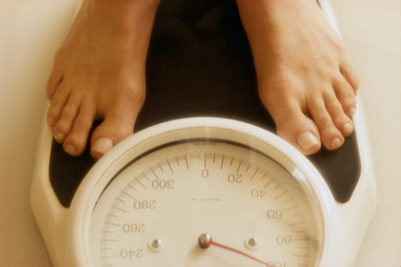

- Identifying potential barriers to long-term weight loss.
- The right approach for the right patient.
- Interdisciplinary approach.
Talk to your patient about weight/waist management!

Slide 41
Adiposity and Cardiovascular Disease: Are we Using the Right Definition of Obesity?
Refinement of some cardiovascular risk factors
 | Lipid profile | Blood pressure | “At risk” obesity
Past | Total cholesterol | Resting blood pressure | Weight
Present | LDL, HDL, TG | 24-hour blood pressure monitoring | BMI
Future (?) | Apo AI, Apo B | Early morning blood pressure | Waist circumference + TG Waist-to-hip ratio
Apo: apolipoprotein
BMI: body mass index
TG: triglycerides
Adapted from Poirier P Eur Heart J 2007;28:2047-8

Slide 42
Conclusion
Management of blood pressure in diabetes
Guidelines
Multidrug regimen
ACCORD
ACE-inhibitors, angiotensin receptor blockers
139 to 133 mm Hg - 2.3 drugs
139 to 119 mm Hg - 3.4 drugs
Look AHEAD
~5 mm Hg as an add-on therapy
Aggressive nonpharmacological approach

Slide 43


