Slide 1
Lifestyle Modification in the Prevention of Type 2 Diabetes: The Experience with the DIABETES PREVENTION PROGRAM and LOOK AHEAD Studies
Edward S Horton, MD
Joslin Diabetes Center
Harvard Medical School
Boston, MA

Slide 2









Global Projections for the Diabetes Epidemic: 2003-2025 (in Millions)
58.6
48.4
Europe
75.8
36.2
39.4
Western pacific
43.0
23.0
North America
19.2
Eastern Mediterranean and Middle East
21%
57%
105%
81.6
76%
39.3
South-East Asia
15.0
108%
7.1
Africa
26.2
14.2
South and Central America
111%
333
2003
85%
194
2025
World
72%
Adapted from Diabetes Atlas Committee. Diabetes Atlas 2nd Edition: IDF 2003

Slide 3








Global Projections for the Diabetes Epidemic: 2011-2030 (in Millions)
187.9
52.6
64.0
131.9
Europe
Western Pacific
51.2
37.7
North America and Carribean
22%
120.9
32.8
59.7
36%
Middle East and North Africa
42%
71.4
South-East Asia
83%
28.0
69%
14.7
Africa
39.9
South and Central America
551.8
25.1
2011
90%
366.2
2030
59%
World
51%
Adapted from Diabetes Atlas Committee. Diabetes Atlas 5th Edition: IDF 2011

Slide 4
Obesity Is the Primary Risk Factor for Type 2 Diabetes
Age-adjusted relative risk of type 2 diabetes
50
100
93.2
Men¹
Women²
42.1
40
75
30
Relative risk
50
20
40.3
11.6
25
10
2.2
8.1
1.0
1.0
0
0
<23
25
31
≥35
<22
25
31
≥35
Body mass index (kg/m²)
¹Chan JM et al. Diabetes Care 1994;17:961-9
²Colditz G et al. Ann Intern Med 1995;122:481-6

Slide 5
The Dual Epidemic: Obesity and Diabetes
65% of adult Americans are overweight (BMI >25 kg/m²) and 32% are obese (BMI >30 kg/m²).
34% have the metabolic syndrome (NCEP-ATP III criteria).
There are now an estimated 25.8 million people with diabetes in the USA (11.3% of adults) and 79 million with pre-diabetes (IFG/IGT).
The lifetime risk of developing diabetes for people born in 2000 is 33% for men and 39% for women. For Hispanic women it is 50%.
In this population cardiovascular disease is the major cause of mortality.
IFG: Impaired fasting glucose
IGT: Impaired glucose tolerance

Slide 6
Changes in our lifestyle!
What is driving the dual epidemic?

Slide 7

Diabetes
Metabolic syndrome?

Slide 8
Prevention and Treatment of Diabetes
A major goal of treatment of pre-diabetes and diabetes is to prevent both the microvascular and the macrovascular complications!

Slide 9
Trials to Prevent / Delay Progression from Impaired Glucose Tolerance to Type 2 Diabetes
Medications
Diabetes Prevention Program: metformin, (troglitazone)
TRIPOD: troglitazone
STOP-NIDDM: acarbose
NAVIGATOR: nateglinide and valsartan
DREAM: rosiglitazone and ramipril
XENDOS: orlistat
ORIGIN: glargine insulin
ACT NOW: pioglitazone
Voglibose Study
Lifestyle changes
Malmo Study
Da Qing Study
Finnish Diabetes Prevention Study
Diabetes Prevention Program
ACT NOW: Actos Now for Prevention of Diabetes
DREAM: Diabetes Reduction Approaches with Ramipril and Rosiglitazone
NAVIGATOR: Nateglinide and Valsartan in Impaired Glucose Tolerance Outcomes Research
ORIGIN: Outcomes Reduction with Initial Glargine Introduction
STOP-NIDDM: Study to Prevent Non–Insulin-Dependent Diabetes Mellitus
TRIPOD: Troglitazone in Prevention of Diabetes Study
XENDOS: Xenical in the Prevention of Diabetes in Obese Subjects

Slide 10
Summary of Medication Trials to Prevent Type 2 Diabetes
RRR
AGIs (STOP-NIDDM, Voglibose)
Metformin (Diabetes Prevention Program)
TZDs (TRIPOD, DREAM, ACT NOW)
25-40%
31%
55-80%
The major concerns are long-term safety, tolerance, efficacy and cost-effectiveness of medications:
AGIs: gastrointestinal side effects
Metformin: gastrointestinal side effects
TZDs: weight gain, fluid retention, cardiovascular disease, fractures
ACT NOW: Actos Now for Prevention of Diabetes
AGIs: alpha-glucosidase inhibitors
DREAM: Diabetes Reduction Approaches with Ramipril and Rosiglitazone
RRR: Relative risk reduction
STOP-NIDDM: Study to Prevent Non–Insulin-Dependent Diabetes Mellitus
TRIPOD: Troglitazone in Prevention of Diabetes Study
TZDs: thiazolidinediones

Slide 11
A randomized clinical trial to prevent type 2 diabetes in persons at high risk
The Diabetes Prevention Program (DPP)
Sponsored by the NIH, NIDDK,
NIA, NICHD, IHS, CDC, ADA and other agencies and corporations

Slide 12
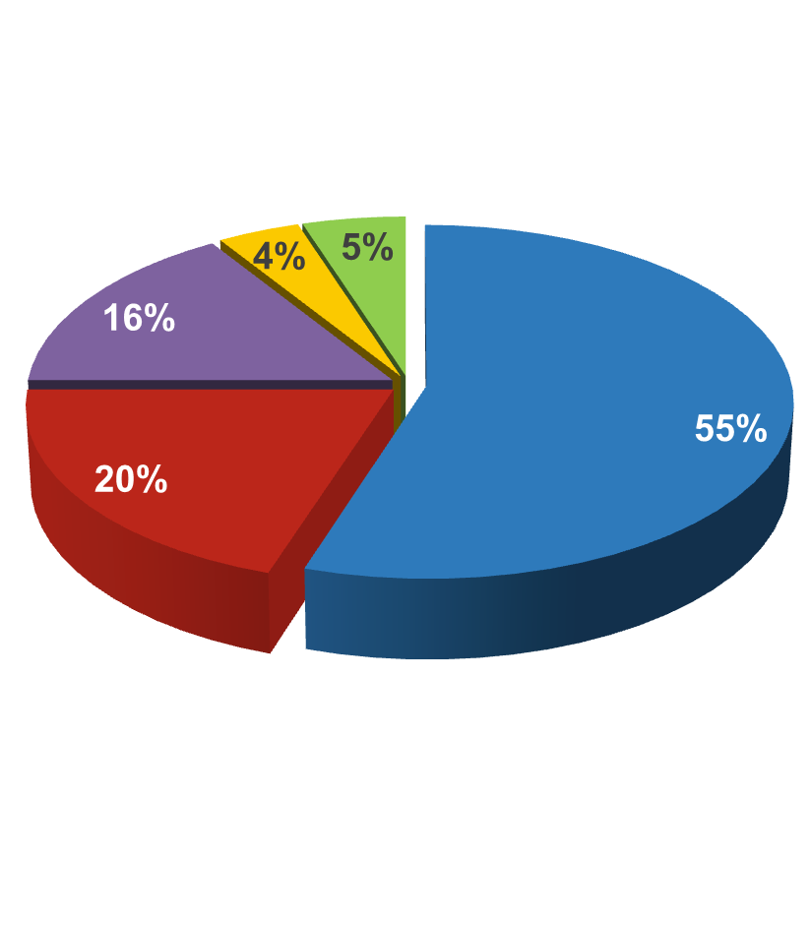
Study Population
Caucasian
African-American
Hispanic-American
Asian
American Indian
Caucasian
African-American
Hispanic-American
Asian-American & Pacific Islander
American Indian
Total
1768
645
508
142
171
3234
Adapted from Knowler WC et al. N Engl J Med 2002;346:393-403

Slide 13
Study Interventions
Eligible participants
Randomized
Standard lifestyle recommendations
Intensive lifestyle
Metformin
Placebo
(n=1079)
(n=1073)
(n=1082)

Slide 14
Lifestyle & Metformin Interventions
Intensive lifestyle goals
Reduction of fat and calorie intake
Physical activity at least 150 minutes/week
Achieve and maintain at least 7% weight loss
Metformin goals
Metformin 850 mg twice daily

Slide 15
Study Timeline
2002
DPPOS began
2009
DPPOS midpoint results
2013
2001
DPPOS visits end
1999
DPP results
1996
DPP enrollment completed
DPP recruitment began
1998
2000
2002
2004
2006
2008
2010
2012
June 1996
December 2013
DPP: Diabetes Prevention Program
DPPOS: Diabetes Prevention Program Outcomes Study
Adapted from Diabetes Prevention Program Research Group Lancet 2009;374:1677-86

Slide 16
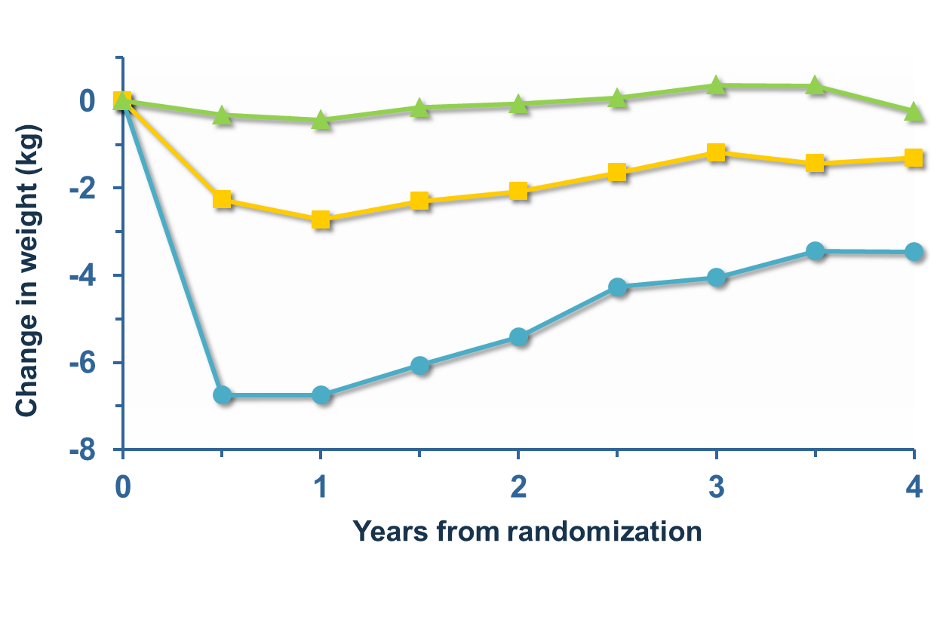
Mean Weight Change
Placebo
Metformin
Lifestyle
Adapted from Knowler WC et al. N Engl J Med 2002;346:393-403

Slide 17
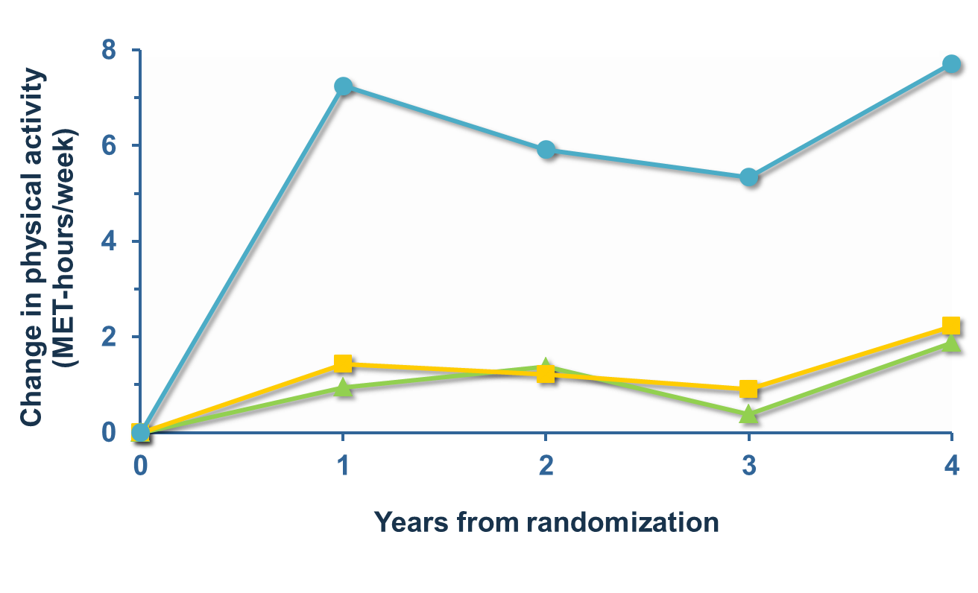
Mean Change in Leisure Physical Activity
Placebo
Metformin
Lifestyle
Adapted from Knowler WC et al. N Engl J Med 2002;346:393-403

Slide 18
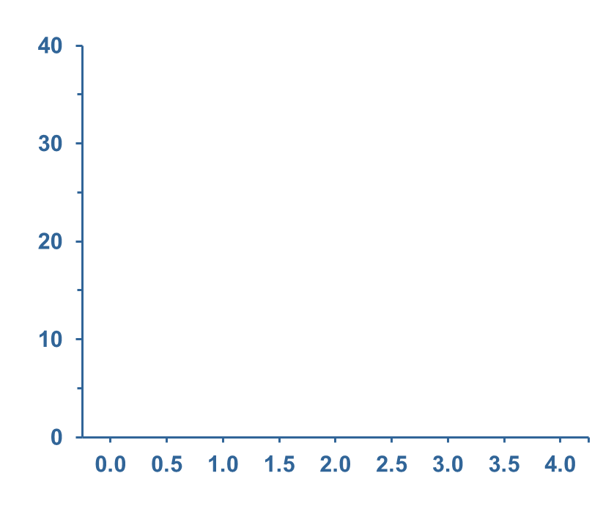
Incidence of Diabetes
Risk reduction
31% by metformin
58% by lifestyle
Cumulative incidence
of diabetes (%)
Placebo
Metformin
Lifestyle
Study year
Placebo: n=1082
Metformin: n=1073, p<0.001 vs. placebo
Lifestyle: n=1079, p<0.001 vs. metformin, p<0.001 vs. placebo
Adapted from Orchard TJ et al. Ann Intern Med 2005;142:611-9

Slide 19
Metabolic Syndrome − NCEP-ATP III Clinical Criteria (3 of 5)
Obesity
(esp. abdominal
obesity)
Waist circumference
Men: ≥102 cm (40 in)
Women: ≥88 cm (35 in)
Atherogenic
dyslipidemia
Triglycerides
≥1.69 mmol/l
HDL cholesterol
Men: <1.03 mmol/l
Women: <1.29 mmol/l
Genetic variation in
cardiovascular disease
risk factor regulation
Pro-
inflammatory
state
Elevated blood
pressure
Insulin resistance
Pro-thrombotic state
≥130/85 mmHg
Fasting glucose
≥5.6 mmol/l (modified)
Adapted from Expert Panel on Detection, Evaluation, and Treatment of High Blood Cholesterol in Adults
JAMA 2001;285:2486-97

Slide 20
Prevalence of Metabolic Syndrome at Randomization
  1711 (53%) of the 3234 participants had the syndrome at randomization.
  Prevalence of the syndrome did not vary by gender or age group (<45, 45-64, 65+ years).
  Prevalence did vary by ethnicity, being lowest in Asians (41%) and highest in Caucasians (57%).
  Prevalence of the individual components did vary by ethnicity and by age group.

Slide 21
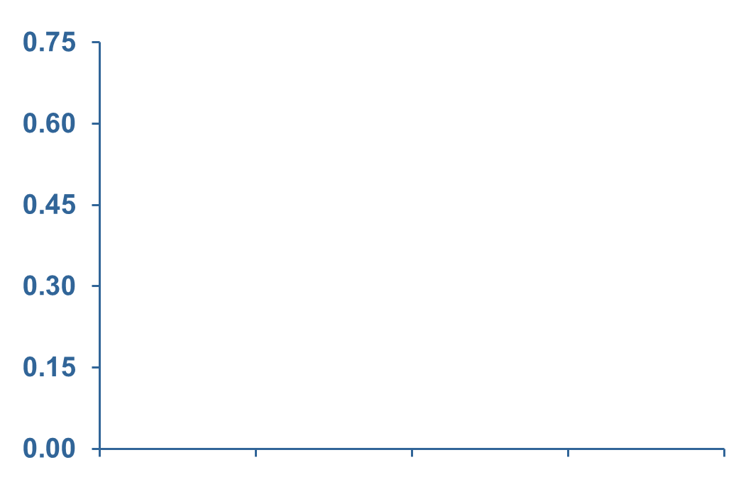
Cumulative Incidence of Metabolic Syndrome by Treatment Group
Risk reduction:
17%* by metformin
41%** by lifestyle
Lifestyle vs. metformin 29%**
Cumulative incidence of metabolic syndrome (%)
Placebo n=490
Metformin n=503
Lifestyle n=530
0
1
2
3
4
* p<0.05
** p<0.001
Time since randomization (years)
Adapted from Orchard TJ et al. Ann Intern Med 2005;142:611-9

Slide 22
Three-Year Incidence of Components by Treatment Group
 | Placebo (%) | Metformin (%) | Lifestyle (%)
High waist circumference | 33 | 15* | 8*
Low HDL cholesterol | 70 | 67 | 68
High triglycerides | 27 | 30 | 18*
High fasting plasma glucose | 40 | 29* | 28*
High blood pressure | 41 | 44 | 35*
*p<0.001 comparison vs. placebo
Adapted from Orchard TJ et al. Ann Intern Med 2005;142:611-9

Slide 23
Key Findings
Hypertension was present in 30% of subjects at baseline; over 3 years it increased in the placebo and metformin groups, but significantly decreased in the intensive lifestyle group.
Triglycerides decreased in all groups, but fell significantly more in intensive lifestyle group.
Intensive lifestyle group significantly increased HDL cholesterol and decreased LDL phenotype B.
After 3 years, the use of medications to achieve targets for hypertension was 27-28% less and for dyslipidemia was 25% less in the intensive lifestyle group.

Slide 24
Study Timeline
2002
DPPOS began
2009
DPPOS midpoint results
2013
2001
DPPOS visits end
1999
DPP results
1996
DPP enrollment completed
DPP recruitment began
1998
2000
2002
2004
2006
2008
2010
2012
June 1996
December 2013
DPPOS midpoint follow-up after 7 years
Time since original DPP randomization (10 years)
DPP: Diabetes Prevention Program
DPPOS: Diabetes Prevention Program Outcomes Study
Adapted from Diabetes Prevention Program Research Group Lancet 2009;374:1677-86

Slide 25
Diabetes Prevention Program Outcomes Study (DPPOS) Goals
  Diabetes delay or prevention.
  Prevention of diabetes complications such as kidney, eye and nerve problems, and heart disease.

Slide 26
Diabetes Prevention Program Outcomes Study (DPPOS) Treatments
  Original Placebo group
  HELP classes four times a year
  Original Metformin group
  Metformin 850 mg twice daily
  HELP classes four times a year
  Original Lifestyle group
  HELP classes four times a year
  Boost lifestyle classes twice a year

Slide 27
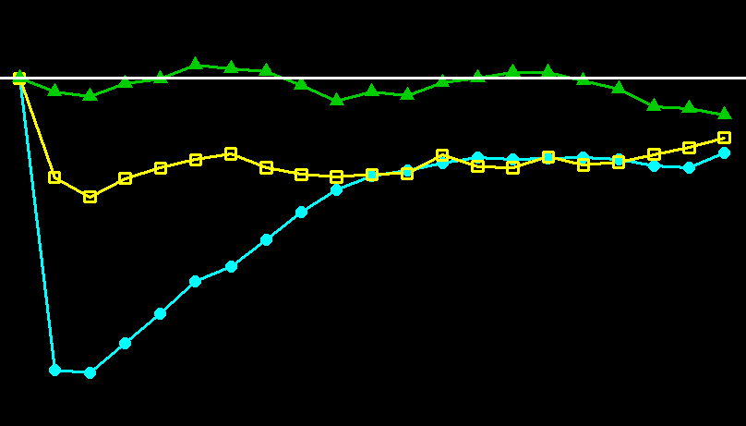
Weight Change Over Time
0
-2
Change in weight (kg)
-4
Placebo
-6
Metformin
Lifestyle
-8
0
2
4
6
8
10
Year since DPP randomization
Adapted from Diabetes Prevention Program Research Group Lancet 2009;374:1677-86

Slide 28
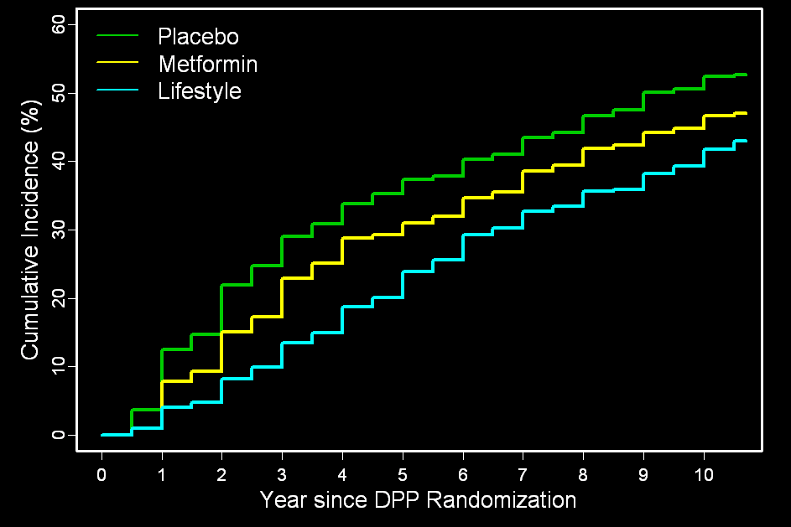
Diabetes Prevention Program Outcomes Study (DPPOS) Incidence of Diabetes
60
Placebo
50
Metformin
Lifestyle
40
Cumulative incidence (%)
30
20
10
0
0
2
4
6
8
10
Year since DPP randomization
Adapted from Diabetes Prevention Program Research Group Lancet 2009;374:1677-86

Slide 29
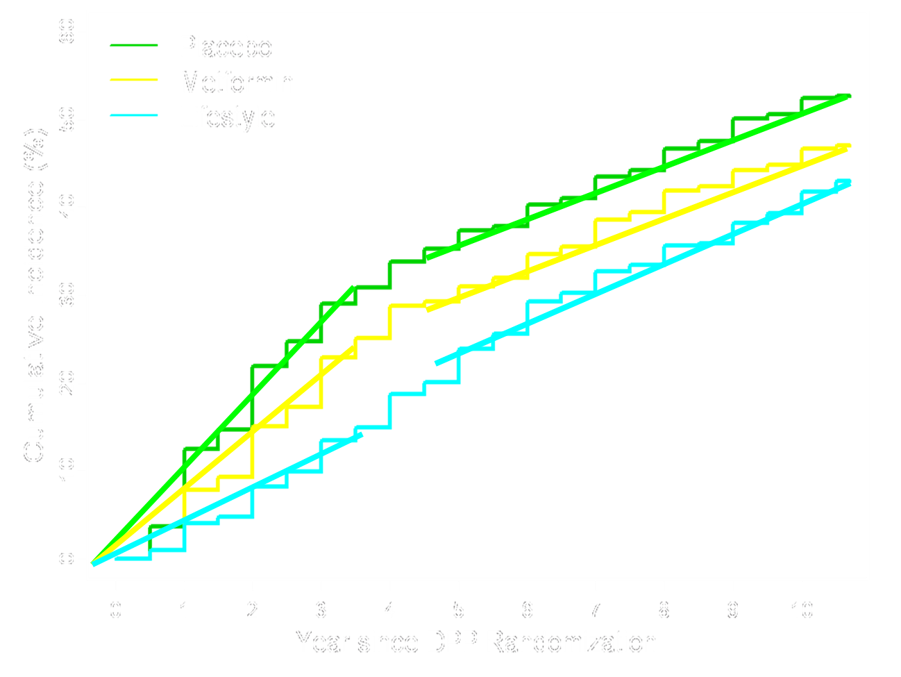
Diabetes Prevention Program Outcomes Study (DPPOS) Incidence of Diabetes
60
Placebo
50
Metformin
Lifestyle
40
30
Cumulative incidence (%)
20
10
Risk reduction:
18% with metformin
34% with lifestyle
0
0
2
4
6
8
10
Year since DPP randomization
Adapted from Diabetes Prevention Program Research Group Lancet 2009;374:1677-86

Slide 30
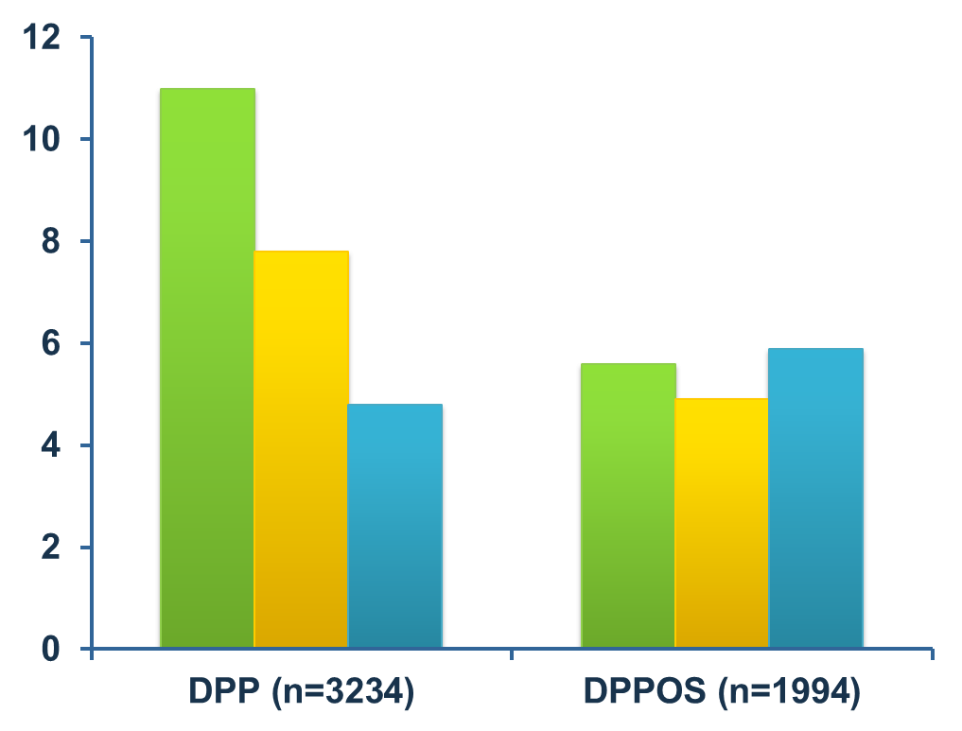
Diabetes Prevention Program (DPP) vs. Diabetes Prevention Program Outcomes Study (DPPOS) Diabetes Rates
Placebo
Metformin
Lifestyle
Crude rate per 100 person-years
Adapted from Diabetes Prevention Program Research Group Lancet 2009;374:1677-86

Slide 31
Diabetes Development in Diabetes Prevention Program Outcomes Study (DPPOS)
  Original Lifestyle participants continue to develop diabetes at the lower rate they developed diabetes during Diabetes Prevention Program (DPP).
  Original Placebo and Metformin participants have lowered their rate of diabetes development to a similar rate as the Lifestyle group.

Slide 32
Diabetes Prevention Program Outcomes Study (DPPOS) Diabetes Risk Reduction
  Delay in diabetes onset after 10 years of follow-up:
    4 years for Lifestyle group
    2 years for Metformin group
  The lower rate of diabetes development for lifestyle and metformin during Diabetes Prevention Program (DPP) means:
    Original Lifestyle participants have a 34% lower risk of diabetes compared to Placebo participants.
    Original Metformin participants have a 18% lower risk of diabetes compared to Placebo participants.

Slide 33
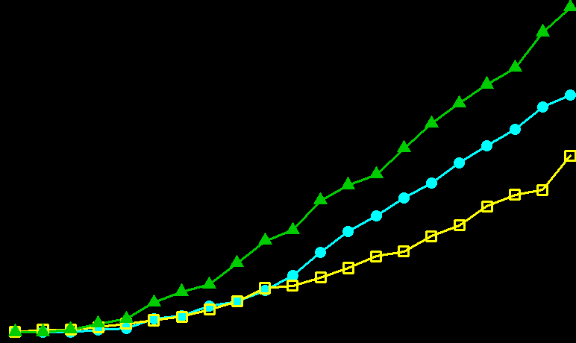
Use of Anti-Diabetic Medicines
30
Placebo
25
Metformin
Lifestyle
20
Use of antidiabetic medications (%)
15
10
5
0
0
2
4
6
8
10
Year since DPP randomization
Adapted from Diabetes Prevention Program Research Group Lancet 2009;374:1677-86

Slide 34

Look AHEAD Clinical Trial
AIM:
To determine whether cardiovascular morbidity and mortality in persons with type 2 diabetes can be reduced through intensive lifestyle intervention aimed at producing and maintaining weight loss.

Slide 35
Primary Outcome
  The incidence rate of the first post-randomization occurrence of a composite outcome, including:
  cardiovascular death (fatal myocardial infarction and stroke)
  nonfatal myocardial infarction
  nonfatal stroke
  hospitalization for angina
Over 13.5-year follow-up is reduced in the Intensive Lifestyle Intervention group compared to Diabetes Support and Education group.

Slide 36
Other Outcomes
All-cause mortality
Cardiovascular disease risk factors
Costs and cost effectiveness
Diabetes control and complications
General health
Hospitalizations
Quality of life and psychological outcomes

Slide 37
Look AHEAD Interventions
Intensive Lifestyle Intervention (ILI)
Diabetes Support & Education (DSE)

Slide 38
Lifestyle Intervention
Phase I: Weight Loss Induction
Months 1-6
Weekly contact
    3 group sessions/month
    1 individual session/month
Personal weight loss goal =10%
Study weight loss goal ≥7%
Adapted from Look AHEAD Research Group Control Clin Trials 2003;24:610-28

Slide 39
Recommendations
Dietary intake
      1200-1500 kcal/day <250 lbs (<113.5 kg)
      1500-1800 kcal/day ≥250 lbs (≥113.5 kg)
      ≤30% calories from fat
      meal replacements
      menu plans
Physical activity
      gradual increase
      175 min/week
      10,000 steps/day (approx. 5 miles)
Adapted from Look AHEAD Research Group Control Clin Trials 2003;24:610-28

Slide 40
Lifestyle Intervention
Phase II: Weight Loss Maintenance
Months 7-12
Reduced contact
      2 group sessions/month
      1 individual session/month
      2 face-to-face contacts/month required; 3 recommended
Individual weight loss goal
      continue weight loss if <10%
      weight maintenance if ≥10%
Adapted from Look AHEAD Research Group Control Clin Trials 2003;24:610-28

Slide 41
Diabetes Support and Education
3-4 meetings/year to promote retention
Health education topics
      diet
      exercise
      social support
Adapted from Look AHEAD Research Group Control Clin Trials 2003;24:610-28

Slide 42
Baseline Characteristics of Participants
 | Lifestyle intervention (N=2570) | Diabetes support and education (N=2575)
Women (%) | 59.3 | 59.6
Age (years) | 58.6 | 58.9
Insulin users (%) | 15 | 16
Baseline BMI (kg/m²) | 35.9 | 36.0
Baseline weight (kg) | 100.5 | 100.9
Baseline waist (cm) | 113.8 | 114.1
History of prior cardiovascular disease event (%) | 15 | 14
Adapted from: Look AHEAD Research Group Obesity (Silver Spring) 2006;14:737-52
and Look AHEAD Research Group Diabetes Care 2007;30:1374-1383

Slide 43
Assessments
  Annual clinic visits
      Weight, blood pressure, lipids.
      Fitness with maximum treadmill test at baseline and sub-max at years 1 and 4.
  Participant’s own physician is responsible for medical care and changes in medications.
Adapted from Look AHEAD Research Group Control Clin Trials 2003;24:610-28

Slide 44
Weight Loss at 1 Year
ILI
DSE
0
-1
0.7%
Change in weight (%)
-2
-3
-4
-5
-6
ILI: Intensive Lifestyle Intervention
DSE: Diabetes Support & Education
-7
-8
8.6%
p<0.0001
-9
Adapted from Look AHEAD Research Group Diabetes Care 2007;30:1374-1383

Slide 45
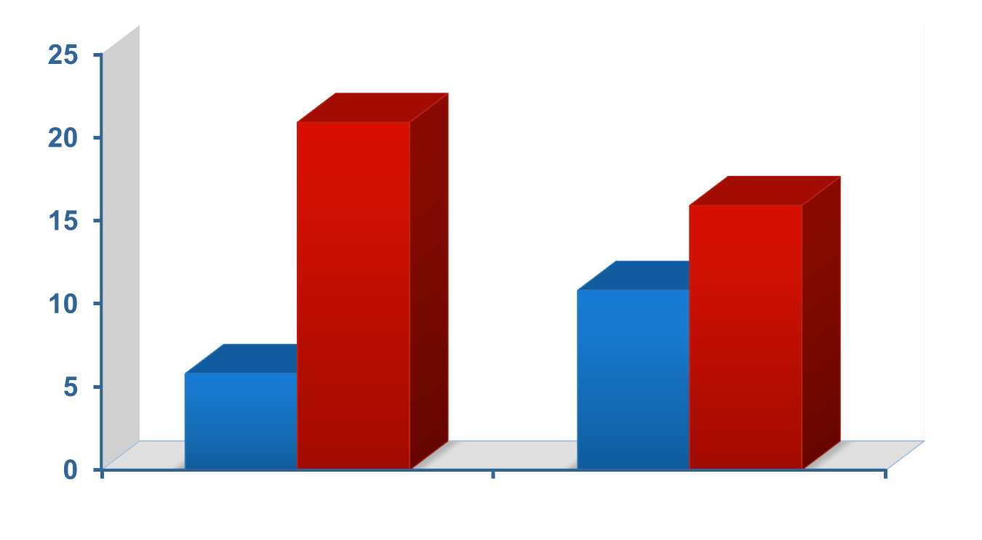
Fitness Change at 1 Year
Mean fitness change (%)
20.9
ILI: Intensive Lifestyle Intervention
DSE: Diabetes Support & Education
15.9
10.8
5.8
DSE
ILI
DSE
ILI
Unadjusted p<0.001
Adjusted for 1 year weight change p<0.001
Adapted from Look AHEAD Research Group Diabetes Care 2007;30:1374-1383

Slide 46
1-Year Changes in Markers of Diabetes Control
Markers of diabetes control | ILI | DSE | p value
Hemoglobin A1c (%), Baseline Hemoglobin A1c (%), Year 1 Year 1 – Baseline | 7.25 6.61 -0.64 | 7.29 7.15 -0.14 | 0.26 <0.001 <0.001
Fasting glucose (mmol/l), Baseline Fasting glucose (mmol/l), Year 1 Year 1 – Baseline | 8.4 7.2 -1.2 | 8.5 8.1 -0.4 | 0.21 <0.001 <0.001
Diabetes medications (%), Baseline Diabetes medications (%), Year 1 Year 1 – Baseline | 86.5 78.6 -7.8 | 86.5 88.7 2.2 | 0.93 <0.001 <0.001
ILI: Intensive Lifestyle Intervention
DSE: Diabetes Support & Education
Adapted from Look AHEAD Research Group Diabetes Care 2007;30:1374-1383

Slide 47
1-Year Changes in Markers of Blood Pressure (BP) Control
Markers of blood pressure control | ILI | DSE | p value
Systolic BP (mmHg), Baseline Systolic BP (mmHg), Year 1 Year 1 – Baseline | 128.2 121.4 -6.8 | 129.4 126.6 -2.8 | 0.01 <0.001 <0.001
Diastolic BP (mmHg), Baseline Diastolic BP (mmHg), Year 1 Year 1 – Baseline | 69.9 67.0 -3.0 | 70.4 68.6 -1.8 | 0.11 <0.001 <0.001
Antihypertensive medications (%), Baseline Antihypertensive medications (%), Year 1 Year 1 – Baseline | 75.3 75.2 -0.1 | 73.7 75.9 2.2 | 0.23 0.54 0.02
ILI: Intensive Lifestyle Intervention
DSE: Diabetes Support & Education
Adapted from Look AHEAD Research Group Diabetes Care 2007;30:1374-1383

Slide 48
1-Year Changes in Markers of Lipid Control
Markers of lipid control | ILI | DSE | p value
LDL cholesterol (mmol/l), Baseline LDL cholesterol (mmol/l), Year 1 Year 1 – Baseline | 2.90 2.77 -0.13 | 2.91 2.76 -0.15 | 0.78 0.74 0.49
HDL cholesterol (mmol/l), Baseline HDL cholesterol (mmol/l), Year 1 Year 1 – Baseline | 1.12 1.21 0.09 | 1.13 1.16 0.04 | 0.80 <0.001 <0.001
Triglycerides (mmol/l), Baseline Triglycerides (mmol/l), Year 1 Year 1 – Baseline | 2.06 1.72 -0.34 | 2.03 1.87 -0.16 | 0.38 <0.001 <0.001
Lipid-lowering medications (%), Baseline Lipid-lowering medications (%), Year 1 Year 1 – Baseline | 49.4 53.0 3.7 | 48.4 57.8 9.4 | 0.52 <0.001 <0.001
ILI: Intensive Lifestyle Intervention
DSE: Diabetes Support & Education
Adapted from Look AHEAD Research Group Diabetes Care 2007;30:1374-1383

Slide 49
Four-Year Results

Slide 50
Percent Weight Change from Baseline
Weight change from baseline (%)
DSE
ILI
Year
Repeated measures adjusted for clinic and baseline level
P value for average effect across all visits: p<0.0001
ILI: Intensive Lifestyle Intervention
DSE: Diabetes Support & Education
Adapted from Look AHEAD Research Group Arch Intern Med 2010;170:1566-75

Slide 51
Percent Fitness Change from Baseline
Fitness change from baseline (%)
DSE
ILI
Year
Repeated measures adjusted for clinic and baseline level
P value for average effect across all visits: p<0.0001
ILI: Intensive Lifestyle Intervention
DSE: Diabetes Support & Education
Adapted from Look AHEAD Research Group Arch Intern Med 2010;170:1566-75

Slide 52
Hemoglobin A1c (HbA1c) Change from Baseline
HbA1c change from baseline (%)
DSE
ILI
Year
Repeated measures adjusted for clinic and baseline level
P value for average effect across all visits: p<0.0001
ILI: Intensive Lifestyle Intervention
DSE: Diabetes Support & Education
Adapted from Look AHEAD Research Group Arch Intern Med 2010;170:1566-75

Slide 53
Systolic Blood Pressure Change from Baseline
Systolic blood pressure change from baseline (mmHg)
DSE
ILI
Year
Repeated measures adjusted for clinic and baseline level
P value for average effect across all visits: p<0.0001
ILI: Intensive Lifestyle Intervention
DSE: Diabetes Support & Education
Adapted from Look AHEAD Research Group Arch Intern Med 2010;170:1566-75

Slide 54
Use of Any Antihypertensive Drug
Year | No baseline use |  |  |  | Baseline use
 | DSE N=684 | ILI N=661 | p value |  | DSE N=1872 | ILI N=1895 | p value
1 | 21.9% | 16.4% | 0.01 |  | 89.9% | 81.3% | <0.001
2 | 31.9% | 24.7% | 0.005 |  | 90.4% | 81.0% | <0.001
3 | 40.3% | 33.3% | 0.01 |  | 91.2% | 82.9% | <0.001
4 | 47.2% | 43.0% | 0.15 |  | 92.7% | 85.0% | <0.001
ILI: Intensive Lifestyle Intervention
DSE: Diabetes Support & Education
Adapted from Look AHEAD Research Group Arch Intern Med 2010;170:1566-75
Notes:
54

Slide 55
HDL Cholesterol Change from Baseline
HDL cholesterol change from baseline (mg/dl)
DSE
ILI
Year
Repeated measures adjusted for clinic and baseline level
P value for average effect across all visits: p<0.0001
ILI: Intensive Lifestyle Intervention
DSE: Diabetes Support & Education
Adapted from Look AHEAD Research Group Arch Intern Med 2010;170:1566-75

Slide 56
Summary: Four-Year Results of Look AHEAD
Intensive lifestyle intervention has been effective in promoting weight loss and improving fitness through four years of follow-up.
The intensive lifestyle intervention has produced sustained improvements in glycemic control, systolic blood pressure, and HDL cholesterol.

Slide 57
Where Do We Go from Here?
The DPP/DPPOS ends in 2014 (~2 years).
Major topics of interest include effects of interventions on development of micro- and macrovascular complications of diabetes, physical and mental function, cancer and other problems of aging in these high-risk populations.

Slide 58
Summary
There is an epidemic of diabetes that is associated with lifestyle changes and obesity.
The metabolic syndrome and impaired glucose tolerance are more prevalent than diabetes.
The metabolic syndrome and impaired glucose tolerance are known risk factors for type 2 diabetes and cardiovascular disease.
Both lifestyle modification and several medications are effective in preventing, delaying and treating type 2 diabetes, but their effectiveness in reducing cardiovascular disease is not yet known.

Slide 59
How Can We Translate These Results into Practice?
The Why WAIT Program at Joslin. http://www.joslin.org/care/why_wait.html
The CDC programs in collaboration with the YMCA, United Health Care and others.
The Joslin Initiative with Center for Medicare & Medicaid Services and others.
Other community-based initiatives.

Slide 60


