Slide 1
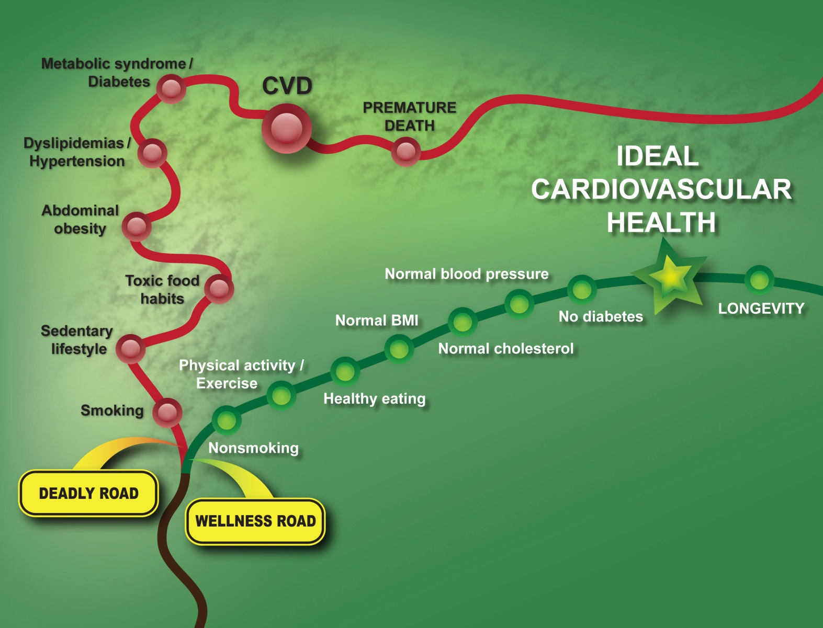
The Roads to Cardiovascular Disease/Health

