Slide 1
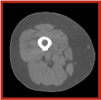
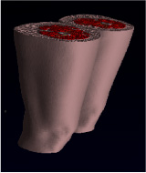
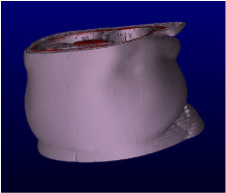
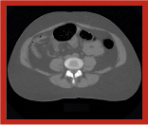
3-D RECONSTRUCTION OF THE THIGH AND ABDOMEN USING MULTIPLE COMPUTED TOMOGRAPHY (CT) IMAGES
CT image at the mid-thigh
3-D reconstruction of the thigh using
50 contiguous CT images
CT image at L4-L5
3-D reconstruction of the abdomen using
40 contiguous CT images

