Slide 1
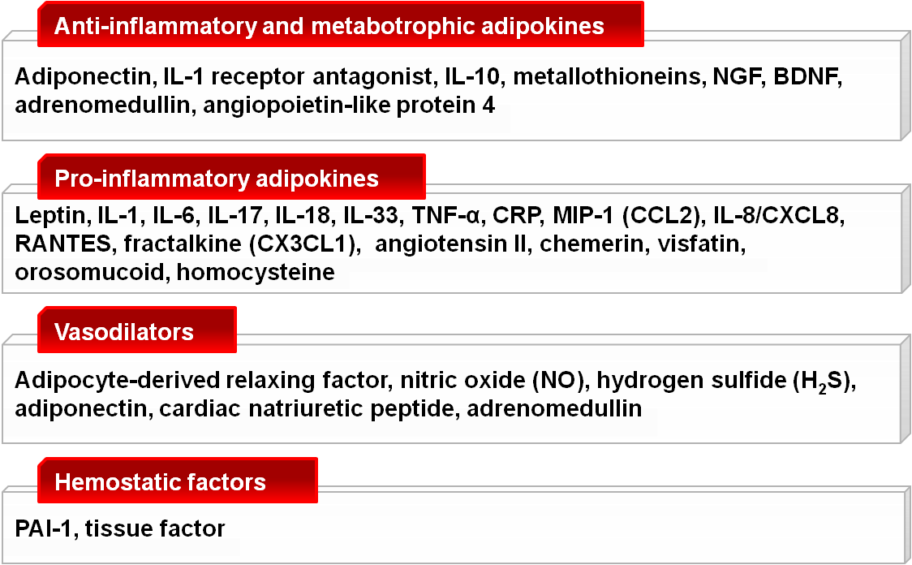
A SELECTED LIST OF ADIPOSE-DERIVED MEDIATORS, AS RELATED TO CARDIOMETABOLIC RISK
BDNF: brain-derived neurotrophic factor
CRP: C-reactive protein
IL: interleukin
MIP-1 (CCL2): monocyte chemoattractant protein MIP-1 (Cysteine-Cysteine motif chemokine ligand 2) NGF: nerve growth factor
PAI-1: plasminogen activator inhibitor-1
RANTES: regulated on activated normal T-cell expressed and secreted
TNF-α: tumour necrosis factor-α
Note: all components of renin-angiotensin system are expressed in perivascular adipose tissue, suggesting their paracrine involvement in cardiovascular disease.
Adapted from Chaldakov G. J Exp Clin Res 2008; 9: 81-8

