Slide 1
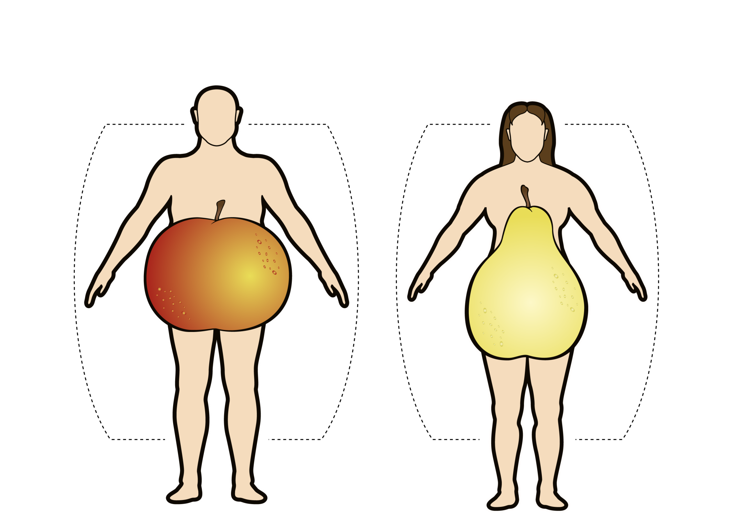
ADIPOSE TISSUE DISTRIBUTION IN MEN AND WOMEN
Android Obesity
Gynoid Obesity
Adapted from Vague J Presse Med 1947; 30: 339-40

