Slide 1
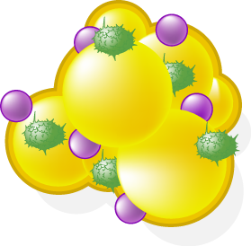
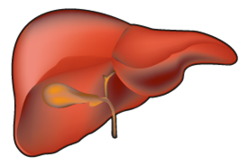
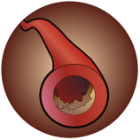
ADIPOSE TISSUE AND SOME OF THE ADIPOKINES/FACTORS INVOLVED IN THE PRO-THROMBOTIC STATE OF INTRA-ABDOMINAL OBESITY
Adipose
Tissue
Leptin
PAI-1
Platelet aggregation
IL-6
Inhibitor of fibrinolysis
(-)
Tissue
factor
Adiponectin
TNF-α
CRP
Initiation of coagulation cascade
Nitric oxide
Inflammation
Liver
Factor VII
and VIII
Oxidative Stress
Hyperactivity of platelets
Hypofibrinolysis
Fibrinogen
Pro-thrombotic
and
Hypofibrinolytic
State
Endothelial dysfunction
Hypercoagulability
Fibrin formation
Platelet aggregation
Thrombotic events
Plasma viscosity

