Slide 1
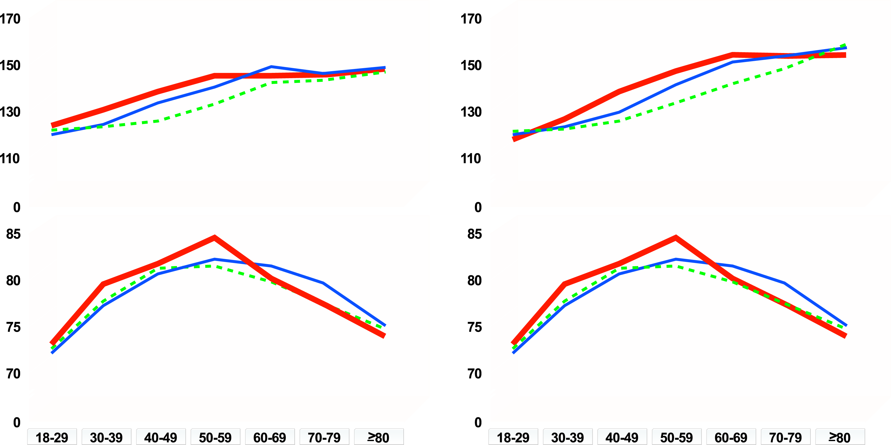
CHANGES IN BLOOD PRESSURE WITH AGE
Non-Hispanic black
Non-Hispanic white
Mexican American
Men
Women
Systolic blood pressure
Systolic blood pressure
Diastolic blood pressure
Diastolic blood pressure
Age
Age
From Burt VL et al. Hypertension 1995; 25: 305-13
Reproduced with permission

