Slide 1
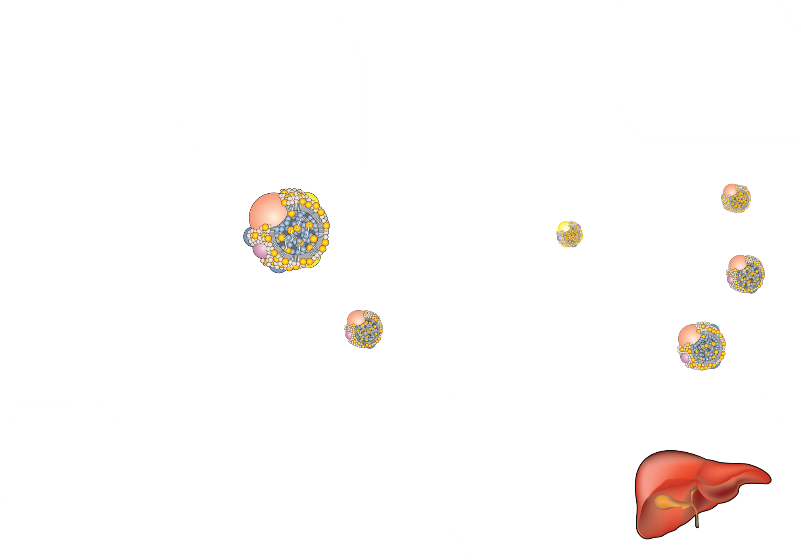
CHOLESTEROL TRANSPORT AND METABOLISM
Intestinal
lumen
Enterocyte
Tissues
Acetyl-CoA
Acetyl-CoA
Dietary
cholesterol
Cholesterol
Cholesterol
LCAT
LDL
Chylomicron
HDL
HTGL
LPL
VLDL
remnant
Bile
CETP
LPL
Chylomicron remnant
VLDL
Excretion
Legend
Cholesterol
CETP = cholesteryl ester transfer protein
HTGL = hepatic triglyceride lipase
LCAT = lecithin cholesterol acyltransferase
LPL = lipoprotein lipase
Acetyl-CoA
Bile salts
Cholesterol
Liver

