Slide 1
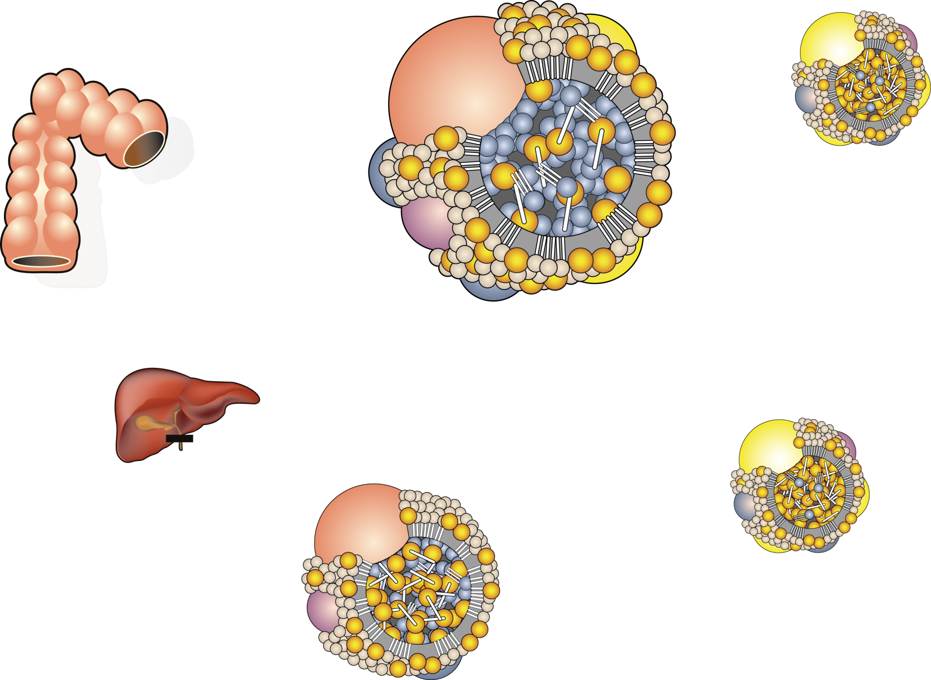
CHYLOMICRON METABOLISM: THE FATE OF DIETARY FAT
Apo AI
Triglyceride
Apo B48
Apo CII
Apo CIII
Apo E
Gut
HDL
Cholesteryl ester
Apo CII
Apo E
Chylomicron
Apo CIII
Fatty acids
Liver
Tissues
(adipose, muscle)
Remnant
receptor (LRP)
LPL
Apo AI, AIV
HDL
Apo CII, CIII
Chylomicron remnant
Legend
LPL = lipoprotein lipase

