Slide 1
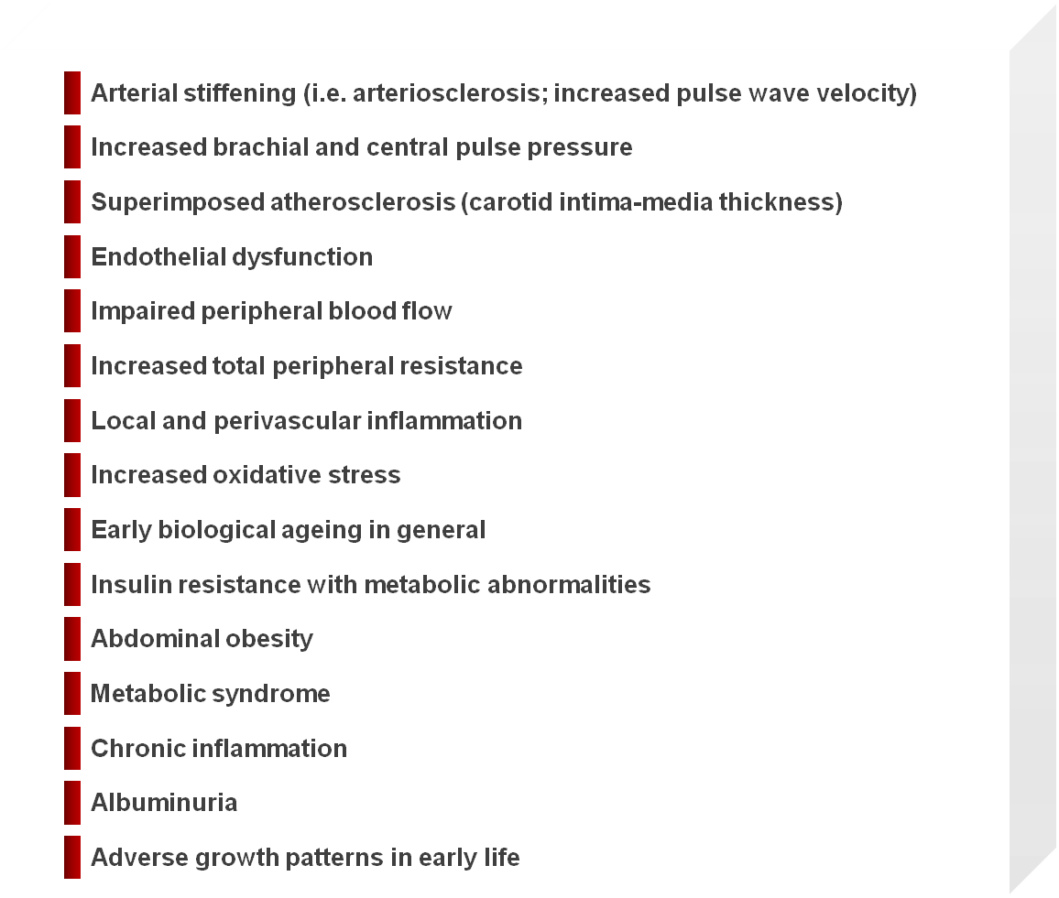
COMPONENT OF THE EARLY VASCULAR AGEING (EVA) SYNDROME AND ASSOCIATED CONDITIONS
Adapted from Nilsson PM et al. J Hypertens 2008; 26: 1049-57

