Slide 1
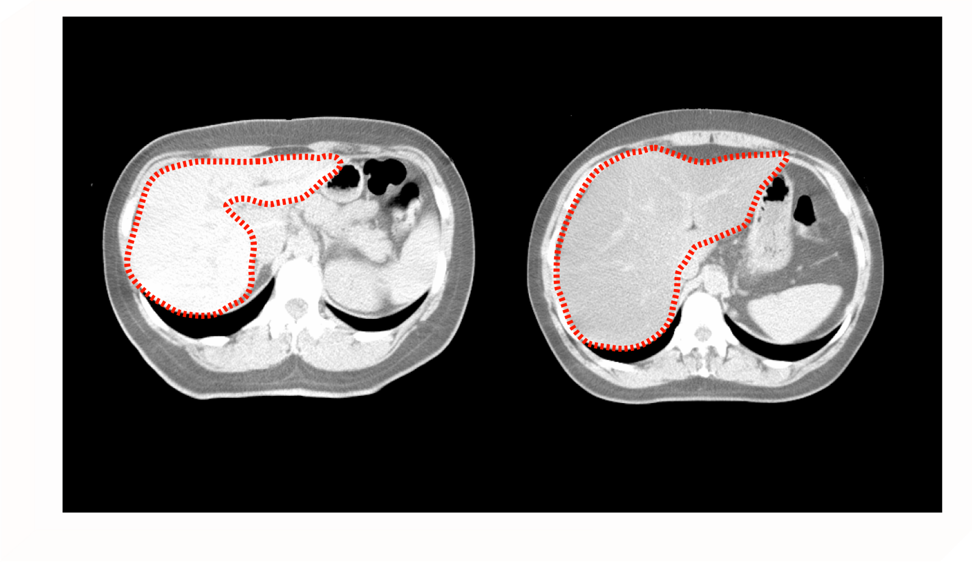
COMPUTED TOMOGRAPHY IMAGING OF A NORMAL AND
FATTY LIVER
Normal liver
Fatty liver
CT Liver (CTL) = 79.44 HU
CT Liver (CTL) = 14.82 HU
The normal liver is free of lipid storage, denser and therefore has a higher Hounsfield unit (HU)
and appears bright in contrast. On the other hand, lipid infiltration as seen in the fatty liver
reduces the density of the liver tissue, thus the HU is lower and the image appears darker.

