Slide 1
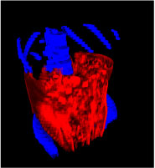
CONTRIBUTION OF INTRA-ABDOMINAL FAT TO TOTAL BODY FAT IN MEN AND WOMEN
10.2
9.3
11.5
5.0
85.7
78.3
% of Total Fat
Intra-abdominal
Fat
Men
Women
Intra-abdominal Fat
Subcutaneous Fat
Other Fat

