Slide 1
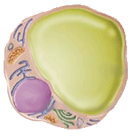
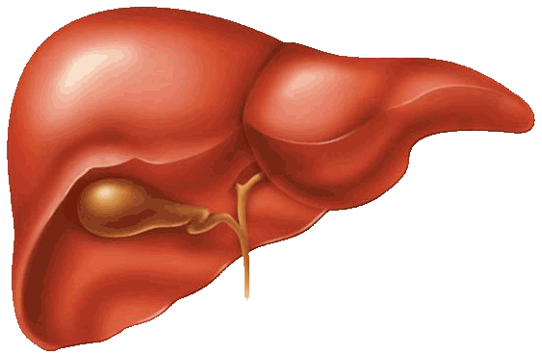
DIFFERENT PATHWAYS THROUGH WHICH ADIPOKINES GENERATED BY AN EXPANDING ADIPOSE TISSUE CONTRIBUTE TO AN INCREASED CARDIOMETABOLIC RISK
Inflammation
IL-6
Adipose tissue
Adipose tissue lipolysis
(-)
TNF-α
Circulating FFA levels
Insulin signalling in adipose
tissue and liver
GLUT4 synthesis
Macrophage
infiltration
Intra-abdominal
obesity
Insulin resistance
Atherogenic dyslipidemia
Gluconeogenesis
Apolipoprotein B
Insulin
Triglycerides

