Slide 1
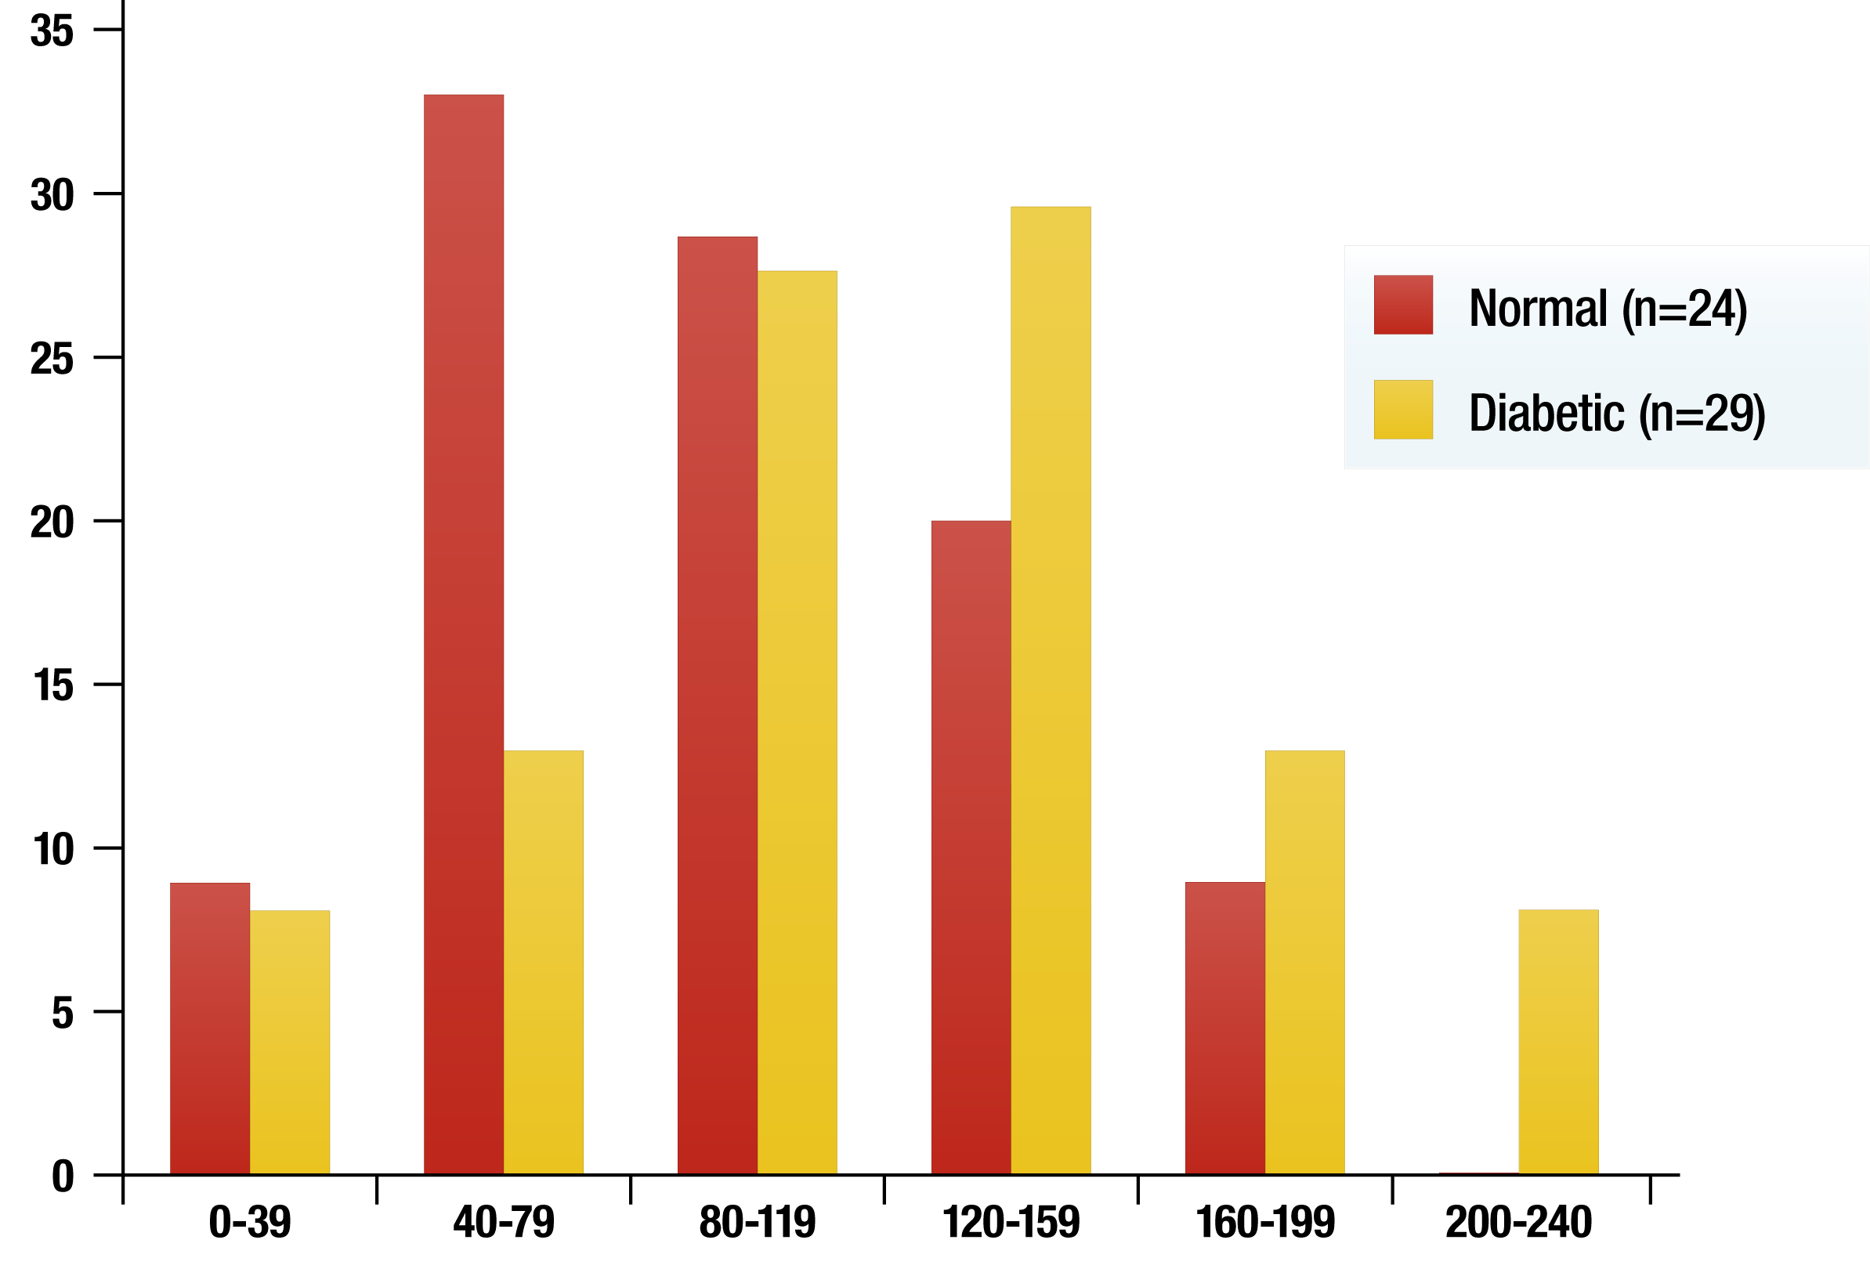
DISTRIBUTION OF INTRA-ABDOMINAL FAT AREA: NORMAL AND DIABETIC JAPANESE-AMERICAN MEN
% of subjects
Intra-abdominal fat area (cm²)
Adapted from Shuman WP et al. Invest Radiol 1986; 21: 483-7

