Slide 1
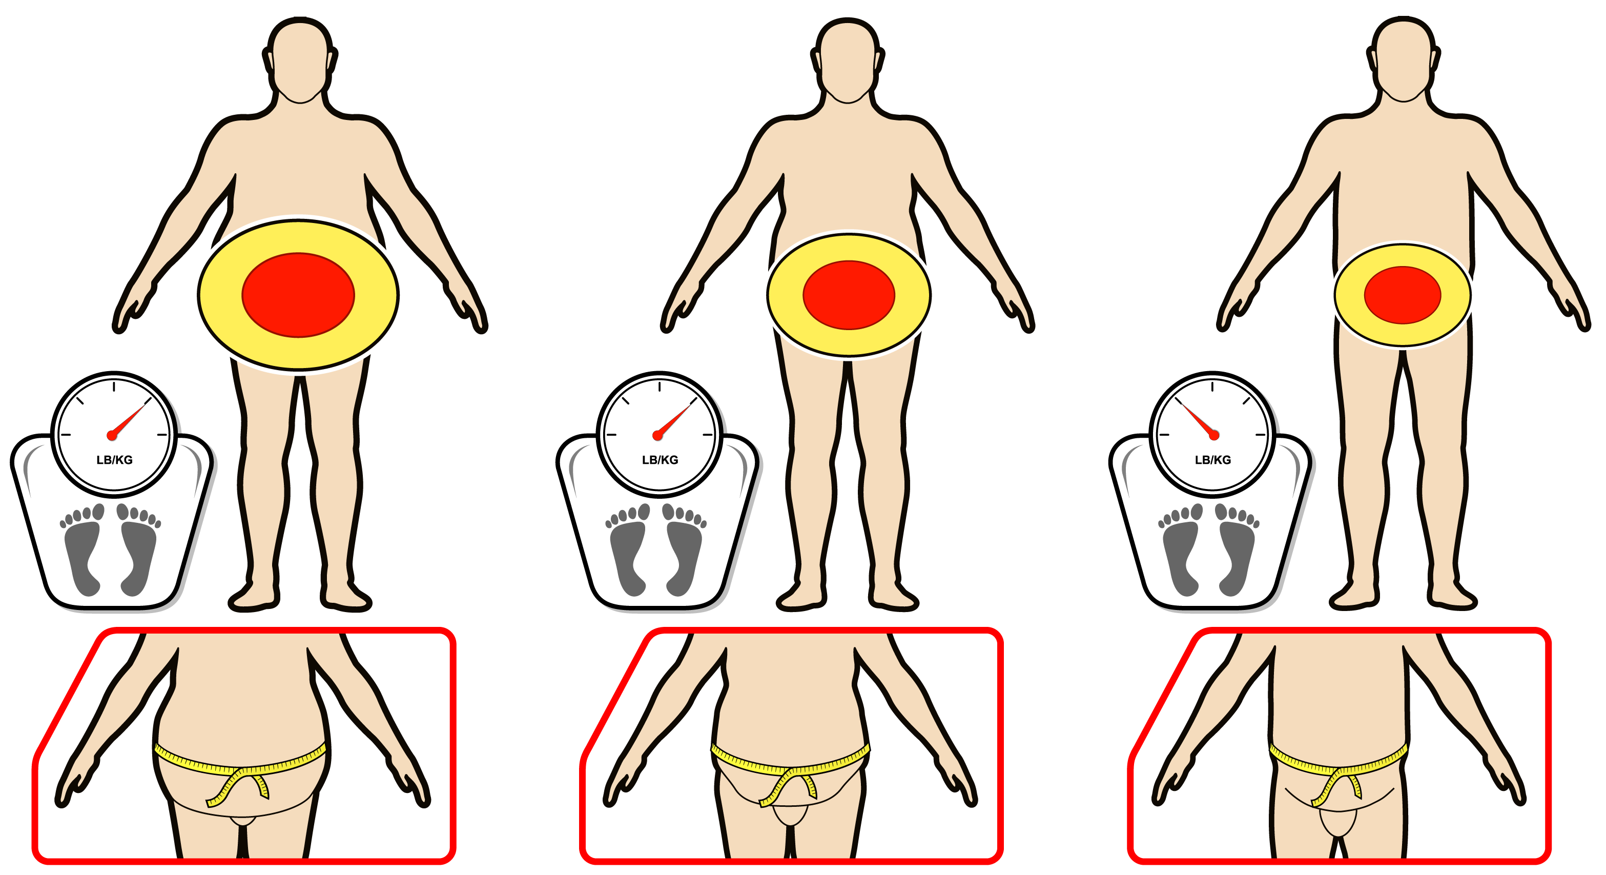
EFFECTS OF EXERCISE WITH AND WITHOUT CONSEQUENT WEIGHT LOSS ON CHANGES IN INTRA-ABDOMINAL FAT (IAF)
Sedentary Obese
Exercise Without Weight Loss
Exercise With Weight Loss
IAF
IAF
IAF
Exercise without weight loss is associated with reduction in intra-abdominal fat (10-20%) and a consequent reduction in waist circumference. However, exercise-induced weight loss leads to greater reductions in both intra-abdominal fat (30%) and waist circumference.

