Slide 1
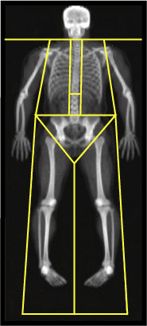
EXAMPLE OF DEXA OUTPUT
DEXA Results Summary
Region
Fat
(g)
Lean + Bone
Mineral Content
(g)
% Fat
Left Arm
1781.3
4183.2
29.9
Right Arm
2045.7
4487.9
31.3
Trunk
19480.8
35845.3
35.2
Left Leg
4788.3
10913.8
30.5
Right Leg
5110.0
11403.3
30.9
Subtotal
33206.2
66833.6
33.2
Head
1203.4
4609.2
20.7
Total
34409.6
71442.8
32.5

