Slide 1
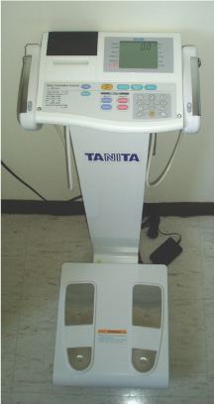
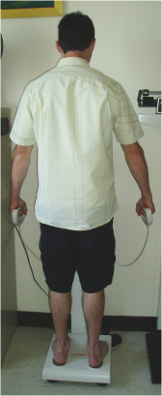
EXAMPLE OF A BIOELECTRICAL IMPEDANCE ANALYSIS (BIA) SEGMENTAL SCALE ALSO SHOWING AN INDIVIDUAL ON THE SCALE

