Slide 1
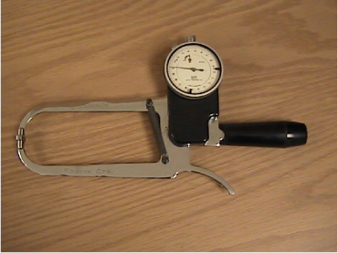
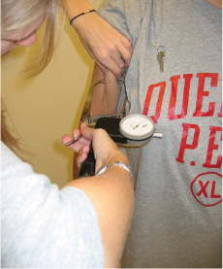
EXAMPLE OF A SKINFOLD CALIPER AND OF A SKINFOLD MEASURMENT (BICEPS)

