Slide 1
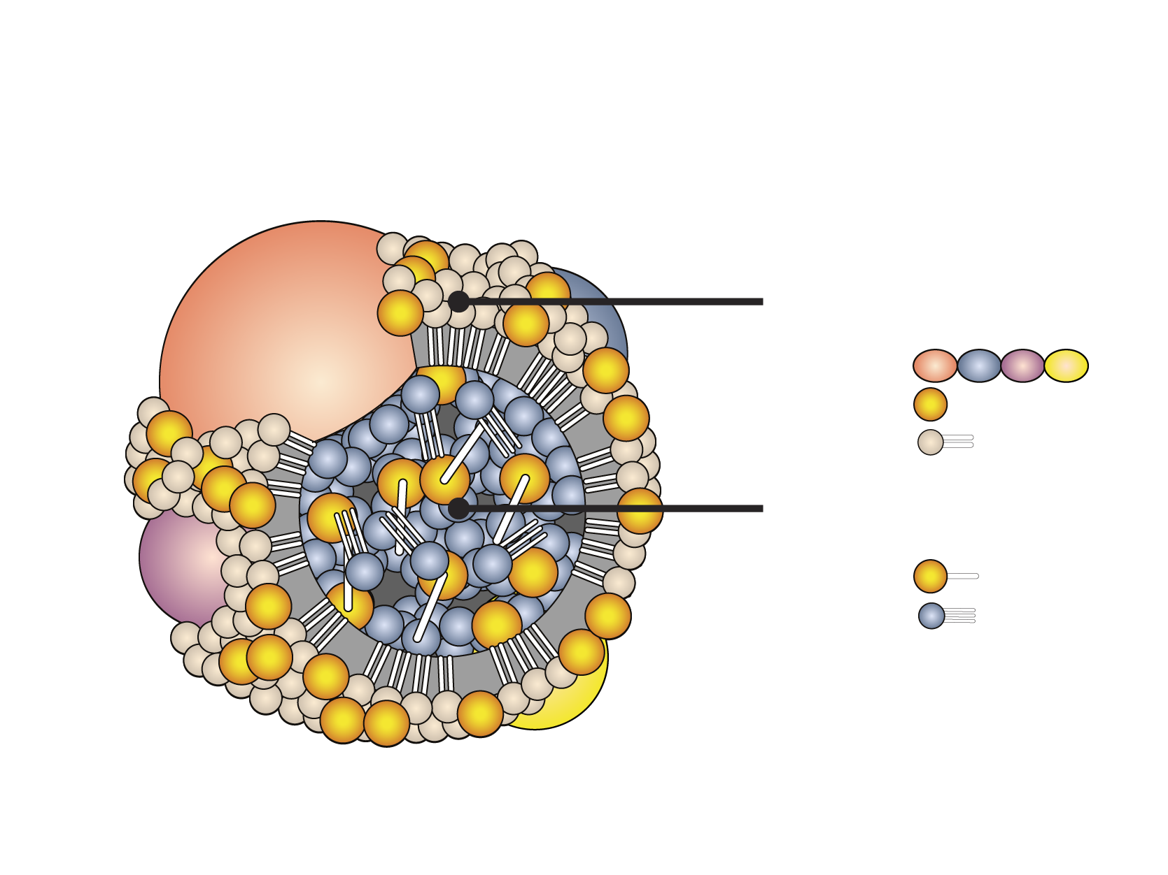
GENERAL STRUCTURE OF A LIPOPROTEIN
Polar surface envelope
Apolipoprotein
Free cholesterol
Phospholipid
Neural lipid core
Cholesteryl ester
Triglyceride

