Slide 1
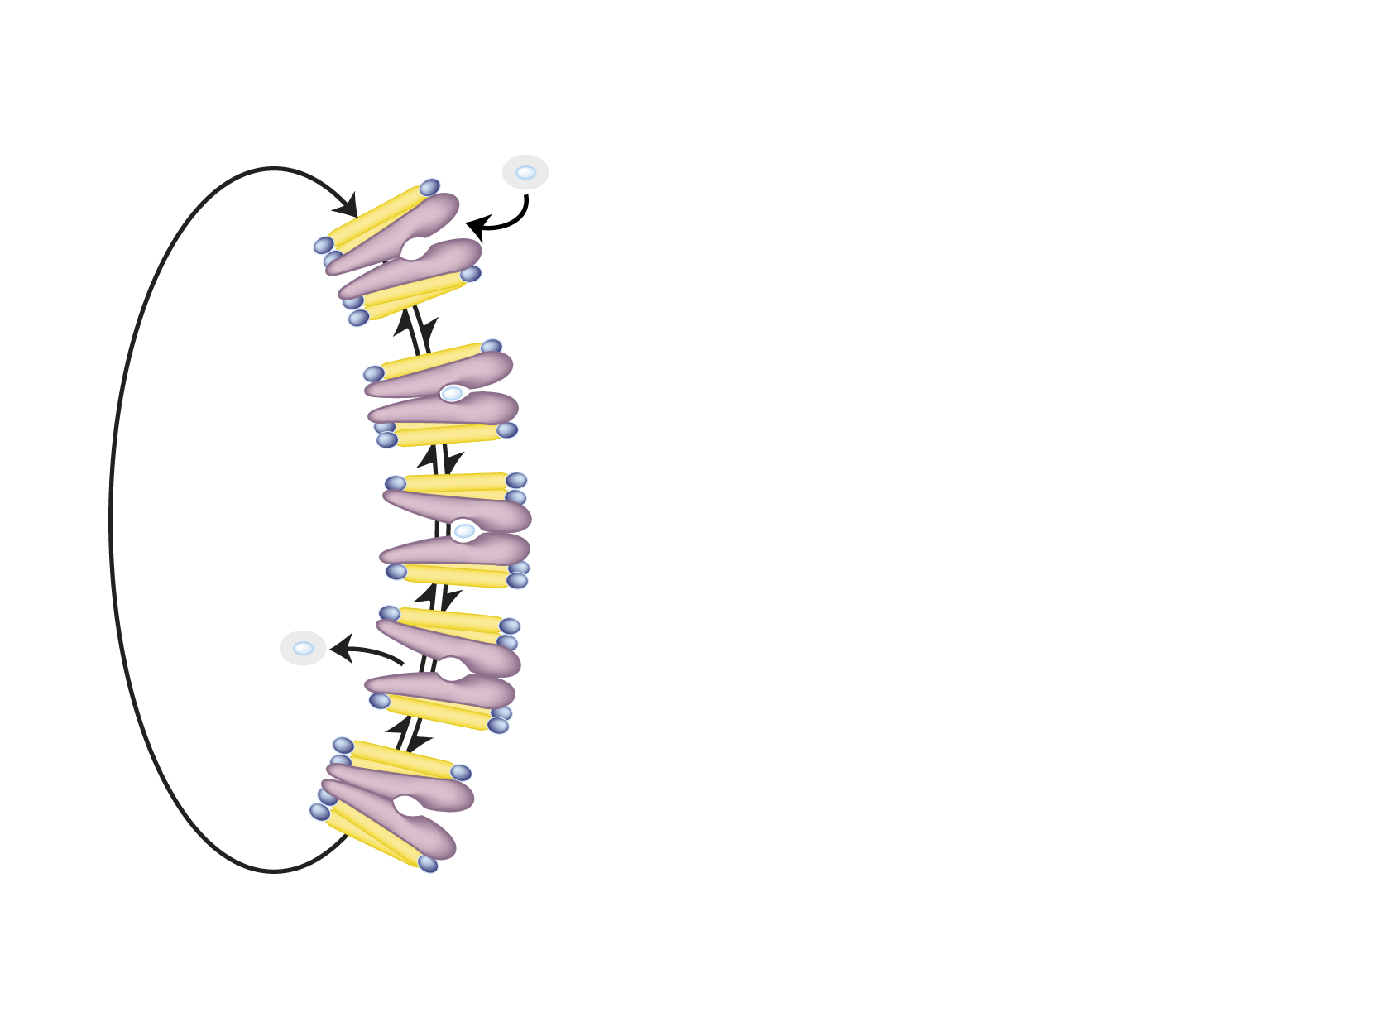
GLUCOSE TRANSPORTERS (GLUT)
D-Glucose
Organ
Transporter
Blood-brain
barrier
GLUT 1
Step 1
Brain
GLUT 3
Intestine
GLUT 5
Inside
Step 2
Liver
GLUT 2
Adipose tissue
GLUT 4*
(GLUT 1)
Step 3
Muscle
GLUT 4*
(GLUT 1)
Pancreas
GLUT 2
Step 4
*Insulin-sensitive
Outside

