Slide 1
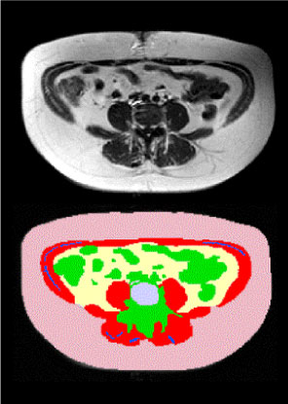
GREYSCALE NON-SEGMENTED AND SEGMENTED MAGNETIC RESONANCE IMAGING (MRI) ABDOMINAL IMAGE AT L4-L5 IN AN OBESE WOMAN
FRONT
Subcutaneous Fat
Intra-abdominal Fat
Inter-muscular Fat
Lean Tissue
Muscle
Bone
BACK

