Slide 1
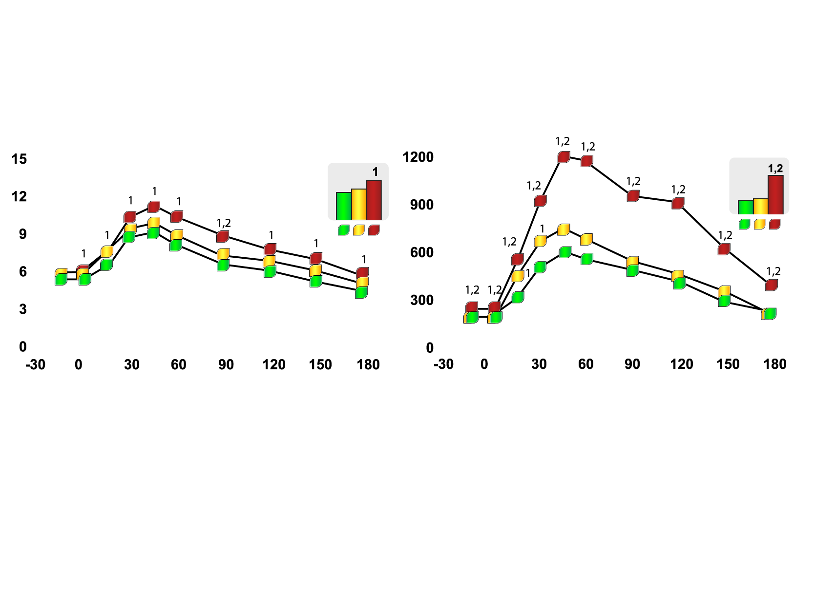
IMPACT OF INTRA-ABDOMINAL FAT ON PLASMA GLUCOSE-INSULIN HOMEOSTASIS
Glucose (mmol/l)
Insulin (pmol/l)
Glucose area
Insulin area
Time (minutes)
Time (minutes)
Non-obese
Obese with low intra-abdominal fat accumulation
Obese with high intra-abdominal fat accumulation
Legend
1 different from non-obese subjects (p<0.05)
2 different from obese subjects with
low intra-abdominal fat (p<0.05)
Copyright© 1992 American Diabetes Association
From Diabetes®, vol. 41, 1992; 826-834
Reprinted with permission from the American Diabetes Association

