Slide 1
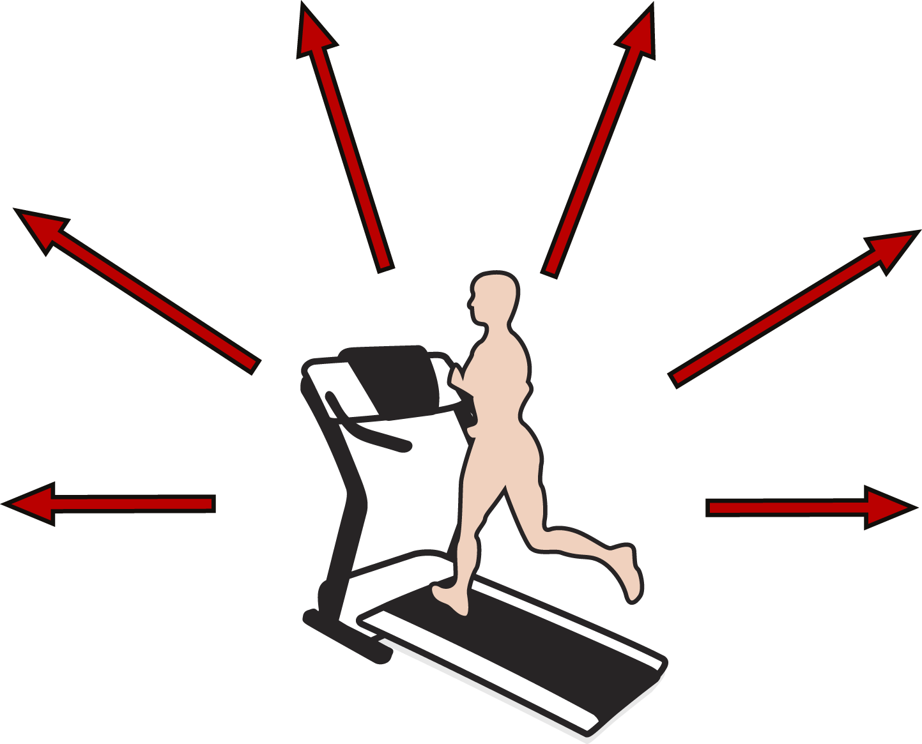
IMPROVEMENTS IN CARDIOMETABOLIC RISK FACTORS INDUCED BY REGULAR EXERCISE
Insulin Resistance
Atherogenic Dyslipidemia
A 30-85% improvement
Increased HDL cholesterol (~5%) and decreased trlglycerldes (~15%) and a shift in the distribution of LDL particle size (from small to large)
Abdominal Obesity
Hypertension
A 30% reduction in
intra-abdominal fat
A 4 mm Hg reduction in
both systolic and diastolic
blood pressure
Thrombosis
Systemic Inflammation
Induces an anti-thrombotic
state (decreased coaguability
and increased fibrinolysis)
Approximately 30% reduction
in inflammatory markers
Moderate intensity endurance exercise on most days of the week

