Slide 1
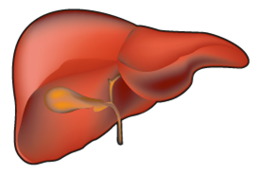
INFLAMMATION: THE LINK BETWEEN ABDOMINAL OBESITY AND GLOBAL CARDIOMETABOLIC RISK (CVD RISK)
Inflammation
Adipose
Tissue
IL-6
CRP
?
?
(-)
TNF-α
FFA
Macrophage
Apo B
(-)
Risk of CVD
Adiponectin
Legend
Glucose
FFA: Free Fatty Acids
Apo B: Apolipoprotein B
CRP: C-Reactive Protein
IL: Interleukln
TNF-α : Tumor Necrosis
Factor -α
Abdominal Obesity
Triglycerides
Insulin
Atherogenic, insulin
resistant dysmetabolic
milieu
Adapled from Després JP Int J Obes Metab Disord 2003; 27: 5224

