Slide 1
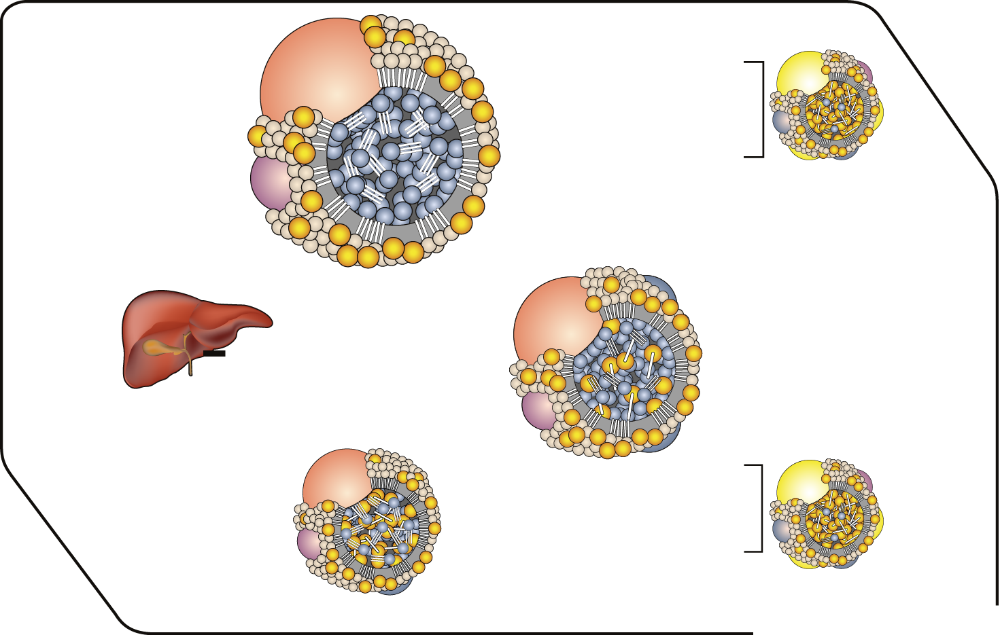
INTRAVASCULAR VLDL METABOLISM
Nascent VLDL
Cholesteryl
esters
Apo CII, CIII
HDL
Apo E
Liver
Apo B/E
receptor
Mature VLDL
LDL
LPL
Apo E
VLDL remnant
Apo CII, CIII
HDL
Fatty acids
Phospholipids
Tissues
(adipose, muscle)
Legend
LPL = lipoprotein lipase

