Slide 1
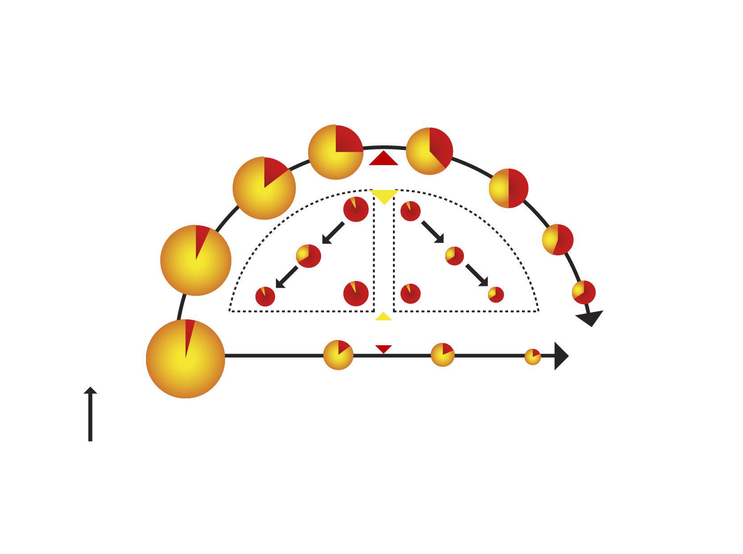
LINK BETWEEN HYPERTRIGLYCERIDEMIA AND SMALL, DENSE LDL AND LOW HDL
Inefficient triglyceride metabolism
Triglycerides
Cholesterol
LPL
Atherogenic
remnant
CETP
HTGL
LDL
HDL
HTGL
Atherogenic
Short ½ life
CETP
Chylomicrons VLDL
Remnant uptake
LPL
Efficient triglyceride metabolism
Fatty acids
Legend
CETP = cholesteryl ester transfer protein
HTGL = hepatic triglyceride lipase
LPL = lipoprotein lipase

