Slide 1
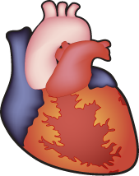
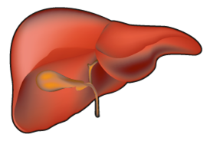
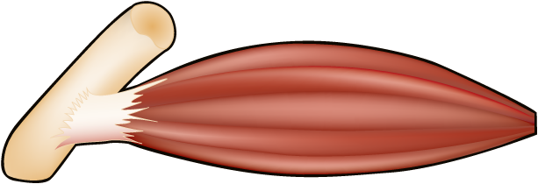
LIPID OVERFLOW HYPOTHESIS FOR THE PATHOGENESIS OF LIVER FAT
Caloric Intake
and/
or
Energy Expenditure
Positive Energy Balance
Lipid overflow into liver,
muscle or epicardium
Buffering of excess
energy in healthy
adipose tissue
Exhaustion of
buffering capacity of
adipose tissue
Metabolic Abnormalities

