Slide 1
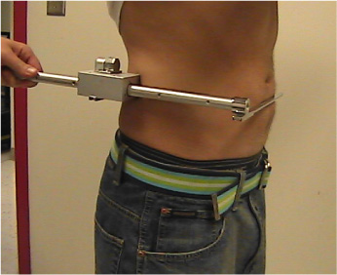
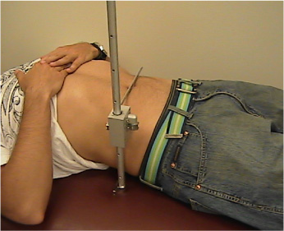
MEASUREMENT OF SAGITTAL DIAMETER IN THE STANDING AND SUPINE POSITIONS
Standing
Supine

