Slide 1
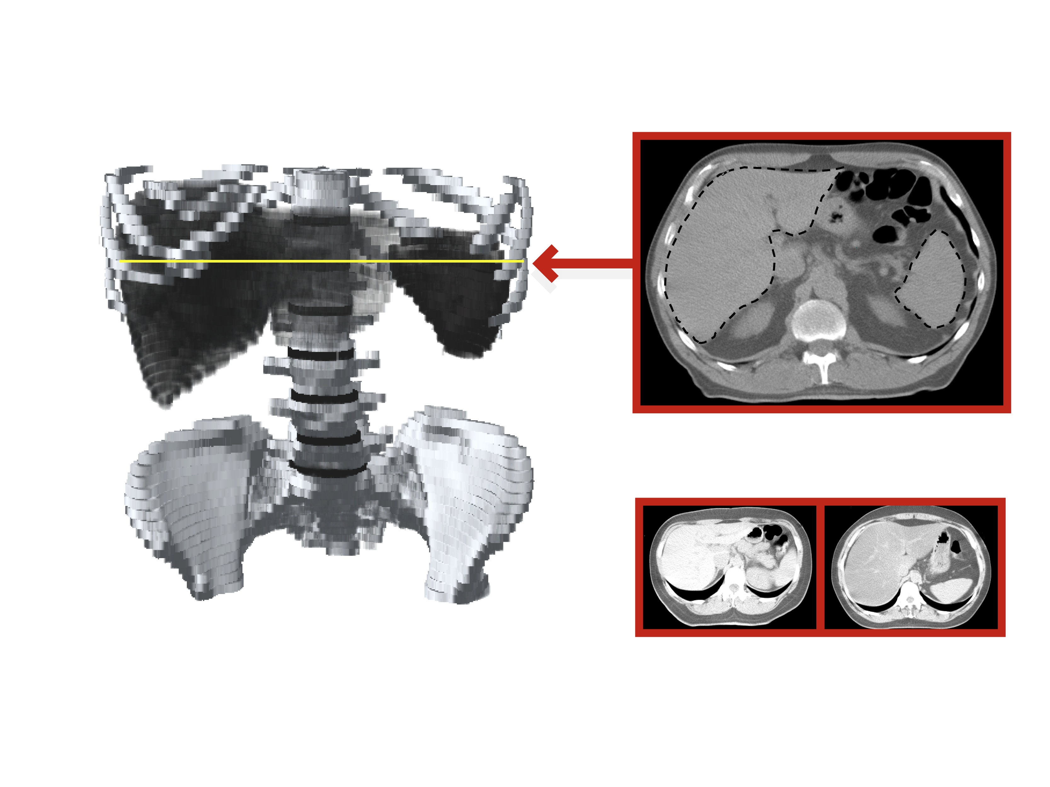
MEASURING LIVER FAT BY COMPUTED TOMOGRAPHY (CT): NORMAL VERSUS FATTY LIVER
T11
T12
Liver
LIVER
L1
SPLEEN
Spleen
L2
L3
L4
L5
Mean Liver Attenuation Value
Mean Spleen Attenuation Value
CTL/CTS
("Fatty Liver" Index)
79.4 HU
59.6 HU
14.8 HU
60.7 HU
HU: Hounsfield unit
Normal Liver
CTL/CTS = 1.33
"Fatty Liver"
CTL/CTS = 0.24
Adapted from Davidson LE et al. J Appl Physiol 2005; 100: 864-8

