Slide 1
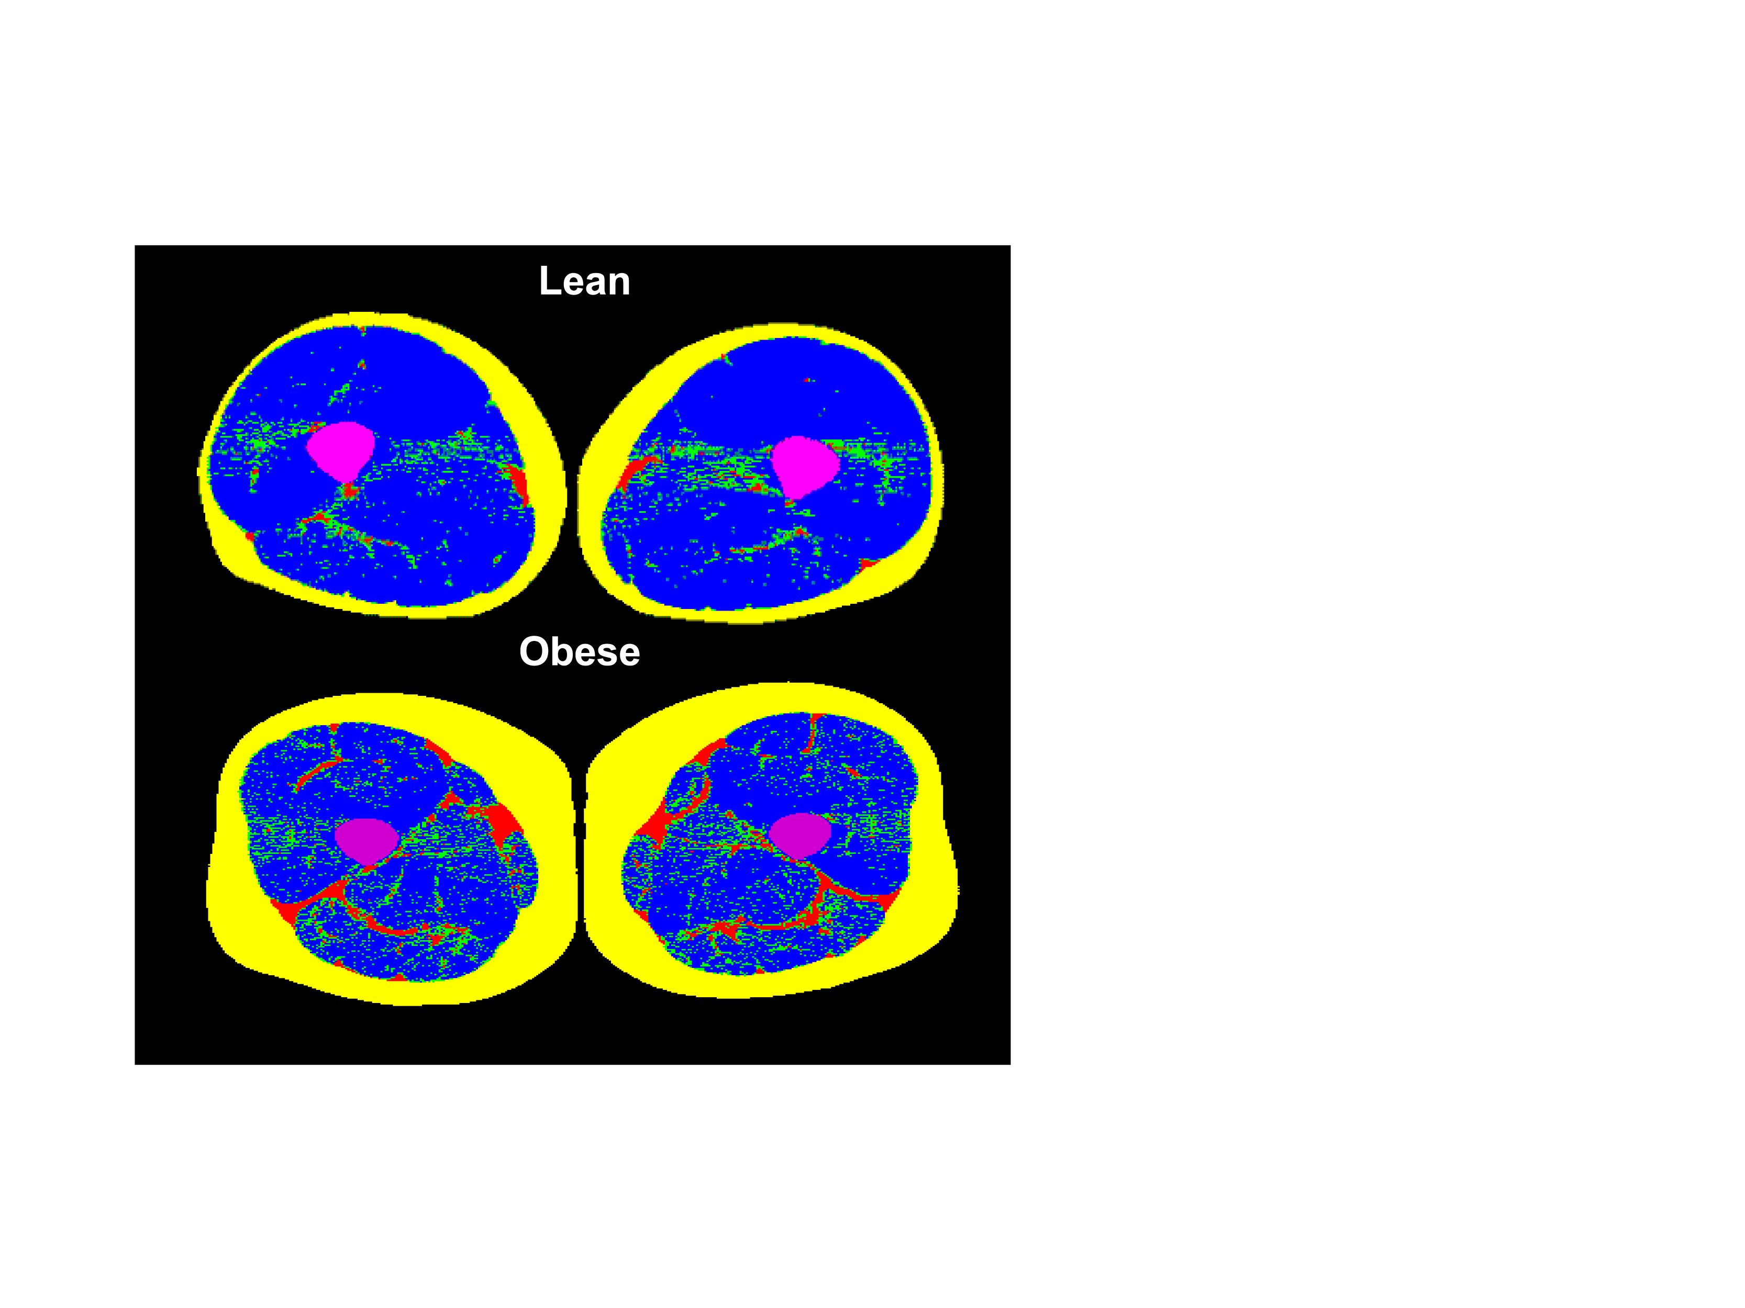
MEASURING SKELETAL MUSCLE LIPID CONTENT BY COMPUTED TOMOGRAPHY (CT) IN LEAN AND OBESE MEN
Bone
Subcutaneous Fat
Inter-muscular Fat
Low-density Muscle
High-density Muscle

