Slide 1
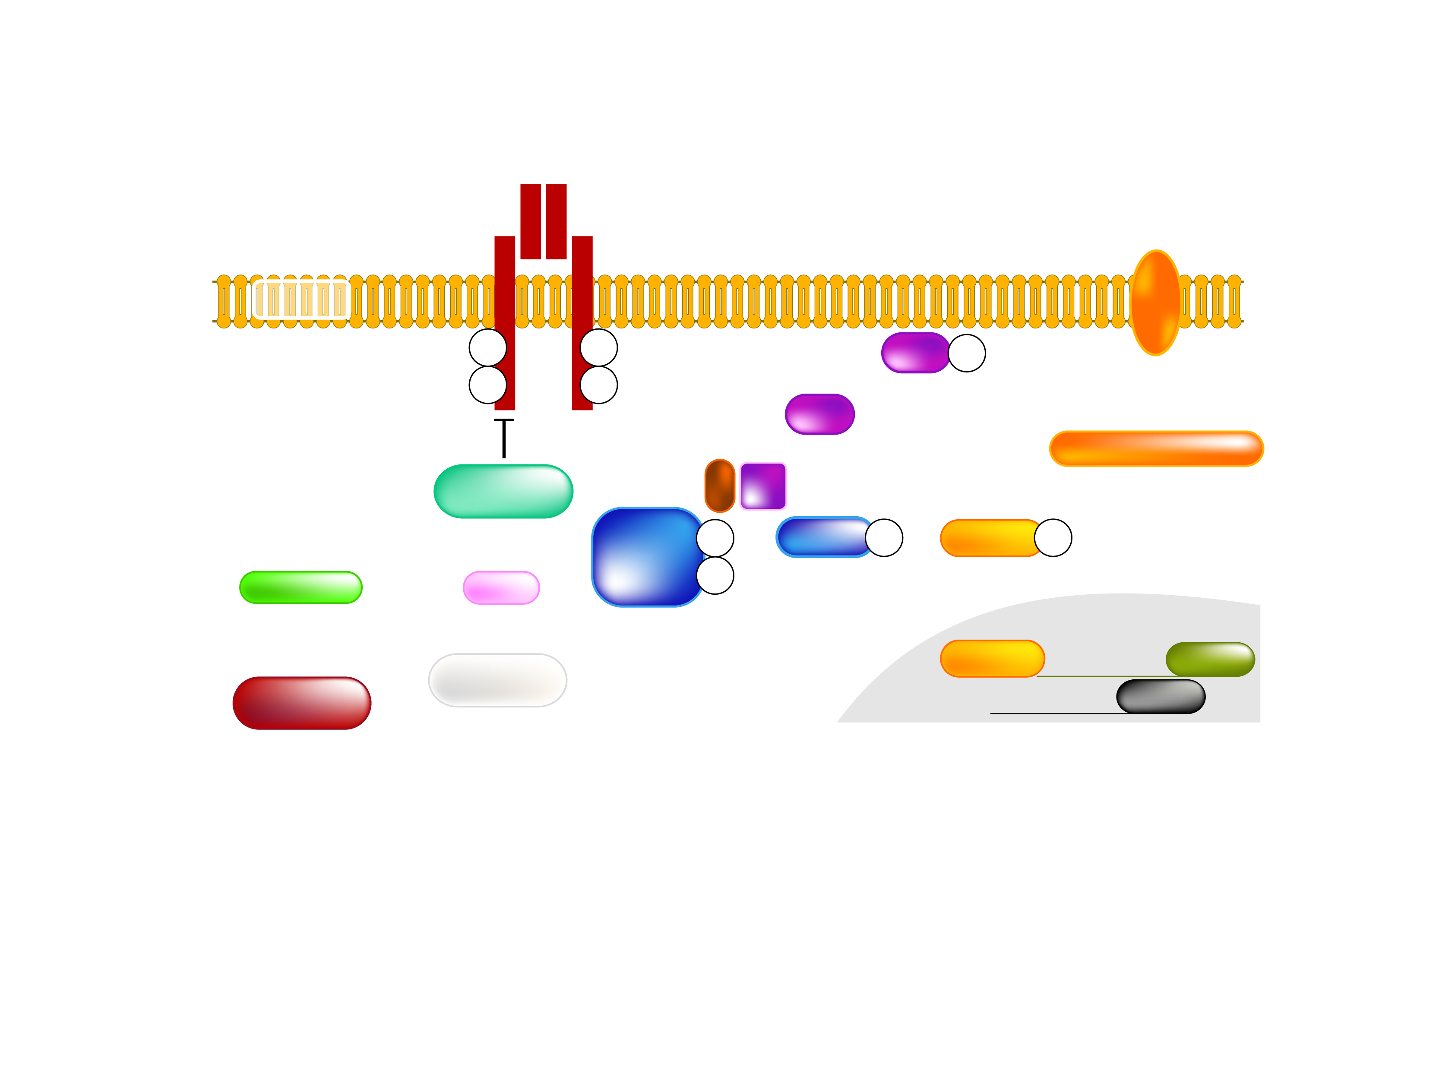
MECHANISM OF FATTY ACID-INDUCED INSULIN RESISTANCE IN LIVER
Insulin Receptor
GLUCOSE
Fatty Acid
FATPs
GLUT 2
pY
pY
PDK
Akt
pS/T
pY
pY
PIP3
Akt
PI3K
Gluconeogenesis
PKC-ε
Ser/Thr kinase
IRS-2
pY
GSK3
pS/T
FOXO
pS/T
LCCoA
DAG
pY
Glycogen Synthesis
β-oxidation?
FOXO
PEPCK
de novo lipid synthesis
NUCLEUS
G6Pase
Legend
Akt = protein kinase B
DAG = diacylglycerol
FATPs = fatty acid transport proteins
FOXO = forkhead box protein O
G6P = glucose 6-phosphate
GLUT = glucose transporter
GSK3 = glycogen synthase kinase-3
IRS-2 = insulin receptor substrate-2
LCCoA = long-chain acylcoenzyme A
PDK = phosphoinositide-dependent protein kinase
PKC = protein kinase C
PEPCK = phosphoenolpyruvate carboxykinase
PI3K = phosphatidynositol [3,4,5] kinase
PIP3 = phosphatidylinositol 3 triphosphate
pS/T = serine/threonine phosphorylation
pY = tyrosine phosphorylation
Ser/Thr = serine/threonlne
Adapted from Savage DB et al. Physiol Rev 2007; 87: 507-20

