Slide 1
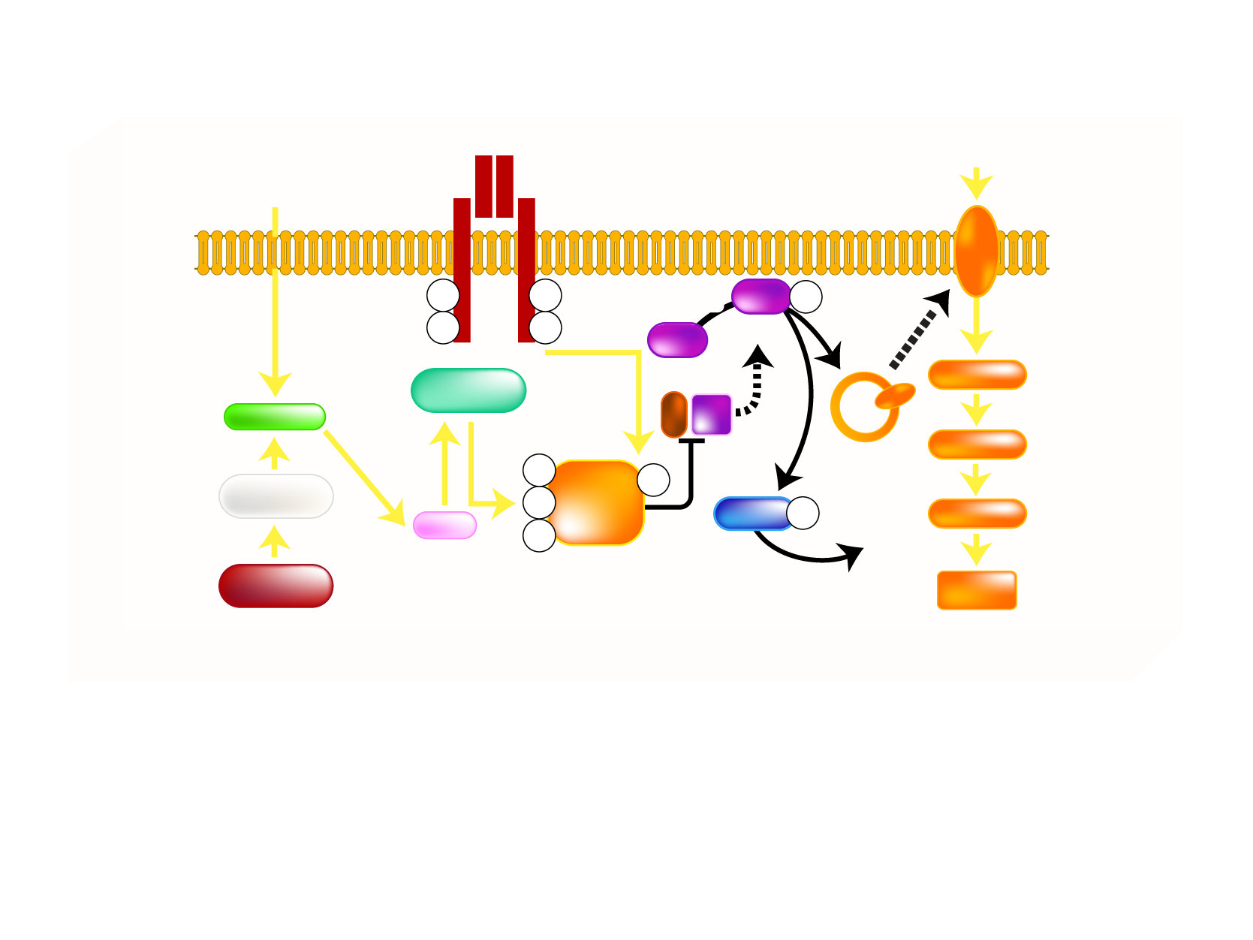
MECHANISM OF FATTY ACID-INDUCED INSULIN RESISTANCE IN SKELETAL MUSCLE
Insulin Receptor
GLUCOSE
Fatty Acid
FATPs
GLUT 4
pY
pY
PDK
Akt
pS/T
pY
pY
PIP3
Translocation
Akt
PKC-θ
Ser/Thr kinase
PI3K
Glucose
LCCoA
G6P
pS
pY
β-oxidation
pS
IRS-1
GSK3
pS/T
UDP-glucose
DAG
pS
GS activity
Mitochondrial
Density
Glycogen
Synthesis
Legend
Akt = protein kinase B
DAG = diacylglycerol
FATPs = fatty acid transport proteins
G6P = glucose 6-phosphate
GLUT = glucose transporter
GS = glycogen synthase
GSK3 = glycogen synthase kinase-3
IRS-1 = insulin receptor substrate-1
LCCoA = long-chain acylcoenzyme A
PDK = phosphoinositide-dependent protein kinase
PKC = protein kinase C
PI3K = phosphatidylinositol [3,4,5] kinase
PIP3 = phosphatidylinositol 3 triphosphate
pS = serine phosphorylation
pS/T = serine/threonine phosphorylation
pY = tyrosine phosphorylation
Ser/Thr = serine/threonine
UDP = uridine diphosphate glucose
Adapted from Savage DB et al. Physiol Rev 2007; 87: 507-20

