Slide 1
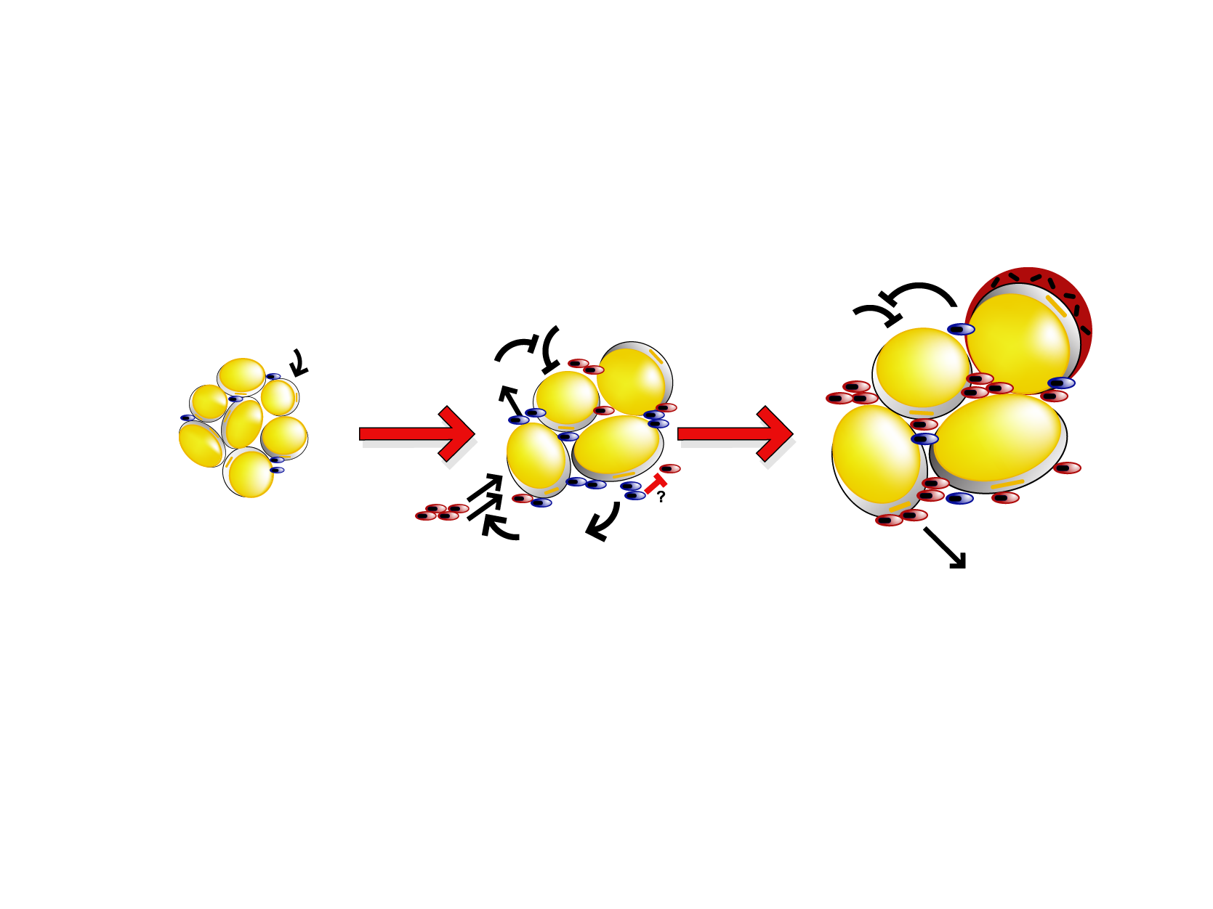
MODEL FOR ADIPOSE TISSUE MACROPHAGE POLARIZATION AND ITS FUNCTION IN ADIPOSE TISSUE WITH PROGRESSIVE OBESITY
Leanness
Insulin-sensitive
Mild Obesity
Insulin-sensitive
Severe Obesity
Insulin-resistant
↑ iNOS
↑ TNF-α
↑ IL-6
↓ IL-10
CLS
↑Arginase
↑ IL-10
↑↑ iNOS
↑↑ TNF-α
↑↑ IL-6
Insulin
resistance
↑Arginase
↑ IL-10
DIO
DIO
JNK
NF-κB
CCR2⁺
MCP-1
FFA
Inflammatory
adipo-cytokines
Legend
Arginase: less NO production
IL-10: anti-inflammatory
ATM = adipose tissue macrophage
CLS = crownlike structures
DIO = diet-induced obesity
FFA = free fatty acids
IL = interleukin
iNOS = inducible nitric oxide synthase
JNK = C-jun N-terminal kinase
MCP-1 = monocyte chemoattractant protein-1
NF-κB = nuclear factor-кB
NO = nitric oxide
TNF-α = tumor necrosis factor-α
M2 ATM
CX3CR1^{high}CCR2⁻
Tissue repair
Less NO production
M1 ATM
CX3CR1^{low}CCR2⁺
Pro-inflammatory
More NO production
Adapted from Lumeng CN et al. J Clin Invest 2007; 117: 175-84
Reproduced with permission

