Slide 1
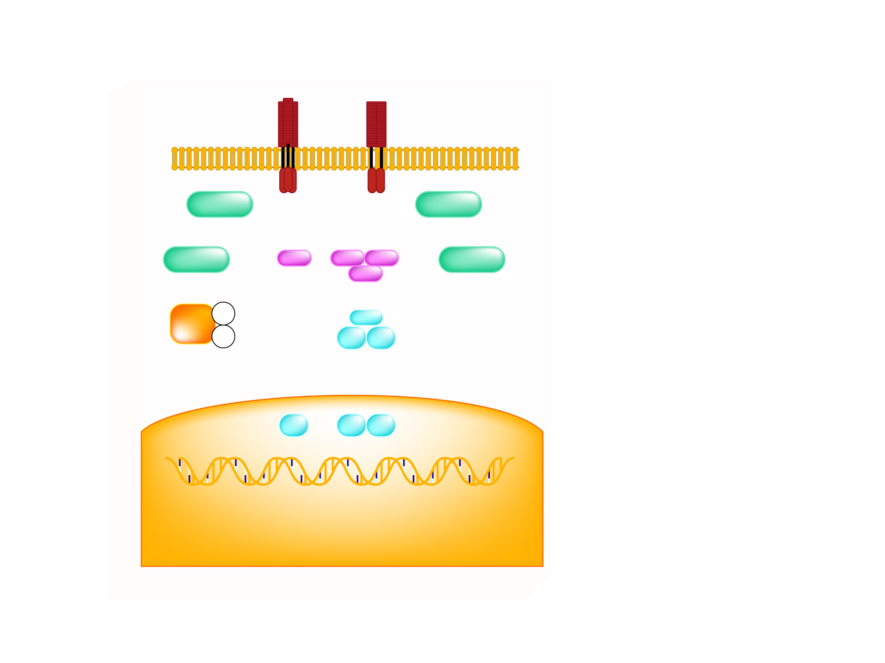
POTENTIAL CELLULAR MECHANISMS FOR ACTIVATING INFLAMMATORY SIGNALING
Legend
TNFR, RAGE
TLRs, IL-1R
AP-1 = activator protein-1
ER = endoplasmic reticulum
IKK = IкB kinase
IL-1 R = interleukin-1 receptor
INOS = inducible nitric oxide
synthase
IRS-1 = insulin receptor substrate-1
JNK = C-jun N-terminal kinase
NF = nuclear factor
PKC = novel protein kinase
RAGE = receptor of advanced
glycation endproducts
ROS = reactive oxygen species
TLR = toll-like receptor
TNFR = tumor necrosis factor
receptor
TZD = thiazolidinediones
Plasma Membrane
Ceramide
PKCs
ROS
JNK
IKKα
IKKβ
ER stress
IKKγ
Salicylates, TZDs, and statins
IRS-1
pS
IκBα
pS
?
p65
p50
NF-κB
AP-1
NF-кB
iNOS and other inflammatory mediators
p65
p50
Nucleus
Insulin Resistance
Adapted from Shoelson SE et al. J Clin Invest 2006; 116: 1793-1801

