Slide 1
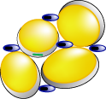
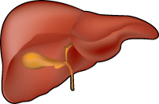
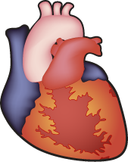
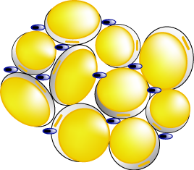
POTENTIAL MECHANISMS FOR OBESITY-INDUCED INFLAMMATION
Lean
Nutrient excess
Expansion of fat mass
Adipocyte production of cytokines and chemokines
Insulin resistance
Endothelial cell expression
of adhesion molecules
Pro-inflammatory and
post-atherogenic mediators
Monocyte recruitment
and differentiation
Atherosclerosis
Macrophage infiltration
and cytokine production
Obese

