Slide 1
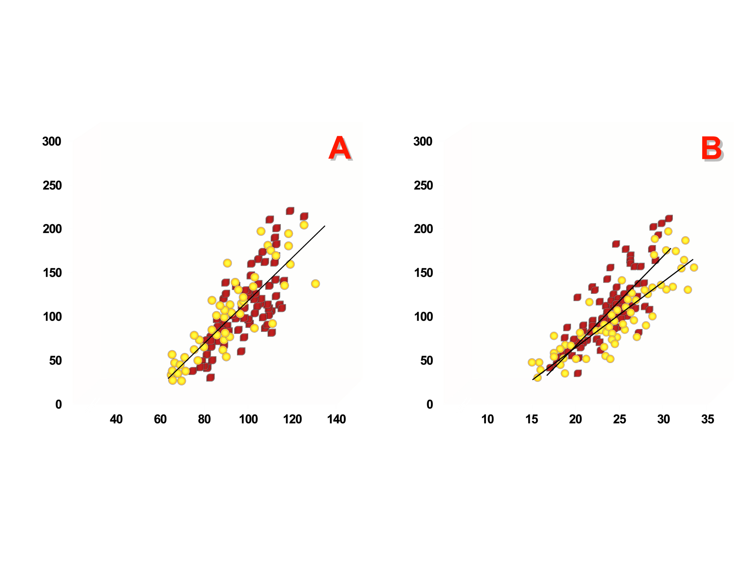
RELATIONSHIP BETWEEN INTRA-ABDOMINAL FAT WITH WAIST CIRCUMFERENCE (A) AND SAGITTAL DIAMETER (B)
r=0.87
r=0.87
r=0.77
r=0.80
Intra-abdominal Fat (cm²)
Intra-abdominal Fat (cm²)
Waist Circumference (cm)
Abdominal Sagittal Diameter (cm)
From Pouliot MC et al. Am J Cardiol 1994; 73: 460-8
Reproduced with permission

