Slide 1
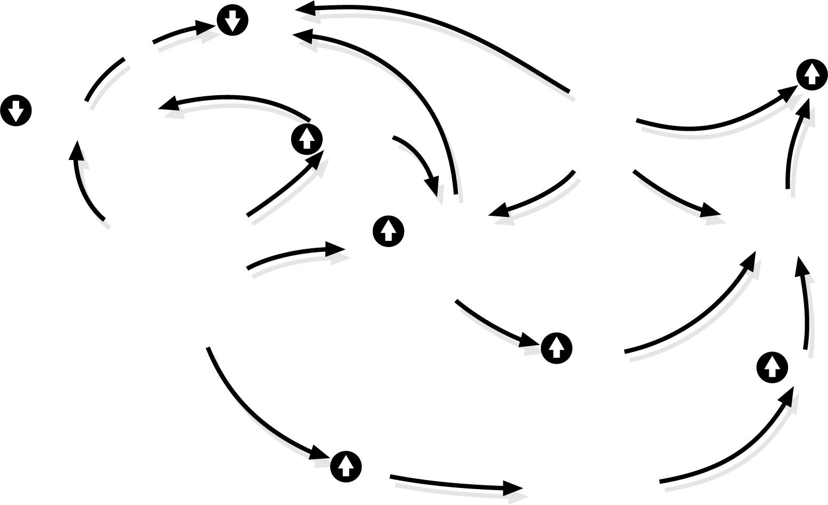
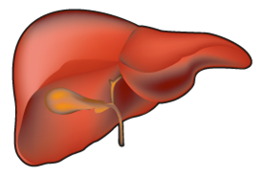
Schematic representation of how smoking might add several mechanisms linking obesity to cardiovascular disease
HDL
Obesity
ICAM-1
Adiponectin
TNF- ᾳ
Endothelial
dysfunction
Intra-abdominal
Adipose tissue
Insulin
resistance
ROS
CRP
Legend
CRP: C-reactive protein
ICAM-1: intracellular adhesion molecule-1
IL-6: interleukin-6
THF- ᾳ: tumor necrosis factor - ᾳ
ROS: reactive oxygen species
IL-6
Red arrows indicate an effect of smoking
Source: International Chair on Cardiometabolic Risk
www.cardiometabolic-risk.org
Adapted from Van Gaal LF et al. Nature 2006; 444: 875-80
Reproduced with permission from Macmillan Publishers Ltd.

